Slide 1
Reporting/Producing news stories for scientific issues
School of Journalism and Mass Communications, AuTh

Slide 2
Narratives in Sci Jour
Narratives offer increased comprehension, interest, and engagement.
Narratives are also intrinsically persuasive, which offers science communicators tactics for persuading otherwise resistant audiences, although such use also raises ethical considerations (Dahlstrom, 2014).

Slide 3
Narratives in Sci Jour
Research has shown that narratives can be used to sway beliefs about numerous science topics, such as vaccines, proenvironmental beliefs and HIV/AIDS.
Science communicators could leverage the influence of narratives to persuade otherwise resistant audiences about issues related to science (Dahlstrom, 2014).

Slide 4
Ethical aspects
Persuasion or Comprehension?
The Public Understanding of Science Model vs The Public Engagement in Science and Technology

Slide 5
Time for discussion
Persuasion or Comprehension?
Should science communication create agreement toward a preferred outcome or promote personal autonomy to make choices?
Case study: The Covid-19 vaccines coverage.
Are social benefits large enough to outweigh individual choice?

Slide 6
Ethical aspects
Bioethical issues:
Case study: Can a non-ethical research still be a good science story?
Chinese scientist He Jiankui had been editing embryos' genetic codes for seven couples undergoing in-vitro fertilization.
His groundbreaking move sparked significant ethical questions around gene editing and so-called designer babies.

Slide 7
Bioethical issues
Time for discussion
Work in two groups. The first group is pitching the story to the editor and presents its arguments. The second group tries to find arguments to convince the editor in chief that the story should not be published.

Slide 8
Individual Study time
Write down your ideas
What kind of questions would you ask to
yourself before reporting a story like this?
10’
6 groups, 10 minutes of discussion

Slide 9
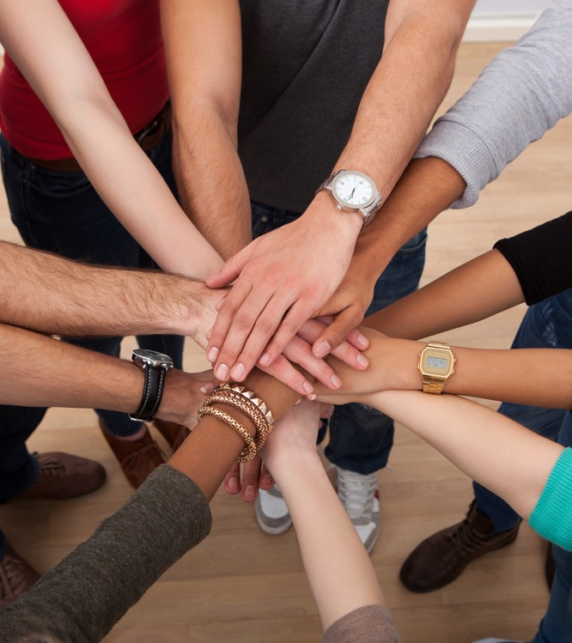
Summary
Research
Critical thinking
Ethical Aspects

Slide 10
Any questions?
Thank you!

Slide 11
Module creator: Ioanna Kostarella
Assistant Professor
ikostarella@jour.auth.gr
Dr Kostarella teaches both postgraduate and graduate courses, while she has contributed to various research papers in journals, refereed conference proceedings and authored chapters in books. Ioanna Kostarella speaks English, German and Italian and her research interests include journalism and new media, communication and journalism for development and social change, the interaction between media and foreign policy, European media, communication and journalism for development and environmental communication.

Slide 12
References
Dahlstrom, M. F. (2014). Using narratives and storytelling to communicate science with nonexpert audiences. Proceedings of the National Academy of Sciences, 111(Supplement 4), 13614-13620.
Dunwoody, S. (1999). Scientists, journalists, and the meaning of uncertainty. Communicating uncertainty: Media coverage of new and controversial science, 59-79.
Nelkin, D. (1995). Science controversies: The dynamics of public disputes in the United States. Handbook of science and technology studies, 444, 456.

Slide 13
References
Rensberger, B. Science journalism: Too close for comfort. Nature 459, 1055–1056 (2009). https://doi.org/10.1038/4591055a
Secko, D. M., Amend, E., & Friday, T. (2013). Four models of science journalism: A synthesis and practical assessment. Journalism Practice, 7(1), 62-80.
www.investigative-manual.org
https://multimedia.journalism.berkeley.edu/tutorials/starttofinish/

