Slide 1
Reporting/Producing news stories for scientific issues
School of Journalism and Mass Communications, AuTh

Slide 2
Objectives:
Learn
Develop
01
To report and produce news stories about scientific issues
To adapt the most appropriate communication means for a given context
03
Multimedia content
Skills to illustrate information needs
Skills to select digital tools and technologies
Encourage
02
To take a sharper and more alert scrutiny of the world around us
To critically assess the credibility and reliability of sources and data

Slide 3
Focus areas
Writing a new story
Understanding the different media formats
Picking up the tools
Dealing with sources

Slide 4
Sci Com
Sci Jour
Science Communication is the practice of communicating science-related topics to non-experts. In the field of Science Communication, this usually extends to the communication of science, technology, engineering and maths (STEM) topics.
Science journalism conveys reporting about science to the public. The field typically involves interactions between scientists, journalists, and the public.
This is our focus.

Slide 5
Current trends
Journalists and scientists
Science journalists must become increasingly multimedia in nature;
Speed/timeliness
Reliability
Validity
A complex relationship
A shared space
Tension
Suspicion

Slide 6
The practice of science journalism
Print or digital oriented?
Science news has so far been overwhelmingly print-oriented and focused on biomedical topics
Television science reinforces the legitimacy and sacredness of science
Coverage of science follows journalistic rather than scientific norms
There is a clear shift to the Internet (Dunwoody, 2021)

Slide 7
Story writing criteria for science journalism
Purpose: Why the story is being written?
Focus: What is the focal point?
Style: How the story is written?
How science should be portrayed in the story?
(Secko et al., 2013)

Slide 8
Story writing criteria for science journalism stories
Sourcing: What information and which voices are included in the story?
Audience: Who the story is written for and what role does the audience play?
Science: How science should be portrayed in the story?
(Secko et al., 2013)

Slide 9
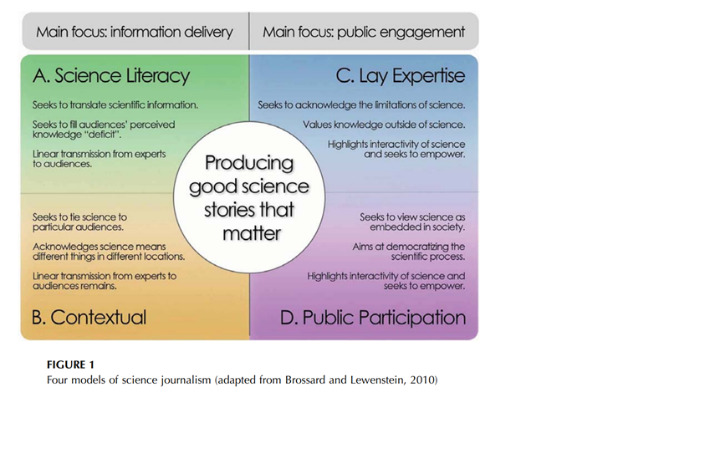
Four models of Sci Jour (in Secko et al., 2013)

Slide 10
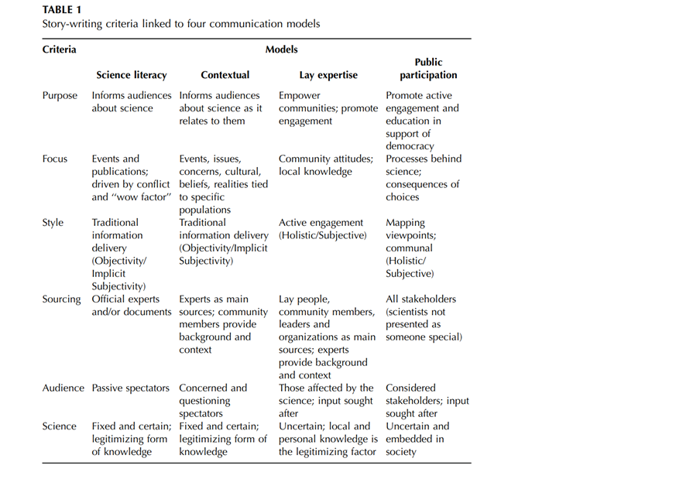
Story writing criteria (in Secko et al., 2013)

Slide 11
Writing our own stories
You’re looking first and foremost for a good story, not a phone book.
We gather information to get a story out of it; we don’t work on stories simply to gather information.
We want to stir emotions.
People are real characters in our stories, not just quotes.

Slide 12
Topics in Sci Jour
What kind of topics are we interested in?
Climate science
Ecoclimate science
Ecological threats
Epidemics
Vaccines
Artificial Intelligence
Emerging technologies

Slide 13
Topics in Sci Jour
Where to look for?
In:
Science Journals
Websites of institutes and universities
Social media, e.g. LinkedIn

Slide 14
Topics in Sci Jour
Where to look for?
PubMed / Web of science/ Scopus/ Science Direct/ JSTOR/ PsycINFO/ Google scholar/ IEEEXplore / DOAJ/ ClinicalTrials.gov
Unpublished reprints:
Arxiv/ Medrxiv/ Biorxiv/ Psyarxiv

Slide 15
But beware of red flags
Red flags are indicators of either bad science or unscientific nonsense. The more of them you can identify in a claim, the less reliable it will be. They should be compared to the Hallmarks of science, which indicate science that’s conducted properly.
Hallmarks of science | Science or not?

Slide 16
Time for some group work…
Write down your ideas on possible stories
Present the story you consider most suitable for publication in the plenary
6 groups, 10 minutes of discussion

Slide 17
The foundations of science news reporting
Where should we start from?
The 5Ws: Who, when, what, where and why
Understanding the differences between breaking news and in-depth reporting

Slide 18
Find the story
Ingredients of a good story
Provides previously unknown information
The report is the product of a reporter’s own initiative
It requires time and effort
There is clear public interest

Slide 19
Working on our plan
Necessary steps
Finding our story
Designing our plan
Choosing our sources
Picking our tools
Narrating our story
Legal and ethical aspects

Slide 20
Designing our plan
How do we work?
An idea is a starting point.
Chart how each stage of the story will unfold.
Compose a story summary.
Ask the right questions, e.g. why people should care? Who is involved? What are the consequences?
Answering these questions will help you think about how a story can be told.

Slide 21
Choosing our sources
Source mapping
Primary sources: (those who provide first-hand experience, e.g. eyewitnesses). Provide direct proof. Hard to find them.
Secondary sources: all kinds of published material and second-hand accounts.

Slide 22
Choosing our sources
Types of sources
The human trail: eyewitnesses, experts and interested parties
The paper trail: official records, documents etc.
The digital trail: websites, digitally stored records etc.
Crowd-sourced: asking data from the audience

Slide 23
Returning to our groups
Write down the sources you would turn to for the story you proposed previously as a group.
6 groups 10’

