Slide 1
Science Communication Opportunities and Challenges of Rapidly Changing World
Assoc. Prof. Inesa BUNEVICIENE Vytautas Magnus University, Kaunas, Lithuania 2021

Slide 2
Issues to be discussed:
Growing inevitability of science in a contemporary risk society: is there a way for more sustainable living?
The major stakeholders and changing processes of science communication in the 21st century: from scientific news, to politics, to society;
Guidelines for effective science communication.

Slide 3
3. Guidelines for science reporting

Slide 4
Spotting a science story worth covering
Telling the story
Science news for public good: bridging the gap between journalists, scientists and public
Journalistic qualities and personal characteristics in science reporting
Covering science in the times of change and crisis

Slide 5
Spotting a science story worth covering
Now…
Imagine, - you are a journalist working for a national news outlet. Your colleague who covers science news got sick and you are the one to replace him/her during the week. You are asked by your editor to find a science news story and tell it by the end of the week.
Question: Where do you start looking for a science story worth covering?

Slide 6
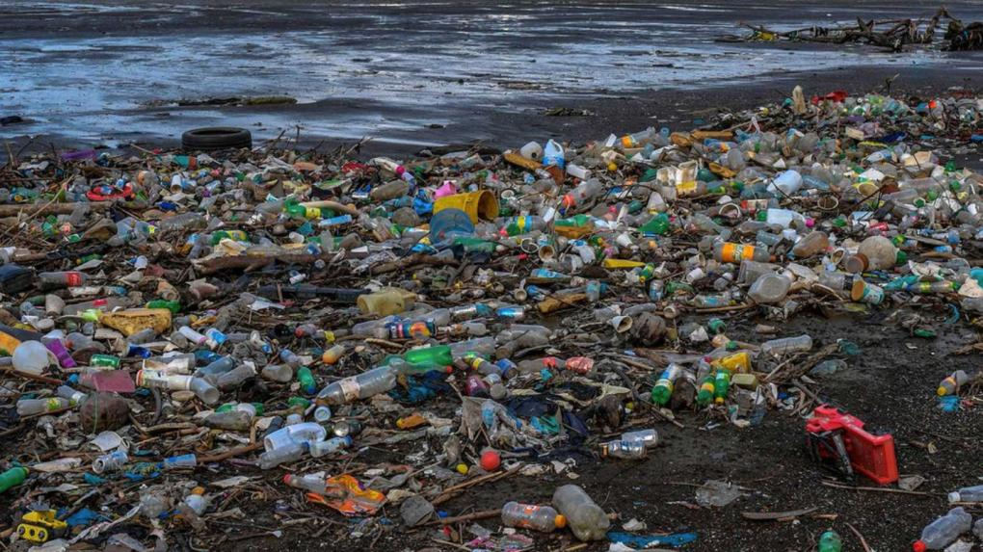
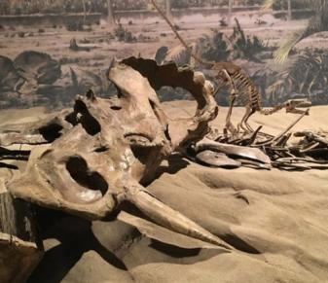
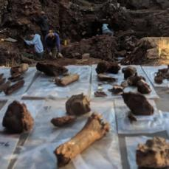
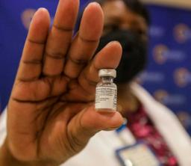
Where to look? Science journals, websites of universities, science institutes, other organizations, etc. Many scientists and scientific institutions can be found online, - ResearchGate, LinkedIn, Facebook, Twitter and Academia.edu, etc.
What to look for? Criteria of journalistic newsworthiness (news values): timing, proximity, significance, human interest, novelty, prominence (stories about famous people), etc.
It’s not everyday that NASA’s Perseverance rover successfully touches the surface of Mars. There is so much more…
Smitsonian Magazine | The Ten Most Significant Science Stories of 2020
https://www.smithsonianmag.com/science-nature/ten-most-significant-science-stories-2020-180976660/
Notes:
Journals, other media channels, scientists, universities, etc.
Be in constant contact to them. Always be ready.
It’s not everyday that NASA’s Perseverance rover successfully touches the surface of Mars. There is so much more… some of the stories are not so excited, but might be equally important. So, look carefully. And here are some examples.
Companies Develop Covid-19 Vaccines in Record Time: While we all heard news related to development and distribution of COVID-19 vaccines, in 2020 there were much more in scientific arena going on.
Microplastics Invade the Furthest Reaches of the Globe: scientists published several studies showing that the amount of microplastic is much greater than previously thought and the reach is much further than previously documented. In April, researchers documented microplastics in Antarctic sea ice for the first time.
Three Different Early Humans May Have Lived Together in South Africa: Despite being widely discredited in modern archaeology, orthogenesis—the theory that species evolve in neat succession, with new species replacing extinct species without much overlap—still looms large in the public understanding of human evolution. Researchers now say that evolution may have looked more like a scene first described in April this year, where three different species of possible human ancestors lived together in the same ancient cave in South Africa’s Cradle of Humanity.
Dinosaurs also had cancer: And in the case of a particular bone found in the roughly 75 million-year-old rock of Alberta, a medical examination has revealed that dinosaurs suffered from a cancer that afflicts humans today. In the end, the experts arrived at a diagnosis of osteosarcoma–a malignant bone cancer that afflicts about 3.4 out of every million people worldwide. The team’s new study, published in The Lancet, provides the most detailed evidence yet for cancer in a dinosaur. Other paleontologists have found cancer in dinosaur bones before, but, Evans notes, this is the first time a malignant cancer has been confirmed through multiple lines of evidence.

Slide 7
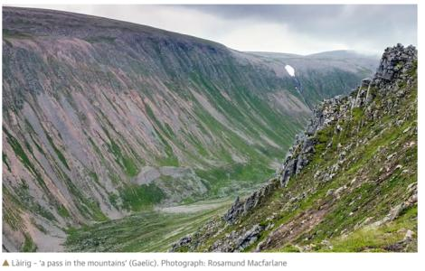
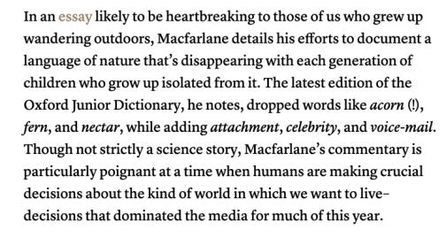
Full article by Robert MacFarlane | in TheGuardian: https://www.theguardian.com/books/2015/feb/27/robert-macfarlane-word-hoard-rewilding-landscape
More examples from Laura Dattaro | CJR: https://www.cjr.org/opinion/six_great_pieces_of_science_writing_you_may_have_missed_this_year.php

Slide 8
I’ve found the story! What’s next?
Is your story really worth covering? Find/contact/read the primary source. What’s important in scientific article? – No, it’s not only the abstract!
Question for a discussion: What would be your suggestions for the journalists on reading scientific articles? What is the most important parts to read/analyze and why?
Is the study peer-reviewed?
What is the date of publication?
What is the sample size?
Research design and methods?
Contribution to the field?
Who conducted the study?
Who funded the research?
What are the limitations?
Put the research in context
Notes:
So, different kind and scale science stories can be interesting and important. However, when you believe you have found one – it is crucial to start checking facts and verify information. And in the time of “infodemics” this gains even more importance. First, because we need to be sure that our story is true and we are not spreading fake or misleading information. Second of all, because we are responsible for what we communicate and we have knowledge how to do it in a professional way.
While we do have plenty of ways to verify information, we should start by finding, contacting or reading a primary source. In many cases it is science article. So now, lets stop here for a moment. While we all more or less know the structure of scientific article, do we really know where to look for the most important information? QUESTION TO THE STUDENTS: How do you think journalists should read the scientific article? What parts are most important? Why?
Its not only about the abstract: other parts are also important: questions to ask while reading: 1) is the study peer-reviewed?; 2) When the study was published and performed?; 3) What is the sample size and can you do any assumptions about the population in general from the sample?; 4) What is the reasearch design and methods – talk about them in your popular science piece – educate your audience; 5) what is the contribution to the field?; 6) who conducted the study - institution, group, researcher – who are they and if they have previous experience?; 7) who funded the research – are there any conflicts of interest?; 8) what are the limitations of the study? 9) put the research in the general context? What does it mean?
Thanks to the new internet based technologies we also have plenty of tools and ways to check our facts.

Slide 9
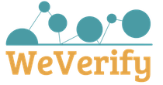
Traditional ways are still valid!
Check the facts! There can be a multiple-ways to check and verify your information, including technology-based choices or traditional ways.
Use e-mails and phone calls to fact-check. Sometimes the only and the best way to check the fact is to get in contact directly with the source.
Other traditional fact-check resources: Libraries, subject databases, dictionaries, review articles, scholarly publications, press releases, etc…
Notes:
Politifact:
PolitiFact is owned by the nonprofit Poynter Institute for Media Studies. PolitiFact had been owned by the Tampa Bay Times, but in 2018 direct ownership of PolitiFact was transferred from the Times to Poynter, which is the newspaper’s parent company. The move allows PolitiFact to function fully as a not-for-profit national news organization.
- Facebook and TikTok flag posts that they believe may be factually inaccurate or misleading. PolitiFact fact-checkers examine the posts and provide feedback to the social media companies as to the accuracy of the claims made in the posts. While PolitiFact determines the accuracy of the posts, TikTok and Facebook decide what, if any, action to take on their platforms.
Each day, PolitiFact journalists look for statements to fact-check. We read transcripts, speeches, news stories, press releases, and campaign brochures. We watch TV and scan social media. Readers send us suggestions via email to truthometer@politifact.com; we often fact-check statements submitted by readers. Because we can't feasibly check all claims, we select the most newsworthy and significant ones.

Slide 10
Telling the story
Question for a discussion:
What are traditional and new challenges while telling the scientific news story?
Can you name some of them?

Slide 11
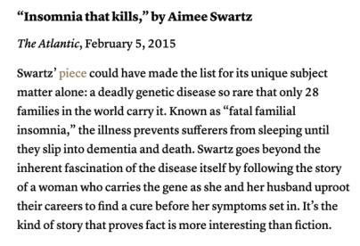
Educating and empowering audiences through socially responsible news coverage:
#1. Balanced but fair reporting: representing opposite sides while also fairly acknowledging their scale and significance in the field.
#2. Personal but verified stories can be a good choice, however, accuracy and precision cannot be sacrificed for visibility or attractivity.
#3. Responsible framing: Indeed it can be difficult to decide and understand the effect selected frame could have on the audience, but it is important to closely follow scientific discussions regarding these issues and follow recommendations of responsible global and national experts and institutions.
Notes:
Today telling about a science to a lay people it is much more that educating, its more about empowering and engaging. So, how do we do it?
Balanced but fair reporting: a very well know example is climate change consensus.
While 97% of scientists agree that climate change is happening and is mainly related to human activities.
Studies of climate change media coverage indicate that media highly misrepresents scientific understanding of man-made global warming: only in 28% of the media coverage global warming in depicted human contribution to global warming as a significant factor, while 72% covered it in a sceptic way. Indeed, very often we can see an article about climate change where issue is discussed interviewing ”experts” from both sides, but are those experts equally important and trustworthy? Who is an expert nowadays?
And the effects of media coverage are evident on public perception of global warming, - only 26% of people believe that global warming is happening and related to human activities. So, media coverage is not balanced in a fair way.

Slide 12
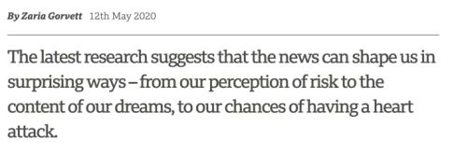
#4. Good science journalist most of all aspires to educate, engage and enable publics, by explicitly explaining the research instead of oversimplifying it.
#5. Education on media effects: public education on media effects should be also a significant part of socially responsible journalism.
*
Article accessible here:
https://www.bbc.com/future/article/20200512-how-the-news-changes-the-way-we-think-and-behave

Slide 13
Science news for public good: bridging the gap between journalists, scientists and public
Question for a discussion:
What are traditional and new challenges related to the relations between journalists, scientists and society?
Can you name some of them?
How should they be addressed and solved?

Slide 14
#1. Building and maintaining close relationships based on trust and respect with scientists and representatives of scientific institutions (e.g., press officers).
#2. While working with a scientist, focus on common goals instead of differences. Being aware of all the differences between the two cultures and problems that can cause may help you to better overcome them.
United in service for truth in the time of fake news and disinformation
Full story by Daniel Colón-Ramos, Elliot Kirschner, Dan Rather accessible here: https://blogs.scientificamerican.com/observations/what-journalists-and-scientists-have-in-common/
Notes:
We recognize that there are differences between the ways journalists and scientists perform their professions, and those differences could serve as barriers for cooperation. Scientists often are wary of the way their work might be presented by journalists. They have seen nuanced research oversimplified or hyped for more dramatic (and sometimes misleading) headlines. At the same time, journalists can be frustrated by scientists who respond to straightforward questions with jargon and are unable or unwilling to explain the essence of their discoveries without caveats and qualifiers.
We believe, however, this mistrust is superficial and can be overcome for the benefit of all of society. Scientists and journalists share core aspirations. Both disciplines are about observing the world, questioning the unknown and collecting facts. Both scientists and journalists know their work is built on the work of others and they must find a way to share their discoveries. Scientists may tell their stories in papers they publish to share with their colleagues in the field. Journalists may tell their stories in print, radio or film, often trying to reach as wide an audience as possible. But the mission is the same. Knowledge can only have an impact if others hear about it.

Slide 15
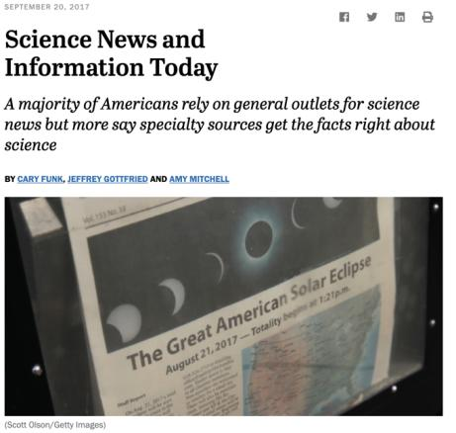
#3. Communicating science today often is about engaging public for common action, to reach that goal the knowledge about the audience is critical – how your audience feel about the topic (?); what do they know/don’t know (?); what are the myths or misconceptions (?). Always keep your audience close to yourself by traditional and new (technology assisted ways) – this is an important part of your work.
#4. Social responsibility – is in the core of science journalism. The true essence of journalism lies in the common good, therefore, caring for your audience is an indispensable requirement for the true science journalist, this includes making sure to work on better public science literacy as well as better public media literacy.
Pew Research Center: https://www.journalism.org/2017/09/20/science-news-and-information-today/.

Slide 16
Journalistic qualities and personal characteristics in science reporting
#1. Professional ethics is one of the most important qualities good journalist must follow: truthfulness and accuracy in reporting; the harm limitation principle; and the principle of independence are among those mostly valued principles of good journalists including science journalists.
#2. However, while working under increased pressure, which is often the case while dealing with topics related to risks, crisis, global change, etc., it can be challenging to follow the ethics. Being aware of such “moments of weakness” and preparing for them, would be the first step to take.
#3. And of course, you will make mistakes, if so, - acknowledge your mistakes, inform your audience about them, learn from them and move on.

Slide 17
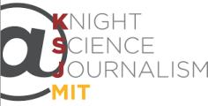
#4. Attitudes, growth mindset, commitment and passion might be more important in the daily work of science journalism than compared to formal education in science or communication.
#5. In this rapidly changing environment it is essential to never stop learning and growing. And this is not a difficult task, as there are plenty of different platforms to update your knowledge or learn something new.
Holds its annual journalism workshops in conjunction with the Council for the Advancement of Science Writing (CASW), a fifty-year-old educational organization started by science journalists to improve the quality of science information reaching the public.
https://www.nasw.org/
The Ethical Journalism Network brings together news on media ethics, self-regulation, media literacy, corruption, hate speech and accountable journalism from around the world.
https://ethicaljournalismnetwork.org/
The Knight Science Journalism Program at MIT seeks to advance science journalism in the public interest by nurturing and enhancing the ability of journalists to accurately and thoughtfully illuminate science and its intersection with human culture.
https://ksj.mit.edu/

Slide 18
Covering science in times of change and crisis
#1. Pandemic had a strong impact on journalists’ agendas by shifting the focus towards COVID-19 issues and often ignoring other topics.
While crisis related information indeed is important, other issues, corresponding public interest should not be left aside and should be included into the coverage by ensuring balanced agenda.
Furthermore, it is also essential to choose quality over quantity while reporting long lasting crisis news.
Notes:
The coronavirus disease 2019 (COVID-19) pandemic has sparked an explosion in biological and medical research worldwide, with more than 30,000 COVID- 19 PubMed-indexed publications and 6200 medRxiv and bioRxiv preprints this year as of July 9th, 2020.¹
^{,2}
However, while immediate access to the latest research is undoubtedly crucial in combating this pandemic, the scientific community must be wary of the potential tradeoff between quantity and quality. In this letter, we discuss the implications of this surge in the rate of publications and suggest measures to minimize undesirable consequences.

Slide 19
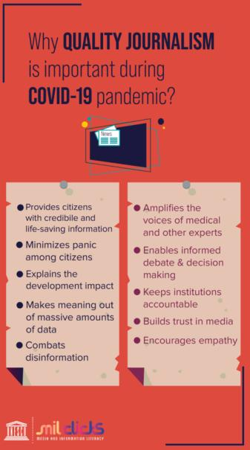
#2. Working on highly uncertain scientific topics is never an easy task.
...increasing speed of science making and communicating indeed raises questions about the quality and trust.
…intensified situation in the media ecosystem – increased volumes of fake news, disinformation, information overload, etc. - also poses additional challenges to the journalists covering science.
Therefore, extra precautions have to be taken by reporters, especially when the news are focusing on a single study or when the only source is a press-release (without a original research paper).
Journalists are expected to demonstrate their excellence in fast and reliable ways of information verification and fact checking applying technology based or traditional ways.

Slide 20
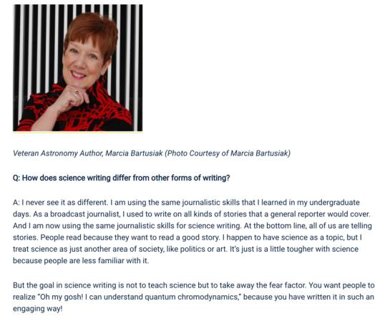
Social responsibility: the power journalists have – not so much of information coverage or dissemination, but of professional ability to verify, check and distinguish between true and false news – also requires to take responsibility of those who are more vulnerable to a “sick” information environment we find ourselves today.
Growth mindset: constant learning, improving, acknowledging and learning from mistakes, being on top of the news in the field, following world leading sources, easily adapting to technology assisted ways of information gathering or verification, being flexible, being open, being adaptive, etc.
Professional ethical principles and values - one and very important thing to keep stable.
While conspiracies, fake news, disinformation are fueling public fears, science and professional reporting of science news are aiming to eliminate the fear factor and open their minds for true facts.
*
Full interview available here: https://ecrcommunity.plos.org/2018/01/23/take-the-strange-and-make-it-familiar-advice-on-science-writing/
Notes:
Marcia Bartusiak is an award-winning science journalist, author and Professor of Science Writing at MIT. She has written on astronomy for about four decades, with features in Discover, Science, Smithsonian, Astronomy and National Geographic. In her interview, she shares some insights into her career, hoping to provide some food for thought for aspiring scientists and science writers: https://ecrcommunity.plos.org/2018/01/23/take-the-strange-and-make-it-familiar-advice-on-science-writing/
While conspiracies, fake news, disinformation are fueling public fears, science and professional reporting of science news are aiming to eliminate the fear factor and open their minds for true facts.

Slide 21
So, what is you story and how are you going to tell it? INDIVIDUAL ASSIGNMENT
Please write a popular science piece (science news story) following the provided guidelines and other recommendations discussed.
Requirements:
The article you are about to write should be based on an actual scientific research (peer reviewed article, data-set, scientific report, etc.). Please, include the link to the original source at the end of your paper.
The recommended length of the article is between 700 to 1000 words.
It is very important that you follow all the guidelines while covering your chosen topic.

Slide 22
Readings and other related materials:
ERUM Guidelines
Casasbuenas, J., Appiah, B. (2016). How to report scientific findings. SciDev.Net. Accessible online at: https://www.scidev.net/global/practical-guides/how-to-report-scientific-findings/
Cornelissen, J. (2018). The Democratization of Data Science. Harvard Business Review. Accessible online at: https://hbr.org/2018/07/the-democratization-of-data-science
Elliott, K. C. (2019). Science Journalism, Value Judgements, And the Open Science Movement. Frontiers in Communication. https://doi.org/10.3389/fcomm.2019.00071
Figdor, C. (2017). (When) Is Science Reporting Ethical? The Case for Recognizing Shared Epistemic Responsibility in Science Journalism. Frontiers in Communication. https://doi.org/10.3389/fcomm.2017.00003
Friedman, S., Dunwoody, S., and Rogers, C. (eds.) (1999). Communicating Uncertainty: Media Coverage of New and Controversial Science. Mahwah, NJ: Lawrence Erlbaum Associates.
Bottemanne, H., Morlaàs, O., Fossati, P., Schmidt, L. (2020). Does the Coronavirus Epidemic Take Advantage of Human Optimism Bias? Front. Psychol. 11:2001. doi: 10.3389/fpsyg.2020.02001

Slide 23
Assoc. prof. Inesa BUNEVIČIENĖ E-mail: inesa.buneviciene@vdu.lt
Department of Public Communication Vytautas Magnus University, Kaunas, Lithuania
|2021

