Slide 1
Science Communication Opportunities and Challenges of Rapidly Changing World
Assoc. Prof. Inesa BUNEVICIENE Vytautas Magnus University, Kaunas, Lithuania 2021

Slide 2
Issues to be discussed:
Growing inevitability of science in a contemporary risk society: is there a way for more sustainable living?
The major stakeholders and changing processes of science communication in the 21st century: from scientific news, to politics, to society;
Guidelines for effective science communication.

Slide 3
2. Science communication in the 21st century. Main actors and changing communication processes

Slide 4
Defining science communication and science news reporting;
Democratization of science and the public participation model;
Bridging the gap between scientists, journalists and society:
Science and society: Public understanding of science and scientists’ understanding of public;
Science and media: too different to work for the same goals?

Slide 5
Defining science communication and science news reporting
Science communication
communication between scientists and other concerned groups or separate individuals. Science communication can be divided into several levels according to the communication actors:
communication between scientists inside the community of scientists;
communication between scientists and media;
communication between scientists and society;
communication between scientists and political bodies; etc.
Science news reporting
transmission and translation of scientific knowledge into the language understandable to lay audiences.
In society as we know it today, it is very important to communicate scientific information to general public and provide them with essential knowledge enabling them to knowledgeable actions and justified decisions.

Slide 6
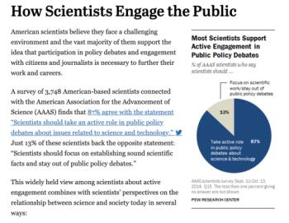
Democratization of science: communicating science to involve and empower
The public participation model
society is realized as able to take part in common discourse together with scientists.
The contextual model
in order to effectively communicate scientific knowledge, it is vital to evaluate dominant social and psychological factors, shaped by prior experiences, cultural context and personal conditions. Scientific knowledge is accepted and interpreted by society in the context of all these factors.
Deficit model
society demonstrate low scientific illiteracy; do not have any competences and skills to interpret scientific knowledge and scientists, politicians or journalist try to fill in this gap with scientific information, however, information is send without any further expectations to be involved into longer discussions or dialogues.
Read more: Pew Research Center (2015). How Scientists Engage the Public

Slide 7
Scientists aim to: Bring their investigations to life, to present them and show, how they can improve daily life or solve some big problems, manage risks, and gain trust and acceptance from society, etc. But… communicating with lay audiences requires time, knowledge and other skills, therefor in many cases scientists themselves are not capable of doing it by themselves.
➢
JOURNALISTS
THE PROCESS OF SCIENCE REPORTING
SCIENTISTS
Journalists aim to: Inform public by following their professional values, journalistic norms and other requirements of contemporary journalism. Although scientific issues may often related to public interest, But… covering such issues requires specific knowledge and investigations. Science journalism is rather expensive, therefore not every media organization is capable and interested of having someone covering science.
➢
➢
Public aim to: Get reliable information, necessary to make decisions and evaluate/manage risks, crisis. But… not everyone can understand scientific language and scientific process itself, therefore media is the main sources of science news for public. However, the way science is covered in media is often far from the message scientists wanted to communicate.
➢
PUBLIC
Notes:
For public participation model it is very important that all the actors of communication process are involved and engaged, most importantly, - scientists, public and journalists.
While it can be promising to include society into the processe of science, however, there are a number of pitfalls to reconsider.
Let’s start with different aims scientists, society and journalists may have in the process of science communication.
So, for instance, Scientists aim to Bring their investigations to life, to present them and show, how they can improve daily life or solve some big problems, manage risks, and gain trust and acceptance from society, etc. But… communicating with lay audiences requires time, knowledge and other skills, therefor in many cases scientists themselves are not capable of doing it by themselves.
Meanwhile public aim to: Get reliable information, necessary to make decisions and evaluate/manage risks, crisis. But… not everyone can understand scientific language and scientific process itself, therefore media is the main sources of science news for public. However, the way science is covered in media is often far from the message scientists want to communicate.
And of course journalists

Slide 8
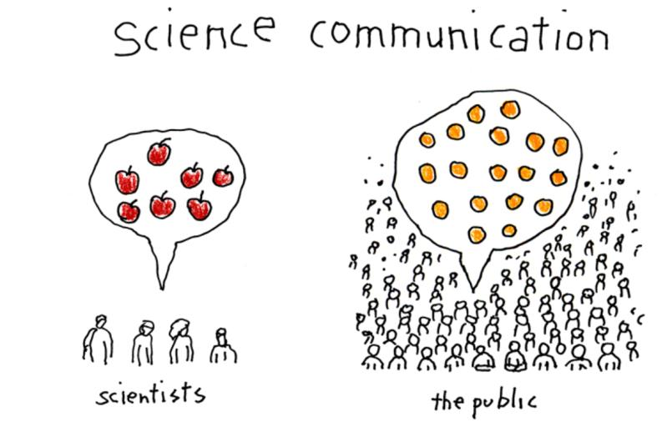
Cartoon by Tom Dunne from American Scientist | Accessible here.
Notes:
So, we do have a lot of examples, when it is difficult for scientists and society to talk to each other and understand each other – when scientists are talking about apples, and public is concerned about oranges… When scientist say that vaccination is the best and most important way to manage pandemic and still a lot of people decide that its harmful, not safe, etc.
It is important to understand that common we cannot speak about public participation in society with low scientific literacy or nor sufficient public understanding of science or low public awareness of scientific issues. Theses are the terms I am going to cover next…

Slide 9
Science and society: Public understanding of science
Scientific literacy is a concept defining level of public knowledge regarding scientific issues. Scientific literate public is a public which have least necessary knowledge to effectively act in a society.
Term of public understanding of science is a narrower concept than scientific literacy and it implies required knowledge about scientific content (scientific concepts), scientific enquiry (scientific processes), and scientific impact on society (social factors) (for more see Burns, O’Connor & Stocklmayer, 2003; Millar, 1996).
Meanwhile, concept of public awareness of science is a set of positive attitudes toward science (and technology) that are evidenced by a series of skills and behavioral intentions (Gilbert, Stocklmayer, and Garnett, 1999).
Public participation and engagement: Public participation is a concept describing public’s actions related to assistance in decision making, support for policy implementation, etc. Ideas of public participation lies in the core of democratic ideals – public must have a right to express their beliefs and attitudes about public issues which concern them and their life (Stave, 2002; Cox, 2013)
Facts are not everything in the post-truth world.
The way people understand and evaluate science might be related to their political ideologies. Pew Research Center (2020) concluded that “Some public divides over science issues are aligned with partisanship [including climate change or vaccination], while many others are not.
Trust in science is crucial to manage and fight contemporary global risks and crisis.
Notes:
If we can agree the main goal of science communication today is Public participation and engagement: Public participation is a concept describing public’s actions related to assistance in decision making, support for policy implementation, etc. Ideas of public participation lies in the core of democratic ideals – public must have a right to express their beliefs and attitudes about public issues which concern them and their life (Stave, 2002; Cox, 2013) especially when scientists are about to make decisions about very sensitive issues or issues with high level of uncertainty, like climate change, like ivf, artificial intelligence or genetically modified organizms.
However, to reach this level, it is important to ensure that society demonstrate sufficient scientific literacy, which refers to level of public knowledge regarding scientific issues. Scientific literate public is a public which have least necessary knowledge to effectively act in a society. In other words people are able to answer the question – what does it mean?
Also, public is expected to have proper understanding of science, which is a is a narrower concept than scientific literacy and it implies required knowledge about scientific content (scientific concepts), scientific enquiry (scientific processes), and scientific impact on society (social factors). In other words, people have knowledge and understanding where this kind of information is coming from, how it was attained.
And have awareness of science: concept of public awareness of science is a set of positive attitudes toward science (and technology) that are evidenced by a series of skills and behavioral intentions (Gilbert, Stocklmayer, and Garnett, 1999).
Indeed facts are not everything in the post-truth world. For instance, The way people understand and evaluate science might be related to their political ideologies. Pew Research Center (2020) concluded that “Some public divides over science issues are aligned with partisanship [including climate change or vaccination], while many others are not. Trust is another concept, which is crucial in building proper relations between science and public.

Slide 10
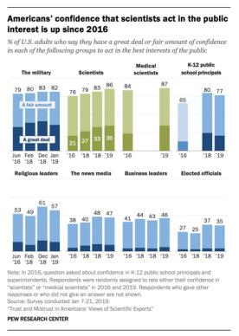
People trust in science, but they do not believe in it? (Pew Research Center, 2017)
public confidence in the scientific community remains relatively strong;
public trust in scientists in matters connected with childhood vaccines, climate change, and genetically modified (GM) foods is more varied;
only 47% of people say that medical scientists understand the health effects of the measles, mumps, and rubella (MMR) vaccine “very well.”
Pew Research Center, 2019: Trust in practitioners like medical doctors and dietitians is stronger than that for researchers in these fields, but skepticism about scientific integrity is widespread”.
Source: https://www.pewresearch.org/fact-tank/2020/02/12/key-findings-about-americans-confidence-in-science-and-their-views-on-scientists-role-in-society/
Notes:
Regarding public trust in science, we should mention, that public trust is quite high and stable, but when it comes to more sensitive and controvercial topics like climate change, vaccination, genetically modified foods, etc., trust is more varied. To be more precise, - only 47% of people say that medical scientists understand the health effects of the measles, mumps, and rubella (MMR) vaccine “very well.”
What does it mean? It raises questions, how to communicate this kind of topics to build and maintain public trust in science and scientists?

Slide 11
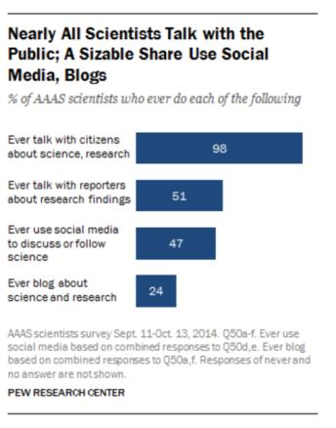
Science and society: Scientist’s understanding of the publics
Serving to public good is in the very core of science, however, in many cases issues scientists try to solve are far from what public actually want scientists to do.
But data indicate that 98% of scientists say they have some level of interaction with citizens at least from time to time, and 51% have at least some contact with reporters about research findings (Pew Research Center, 2015).
Notes:
And while we can find a lot of discussions going on about how public understand, perceive and engage with science, there is another side to consider – scientists understanding of the publics. If scientists are actually doing their best to communicate their findings? Serving to public good is in the very core of science, however, in many cases issues scientists try to solve are far from what public actually want scientists to do.
However, it seems that situation is changing to the better – according to the Pew Research Center in 2014 nearly all scientists said they talk with the public in one another form while discussing science or their research.
In 2015 98 percent said they have some level of interaction with citizens at least from time to time, and 51% have at least some contact with reporters about research findings.

Slide 12
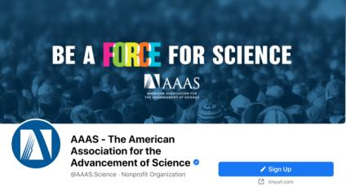
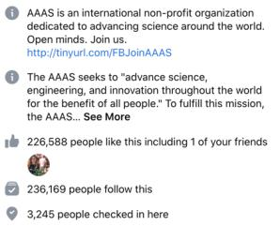
Is social media helpful for closing the gap?
In addition, nearly half of AAAS (American Association for Advancement of Science) scientists – 47% – use social media to talk about science or read about scientific developments at least some of the time. Some 24% of these AAAS scientists blog about science and research.
ResearchGate, LinkedIn, Facebook, Twitter and Academia.edu were the top five sites visited by scientists and engineers participating in a separate 2014 survey (https://go.nature.com/2Dk1L6v).
Notes:
Indeed, different social media tools and challels are very helpful in bridging the gap: 47% of AAAS scientists use social media to talk about science or read about scientific developments at least some of the time. Some 24% of these AAAS scientists blog about science and research.
ResearchGate, LinkedIn, Facebook, Twitter and Academia.edu were the top five sites visited by scientists and engineers participating in a separate 2014 survey (https://go.nature.com/2Dk1L6v).

Slide 13
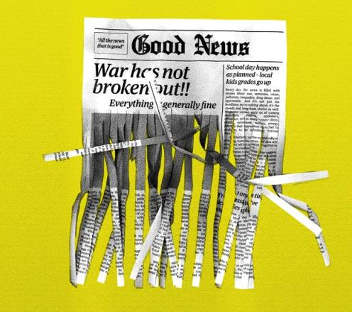
Reporting science news: the role of media
Notes:
Of course, mainstream media also play a crucial role.
However, practice show that in some cases communicating science through media might result in misinformation and misunderstanding as well as decreasing public trust in science.
Let me provide you with some examples.

Slide 14
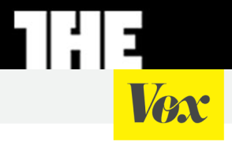
Science and media: too different to work for the same goals?
A majority of AAAS scientists say it is not too or not at all important for career advancement to have their research covered in the news (56%), and 77% say it is not too or not at all important for career advancement to promote their findings on social media.
However, 43% of AAAS scientists say it is important or very important for scientists in their specialty to get coverage of their work in news media, up from 37% who said that in a 2009 survey.
Besides, most scientists believe that science news coverage can pose problems for science: 79% of scientists believe it is a major problem for science that news reports don’t distinguish between well-founded and not well-founded scientific findings.
Read more here.
Notes:
For a long time the question why media and scientists can not easily get along in working together for public good was discussed.
And a number of conditions excists why this is the case.
A majority of scientists from American Association for Advancement of Science say it is not too or not at all important for career advancement to have their research covered in the news (56%), and 77% say it is not too or not at all important for career advancement to promote their findings on social media.
However, 43% of AAAS scientists say it is important or very important for scientists in their specialty to get coverage of their work in news media, up from 37% who said that in a 2009 survey.
Besides, most scientists believe that science news coverage can pose problems for science: 79% of scientists believe it is a major problem for science that news reports don’t distinguish between well-founded and not well-founded scientific findings.

Slide 15
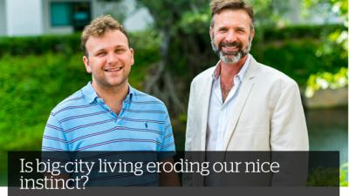
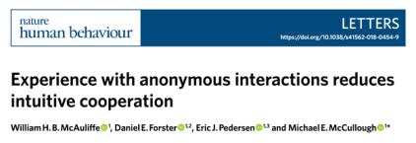
“Game of broken telephone”?
University press-release
Original paper
Headline in media
Read full paper here
The study concluded: people become less generous over time when they make decisions in an environment where they don’t know or interact with other people.
This interpretation wasn’t correct, because the study was conducted in a lab, not a city. And it measured investing money, not overall kindness.
Notes:
Many are referring to the science journalism as a “game of broken telephone” and for sure we do have a number of examples which in many cases prove it.
For instance, in 2018 group of scientists from the USA published their research paper “Experience with anonymous interactions reduces intuitive cooperation”. The paper presents their research where they investigated how people make decisions about donating their money to different causes. They followed the methodology of Dictator Game and Trust Game. 276 participlants were included in the study and played some rounds of the mentioned games. In between of the sessions participants also watched different videos by different charity organizations - Oxfam, Feeding America and International Rescue Committee. Results demonstrated that “people are less cooperative over time in laboratory paradigms in which cooperation cannot promote self-interest, but are just as cooperative over time in paradigms that have the potential to promote self-interest.

Slide 16
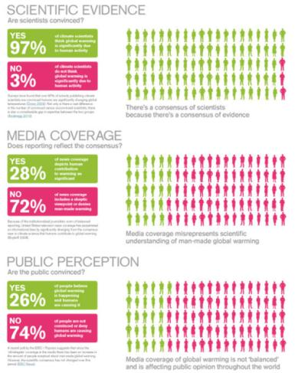
Educating and empowering audiences through socially responsible news coverage:
When everyone is an expert on everything… By: Bronwyn Williams
Full article by Anup Shah in Global Issues: https://www.globalissues.org/article/710/global-warming-spin-and-media
Notes:
Another issue which is often found in the media coverage is dealing with journalistic principle of balanced reporting.
a very well know example is climate change consensus.
While 97% of scientists agree that climate change is happening and is mainly related to human activities.
Studies of climate change media coverage indicate that media highly misrepresents scientific understanding of man-made global warming: only in 28% of the media coverage global warming in depicted human contribution to global warming as a significant factor, while 72% covered it in a sceptic way. Indeed, very often we can see an article about climate change where issue is discussed interviewing ”experts” from both sides, but are those experts equally important and trustworthy? Who is an expert nowadays?
And the effects of media coverage are evident on public perception of global warming, - only 26% of people believe that global warming is happening and related to human activities. So, media coverage is not balanced in a fair way.

Slide 17
Readings and question for the discussion:
Readings:
Speaking science-ese | The Participation Model
Issues in Science and Technology | Forget Politicizing Science. Let’s Democratize Science!
AAAS | Microbiologist Maria Elena Bottazzi Counters Vaccine Misinformation (video available)
AAAS | Astrid Caldas Addresses Climate Change Misinformation (video available)
Question for the discussion:
? What are traditional and new challenges related to the relations between journalists, scientists and society?
? How should they be addressed and solved?
Notes:
So, to wrap everytnig we’ve been talking in this part, it is important to stress three things:
First, communication of scientific information is important precondition to build stronger bonds betweens actors, especially between scientists and society;
However, several problems exists which makes it harder to bridge the gap
Finally, today, telling about a science to a lay people it is much more that educating, its more about empowering and engaging. So, how do we do it?

Slide 18
3. Guidelines for science reporting

Slide 19
Spotting a science story worth covering
Telling the story
Science news for public good: bridging the gap between journalists, scientists and public
Journalistic qualities and personal characteristics in science reporting
Covering science in the times of change and crisis

Slide 20
Spotting a science story worth covering
Now…
Imagine, - you are a journalist working for a national news outlet. Your colleague who covers science news got sick and you are the one to replace him/her during the week. You are asked by your editor to find a science news story and tell it by the end of the week.
Question: Where do you start looking for a science story worth covering?

Slide 21
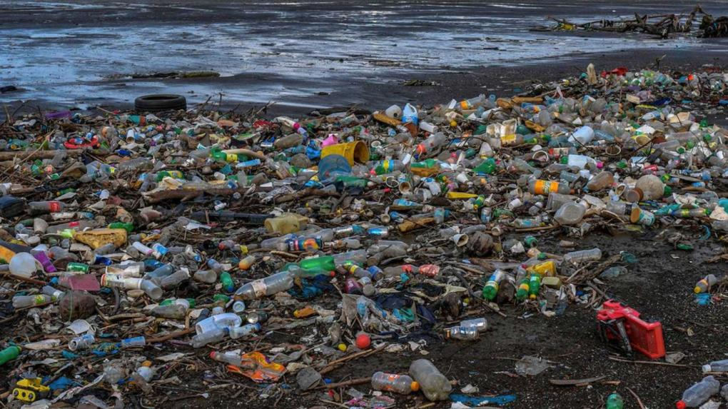
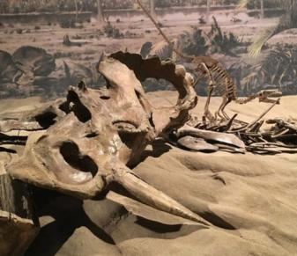
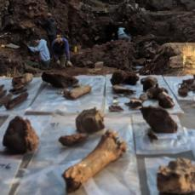
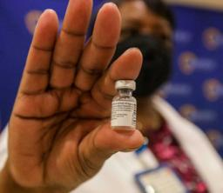
Where to look? Science journals, websites of universities, science institutes, other organizations, etc. Many scientists and scientific institutions can be found online, - ResearchGate, LinkedIn, Facebook, Twitter and Academia.edu, etc.
What to look for? Criteria of journalistic newsworthiness (news values): timing, proximity, significance, human interest, novelty, prominence (stories about famous people), etc.
It’s not everyday that NASA’s Perseverance rover successfully touches the surface of Mars. There is so much more…
Smitsonian Magazine | The Ten Most Significant Science Stories of 2020
https://www.smithsonianmag.com/science-nature/ten-most-significant-science-stories-2020-180976660/
Notes:
Journals, other media channels, scientists, universities, etc.
Be in constant contact to them. Always be ready.
It’s not everyday that NASA’s Perseverance rover successfully touches the surface of Mars. There is so much more… some of the stories are not so excited, but might be equally important. So, look carefully. And here are some examples.
Companies Develop Covid-19 Vaccines in Record Time: While we all heard news related to development and distribution of COVID-19 vaccines, in 2020 there were much more in scientific arena going on.
Microplastics Invade the Furthest Reaches of the Globe: scientists published several studies showing that the amount of microplastic is much greater than previously thought and the reach is much further than previously documented. In April, researchers documented microplastics in Antarctic sea ice for the first time.
Three Different Early Humans May Have Lived Together in South Africa: Despite being widely discredited in modern archaeology, orthogenesis—the theory that species evolve in neat succession, with new species replacing extinct species without much overlap—still looms large in the public understanding of human evolution. Researchers now say that evolution may have looked more like a scene first described in April this year, where three different species of possible human ancestors lived together in the same ancient cave in South Africa’s Cradle of Humanity.
Dinosaurs also had cancer: And in the case of a particular bone found in the roughly 75 million-year-old rock of Alberta, a medical examination has revealed that dinosaurs suffered from a cancer that afflicts humans today. In the end, the experts arrived at a diagnosis of osteosarcoma–a malignant bone cancer that afflicts about 3.4 out of every million people worldwide. The team’s new study, published in The Lancet, provides the most detailed evidence yet for cancer in a dinosaur. Other paleontologists have found cancer in dinosaur bones before, but, Evans notes, this is the first time a malignant cancer has been confirmed through multiple lines of evidence.

Slide 22
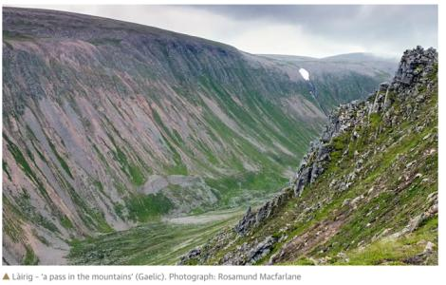
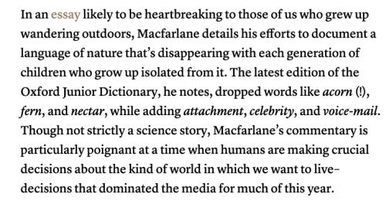
Full article by Robert MacFarlane | in TheGuardian: https://www.theguardian.com/books/2015/feb/27/robert-macfarlane-word-hoard-rewilding-landscape
More examples from Laura Dattaro | CJR: https://www.cjr.org/opinion/six_great_pieces_of_science_writing_you_may_have_missed_this_year.php

Slide 23
I’ve found the story! What’s next?
Is your story really worth covering? Find/contact/read the primary source. What’s important in scientific article? – No, it’s not only the abstract!
Question for a discussion: What would be your suggestions for the journalists on reading scientific articles? What is the most important parts to read/analyze and why?
Is the study peer-reviewed?
What is the date of publication?
What is the sample size?
Research design and methods?
Contribution to the field?
Who conducted the study?
Who funded the research?
What are the limitations?
Put the research in context
Notes:
So, different kind and scale science stories can be interesting and important. However, when you believe you have found one – it is crucial to start checking facts and verify information. And in the time of “infodemics” this gains even more importance. First, because we need to be sure that our story is true and we are not spreading fake or misleading information. Second of all, because we are responsible for what we communicate and we have knowledge how to do it in a professional way.
While we do have plenty of ways to verify information, we should start by finding, contacting or reading a primary source. In many cases it is science article. So now, lets stop here for a moment. While we all more or less know the structure of scientific article, do we really know where to look for the most important information? QUESTION TO THE STUDENTS: How do you think journalists should read the scientific article? What parts are most important? Why?
Its not only about the abstract: other parts are also important: questions to ask while reading: 1) is the study peer-reviewed?; 2) When the study was published and performed?; 3) What is the sample size and can you do any assumptions about the population in general from the sample?; 4) What is the reasearch design and methods – talk about them in your popular science piece – educate your audience; 5) what is the contribution to the field?; 6) who conducted the study - institution, group, researcher – who are they and if they have previous experience?; 7) who funded the research – are there any conflicts of interest?; 8) what are the limitations of the study? 9) put the research in the general context? What does it mean?
Thanks to the new internet based technologies we also have plenty of tools and ways to check our facts.

Slide 24
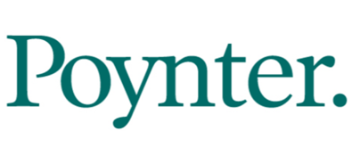
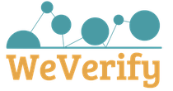
Traditional ways are still valid!
Check the facts! There can be a multiple-ways to check and verify your information, including technology-based choices or traditional ways.
Use e-mails and phone calls to fact-check. Sometimes the only and the best way to check the fact is to get in contact directly with the source.
Other traditional fact-check resources: Libraries, subject databases, dictionaries, review articles, scholarly publications, press releases, etc…
Notes:
Politifact:
PolitiFact is owned by the nonprofit Poynter Institute for Media Studies. PolitiFact had been owned by the Tampa Bay Times, but in 2018 direct ownership of PolitiFact was transferred from the Times to Poynter, which is the newspaper’s parent company. The move allows PolitiFact to function fully as a not-for-profit national news organization.
- Facebook and TikTok flag posts that they believe may be factually inaccurate or misleading. PolitiFact fact-checkers examine the posts and provide feedback to the social media companies as to the accuracy of the claims made in the posts. While PolitiFact determines the accuracy of the posts, TikTok and Facebook decide what, if any, action to take on their platforms.
Each day, PolitiFact journalists look for statements to fact-check. We read transcripts, speeches, news stories, press releases, and campaign brochures. We watch TV and scan social media. Readers send us suggestions via email to truthometer@politifact.com; we often fact-check statements submitted by readers. Because we can't feasibly check all claims, we select the most newsworthy and significant ones.

Slide 25
Telling the story
Question for a discussion:
What are traditional and new challenges while telling the scientific news story?
Can you name some of them?

Slide 26
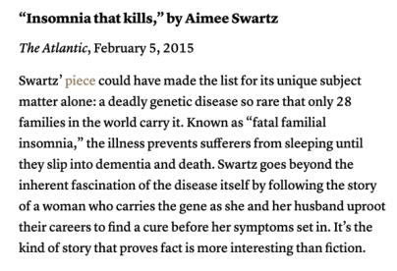
Educating and empowering audiences through socially responsible news coverage:
#1. Balanced but fair reporting: representing opposite sides while also fairly acknowledging their scale and significance in the field.
#2. Personal but verified stories can be a good choice, however, accuracy and precision cannot be sacrificed for visibility or attractivity.
#3. Responsible framing: Indeed it can be difficult to decide and understand the effect selected frame could have on the audience, but it is important to closely follow scientific discussions regarding these issues and follow recommendations of responsible global and national experts and institutions.
Notes:
Today telling about a science to a lay people it is much more that educating, its more about empowering and engaging. So, how do we do it?
Balanced but fair reporting: a very well know example is climate change consensus.
While 97% of scientists agree that climate change is happening and is mainly related to human activities.
Studies of climate change media coverage indicate that media highly misrepresents scientific understanding of man-made global warming: only in 28% of the media coverage global warming in depicted human contribution to global warming as a significant factor, while 72% covered it in a sceptic way. Indeed, very often we can see an article about climate change where issue is discussed interviewing ”experts” from both sides, but are those experts equally important and trustworthy? Who is an expert nowadays?
And the effects of media coverage are evident on public perception of global warming, - only 26% of people believe that global warming is happening and related to human activities. So, media coverage is not balanced in a fair way.

Slide 27
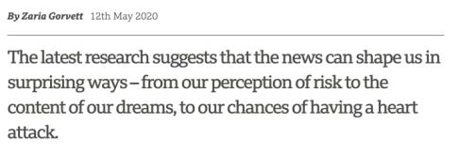
#4. Good science journalist most of all aspires to educate, engage and enable publics, by explicitly explaining the research instead of oversimplifying it.
#5. Education on media effects: public education on media effects should be also a significant part of socially responsible journalism.
*
Article accessible here:
https://www.bbc.com/future/article/20200512-how-the-news-changes-the-way-we-think-and-behave

Slide 28
Science news for public good: bridging the gap between journalists, scientists and public
Question for a discussion:
What are traditional and new challenges related to the relations between journalists, scientists and society?
Can you name some of them?
How should they be addressed and solved?

Slide 29
#1. Building and maintaining close relationships based on trust and respect with scientists and representatives of scientific institutions (e.g., press officers).
#2. While working with a scientist, focus on common goals instead of differences. Being aware of all the differences between the two cultures and problems that can cause may help you to better overcome them.
United in service for truth in the time of fake news and disinformation
Full story by Daniel Colón-Ramos, Elliot Kirschner, Dan Rather accessible here: https://blogs.scientificamerican.com/observations/what-journalists-and-scientists-have-in-common/
Notes:
We recognize that there are differences between the ways journalists and scientists perform their professions, and those differences could serve as barriers for cooperation. Scientists often are wary of the way their work might be presented by journalists. They have seen nuanced research oversimplified or hyped for more dramatic (and sometimes misleading) headlines. At the same time, journalists can be frustrated by scientists who respond to straightforward questions with jargon and are unable or unwilling to explain the essence of their discoveries without caveats and qualifiers.
We believe, however, this mistrust is superficial and can be overcome for the benefit of all of society. Scientists and journalists share core aspirations. Both disciplines are about observing the world, questioning the unknown and collecting facts. Both scientists and journalists know their work is built on the work of others and they must find a way to share their discoveries. Scientists may tell their stories in papers they publish to share with their colleagues in the field. Journalists may tell their stories in print, radio or film, often trying to reach as wide an audience as possible. But the mission is the same. Knowledge can only have an impact if others hear about it.

Slide 30
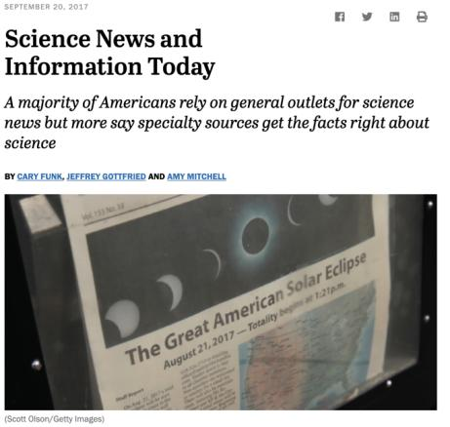
#3. Communicating science today often is about engaging public for common action, to reach that goal the knowledge about the audience is critical – how your audience feel about the topic (?); what do they know/don’t know (?); what are the myths or misconceptions (?). Always keep your audience close to yourself by traditional and new (technology assisted ways) – this is an important part of your work.
#4. Social responsibility – is in the core of science journalism. The true essence of journalism lies in the common good, therefore, caring for your audience is an indispensable requirement for the true science journalist, this includes making sure to work on better public science literacy as well as better public media literacy.
Pew Research Center: https://www.journalism.org/2017/09/20/science-news-and-information-today/.

Slide 31
Journalistic qualities and personal characteristics in science reporting
#1. Professional ethics is one of the most important qualities good journalist must follow: truthfulness and accuracy in reporting; the harm limitation principle; and the principle of independence are among those mostly valued principles of good journalists including science journalists.
#2. However, while working under increased pressure, which is often the case while dealing with topics related to risks, crisis, global change, etc., it can be challenging to follow the ethics. Being aware of such “moments of weakness” and preparing for them, would be the first step to take.
#3. And of course, you will make mistakes, if so, - acknowledge your mistakes, inform your audience about them, learn from them and move on.

Slide 32
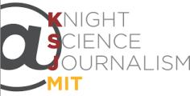
#4. Attitudes, growth mindset, commitment and passion might be more important in the daily work of science journalism than compared to formal education in science or communication.
#5. In this rapidly changing environment it is essential to never stop learning and growing. And this is not a difficult task, as there are plenty of different platforms to update your knowledge or learn something new.
Holds its annual journalism workshops in conjunction with the Council for the Advancement of Science Writing (CASW), a fifty-year-old educational organization started by science journalists to improve the quality of science information reaching the public.
https://www.nasw.org/
The Ethical Journalism Network brings together news on media ethics, self-regulation, media literacy, corruption, hate speech and accountable journalism from around the world.
https://ethicaljournalismnetwork.org/
The Knight Science Journalism Program at MIT seeks to advance science journalism in the public interest by nurturing and enhancing the ability of journalists to accurately and thoughtfully illuminate science and its intersection with human culture.
https://ksj.mit.edu/

Slide 33
Covering science in times of change and crisis
#1. Pandemic had a strong impact on journalists’ agendas by shifting the focus towards COVID-19 issues and often ignoring other topics.
While crisis related information indeed is important, other issues, corresponding public interest should not be left aside and should be included into the coverage by ensuring balanced agenda.
Furthermore, it is also essential to choose quality over quantity while reporting long lasting crisis news.
Notes:
The coronavirus disease 2019 (COVID-19) pandemic has sparked an explosion in biological and medical research worldwide, with more than 30,000 COVID- 19 PubMed-indexed publications and 6200 medRxiv and bioRxiv preprints this year as of July 9th, 2020.¹
^{,2}
However, while immediate access to the latest research is undoubtedly crucial in combating this pandemic, the scientific community must be wary of the potential tradeoff between quantity and quality. In this letter, we discuss the implications of this surge in the rate of publications and suggest measures to minimize undesirable consequences.

Slide 34
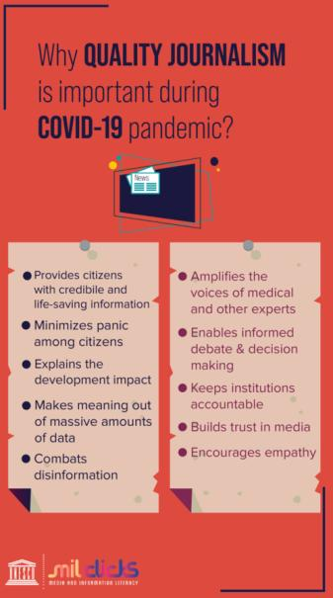
#2. Working on highly uncertain scientific topics is never an easy task.
...increasing speed of science making and communicating indeed raises questions about the quality and trust.
…intensified situation in the media ecosystem – increased volumes of fake news, disinformation, information overload, etc. - also poses additional challenges to the journalists covering science.
Therefore, extra precautions have to be taken by reporters, especially when the news are focusing on a single study or when the only source is a press-release (without a original research paper).
Journalists are expected to demonstrate their excellence in fast and reliable ways of information verification and fact checking applying technology based or traditional ways.

Slide 35
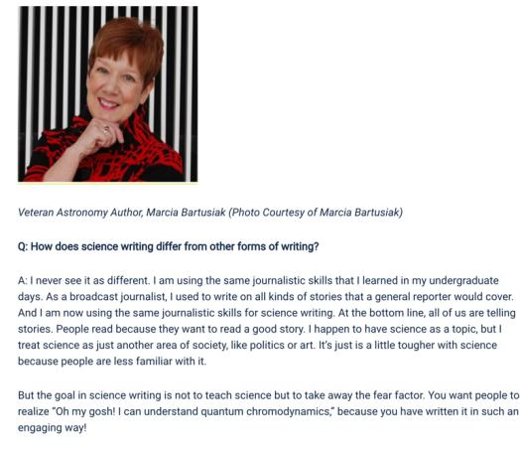
Social responsibility: the power journalists have – not so much of information coverage or dissemination, but of professional ability to verify, check and distinguish between true and false news – also requires to take responsibility of those who are more vulnerable to a “sick” information environment we find ourselves today.
Growth mindset: constant learning, improving, acknowledging and learning from mistakes, being on top of the news in the field, following world leading sources, easily adapting to technology assisted ways of information gathering or verification, being flexible, being open, being adaptive, etc.
Professional ethical principles and values - one and very important thing to keep stable.
While conspiracies, fake news, disinformation are fueling public fears, science and professional reporting of science news are aiming to eliminate the fear factor and open their minds for true facts.
*
Full interview available here: https://ecrcommunity.plos.org/2018/01/23/take-the-strange-and-make-it-familiar-advice-on-science-writing/
Notes:
Marcia Bartusiak is an award-winning science journalist, author and Professor of Science Writing at MIT. She has written on astronomy for about four decades, with features in Discover, Science, Smithsonian, Astronomy and National Geographic. In her interview, she shares some insights into her career, hoping to provide some food for thought for aspiring scientists and science writers: https://ecrcommunity.plos.org/2018/01/23/take-the-strange-and-make-it-familiar-advice-on-science-writing/
While conspiracies, fake news, disinformation are fueling public fears, science and professional reporting of science news are aiming to eliminate the fear factor and open their minds for true facts.

Slide 36
So, what is you story and how are you going to tell it? INDIVIDUAL ASSIGNMENT
Please write a popular science piece (science news story) following the provided guidelines and other recommendations discussed.
Requirements:
The article you are about to write should be based on an actual scientific research (peer reviewed article, data-set, scientific report, etc.). Please, include the link to the original source at the end of your paper.
The recommended length of the article is between 700 to 1000 words.
It is very important that you follow all the guidelines while covering your chosen topic.

Slide 37
Readings and other related materials:
ERUM Guidelines
Casasbuenas, J., Appiah, B. (2016). How to report scientific findings. SciDev.Net. Accessible online at: https://www.scidev.net/global/practical-guides/how-to-report-scientific-findings/
Cornelissen, J. (2018). The Democratization of Data Science. Harvard Business Review. Accessible online at: https://hbr.org/2018/07/the-democratization-of-data-science
Elliott, K. C. (2019). Science Journalism, Value Judgements, And the Open Science Movement. Frontiers in Communication. https://doi.org/10.3389/fcomm.2019.00071
Figdor, C. (2017). (When) Is Science Reporting Ethical? The Case for Recognizing Shared Epistemic Responsibility in Science Journalism. Frontiers in Communication. https://doi.org/10.3389/fcomm.2017.00003
Friedman, S., Dunwoody, S., and Rogers, C. (eds.) (1999). Communicating Uncertainty: Media Coverage of New and Controversial Science. Mahwah, NJ: Lawrence Erlbaum Associates.
Bottemanne, H., Morlaàs, O., Fossati, P., Schmidt, L. (2020). Does the Coronavirus Epidemic Take Advantage of Human Optimism Bias? Front. Psychol. 11:2001. doi: 10.3389/fpsyg.2020.02001

Slide 38
Assoc. prof. Inesa BUNEVIČIENĖ E-mail: inesa.buneviciene@vdu.lt
Department of Public Communication Vytautas Magnus University, Kaunas, Lithuania
|2021

