Slide 1
Science Communication Opportunities and Challenges of Rapidly Changing World
Assoc. Prof. Inesa BUNEVICIENE Vytautas Magnus University, Kaunas, Lithuania 2021

Slide 2
Issues to be discussed:
Growing inevitability of science in a contemporary risk society: is there a way for more sustainable living?
The major stakeholders and changing processes of science communication in the 21st century: from scientific news, to politics, to society;
Guidelines for effective science communication.

Slide 3
1. Growing inevitability of science Is there a way for more sustainable living in a contemporary risk society?

Slide 4
Scientific knowledge is vital for a contemporary person, but also different circumstances make it complicated to bring science to society.
Scientific knowledge: evaluating risks in knowledge society
Increasing speed of science making and growing scientific uncertainties in the era of post-normal science;
Trust issues and commercialization of science: common good versus private good;
Politicization of scientific issues.

Slide 5
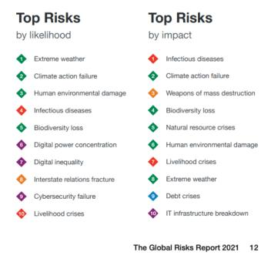
“The primary conflict during the early 20th century focused on the distribution of wealth among different social groups;
after the Second World War, and particularly during the 1960s, the focus changed to the distribution of power in politics and economics.
In more recent times, the major conflict has been about the distribution and the tolerability of risks for different social groups, regions and future generations.”
Renn, 2008
Risks and crisis of contemporary world World Economic Forum \ 2021

Slide 6
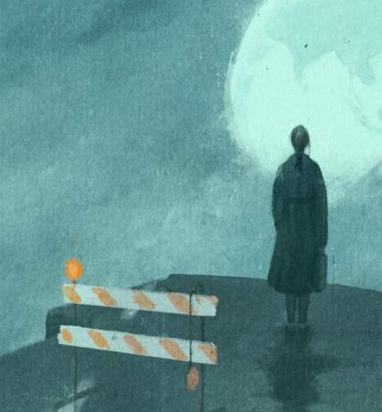
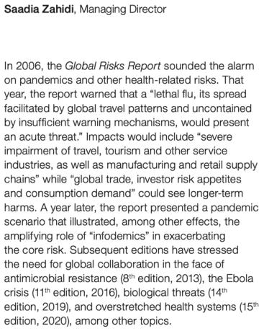

Slide 7
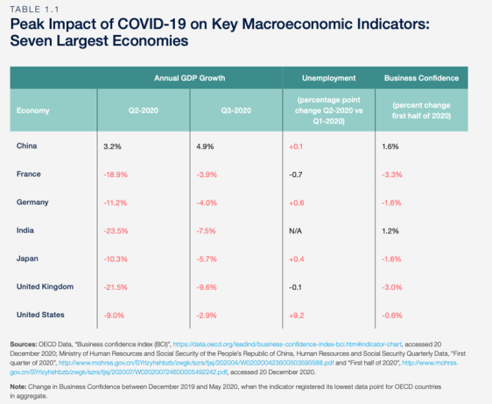
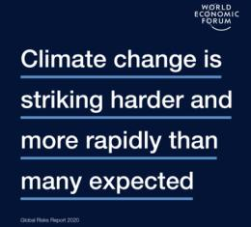

Slide 8
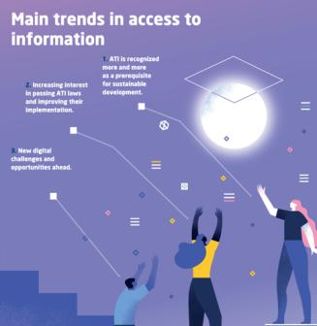
Scientific knowledge: evaluating risks in knowledge society
Scientific information is highly appreciated and even vital in a society full of uncertainties, risks and crisis.
High information literacy is the requirement to the contemporary society to successfully manage daily life, correctly evaluate risks and handle various crisis.
Information literacy is not (only) about the facts!
Ability to access information: Amid the global COVID-19 pandemic, UNESCO has announced “access to information in times of crisis” as the theme of the 2020 edition of the International Day for Universal Access to Information (IDUAI), celebrated every year on 28 September.
Ability to understand and use it in a proper way:
Source: UNESCO (2019). Access to Information: New Promiss to Sustainable Development. Available online at: https://unesdoc.unesco.org/ark:/48223/pf0000370686/PDF/370686eng.pdf.multi

Slide 9
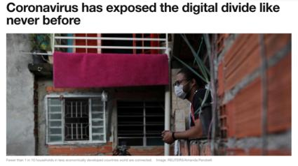
January 2021
4.66 billion people use internet worldwide, which makes up 59.5 percent of the global population.
92.6 percent (4.32 billion) of them accessed the internet via mobile devices.
Northern Europe ranks first with a 96 percent internet penetration rate among the population.
UAE, Denmark, and Sweden have highest internet penetration.
North Korea with virtually no online usage penetration among the general population, ranking last worldwide
Read more here: Statista | Worldwide Digital Population
“In total, 3.7 billion people have no internet access. The majority are in poorer countries, where the need to spread information about how to combat COVID-19 is most urgent. Migrants and the poorest are most vulnerable to the virus, says the World Health Organization (WHO)”.
Read more here: World Economic Forum | COVID19 and Digital Divide

Slide 10
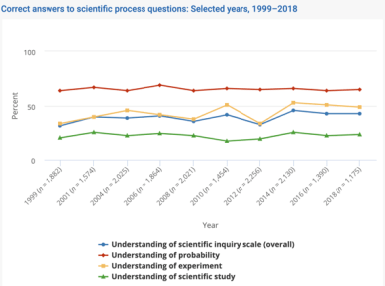
Ability to understand and use scientific knowledge
“The public must be able to understand the basics of science to make informed decisions. Perhaps the most dramatic example of the negative consequences of poor communication between scientists and the public is the issue of climate change, where a variety of factors, not the least of which is a breakdown in the transmission of fundamental climate data to the general public, has contributed to widespread mistrust and misunderstanding of scientists and their research”
Read more: Brownel et al. (2013). Science Communication to the General Public: Why We Need to Teach Undergraduate and Graduate Students this Skill as Part of Their Formal Scientific Training. J Undergrad Neurosci Educ.
Read more here: https://ncses.nsf.gov/pubs/nsb20207/public-familiarity-with-s-t-facts

Slide 11
Changing conditions of science:
Growing scientific uncertainties in the era of post-normal science;
Speed and quality in science during global pandemic;
Commercialization and commodification of science;
Politicization of scientific issues;

Slide 12
Growing scientific uncertainties in the era of post-normal science
POST-NORMAL SCIENCE:
A condition where scientists cannot be completely certain about processes or phenomenon they study, where “facts are uncertain, values in dispute, stakes high, and decisions urgent” (Funtowicz & Ravetz, 1992). In other words, traditional scientific models do not provide scholars with instruments able to solve the riddles of our times.
We (don’t) know what we don’t know: Science and scholarly research produces not only progress and well-being but also may cause huge risks and losses. The stakes are high and risk management is required to assess and control science and technology related risks.
In the context of increasing scientific uncertainties, there is a big question of how to communicate uncertain science to the lay audiences?

Slide 13
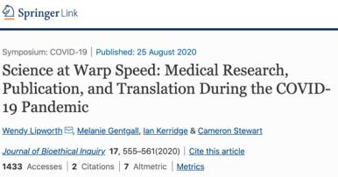
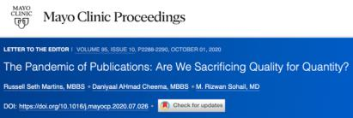
Speed and quality
To make research findings available quickly, many researchers are publishing versions of papers that have not yet been peer reviewed;
A recent study in The Lancet found that much of the discussion (and even policymaking) about COVID-19's transmissibility during January 2020 was driven by preprints rather than peer-reviewed literature. More here.
Article accessible here: https://link.springer.com/article/10.1007/s11673-020-10013-y

Slide 14
Commercialization and commodification of science: common good versus private good
Advantages:
Increased research funding
New possibilities and broader approach to the issue
More successful science results’ applications in practice
Disadvantages:
Increased possibility of science biases
Decreasing trust in science
Concerns about the quality of science
Inequality to access scientific innovations
Today, scientific knowledge is produced in rather broad, transdisciplinary social, economic, political, and social context (Gibbons, et at., 1994).
It is hard to find the dividing line between science and industry, between public interest and private ambitions, between “common good” and “private good”.
Scientific research is increasingly nestled down in private patronage (Bauer, 2008) and science step by step is becoming a commodity, which is produced and sold as any other good.
Krimsky in his book “Science in the Private Interest” (2004) argues that influx of private money into the universities or individual professors’ pockets leads to conflicts of interest and possibly keep academia from pursuing its true social purpose.

Slide 15
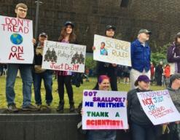
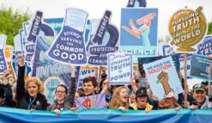
Politicization of scientific issues
‘Stick to the science’: when science gets political: A three-part podcast series explores the intimate relationship between politics and science. Accessible here.
“Politicization is inevitable when governments provide funding for science. The public expects to get something back from the science they support——for example, better health, national security, jobs. This normal politicization does no harm and may even be good for science and society. But politicization taken to the extreme can be very harmful. In extreme politicization, governments or powerful advocacy groups use science and scientists who share or benefit from the politicization to drive science out of technical decisions and to promote a nonscientific agenda”
Read more here: William Happer | Harmful Politicization of science
Source: Northeastern university political review | The Politicization of Science is Going to Kill Us

Slide 16
Democratization of science as a solution?
Researchers of post-normal science suggest that democratization of science is a way out – such ‘‘opening’’ or pluralization of the science allows other thoughts, observations, and data to make their way into the scientific processes to the betterment of scientific knowledge (Funtowicz & Ravetz, 1993; Carolan, 2006).
Democratization of science means that scientific decisions are made not by scientists alone, but instead, they are reached in consultancy with citizens. As scientific issues concern all of us, they also should be discussed openly. Democratization of science first and most importantly refers to what is called “civic science”, which is broad term encompassing three levels of relationship between scientists and society:
science representation (learning publics),
public participation in science (dialogue with publics),
and democratization of science (deliberation with publics) (Walker and Daniel, 2004).

Slide 17
Readings and question for the discussion:
Recommended readings:
United Nations | COVID-19: Governments must promote and protect access to and free flow of information during pandemic – International experts
The New York Times Magazine | Coronavirus is Forcing Medical Research to speed up
Nature | COVID and 2020: An extraordinary year for science
Politico | The speed of science post-COVID19 (video available)
PNAS | The effects of communicating uncertainty on public trust in facts and numbers
Questions for the discussion:
What is situation of scientists and science in your country?
Can you name more challenges and opportunities for science in contemporary world?
How science communication can help to deal with these challenges and opportunities?

