Slide 1
Finding, evaluating, and reporting scientific issues
techniques & tools

Slide 2
Module content
Finding Content
Evaluating Content
Image Verification
Video Verification
Various Verification Tools
Truthnest

Slide 3
Various Verification Tools

Slide 4
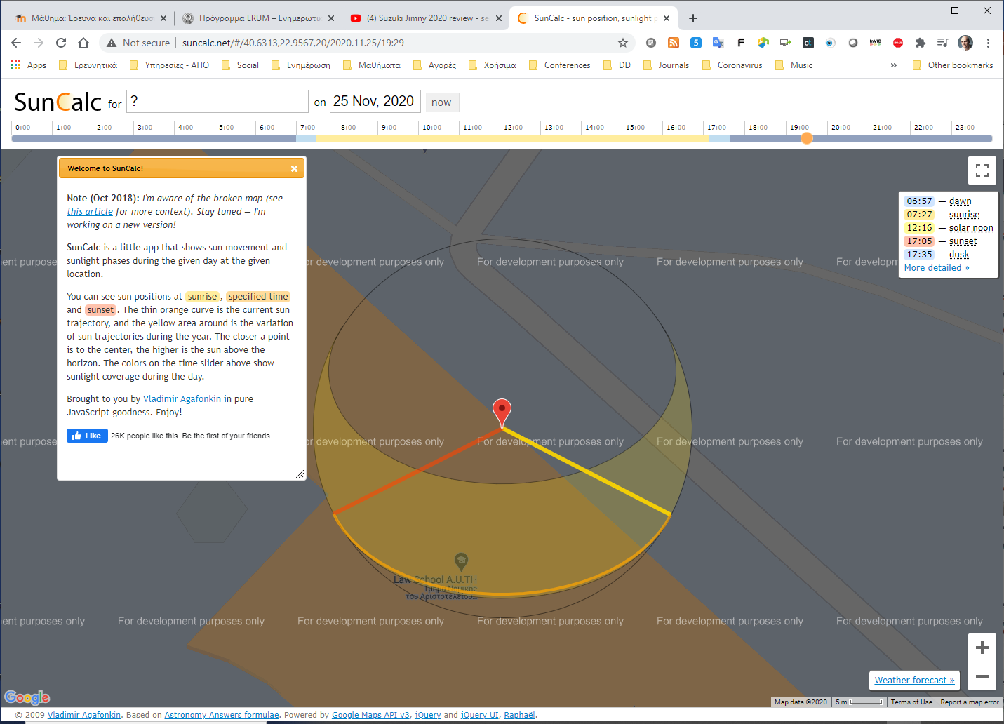
Suncalc
http://suncalc.net/

Slide 5
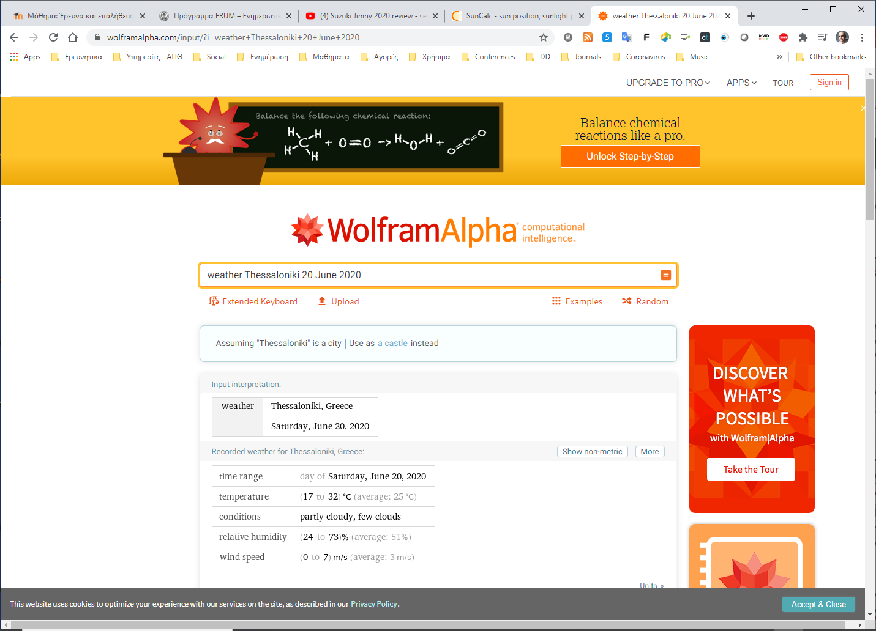
Wolfram Alpha
https://www.wolframalpha.com/

Slide 6
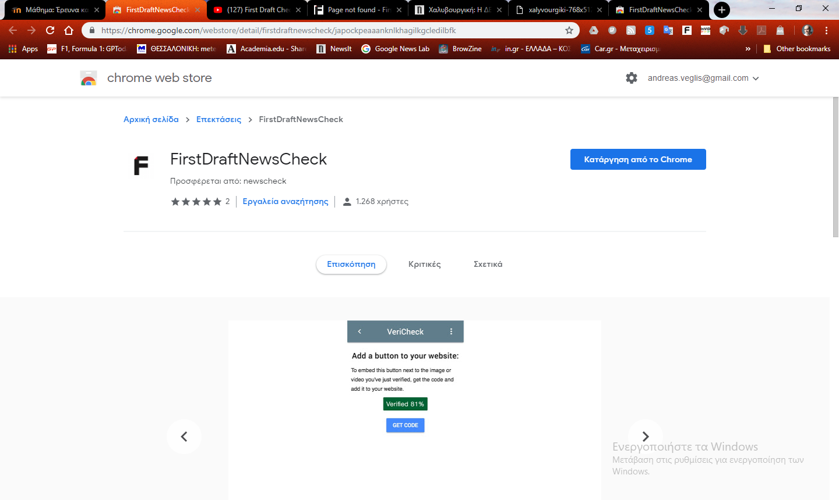
Chrome extension NewsCheck
https://firstdraftnews.com/launching-new-chrome-extension-newscheck/

Slide 7
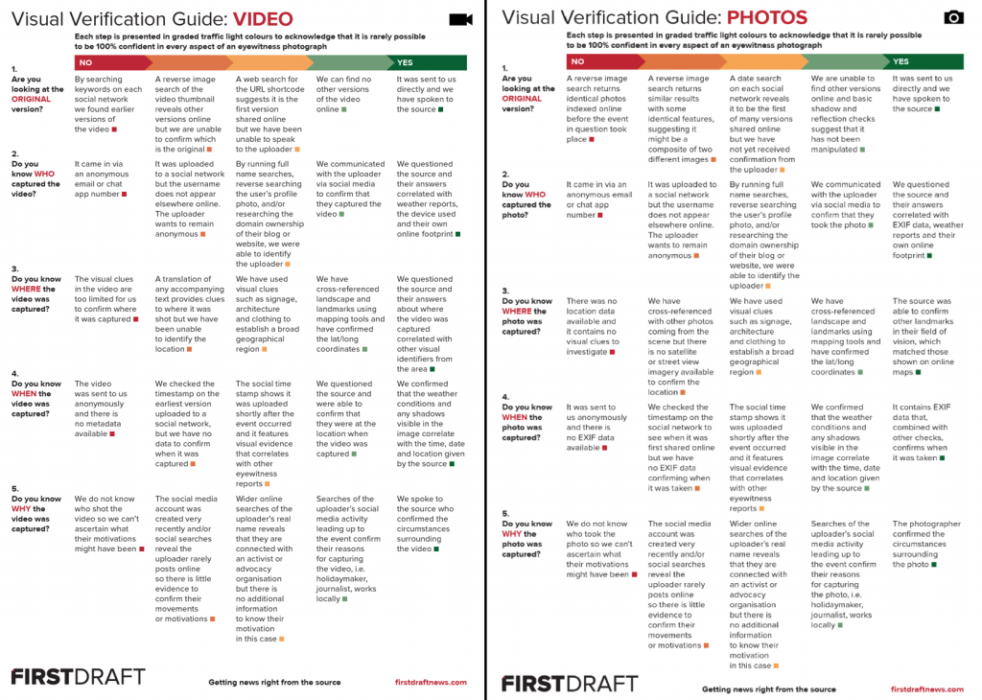

Slide 8

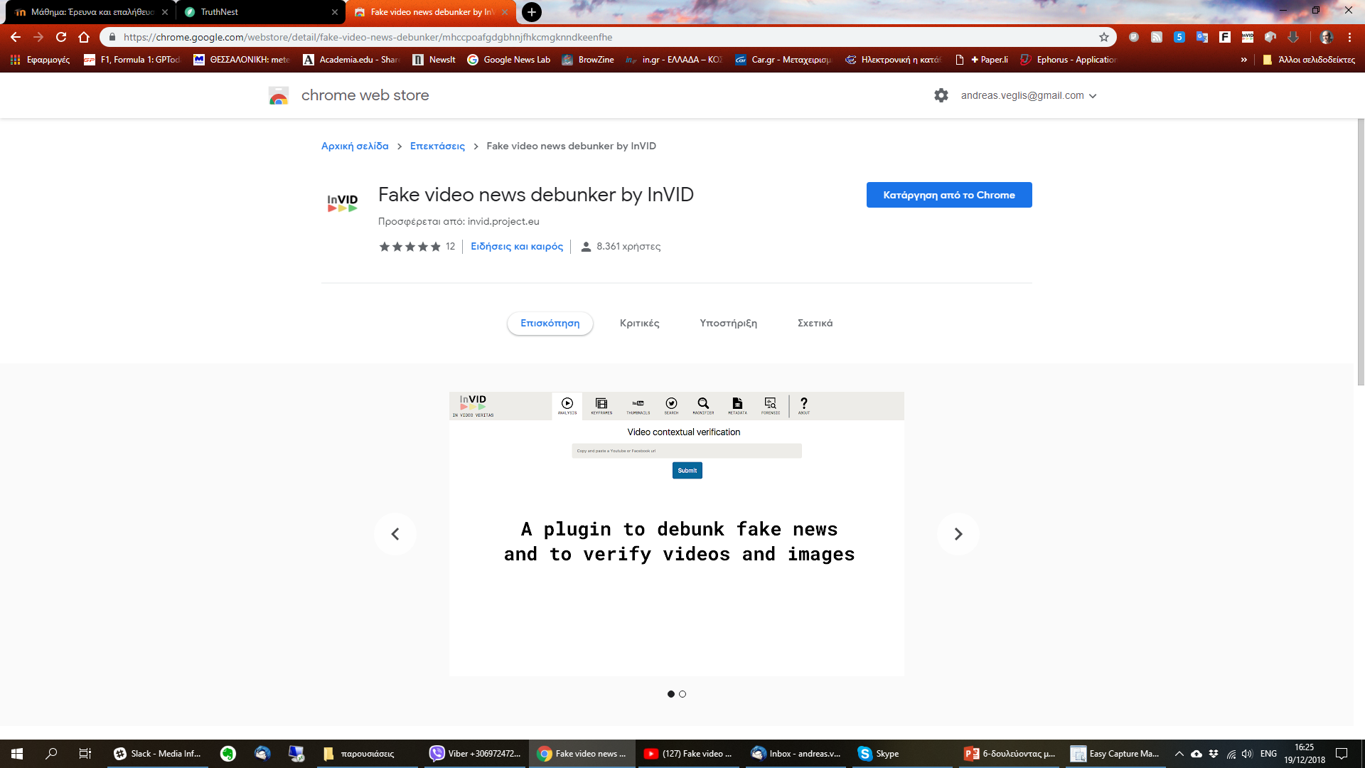
InVID - plugin
InVID – WeVerify European Research Projects (CERTH)
Development of Chrome extension for verifying Video
https://chrome.google.com/webstore/detail/fake-news-debunker-by-inv/mhccpoafgdgbhnjfhkcmgknndkeenfhe?hl=en

Slide 9
Truthnest

Slide 10

TruthNest
A tool for analyzing twitter accounts
Free online service
Athens Technology Center
For login use Twitter account
http://app.truthnest.com/

Slide 11
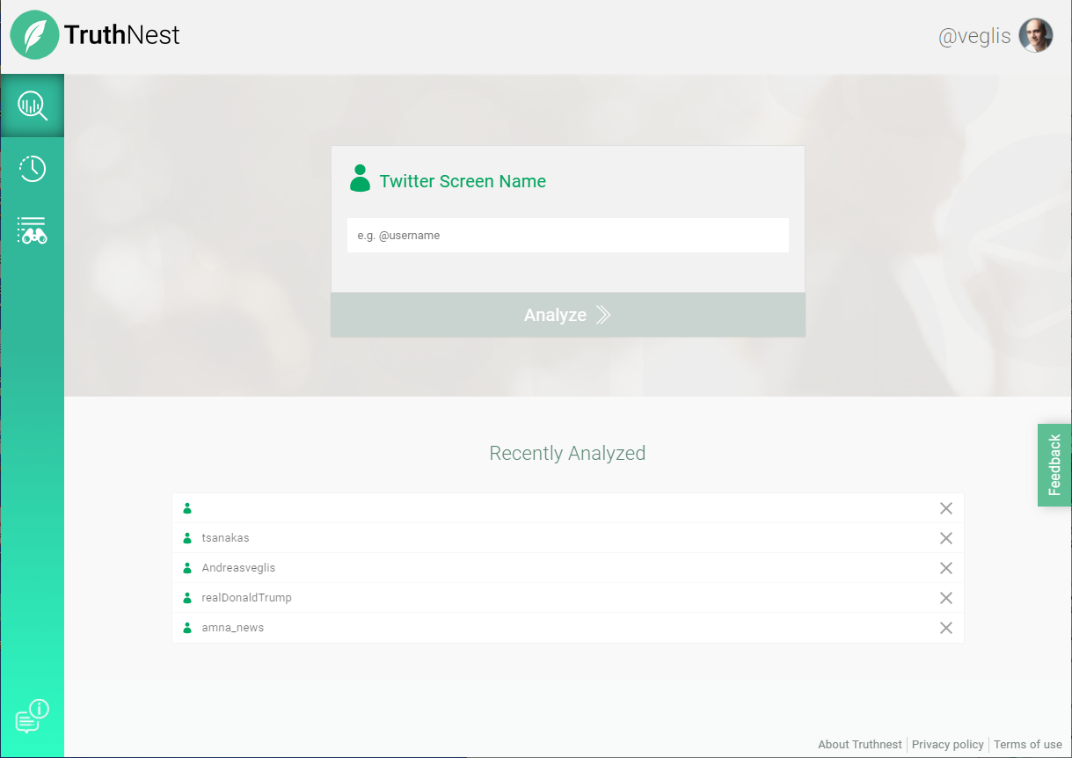

Slide 12
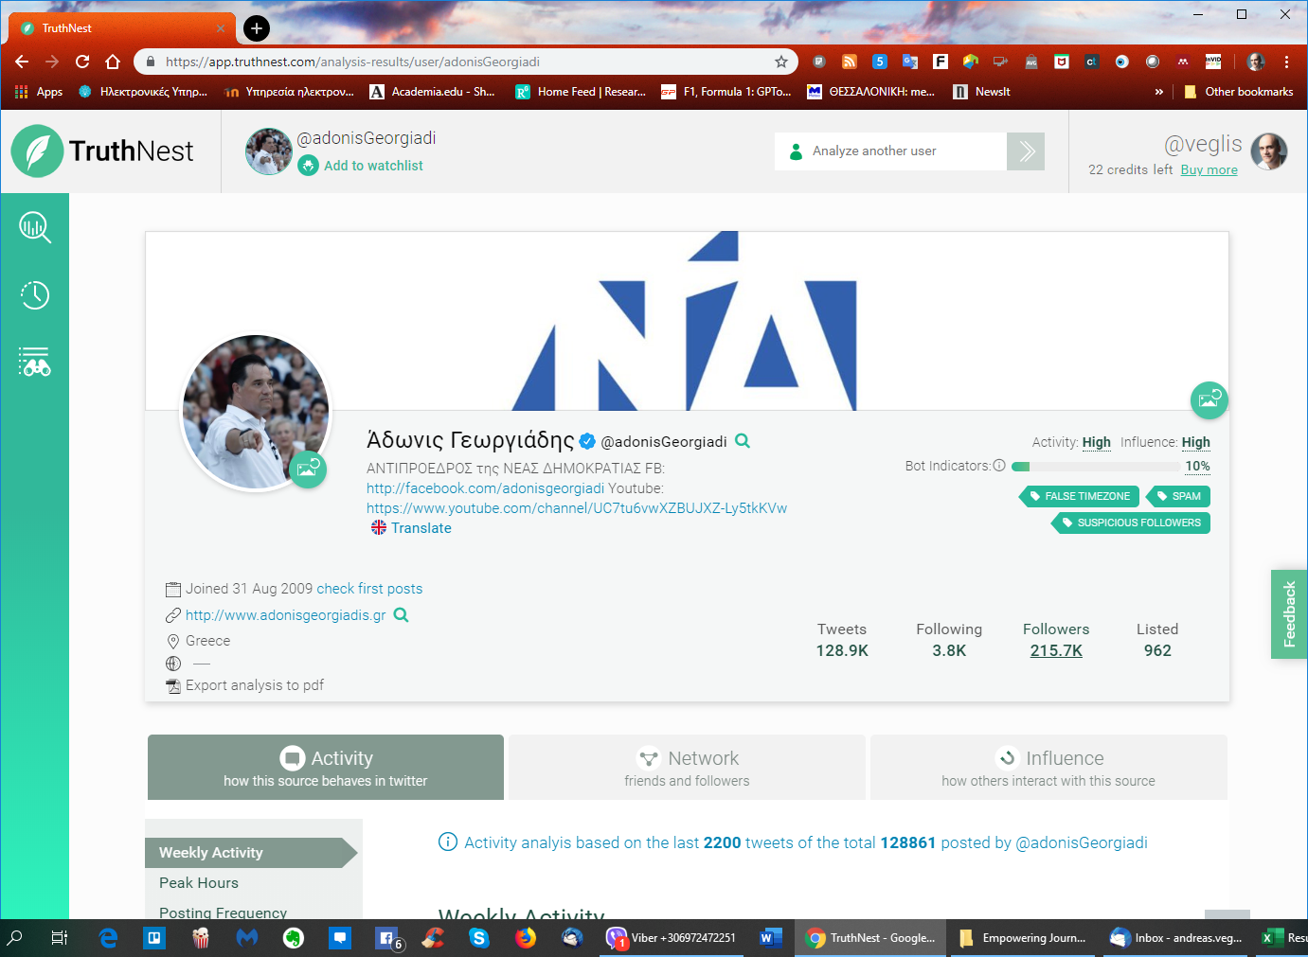

Slide 13
Bot Indicator
Shows the possibility of the account being operated by a bot.
A 0% score indicates a very low to zero probability of the account being operated by a bot
A 100% score indicated a very high probability of the account being operated by a bot.
The score is only an indication and not always correct.

Slide 14
Main categories
The Activity tab shows you information about the user’s behavior and activity on Twitter (e.g. posts made, frequency of posting, interactions with other users, etc.).
The Network tab shows you information about the user’s Twitter network (e.g. network size, acquisition rate of new followers, changes in the network size over time, etc.).
The Influence tab shows you information about the user’s influence in Twitter (e.g. public lists the user has been categorized into, how other users interact with that user, mentions received, etc.).

Slide 15
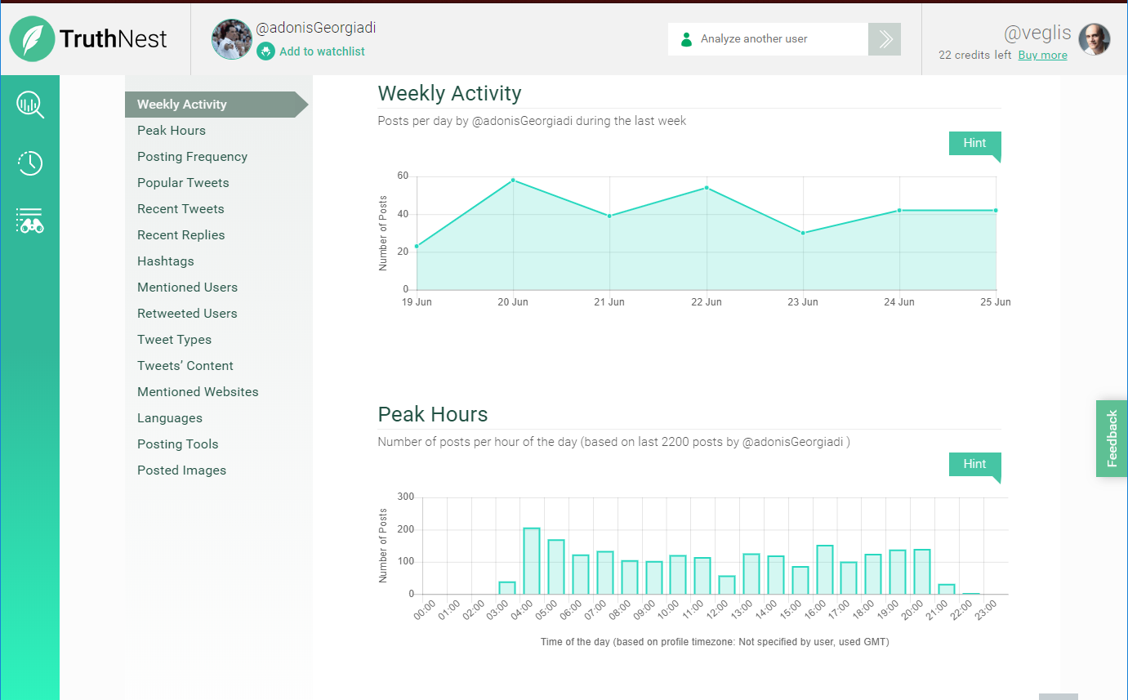

Slide 16
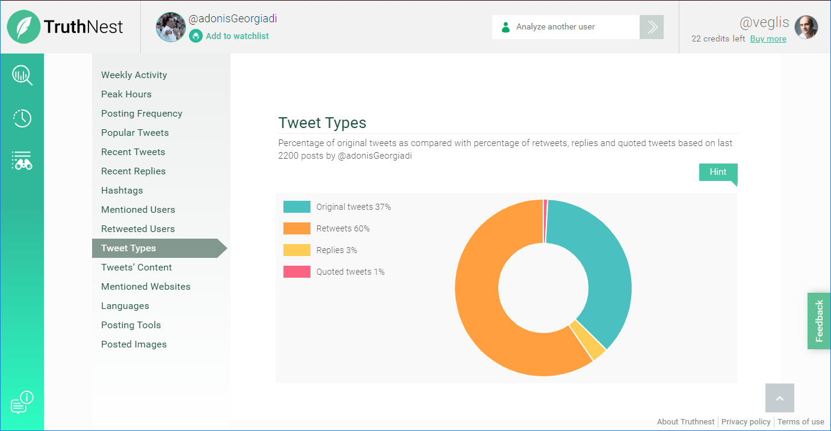

Slide 17
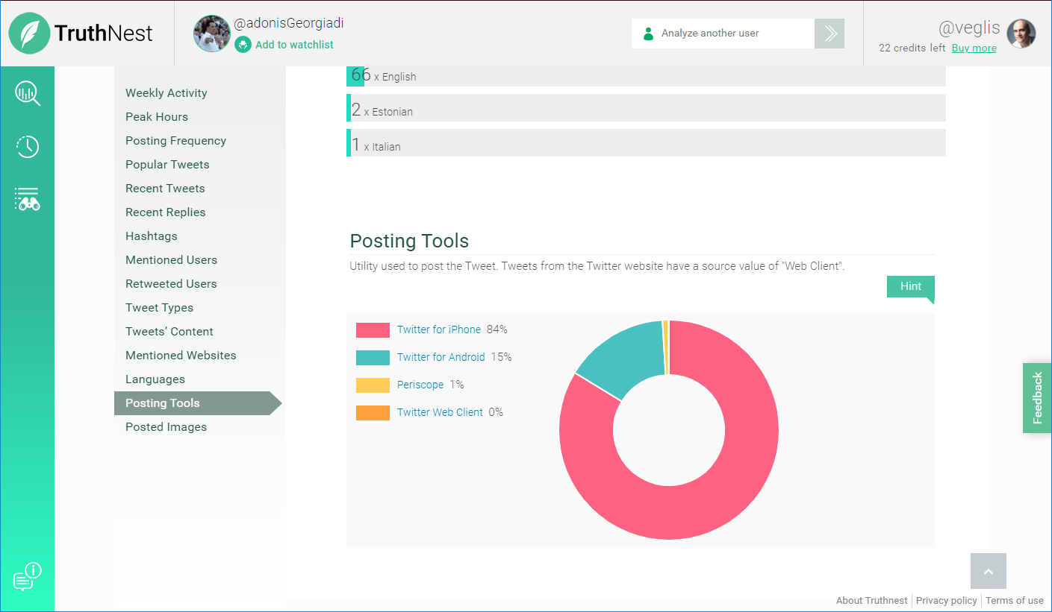

Slide 18
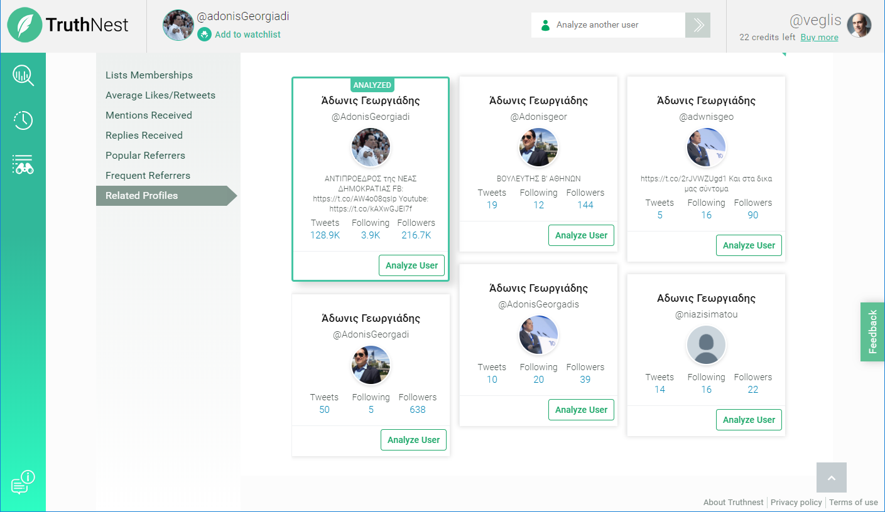

Slide 19
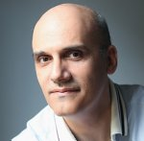
Thank you for your attention
Andreas Veglis
E-mail: veglis@jour.auth.gr
Webpage: http://veglis.webpages.auth.gr
https://auth.academia.edu/AndreasVeglis
https://www.linkedin.com/in/veglis/
https://scholar.google.gr/citations?user=Q2MCvhoAAAAJ
https://publons.com/researcher/1654694/andreas-veglis/
Twitter: @veglis

