Slide 1
Finding, evaluating, and reporting scientific issues
techniques & tools

Slide 2
Module content
Finding Content
Evaluating Content
Image Verification
Video Verification
Various Verification Tools
Truthnest

Slide 3
Video Verification

Slide 4
Video Verification
Significant availability of devices that can capture videos.
Collect User Generated Content (UGC) verify it, secure license - publish.

Slide 5
Problems with video verification
Unknown source
Difficult to find the original video file
Segmentation
Correction
Deletion of original video metadata

Slide 6
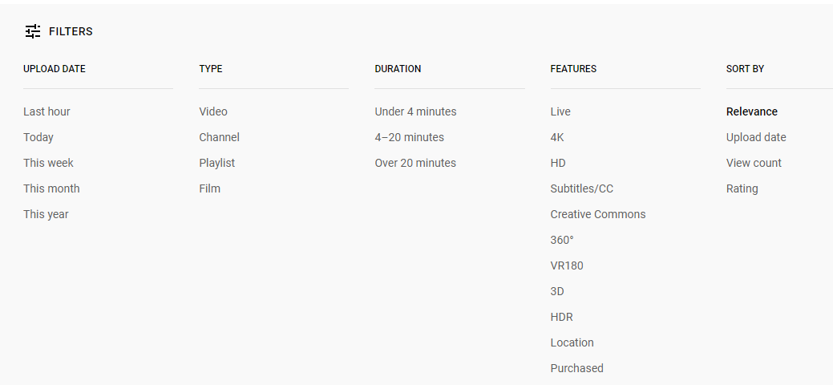
Video source
The video does not always belong to the user who posted it.
Description, tag, comment on the video.
Foreign language → Google Translate
Search using filters

Slide 7
Method for locating an older version of the video
Search for the video icon (thumbnail) using Google Image Search or TinEye
Determine the first time the video and image icons published on the Internet.
Results depend on many factors (image quality, strong video contrast - a discreet color scheme helps).

Slide 8
Source verification (1/2)
Check the user who made the post:
Are we familiar with this account? Was the account holder's content and reports history reliable in the past?
Where is this account registered?
Where is the basis of who made the post, judging by the history of the account?
Are the video descriptions consistent and, above all, from a specific location? Do the videos have a date?
If the videos in the account use a logo, is that logo consistent across all videos? Does it match the avatar on your YouTube or Vimeo account?

Slide 9
Source verification (2/2)
Check the user who made the post:
Does the poster "remove" videos from news organizations and other YouTube accounts or post user-generated content?
Does the poster write in slang or in a dialect that is recognizable in the narration of the video?
Are the videos in this account of consistent quality?
Do video descriptions have file extensions such as .AVI or .MP4 in the video title? This may indicate that the video was uploaded directly from a device.
Does the description of a YouTube video say: "Posted via YouTube Capture"? This may be indicative of the fact that the video was shot from a smartphone.

Slide 10
Link the account activity to any other online account maintained by the source.
Looking for the unique video code on Twitter or Facebook - are there any linked accounts? (Each UGC track has a unique code that appears in the URL. In YouTube and Facebook, for example, the code is placed between "v =" and the next "&" in the URL.)
Are there other accounts out there - a blog or a webpage - that link to the video profile or are linked to the person who posted it?
What information does the linked accounts contain that shows the account holder's recent position, activity, credibility, preferences, or agenda?
How long have these accounts been active? How active are they?
What are the social media accounts that are linked, and what does this tell us about the person who made the post?
Can we find "who is" information about a linked website?

Slide 11
Video tracking
The verification of where a video was shot depends to a large extent on the evidence it presents.
A distinct view of a road, a building, a church, a tree line, a mountain range, a minaret or a bridge are all good benchmarks to compare with satellite imagery and terrestrial photography.
If the camera lens fall on a business name, this may refer to online classifieds or a local directory.
A sign on the road could indicate the exact location.
Car license plates or billboards may indicate provincial details.
Sunlight, shadows and the approach of the time, the day of the event can also be helpful.
If the video contains dialogue, do the accents or dialects meet the requirements it claims to present?

Slide 12
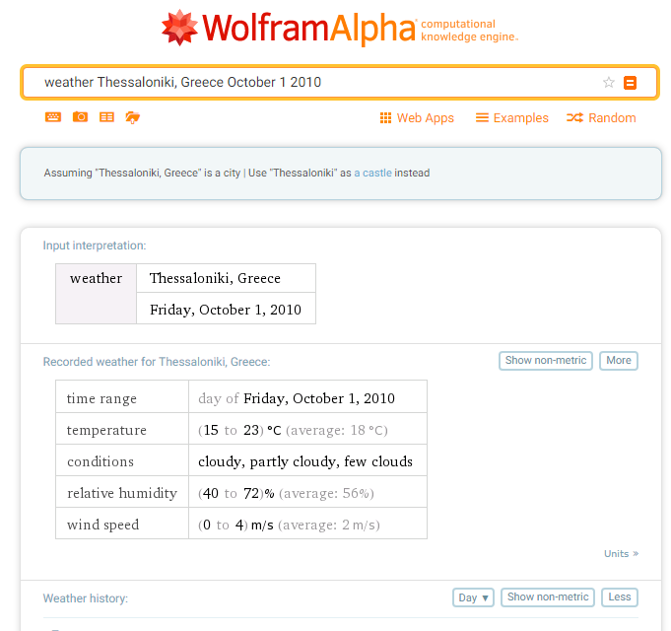
Date Verification
Simple in case of a planned event.
Videos of the same event are likely to exist through news reports and confirmatory images are commonly shared on Twitter, Facebook, Instagram and other social media sites.
YouTube videos are timed by Pacific Time Zone from the time the post starts.
Meteorological reports alone are not enough to verify dates, but they help (Wolfram Alpha).

Slide 13

Thank you for your attention
Andreas Veglis
E-mail: veglis@jour.auth.gr
Webpage: http://veglis.webpages.auth.gr
https://auth.academia.edu/AndreasVeglis
https://www.linkedin.com/in/veglis/
https://scholar.google.gr/citations?user=Q2MCvhoAAAAJ
https://publons.com/researcher/1654694/andreas-veglis/
Twitter: @veglis

