Slide 1
Finding, evaluating, and reporting scientific issues
techniques & tools

Slide 2
Module content
Finding Content
Evaluating Content
Image Verification
Video Verification
Various Verification Tools
Truthnest

Slide 3
Image Verification

Slide 4
Image verification
Specify the creator / sender of the image
Confirm location, date, and approximate image capture time.
Verify that the image is what it says / claims to show.
Get permission from the creator / sender to use the image

Slide 5
Image creator / sender
Direct communication with the specific person.
Person who made the post = creator of the photo.
The search starts with the person who made the post.
Reverse Image Search (Google, TinEye)

Slide 6
Reverse Image Search
Method for examining if the image has been previously posted online
Google Reverse Image Search, TinEye
Sometimes inconclusive results

Slide 7
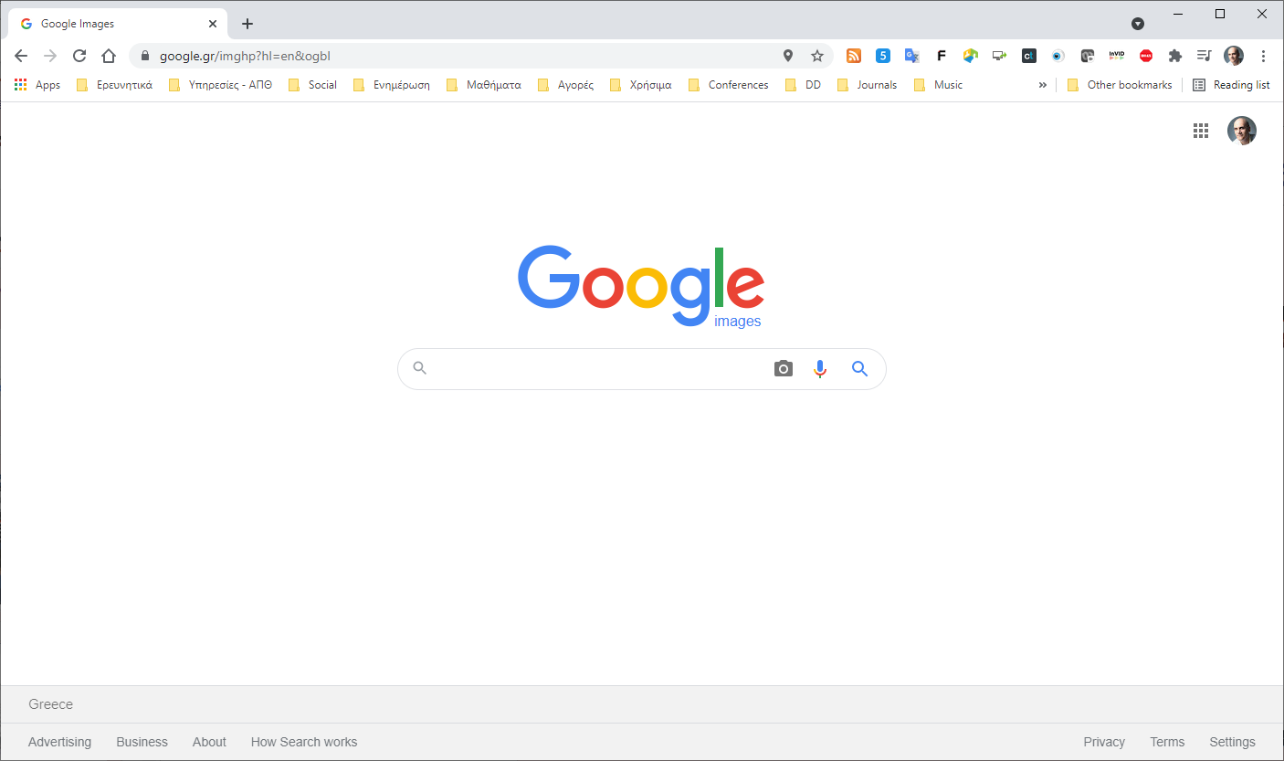
Reverse Image Search with Google

Slide 8
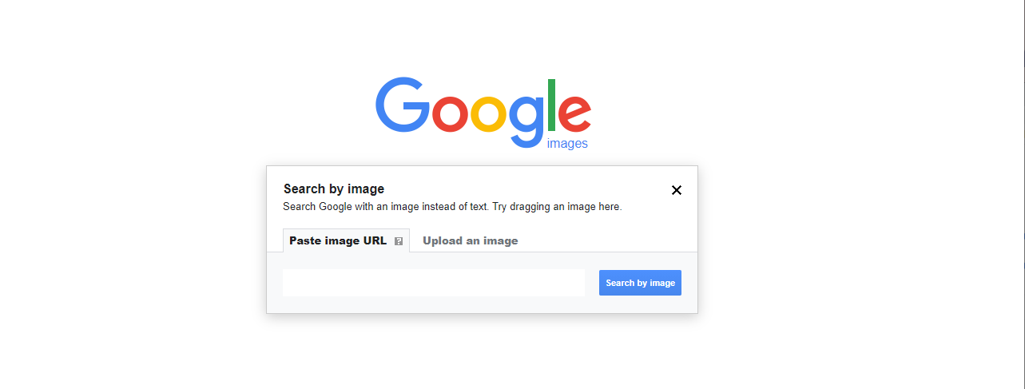
Upload an image or paste the image URL

Slide 9
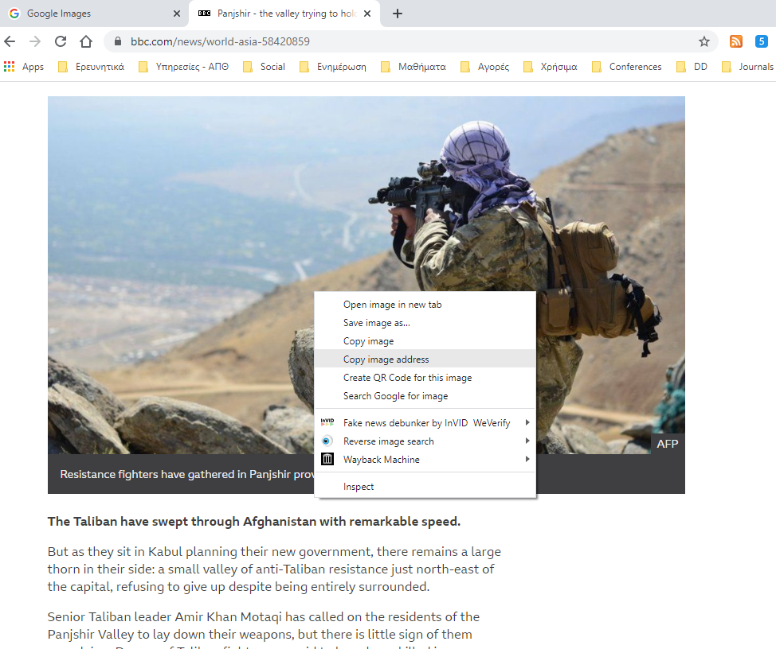
Only in Google Chrome

Slide 10
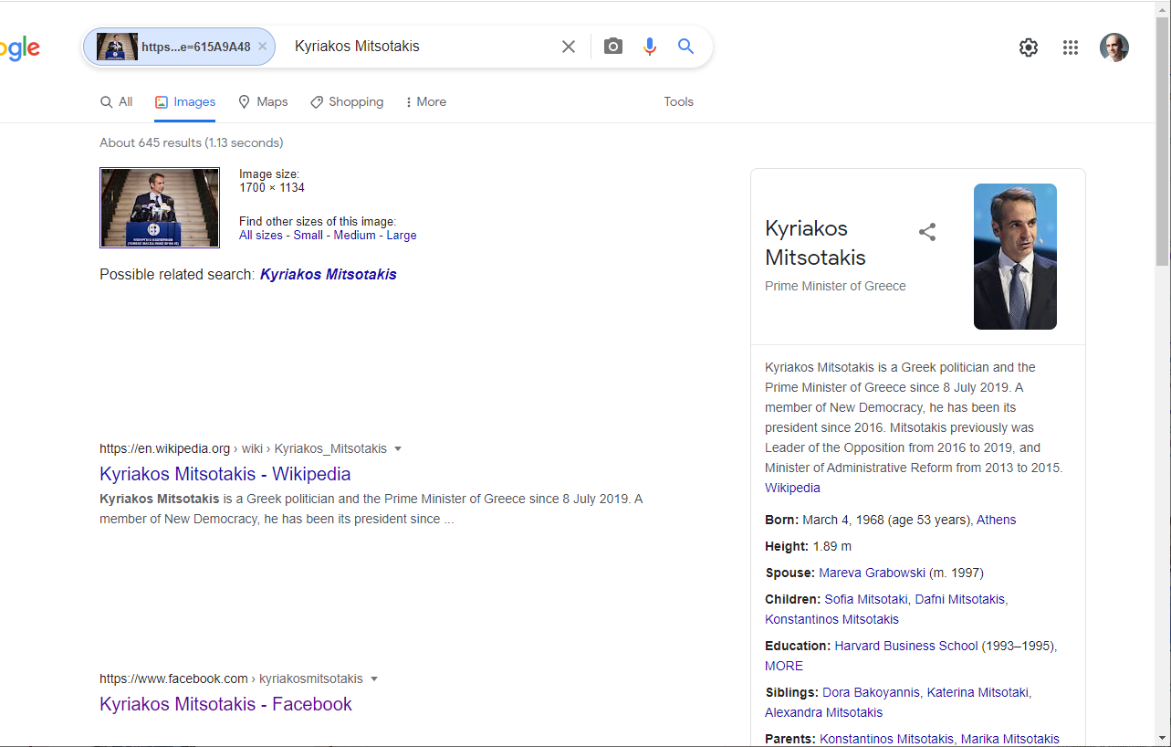
Recognition of faces

Slide 11
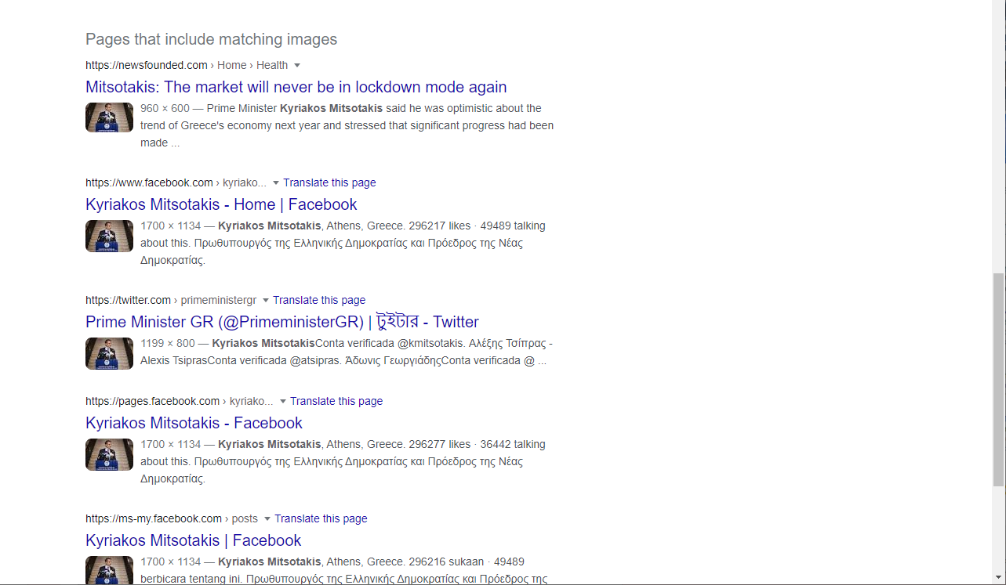
Pages that include the image

Slide 12
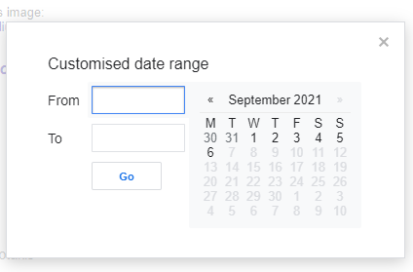
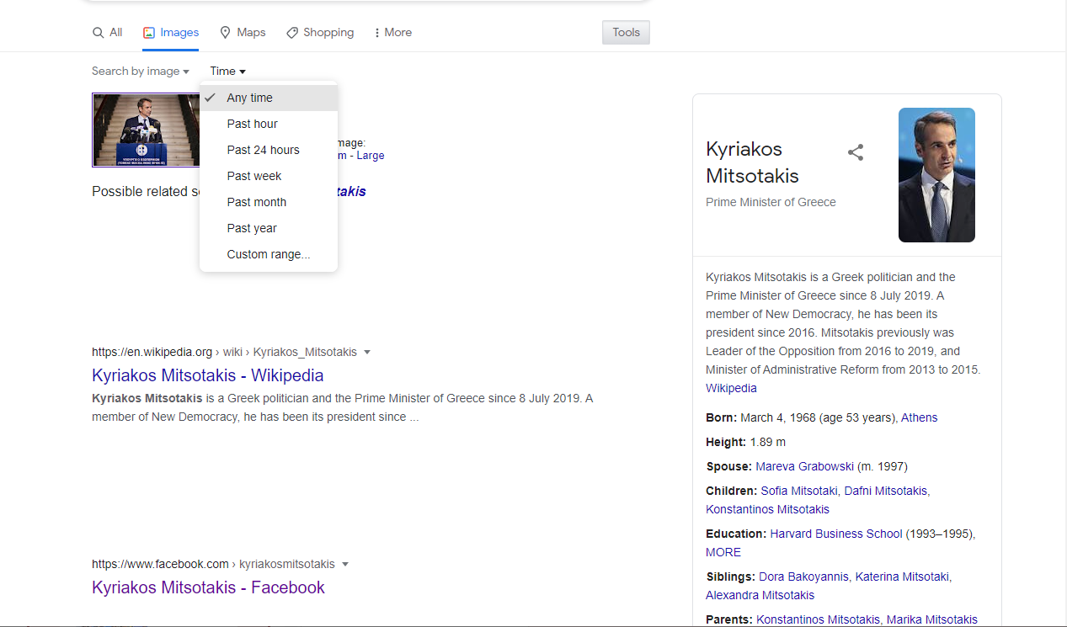
Define time period

Slide 13
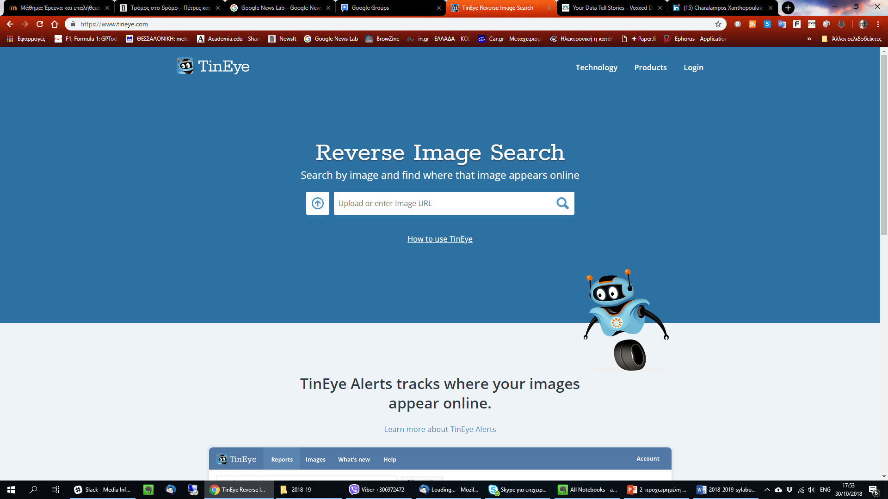
Reverse Image Search with TinEye

Slide 14
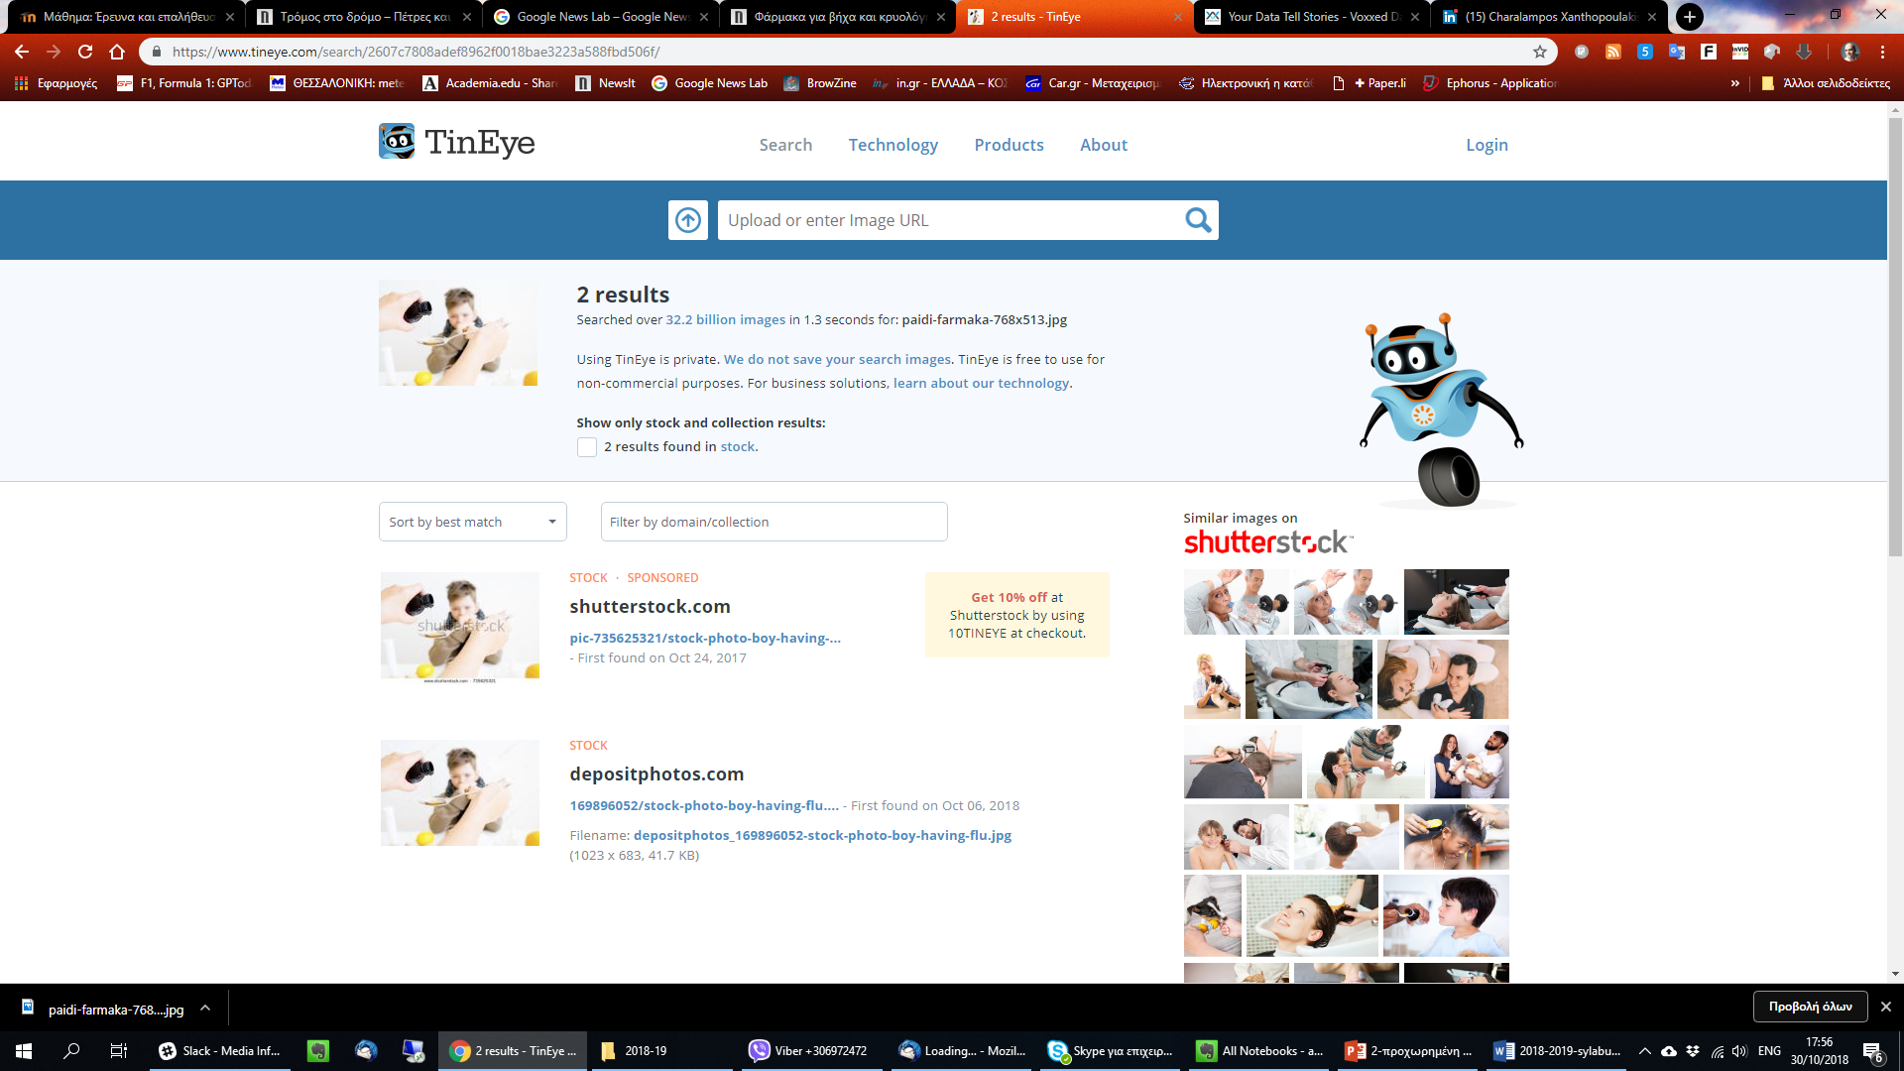
Pinpoint date of publication

Slide 15
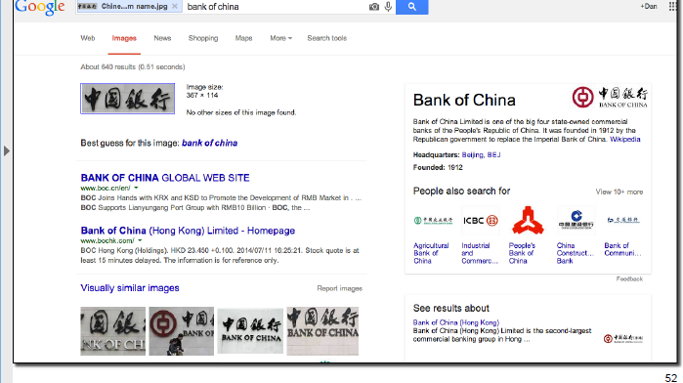
Reverse image search when we do not know what an image stands for

Slide 16
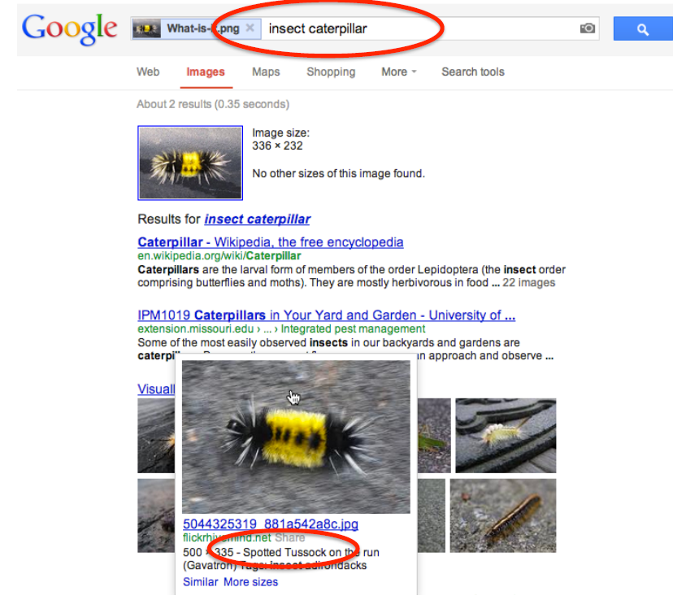
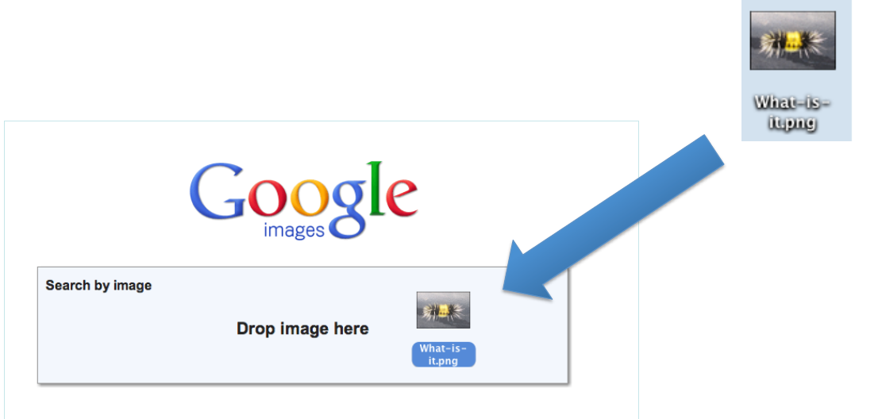
Reverse image search can even identify specific animal or object

Slide 17
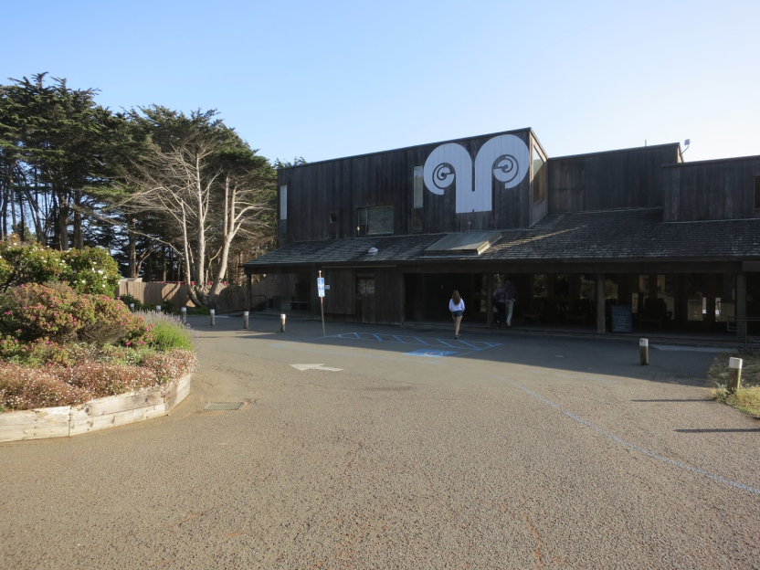
Identify specific part of an image (subimaging)

Slide 18
Location, date and time that the photo was taken
Questions to the person who took the photo:
  Who are they?
  Where are they?
  When did they get there?
  What can they see (and what does their photo show)?
  Why are they there?
Details - description - other photos
Personal safety problem.
Checking metadata (EXIF viewer)
Most social media deletes metadata from photos.

Slide 19
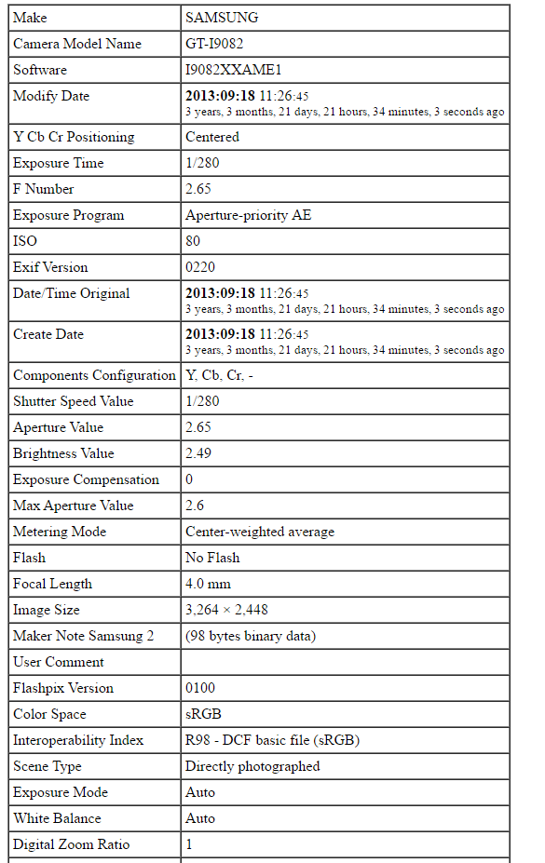
ΕΧΙF Viewer
Usually, online services.
http://exif.regex.info/exif.cgi
http://exif-viewer.com/
http://metapicz.com/#landing

Slide 20
Crosschecking with other sources
Indications in the photo:
License plates / vehicle numbers
Weather conditions
Landmarks
Clothing type
Inscriptions
Recognizable store or building
Land / environment type in the photo

Slide 21
Confirmation that the image is what it claims to show
Photo authentic - inaccurate marking
Google Maps
Bing Maps
Wikimapia
Wolfram Alpha
Google Translate

Slide 22
License from the image creator / sender
Be clear about the image (s) you wish to use.
Explain how the image (s) will be used.
Specify how the photographer wishes to be credited (name, username, etc., given that in some cases they may wish to remain anonymous).

Slide 23

Thank you for your attention
Andreas Veglis
E-mail: veglis@jour.auth.gr
Webpage: http://veglis.webpages.auth.gr
https://auth.academia.edu/AndreasVeglis
https://www.linkedin.com/in/veglis/
https://scholar.google.gr/citations?user=Q2MCvhoAAAAJ
https://publons.com/researcher/1654694/andreas-veglis/
Twitter: @veglis

