Slide 1
Finding, evaluating, and reporting scientific issues
techniques & tools

Slide 2
Module content
Finding Content
Evaluating Content
Image Verification
Video Verification
Various Verification Tools
Truthnest

Slide 3
Evaluating Content

Slide 4
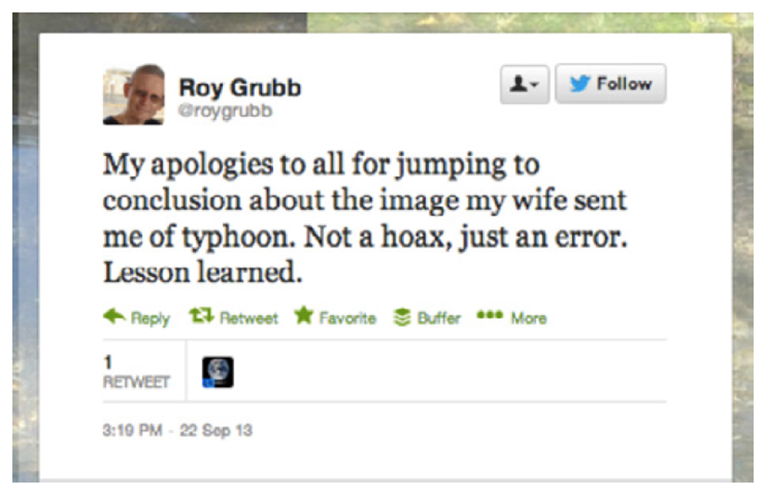
The importance of verification
Deliberate posting of falsified or false information.
Unintentional errors (eg incorrectly labeled notification).
Own other users' material

Slide 5
Verification Checks
Four factors
Origin: Is this content authentic?
Source: Who "uploaded" the content?
Date: When was the content created?
Location: Where was the content created?

Slide 6
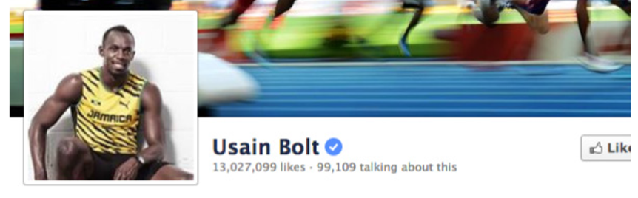
Origin
Understand the falsification tools available.
Fake retweets
Fake tweet in the form of image
Fake FB account confirmation
Checking a social media user's friends-connections

Slide 7
Source
Who created and uploaded the material?
Use of key questions (where, what was around, with what equipment).
Crosscheck of information (EXIF, Google StreetView).
Search for the user on social media.

Slide 8
Date
Difficult process to define a data of the content.
Activists insert evidence proving the date in the videos
Checking the weather at a particular date and area with Wolfram Alpha and Tweets by local meteorologists

Slide 9
Location
Use tools like Google Maps, Google Earth, Wikimapia.
Activists are filming from top to bottom to capture benchmarks.

Slide 10
The verification process
The result of the process not a yes or no.
In many cases we do not get a clear answer.
It is important for the media to clearly state which part of the material they publish is verified.

Slide 11
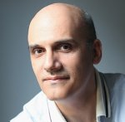
Thank you for your attention
Andreas Veglis
E-mail: veglis@jour.auth.gr
Webpage: http://veglis.webpages.auth.gr
https://auth.academia.edu/AndreasVeglis
https://www.linkedin.com/in/veglis/
https://scholar.google.gr/citations?user=Q2MCvhoAAAAJ
https://publons.com/researcher/1654694/andreas-veglis/
Twitter: @veglis

