Slide 1
Finding, evaluating, and reporting scientific issues
techniques & tools

Slide 2
Module aims
Teach the necessary techniques and tools that can be used for finding evaluating and reporting scientific issues.
The techniques are mainly comprised of methods that are employed to produce journalistic content
They are specifically tailored to address scientific issues
They can exploit all the capabilities that are now available on the internet era.

Slide 3
Module content
Finding Content
Evaluating Content
Image Verification
Video Verification
Various Verification Tools
Truthnest

Slide 4
Finding Content

Slide 5
Information Sources
Content on the Web.
Content on social media
Content Type
  webpages
  PDF files
  xls, xlsx, csv files (spreadsheet formats)
  Images
  Videos

Slide 6
Content - Time
Content that is already available.
Content that will appear at some point from now on.

Slide 7
Content Source
Websites
Social media

Slide 8
Websites
Research institutes, Government websites, scientific journals, scientific conferences, scientific papers
Media Organizations
News from non-traditional sources (opinions, analyses)

Slide 9
National Statistical Organizations
http://en.wikipedia.org/wiki/List_of_national_and_international_statistical_services
http://ec.europa.eu/eurostat

Slide 10
News Aggregators
Websites that collect news from other websites.
The collection is automated, and the link refers to the media article from where it was collected

Slide 11
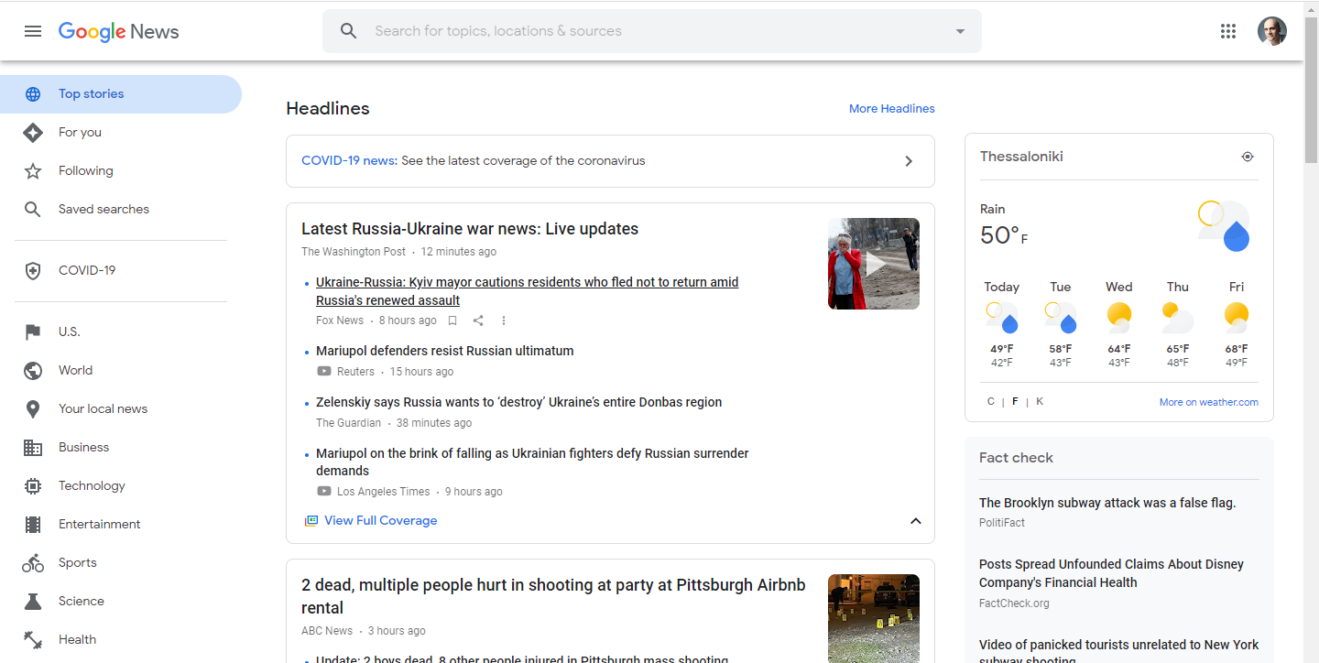
http://news.google.com

Slide 12
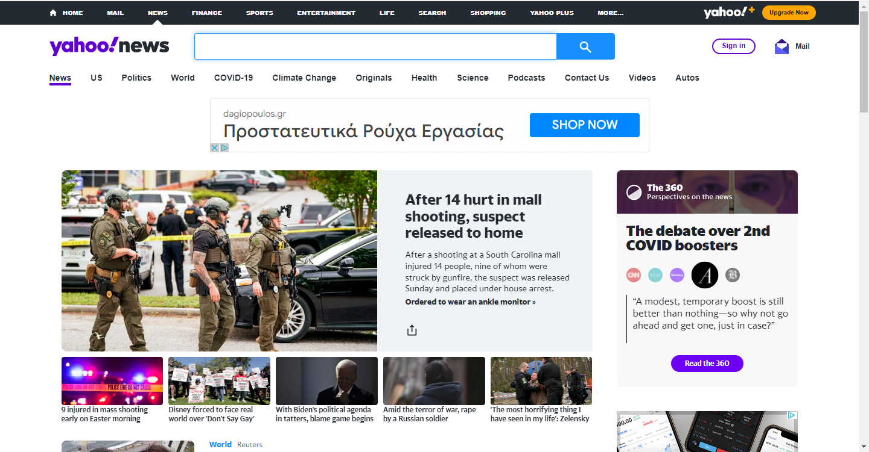
https://news.yahoo.com/

Slide 13
Methods for finding content that will appear at some point from now on.
E-mail alerts
RSS feeds
Twitter alerts
Tools that inform you when a particular page is updated
Google alerts

Slide 14
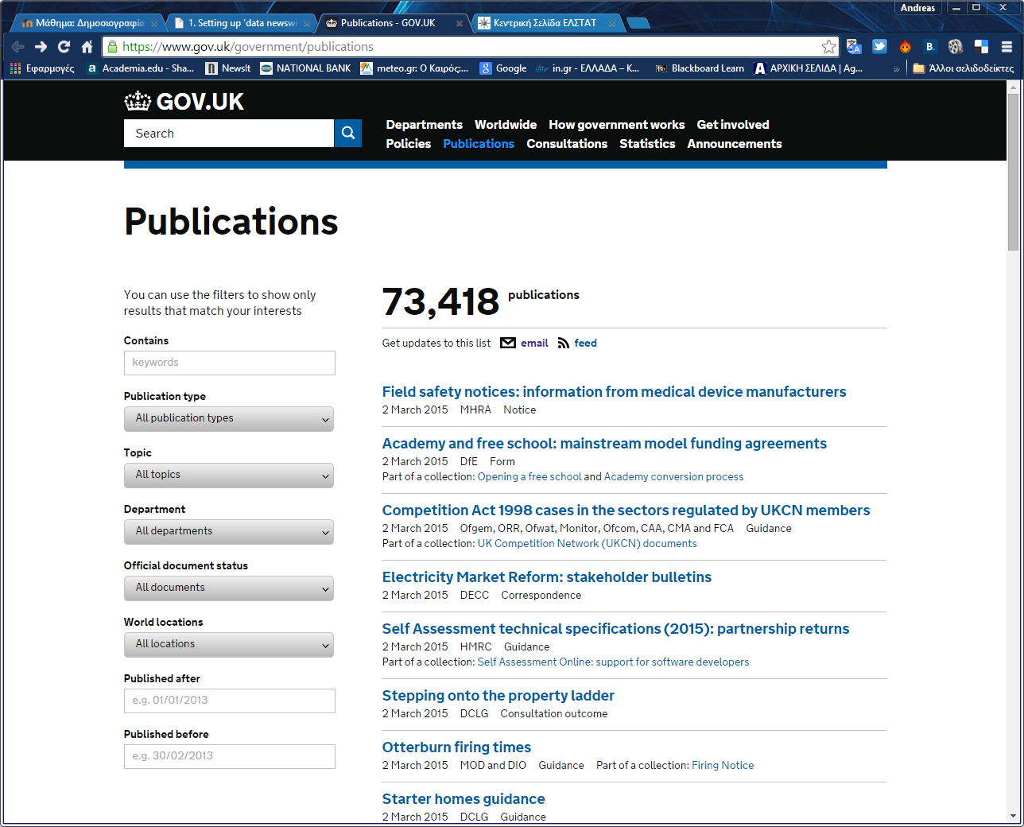

Slide 15
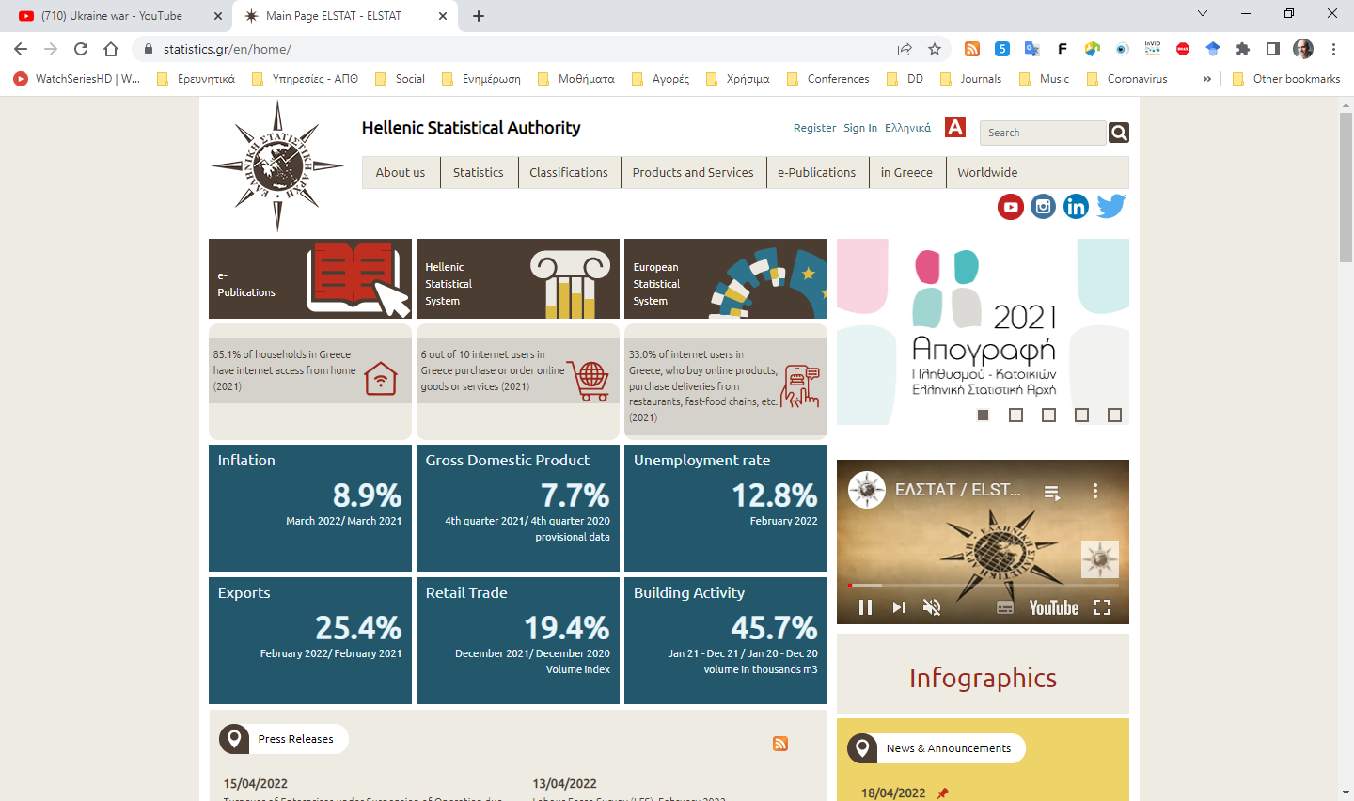

Slide 16
Methods for accessing RSS feed
Web based applications (Bloglines, Feedly, FrescaNews, Feedspot, Flipboard, Digg, News360, My Yahoo!, NewsBlur, and Netvibes).
Desktop applications (NetNewsWire, FeedDemon, Flipboard, Prismatic, and Zite).
Mobile apps (Google Play Newsstand).
Email clients (Mozilla Thunderbird, Opera mail, Pegasus Mail)

Slide 17
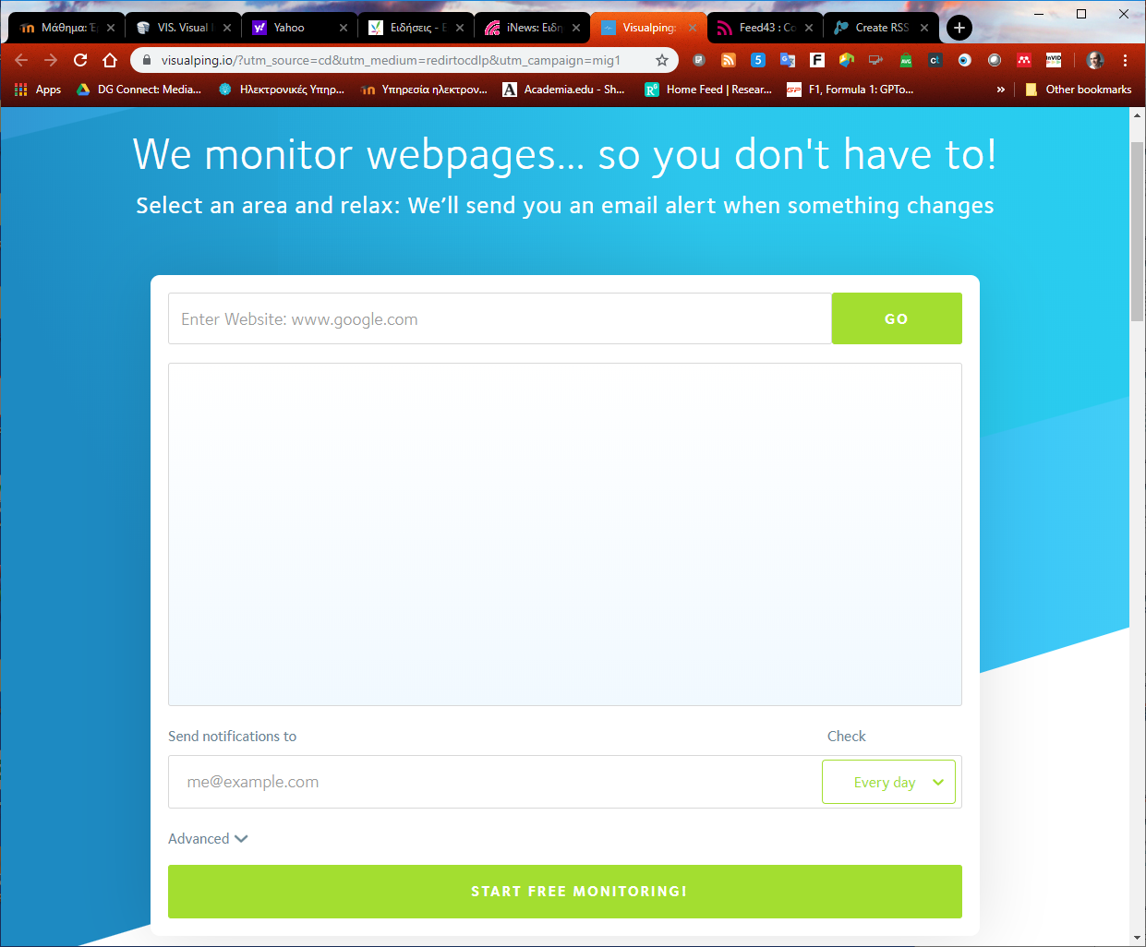

Slide 18


Tools for creating RSS feeds
http://feed43.com
http://feedity.com

Slide 19
Twitter alerts
Follow the Twitter account of the organization that interest you.

Slide 20
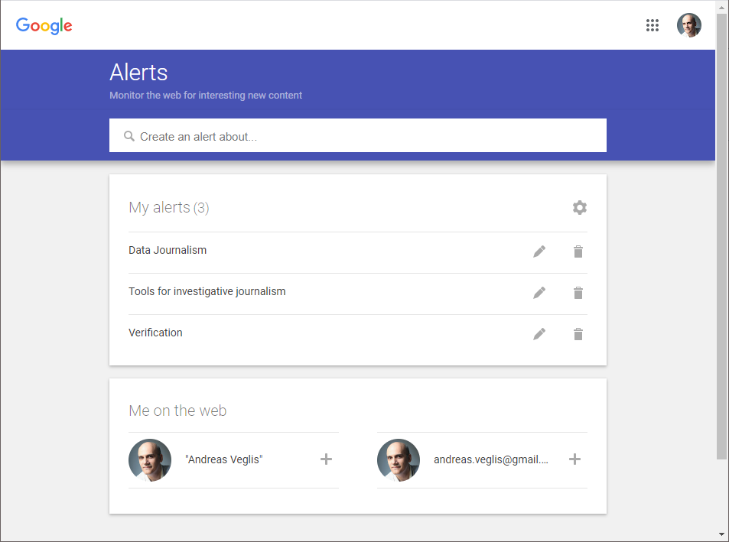
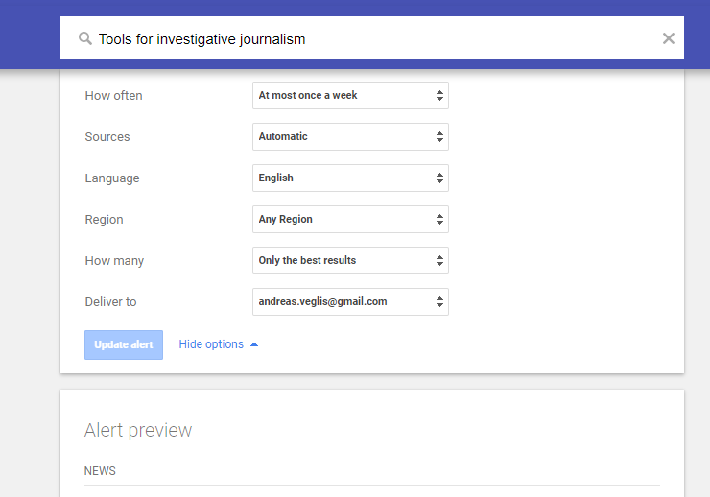
Google alerts www.google.com/alerts

Slide 21

Thank you for your attention
Andreas Veglis
E-mail: veglis@jour.auth.gr
Webpage: http://veglis.webpages.auth.gr
https://auth.academia.edu/AndreasVeglis
https://www.linkedin.com/in/veglis/
https://scholar.google.gr/citations?user=Q2MCvhoAAAAJ
https://publons.com/researcher/1654694/andreas-veglis/
Twitter: @veglis

