Slide 1
Define, explain and identify:
Introduction to “fake news” and 5g technology
Notes:
Introduction of myself
Introduction of the module
Why we choose technology. A lot of engineering courses
Who is this module for. People without knowledge on fake news

Slide 2
Overview
Introduction & Definitions
Fake News and Technology
How it all started: 5G Technology and Covid-19
ERUM sub-report: Does 5g technology pose any health risks?

Slide 3
3
How it all started: 5G Technology and Covid-19

Slide 4
How it all started:
5G Technology and Covid-19
Facebook
Youtube
Social media
Online press
Influencers/Public figures/Actors/Singers
One in four believe the technology poses a health risk
27 per cent are worried it could be used to spy
56 per cent said they won't buy a house too close to a 5G tower.
Notes:
https://www.blayneychronicle.com.au/story/7066248/one-in-four-believe-5g-poses-health-risk/
The Queensland University of Technology team tracked Facebook posts from 1 January to 12 April 2020, and were able to illustrate the “gradual spread of rumours from the fringes to more popular spaces in the Facebook platform” over five distinct phases
The graphs show how Facebook posts containing 5G-coronavirus conspiracy content went from reaching only a few thousand people to pages, profiles and groups with hundreds of millions of followers – potentially contributing to a spate of attacks on phone towers in Australia and across the globe.
Important to showcase this example to understand how a fake news outbreak could start from a simple facebook post.

Slide 5
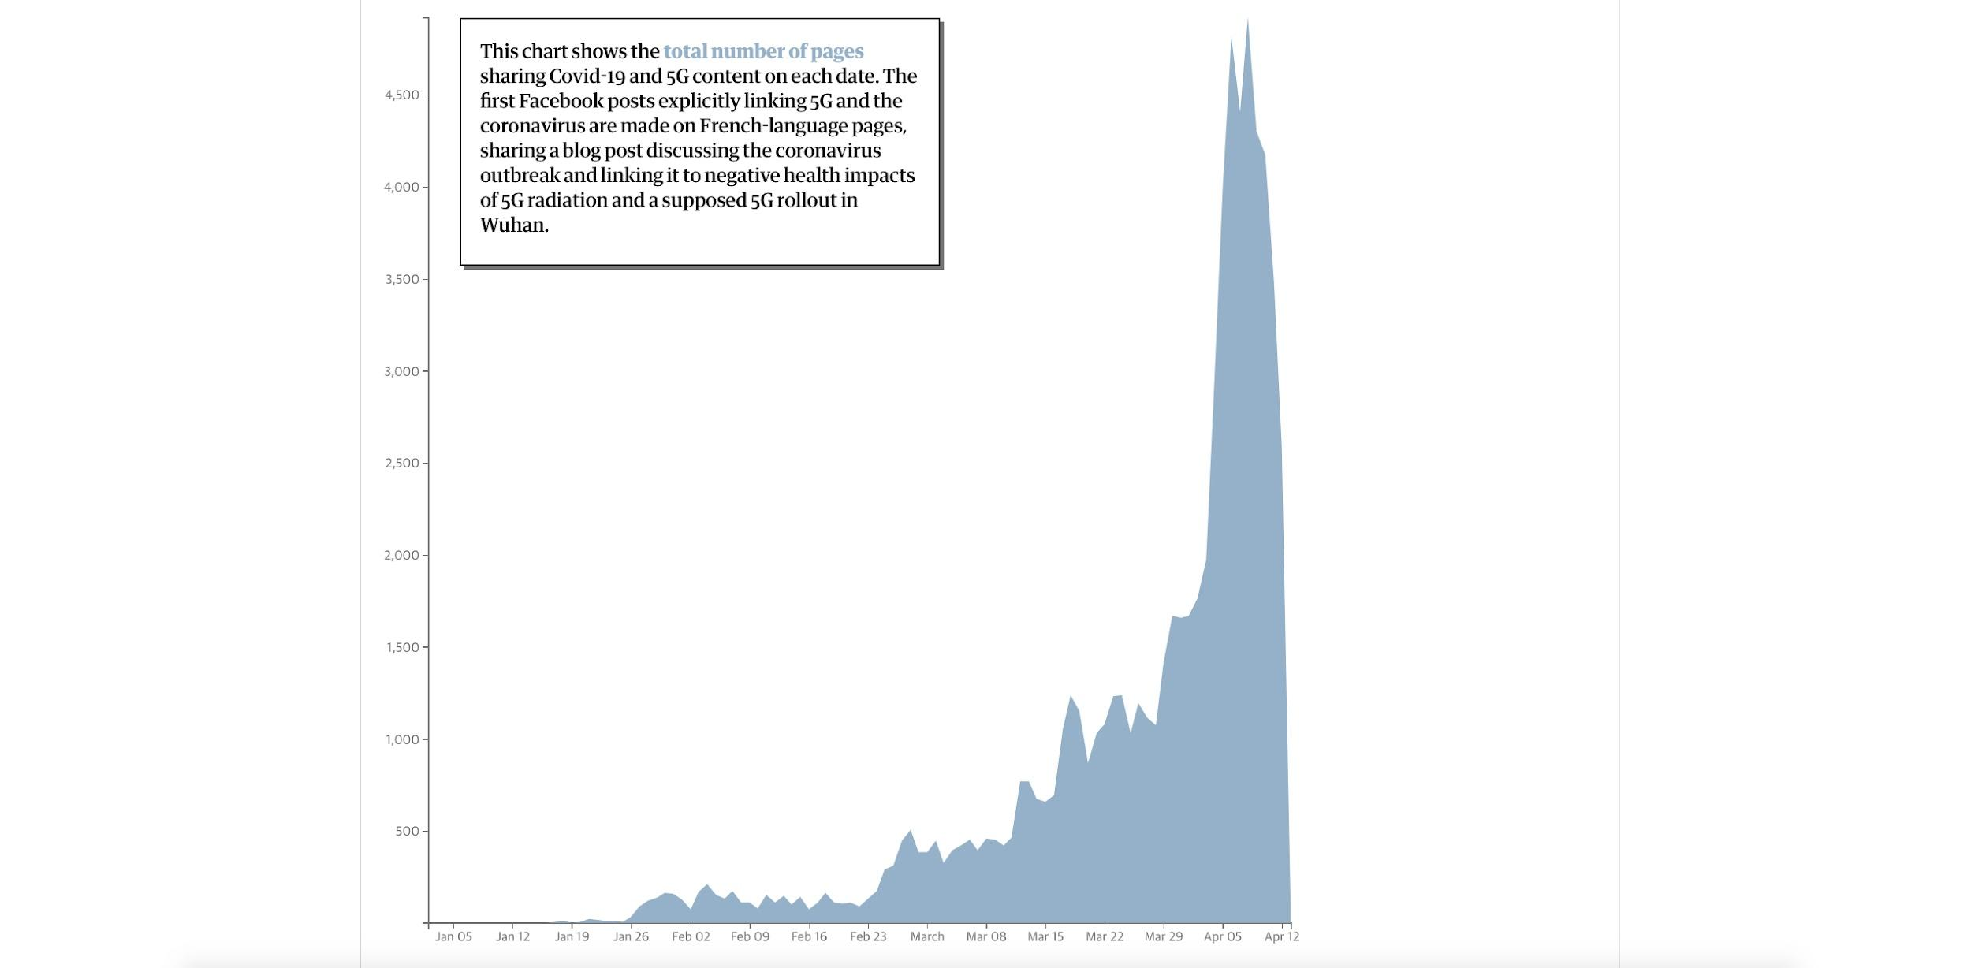
Case study: Facebook, 5G and Coronavirus
how an individual post can reach a global audience within days
Evershed, N., McGowan, M. and Ball, A., (2021). Anatomy of a conspiracy theory: how misinformation travels on Facebook. [online] The Guardian. Available at: https://www.theguardian.com/australia-news/ng-interactive/2021/mar/11/anatomy-of-a-conspiracy-theory-how-misinformation-travels-on-facebook [Accessed 2 September 2021]
Notes:
Shows the total number of pages sharing covid and 5g content on each date
https://www.theguardian.com/australia-news/ng-interactive/2021/mar/11/anatomy-of-a-conspiracy-theory-how-misinformation-travels-on-facebook

Slide 6
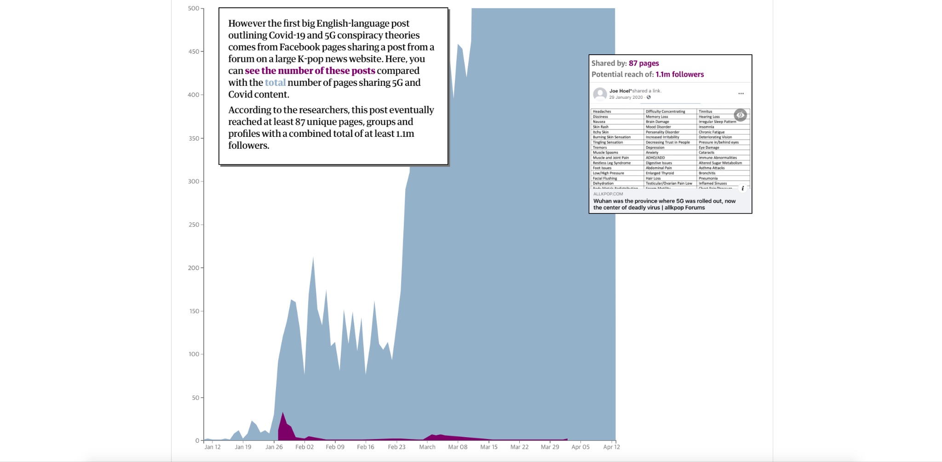
Case study: Facebook, 5G and Coronavirus
how an individual post can reach a global audience within days
Evershed, N., McGowan, M. and Ball, A., (2021). Anatomy of a conspiracy theory: how misinformation travels on Facebook. [online] The Guardian. Available at: https://www.theguardian.com/australia-news/ng-interactive/2021/mar/11/anatomy-of-a-conspiracy-theory-how-misinformation-travels-on-facebook [Accessed 2 September 2021]

Slide 7
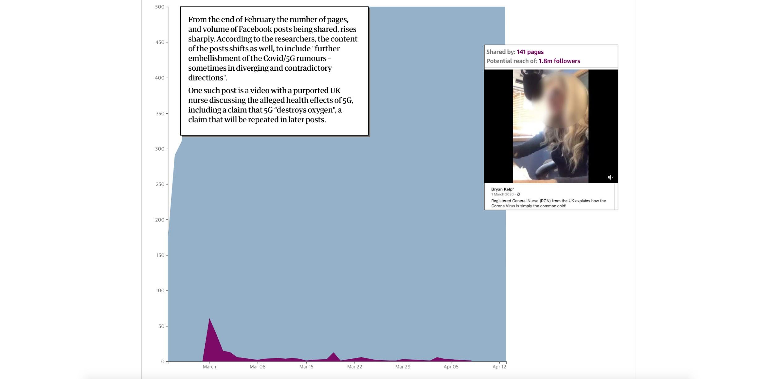
Case study: Facebook, 5G and Coronavirus
how an individual post can reach a global audience within days
Evershed, N., McGowan, M. and Ball, A., (2021). Anatomy of a conspiracy theory: how misinformation travels on Facebook. [online] The Guardian. Available at: https://www.theguardian.com/australia-news/ng-interactive/2021/mar/11/anatomy-of-a-conspiracy-theory-how-misinformation-travels-on-facebook [Accessed 2 September 2021]

Slide 8
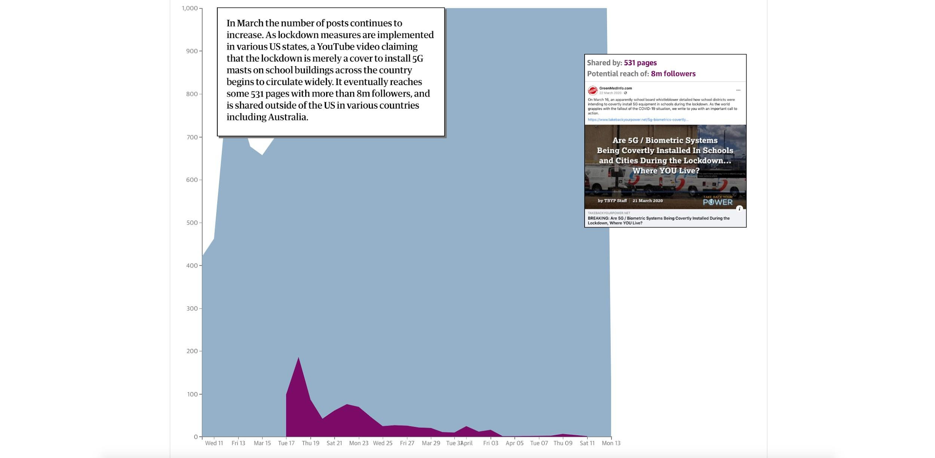
Case study: Facebook, 5G and Coronavirus
how an individual post can reach a global audience within days
Evershed, N., McGowan, M. and Ball, A., (2021). Anatomy of a conspiracy theory: how misinformation travels on Facebook. [online] The Guardian. Available at: https://www.theguardian.com/australia-news/ng-interactive/2021/mar/11/anatomy-of-a-conspiracy-theory-how-misinformation-travels-on-facebook [Accessed 2 September 2021]

Slide 9
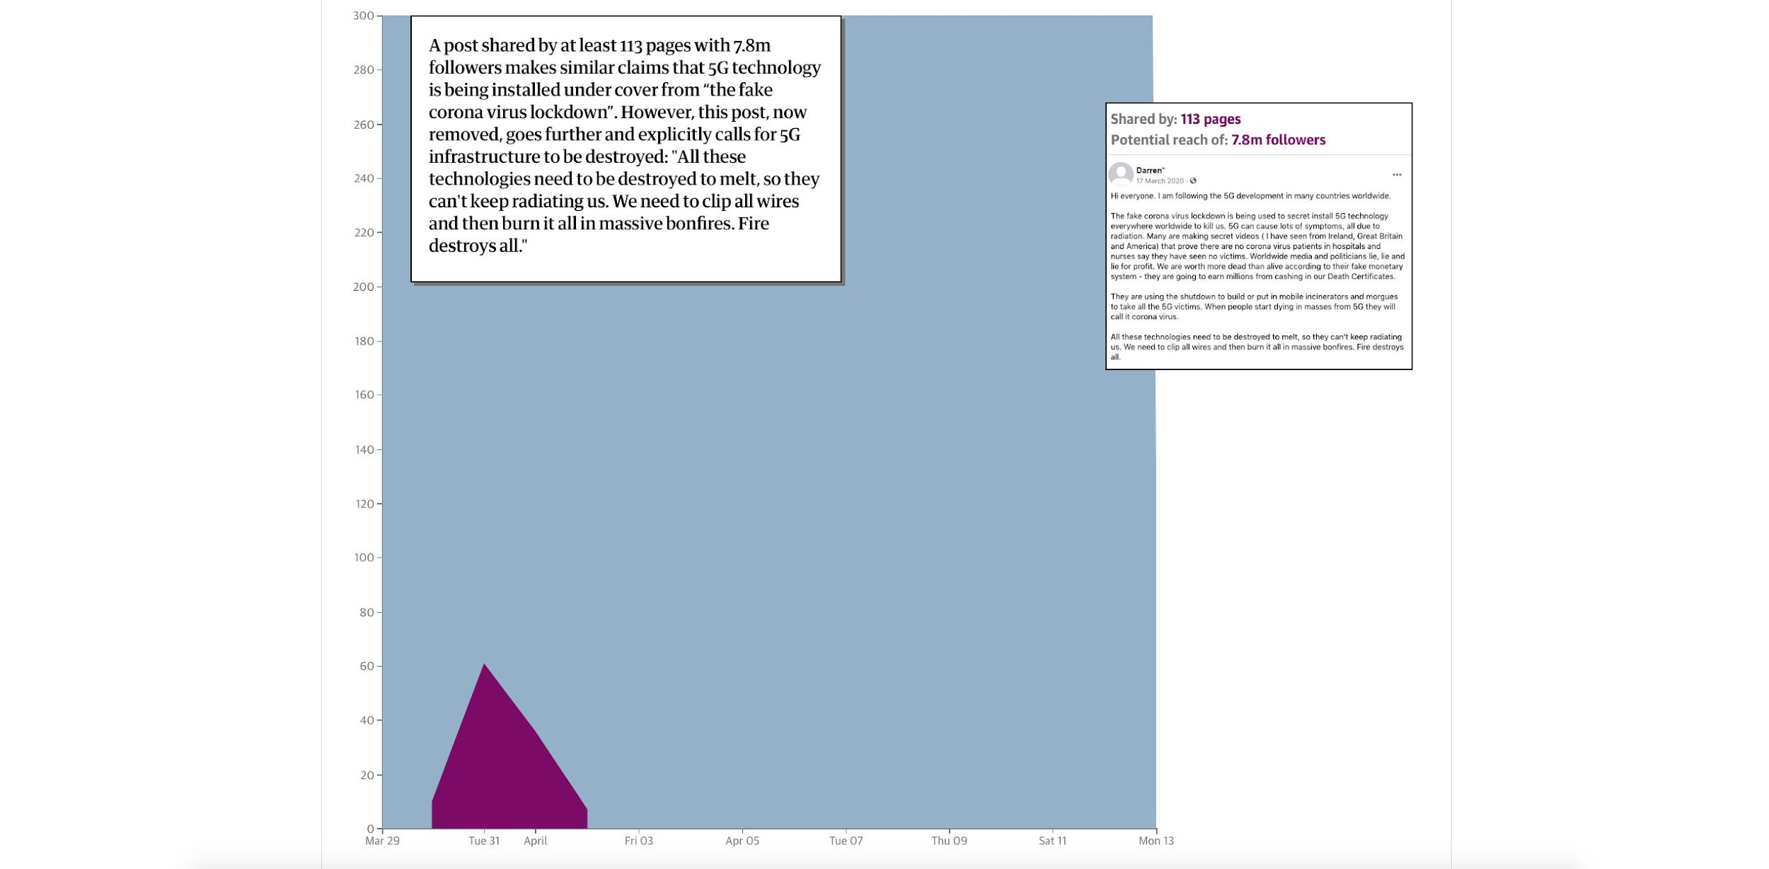
Case study: Facebook, 5G and Coronavirus
how an individual post can reach a global audience within days
Evershed, N., McGowan, M. and Ball, A., (2021). Anatomy of a conspiracy theory: how misinformation travels on Facebook. [online] The Guardian. Available at: https://www.theguardian.com/australia-news/ng-interactive/2021/mar/11/anatomy-of-a-conspiracy-theory-how-misinformation-travels-on-facebook [Accessed 2 September 2021]

Slide 10
Case study: Facebook, 5G and Coronavirus
how an individual post can reach a global audience within days
Evershed, N., McGowan, M. and Ball, A., (2021). Anatomy of a conspiracy theory: how misinformation travels on Facebook. [online] The Guardian. Available at: https://www.theguardian.com/australia-news/ng-interactive/2021/mar/11/anatomy-of-a-conspiracy-theory-how-misinformation-travels-on-facebook [Accessed 2 September 2021]

Slide 11
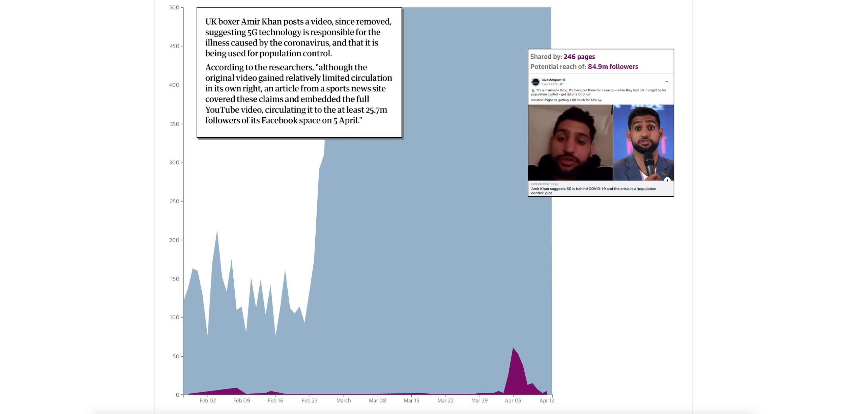
Case study: Facebook, 5G and Coronavirus
how an individual post can reach a global audience within days
Evershed, N., McGowan, M. and Ball, A., (2021). Anatomy of a conspiracy theory: how misinformation travels on Facebook. [online] The Guardian. Available at: https://www.theguardian.com/australia-news/ng-interactive/2021/mar/11/anatomy-of-a-conspiracy-theory-how-misinformation-travels-on-facebook [Accessed 2 September 2021]

Slide 12
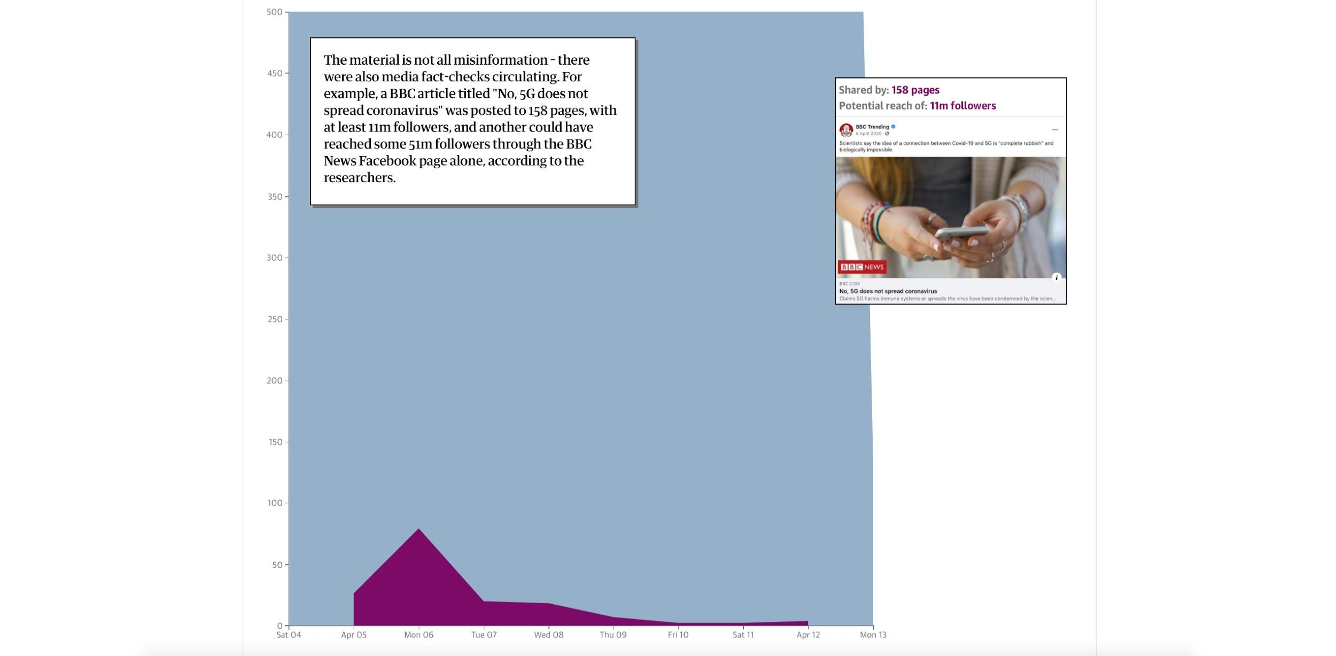
Case study: Facebook, 5G and Coronavirus
how an individual post can reach a global audience within days
Evershed, N., McGowan, M. and Ball, A., (2021). Anatomy of a conspiracy theory: how misinformation travels on Facebook. [online] The Guardian. Available at: https://www.theguardian.com/australia-news/ng-interactive/2021/mar/11/anatomy-of-a-conspiracy-theory-how-misinformation-travels-on-facebook [Accessed 2 September 2021]

Slide 13
Impact
Real life impact of
fake news
“Dozens of 5g antennas vandalised in France during lockdown”
The Connexion
“At least 20 UK phone masts vandalised over false 5G coronavirus claims”
The Guardian
“Burning cell towers, out of baseless fear they spread the virus”
The New York Times
“Coronavirus: 20 suspected phone mast attaches over Easter”
BBC
“5G protesters sabotage Dutch phone towers”
DW

Slide 14
Impact
Real life impact of
fake news
“Opponents of 5G networks set fire to Cyprus’ mobile antennas”
AP News
“How anti-5G sparked a wave of arson attacks”
Politico
“Anti-5G saboteurs raise alarm across Europe”
Fortune
“Conspiracy theorists burn 5G towers claiming link to virus”
CTV News
“Cyprus slams ‘fake news’ over corona - 5G attack”
France24

Slide 15
Did you ever share information on social media that proved to be fake news?
How often do you see information on social media that is fake news?
Who shares this information?
What are the topics of these posts?
DISCUSS!

Slide 16
Literature
Evershed, N., McGowan, M. and Ball, A., (2021). Anatomy of a conspiracy theory: how misinformation travels on Facebook. [online] The Guardian. Available at: https://www.theguardian.com/australia-news/ng-interactive/2021/mar/11/anatomy-of-a-conspiracy-theory-how-misinformation-travels-on-facebook [Accessed 2 September 2021].
Agiwal, M., Roy, A., & Saxena, N. (2016). Next generation 5G wireless networks: A comprehensive survey. IEEE Communications Surveys & Tutorials, 18(3), 1617–1655. https://doi.org/10.1109/COMST.2016.2532458
Anderson, A., Brossard, D., & Scheufele, D. (2012). News coverage of controversial emerging technologies: Evidence for the issue attention cycle in print and online media. Politics and the Life Sciences, 31(1-2), 87–96. https://doi.org/10.1017/S0730938400014283

