Slide 1
Define, explain and identify:
Introduction to “fake news” and 5g technology
Notes:
Introduction of myself
Introduction of the module
Why we choose technology. A lot of engineering courses
Who is this module for. People without knowledge on fake news

Slide 2
Overview
Introduction & Definitions
Fake News and Technology
How it all started: 5G Technology and Covid-19
ERUM sub-report: Does 5g technology pose any health risks?

Slide 3
2
Fake News and Technology
From Past to the Present

Slide 4
Fake News and Technology:
From the past to the present
- Fear of technological evolution is not new.
- Resistance to new technologies is heightened when the public perceives that the benefits of new technologies will only accrue to a small section of society, while the risks are likely to be widespread.
- This is why technologies promoted by large corporations often face stiff opposition from the public.
- New technologies face great opposition when the public perceives that the risks are likely to be felt in the short run and the benefits will only accrue in the long run.
Notes:
Not new
People have this tendency to resist something new
Psychology behind it
People get used to something, like to believe that nothing is as simple as it seems, there is always something behind it, looking for random things to link to what they already believe in.

Slide 5
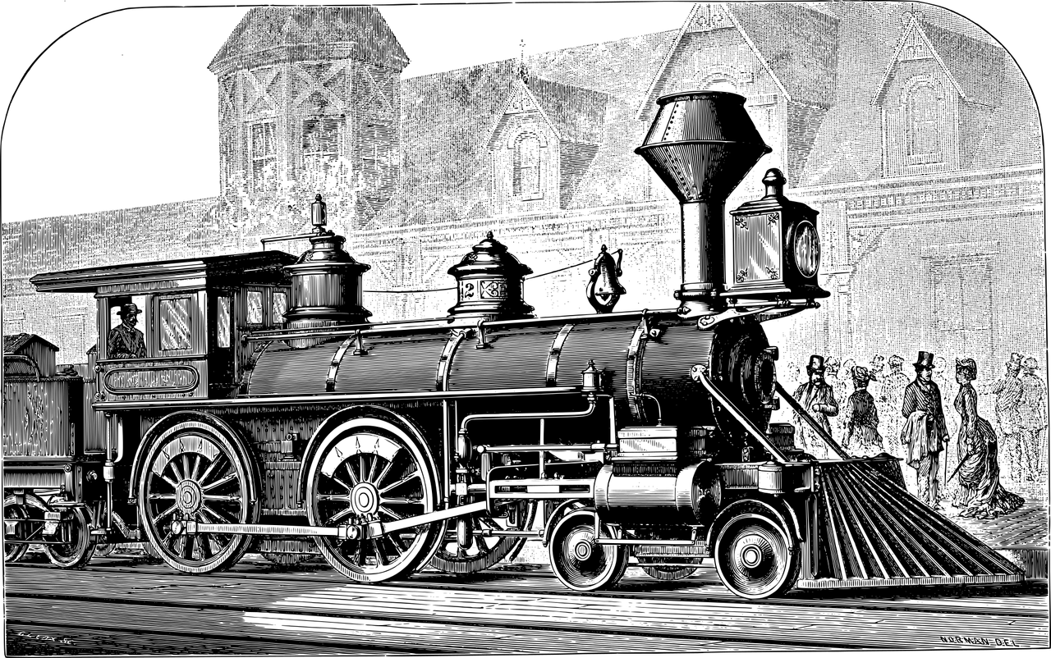
“Trains” - 1825
“Some people believed the body would
simply melt, while others insisted limbs
would be torn from riders' bodies.
Others warned women’s uteruses would
fly out if they reached speeds of 50
miles per hour.”
Danielle, T., n.d. 9 Times in History When Everyone Freaked Out About New Technology. [online] Ranker. Available at: https://www.ranker.com/list/historical-freak-outs-about-new-technology/taeyura [Accessed 4 September 2021].

Slide 6
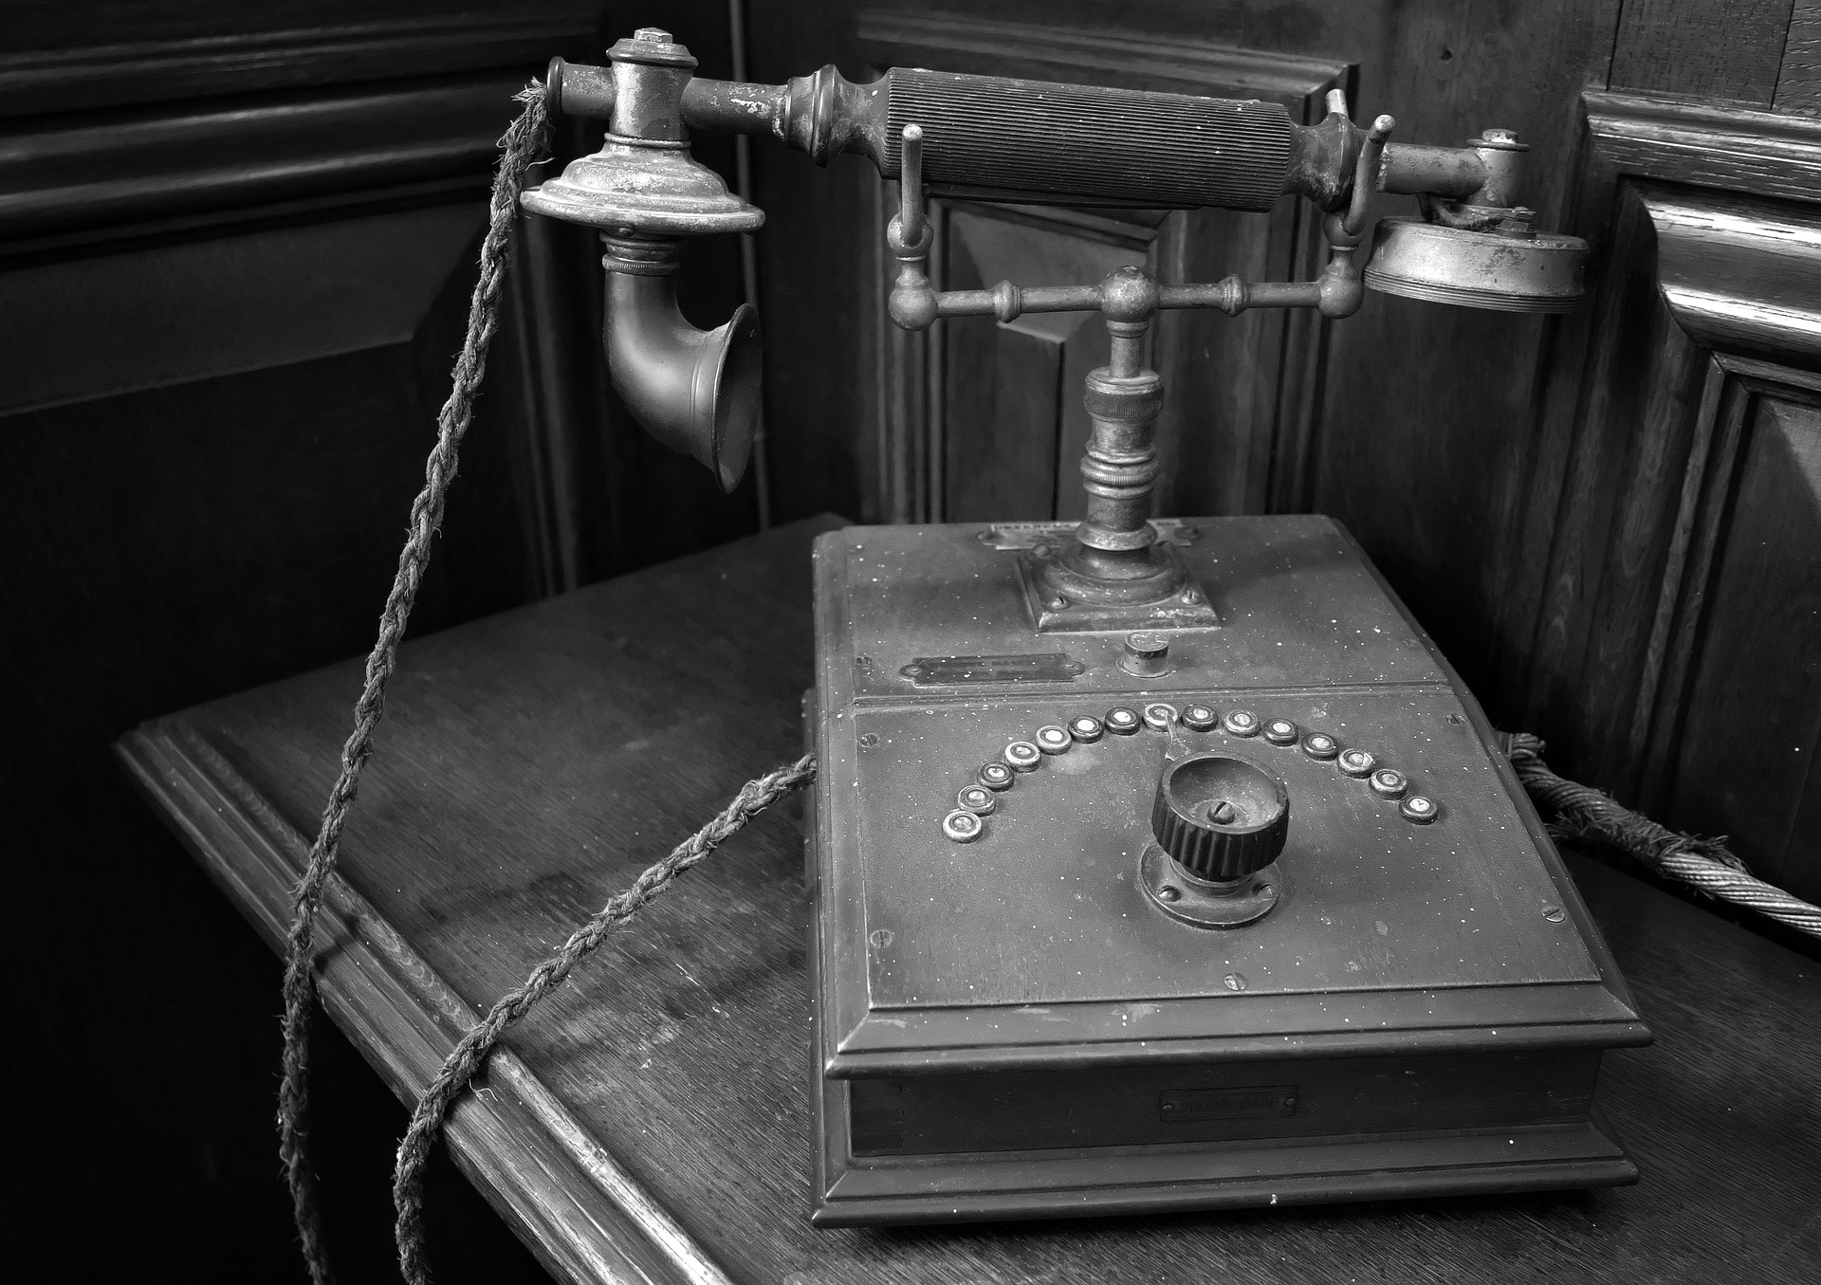
“Telephone” - 1800s
“The telephone introduced society to a
slippery slope where we would soon be
“nothing but transparent heaps of jelly to
each other.” Other attacks on the
telephone insisted that it would make
society lazy and anti-social and some
even claimed the new technology would
be used to communicate with the dead.”
Danielle, T., n.d. 9 Times in History When Everyone Freaked Out About New Technology. [online] Ranker. Available at: https://www.ranker.com/list/historical-freak-outs-about-new-technology/taeyura [Accessed 4 September 2021].
Notes:
Fear for the telephone
Will ruin communication between people, make people lazy and anti-social
People will no longer need to meet to have a conversation so they would lose the sense of being social
Unrealistic theories that we would be able to communicate with the dead

Slide 7
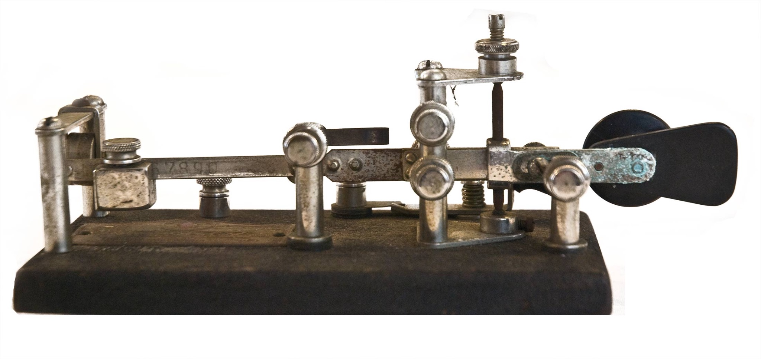
“Telegraph” - 1800s
When the telegraph was first introduced,
critics insisted the new technology would
ruin the poetry of the English language.
The widespread belief was that by
encouraging people to communicate in
short, incomplete sentences, the telegraph
would eventually train people to always
speak in sporadic, choppy thoughts.
Danielle, T., n.d. 9 Times in History When Everyone Freaked Out About New Technology. [online] Ranker. Available at: https://www.ranker.com/list/historical-freak-outs-about-new-technology/taeyura [Accessed 4 September 2021].
Notes:
Telegraph will ruin the language
People will use the language of the telegraph in their everyday lives
Short sentences affect people's thoughts

Slide 8
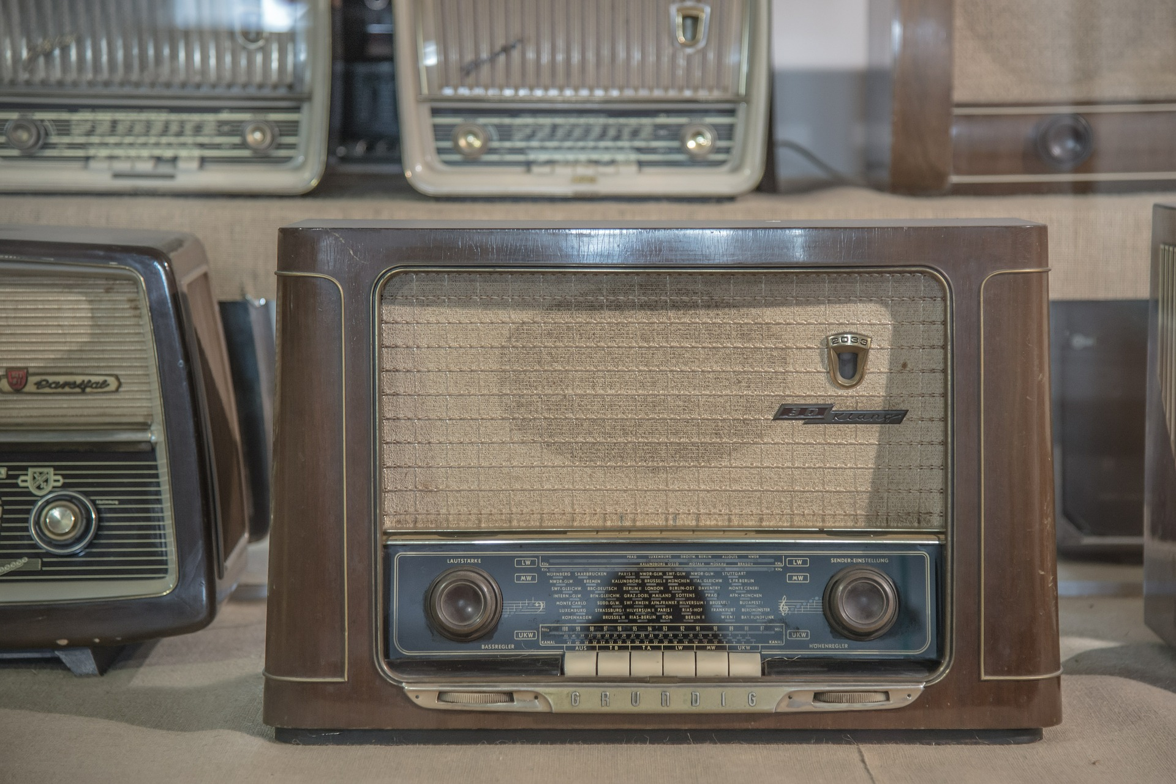
“Radio” - 1940
“Marconi asked himself if he had
“done the world good” or just
“added a menace?” Marconi explained
that he only intended for his invention to
improve communication between ships
at sea. Even he never saw the true
potential the radio introduced in terms
of broadcasting content across an entire
region.”
Danielle, T., n.d. 9 Times in History When Everyone Freaked Out About New Technology. [online] Ranker. Available at: https://www.ranker.com/list/historical-freak-outs-about-new-technology/taeyura [Accessed 4 September 2021].
Notes:
The inventor himself questioned his technology
Different intention
When it was bigger than the intention he feared
Fear of anti-social. That people won’t read anymore

Slide 9
“Television” - 1927
“Everything people feared about the radio
was amplified with the introduction of the
television in 1927. There was a fear that
radio would turn people away from
reading or having intimate conversations
with one another; the television received
that very same critique.”
Danielle, T., n.d. 9 Times in History When Everyone Freaked Out About New Technology. [online] Ranker. Available at: https://www.ranker.com/list/historical-freak-outs-about-new-technology/taeyura [Accessed 4 September 2021].
Notes:
Same with radio but worse
People will become anti-social
No conversations

Slide 10
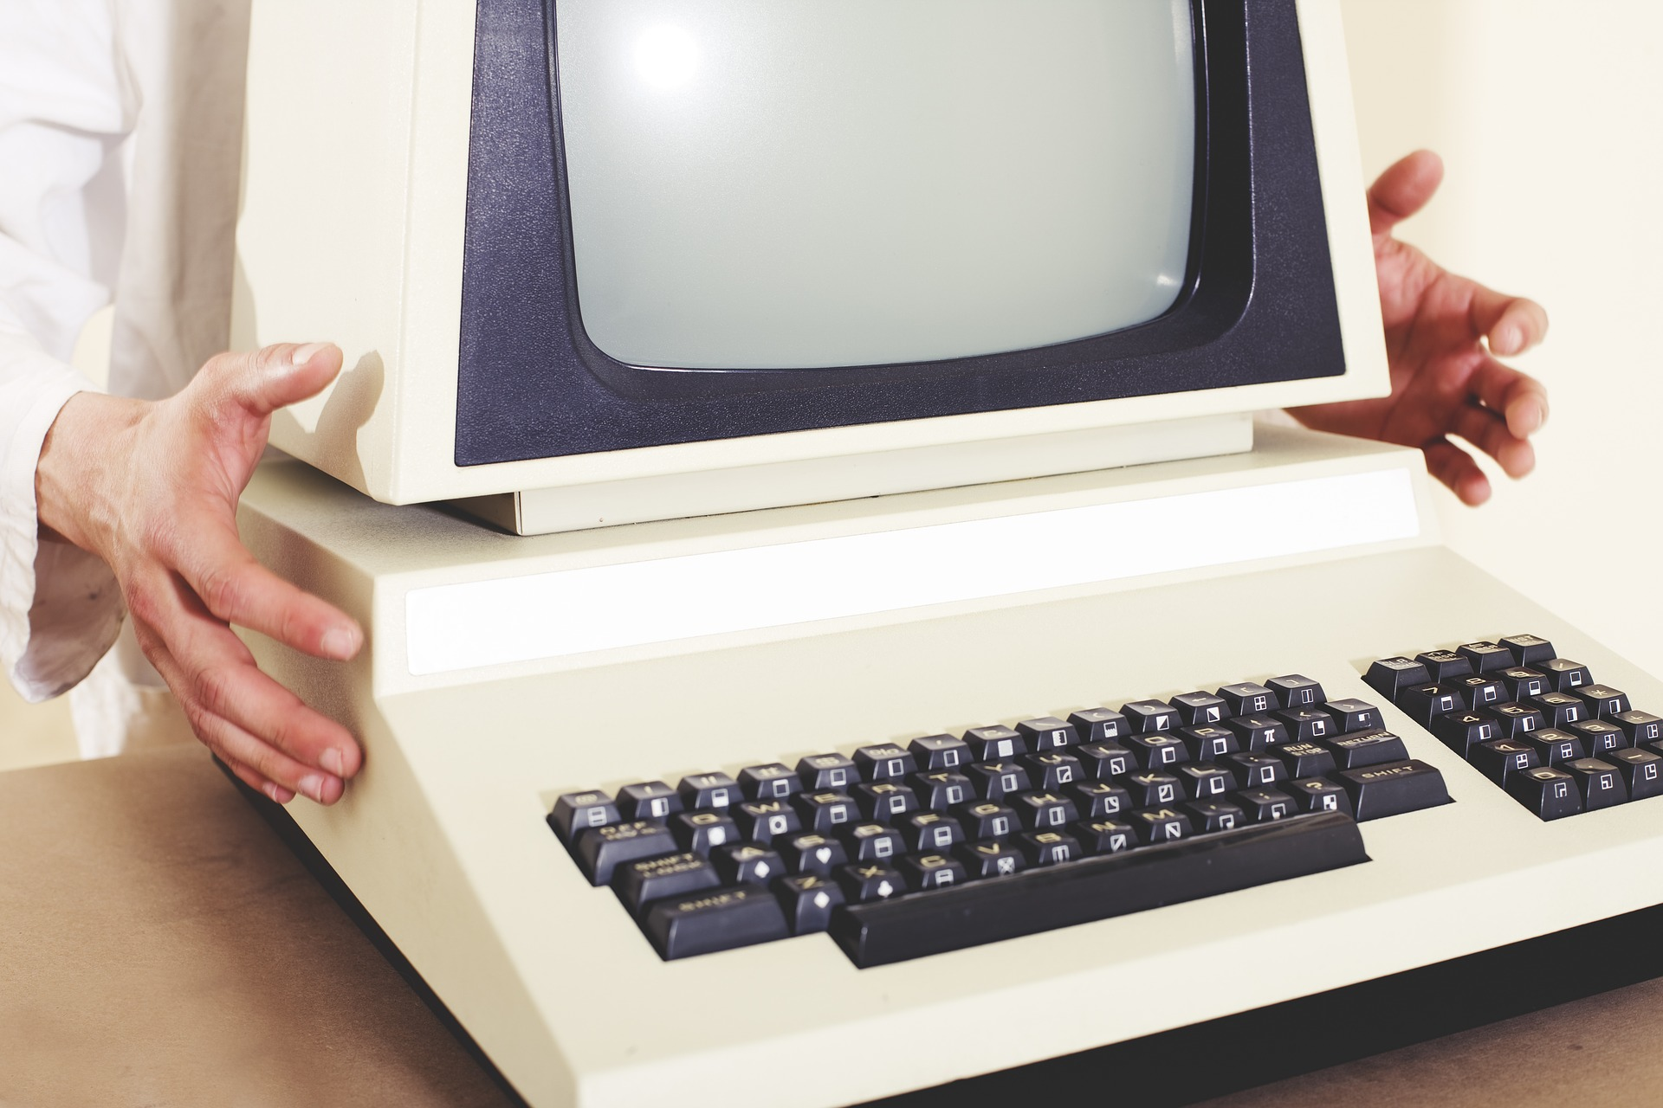
“Computer” - 1990s
A 1996 book titled Women and Computers
explains the variety of phobias that
surrounded computer. According to the text,
“computerphobia” included everything from
the “fear of physically touching the computer
or of damaging what’s inside it” to
“a reluctance to read or talk about computers.”
The book also discusses the crippling fear
of believing computers could replace people
or enslave society as a whole.
Danielle, T., n.d. 9 Times in History When Everyone Freaked Out About New Technology. [online] Ranker. Available at: https://www.ranker.com/list/historical-freak-outs-about-new-technology/taeyura [Accessed 4 September 2021].
Notes:
Computerphobia
Even touching the computer
Couldn’t read or talk about computers
Fear of what is inside
Computers will replace people

Slide 11
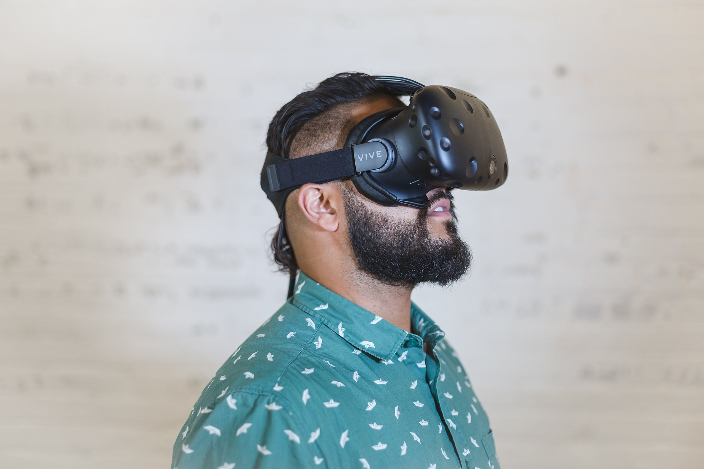
“Virtual Reality” - 1992
Virtual reality has only become available on a
widespread consumer level of late, but the
fear of this technology extends back more
than two decades. “If you are in a virtual world
and you have a model of your office and you
pick up a virtual shotgun and blow your boss
away because it might be amusing, then does
that blur the line between activities you do in
fantasy and the activities you do in real life,”
questioned author Howard Rheingold in 1992.
Danielle, T., n.d. 9 Times in History When Everyone Freaked Out About New Technology. [online] Ranker. Available at: https://www.ranker.com/list/historical-freak-outs-about-new-technology/taeyura [Accessed 4 September 2021].
Notes:
Fear of how people will act inside the vr and outside the vr. Maybe it will encourage criminal acts

Slide 12
“Tech Wearables” - 2015
Wearable technology is constantly being
promoted as the future, but before the first
smart watch even hit the shelves there was
fear that wearable tech would have a negative
impact on our health. The New York Times led
the charge in criticizing new technology,
publishing an article that seemed to suggest
smart watches could cause health issues like
cancer.
Danielle, T., n.d. 9 Times in History When Everyone Freaked Out About New Technology. [online] Ranker. Available at: https://www.ranker.com/list/historical-freak-outs-about-new-technology/taeyura [Accessed 4 September 2021].
Notes:
Negative impact on health like cancer

Slide 13
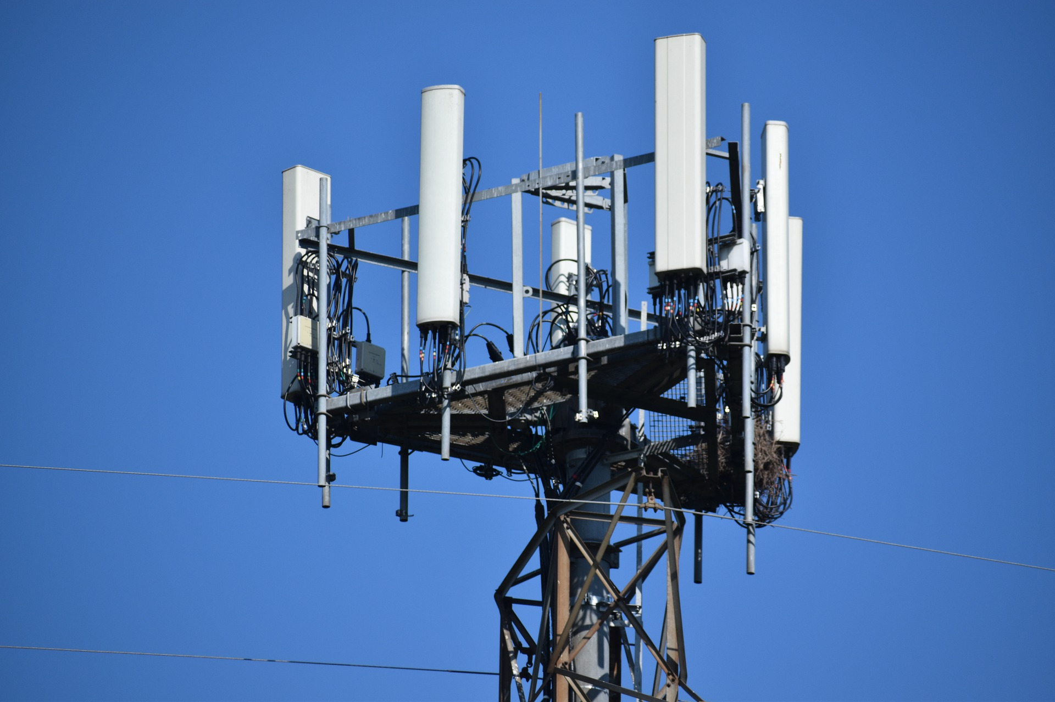
“5G Technology” - 2020
Some groups have even developed conspiracy
theories linking 5G to the COVID-19 pandemic.
These conspiracy theories argue, for example,
that the spread of the virus from the epicentre
of the pandemic in Wuhan, China, is linked to
the large number of 5G towers in the city.
In reality, a 5G network is not even fully
deployed there. Other theories falsely claim
that the waves emitted by the 5G infrastructure
would weaken our immune system.
Notes:
Theory between 5g and coronavirus. 5G is responsible for spreading covid.
https://www.ranker.com/list/historical-freak-outs-about-new-technology/taeyura
https://theconversation.com/conspiracy-theories-about-5g-networks-have-skyrocketed-since-covid-19-139374

Slide 14
Train
Telephone
Telegraph
1800s
Radio
Telephone
Computer
Virtual Reality
1900s
Tech Wearables
5G Technology
2000s

Slide 15
Activity: Example topic
Research: “5G Technology”
Group activity
I. Research and reflect in small groups
- Research and reflect on how the contemporary fake news around 5g technology relate to the old historical roots of the topic
- How did people react to similar technologies in the past? (i.e., 1g, 2g, 3g, 4g)
- What are the common points between the past examples and the present?
II. Discuss in plenum
Notes:
A contemporary example (e.g., fake news about the 5g technology and Covid-19 pandemic) should be the starting point for a research task in small groups (slide 36). In this case students could research beliefs in the past that link to previous wireless technologies (e.g. 1g, 2g, 3g, 4g and their link to illnesses).
The idea is to follow the question of: How does the “contemporary fake news around 5g technology” relate to the old historical roots of the topic?

Slide 16
Literature
Bodner, J., (2021). Covid-19 conspiracy theories : QAnon, 5G, the New World Order and other viral ideas. 1st ed. Jefferson, North Carolina: McFarland & Company, Inc., Publishers.
Cerulus, L., (2020). How anti-5G anger sparked a wave of arson attacks. [online] POLITICO. Available at: https://www.politico.eu/article/coronavirus-5g-arson-attacks-online-theories/ [Accessed 2 September 2021].
Morgan, A., (2020). What is the truth behind the 5G coronavirus conspiracy theory?. [online] euronews. Available at: https://www.euronews.com/2020/05/15/what-is-the-truth-behind-the-5g-coronavirus-conspiracy-theory-culture-clash [Accessed 2 September 2021].
Solis-Moreira, J., (2021). How does fake news of 5G and COVID-19 spread worldwide?. [online] Medicalnewstoday.com. Available at: https://www.medicalnewstoday.com/articles/5g-doesnt-cause-covid-19-but-the-rumor-it-does-spread-like-a-virus [Accessed 2 September 2021].

