Slide 1
Define, explain and identify:
Introduction to “fake news” and 5g technology

Slide 2
Overview
Introduction & Definitions
Fake News and Technology
How it all started: 5G Technology and Covid-19
ERUM sub-report: Does 5g technology pose any health risks?

Slide 3
Introduction and Definition
1

Slide 4
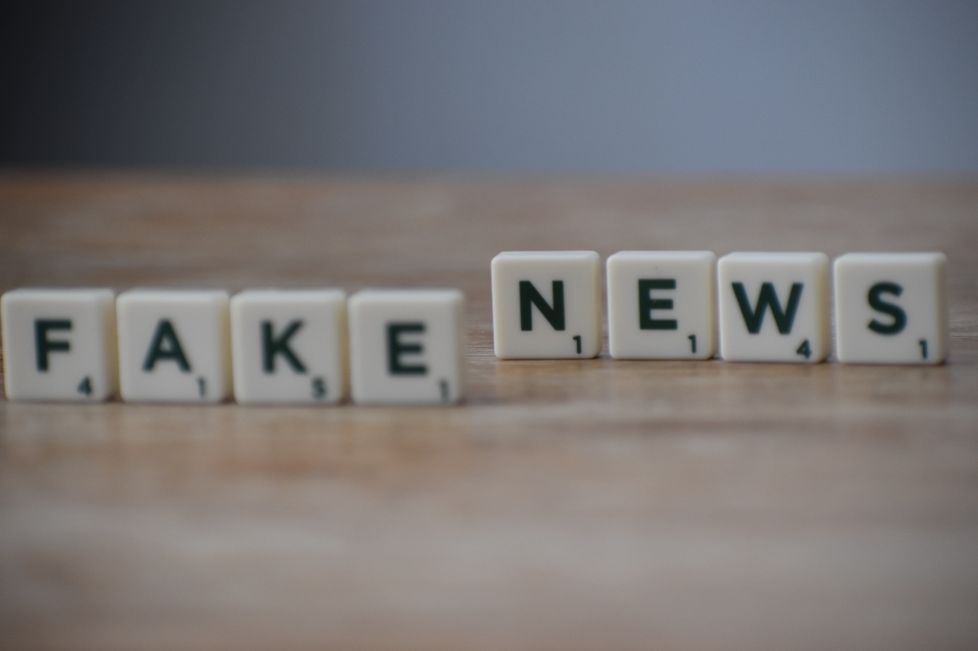
Brainstorming
Notes:
Leading questions:
What comes to your mind when you hear “fake news”?
What topics of “fake news” do you know?
Where do you hear or read “fake news”?
Who is the target?

Slide 5
Fake News
“This is not a 5G antenna”
Actor Woody Harrelson, who has two million Instagram followers, posted the video, saying: "Meanwhile the Chinese are bringing 5g antennas down."
The video is genuine but it's old and shows protesters in Hong Kong in August 2019 tearing down what was reported to be a "smart lamppost" equipped to collect data.
Goodman, J., 2020. Coronavirus: Fake and misleading stories that went viral this week. [online] BBC News. Available at: https://www.bbc.com/news/52124740 [Accessed 1 September 2021].
Notes:
Goodman, J., 2020. Coronavirus: Fake and misleading stories that went viral this week. [online] BBC News. Available at: https://www.bbc.com/news/52124740 [Accessed 1 September 2021].

Slide 6
Fake News
“Croatian earthquake survivors, not Italian patients”
Posts with images of hospital beds and patients being treated on the streets were going viral on social media with the claim that hospitals in Italy have run out of space due to the spread of coronavirus.
The images being shared are genuine, but they are not from Italy.
A reverse image search reveals they were taken in the Croatian capital, Zagreb, after it was hit by an earthquake on 22 March.
The most widely shared post seems to have originated in India just as the government there imposed a nationwide lockdown on 25 March. It has been shared more than 17,000 times and is now being posted by users outside India. Indian journalist Rajat Sharma, also tweeted the images with the misleading claim. He deleted the post within a few hours but it had already been retweeted more than 6,000 times.
Goodman, J., 2020. Coronavirus: Fake and misleading stories that went viral this week. [online] BBC News. Available at: https://www.bbc.com/news/52124740 [Accessed 1 September 2021].
Notes:
Goodman, J., 2020. Coronavirus: Fake and misleading stories that went viral this week. [online] BBC News. Available at: https://www.bbc.com/news/52124740 [Accessed 1 September 2021].

Slide 7
Fake News
“Pope Francis shocks world, endorses Donald Trump for president”
In July 2016, a the web site WTOE 5 News reported that Pope Francis had broken with tradition and unequivocally endorsed Donald Trump for President of the United States.
There was no truth to this story, however. Although WTOE 5 News proclaimed that “news outlets around the world” were reporting on the Pope’s unprecedented endorsement, no reputable news publications confirmed it.
Goodman, J., 2020. Coronavirus: Fake and misleading stories that went viral this week. [online] BBC News. Available at: https://www.bbc.com/news/52124740 [Accessed 1 September 2021].
Notes:
Goodman, J., 2020. Coronavirus: Fake and misleading stories that went viral this week. [online] BBC News. Available at: https://www.bbc.com/news/52124740 [Accessed 1 September 2021].

Slide 8
Give an example of fake news you’ve recently came across
- Where was the topic published?
- What was the story behind the fake news?
- Who was the target?
- What was the expected outcome of the spread of the fake news? What were they trying to chieve?
DISCUSS!

Slide 9
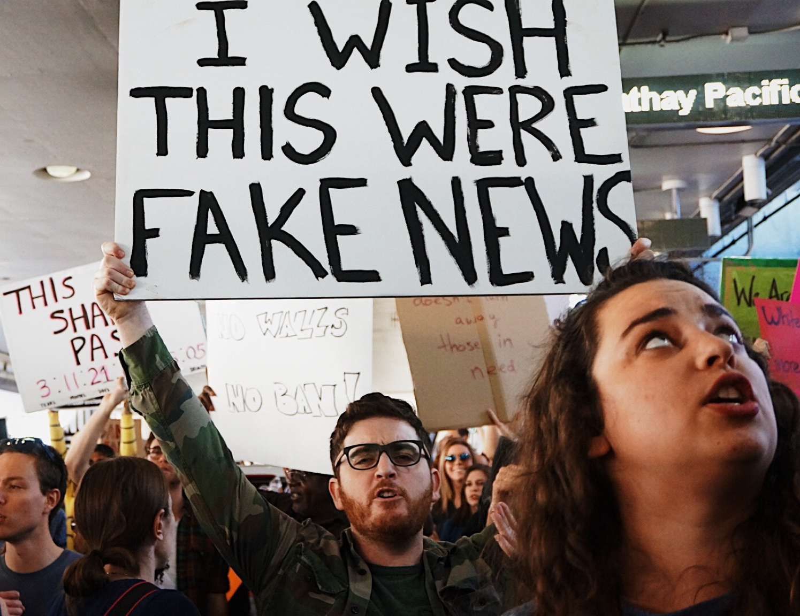
Fake News
Fake news is false or misleading information presented as news. It often has the aim of damaging the reputation of a person or entity, or making money through advertising revenue. However, the term does not have a fixed definition, and has been applied more broadly to include any type of false information, including unintentional and unconscious mechanisms, and also by high-profile individuals to apply to any news unfavourable to his/her personal perspectives.

Slide 10
Misinformation
Misinformation is false, inaccurate, or misleading information that is communicated regardless of an intention to deceive. Examples of misinformation are false rumors, insults, and pranks.

Slide 11
Disinformation
Disinformation is false or misleading information that is spread deliberately to deceive.
Notes:
What differentiates misinformation from disinformation is the intent of the person or outlet sharing it.
Disinformation can be spread using many of the same tactics as misinformation—hoaxes, click-bait, fabricated reports. Disinformation is created to deceive
There are a variety of reasons that individuals’ social media accounts or even business accounts might spread disinformation. It could be to increase their social media marketing effectiveness, boost their online traffic, build more followers for their page or business, incite an emotional response, or create a distraction.
Disinformation can be dangerous on social media because, as previously mentioned, the sheer amount of information there and the length of readers’ attention spans can allow it to go unchecked.

Slide 12
Types of Mis- and Disinformation
False connection
When headlines, visuals or captions don’t support the content
False context
When genuine content is shared with false contextual information
Manipulated content
When genuine information or imagery is manipulated to deceive
Satire or Parody
No intention to cause harm but has potential to fool
Misleading content
Misleading use of information to frame an issue or individual
Imposter content
When genuine sources are impersonated
Fabricated content
Content that is 100% false, designed to deceive and do harm
Propaganda
When content is used to manage attitudes,values and knowledge
Sponsored content
Advertising or PR disguised as editorial content
Error
When established news organisations make mistakes while reporting
Notes:
It’s important to distinguish between the different levels of harm these fake news could cause based on the typology and the intention.

Slide 13
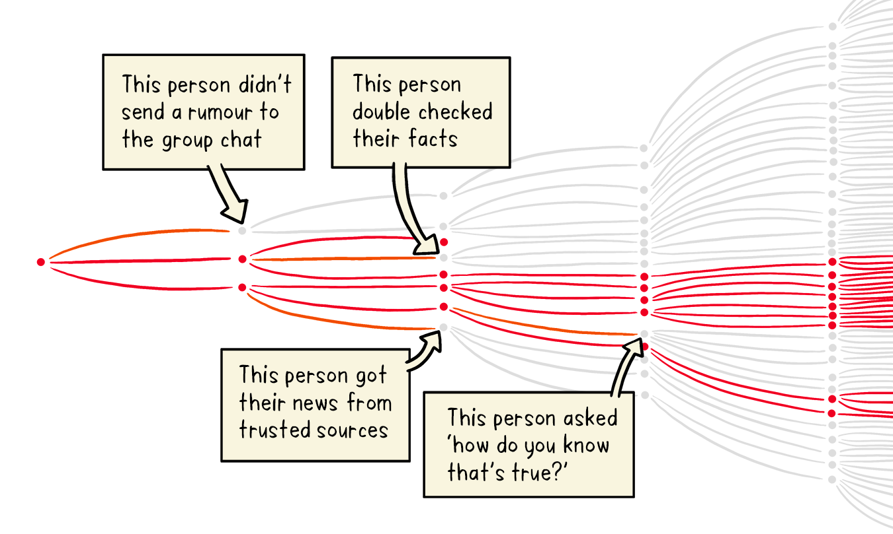
Infodemic
Infodemic is a blend of "information" and "epidemic" that typically refers to a rapid and far-reaching spread of both accurate and inaccurate information about something, such as a disease. As facts, rumors, and fears mix and disperse, it becomes difficult to learn essential information about an issue. Infodemic was coined in 2003, and has seen renewed usage in the time of COVID-19.
Who.int. Let’s flatten the infodemiccurve. [online] Available at: https://www.who.int/news-room/spotlight/let-s-flatten-the-infodemic-curve [Accessed 2 September 2021].
Notes:
An infodemic is too much information including false or misleading information in digital and physical environments during a disease outbreak. It causes confusion and risk-taking behaviours that can harm health. It also leads to mistrust in health authorities and undermines the public health response. An infodemic can intensify or lengthen outbreaks when people are unsure about what they need to do to protect their health and the health of people around them. With growing digitization – an expansion of social media and internet use – information can spread more rapidly. This can help to more quickly fill information voids but can also amplify harmful messages.
Infodemic management is the systematic use of risk- and evidence-based analysis and approaches to manage the infodemic and reduce its impact on health behaviours during health emergencies

Slide 14
What?
What topics of fake news are there?
What fake news have you heard of?
DISCUSS!

Slide 15
What?
What are the topics of fake news that you’ve heard/read?
examples
- media/press
- religion
- environment/climate change
- migration
- politics/government
- health
- science
- aliens/flat-earth
- war
- economy/finance

Slide 16
Where?
Where are fake news spread?
Where did you hear/read about them?
DISCUSS!

Slide 17
Where?
Where did you hear/read about them?
examples
- Online/Social Media
- Family/Friends
- Social circles
- Mainstream media
- Within the political sphere

Slide 18
Who?
Who is responsible for fake news?
Who is spreading fake news?
Who is the target?
DISCUSS!

Slide 19
Who?
Who is responsible for the fake news?
examples
- Policy makers
- Government
- Media
- The public

Slide 20
Why?
Why do people believe fake news?
DISCUSS!

Slide 21
Why?
Why do people believe fake news?
examples
- Psychological explanations
- Social, structural and economical reasons
- Uncertainty, knowledge gap
- Political motivations
- Inability to differentiate between truth and falsehood

Slide 22
How?
How are fake news spread?
DISCUSS!

Slide 23
How?
How are fake news spread?
examples
- Spreading fear
- Creating strong emotional reaction
- Responsibility is transferred to someone else
- Creating the sense that there is something hidden behind the news. And that they can educate themselves with the “truth”.
- Feeling that if you believe you are considered more “awake” from others that listen to mainstream media.

Slide 24
When?
When does fake news gain more publicity?
DISCUSS!

Slide 25
When?
When does fake news gain more publicity?
examples
- Elections
- Times of crisis
- Times of insecurity
- Social controversial topic
- New scientific findings that change what the public is used to
- Economical reasons

Slide 26
Literature
McIntyre, L., (2018). Post-Truth. 1st ed. Cambridge, Massachusetts: The MIT Press.
Shu, K., Liu, H., Wang, S. and Lee, D., (2020). Disinformation, Misinformation, and Fake News in Social Media: Emerging Research Challenges and Opportunities. 1st ed. Switzerland: Springer Nature.
Zimdars, M. and McLeod, K., (2020). Fake News: Understanding Media and Misinformation in the Digital Age. 1st ed. Cambridge, Massachusetts: The MIT Press.
Goodman, J., (2020). Coronavirus: Fake and misleading stories that went viral this week. [online] BBC News. Available at: https://www.bbc.com/news/52124740 [Accessed 2 September 2021].
World Health Organisation. (2021). Let’s flatten the infodemic curve. [online] Available at: https://www.who.int/news-room/spotlight/let-s-flatten-the-infodemic-curve [Accessed 2 September 2021].

