Slide 1
Developing the methodology to detect “fake news” from fact-checked articles.

Slide 2
Overview
Introduction & Social Media: Response to Fake News
Fake News Detection Models
How to Recognise False Content - The 5Ws
The Future of Fake News: AI Generated Synthetic Media

Slide 3
Introduction & Social Media: Response to Fake News
1

Slide 4
Introduction
Information Overload
When people are repeatedly exposed to the same stimuli, such as certain faces, they grow to like those stimuli more than those they have encountered less often. Such biases translate into an irresistible urge to pay attention to information that is going viral—if everybody else is talking about it, it must be important. In addition to showing us items that conform with our views, social media platforms such as Facebook, Twitter, YouTube and Instagram place popular content at the top of our screens and show us how many people have liked and shared something. Few of us realize that these cues do not provide independent assessments of quality.
Hills, T. and Menczer, F., 2020. Information Overload Helps Fake News Spread, and Social Media Knows It. [online] Scientific American. Available at: <https://www.scientificamerican.com/article/information-overload-helps-fake-news-spread-and-social-media-knows-it/> [Accessed 28 September 2021].

Slide 5
Introduction
Echo Chambers
Most of us do not believe we follow the herd. But our confirmation bias leads us to follow others who are like us, a dynamic that is sometimes referred to as homophily—a tendency for like-minded people to connect with one another. Social media amplifies homophily by allowing users to alter their social network structures through following, unfriending, and so on. The result is that people become segregated into large, dense and increasingly misinformed communities commonly described as echo chambers.
Hills, T. and Menczer, F., 2020. Information Overload Helps Fake News Spread, and Social Media Knows It. [online] Scientific American. Available at: <https://www.scientificamerican.com/article/information-overload-helps-fake-news-spread-and-social-media-knows-it/> [Accessed 28 September 2021].

Slide 6
Introduction
Rise of the Bots
Information quality is further impaired by social bots, which can exploit all our cognitive loopholes. Bots are easy to create. Social media platforms provide so-called application programming interfaces that make it fairly trivial for a single actor to set up and control thousands of bots. But amplifying a message, even with just a few early upvotes by bots on social media platforms such as Reddit, can have a huge impact on the subsequent popularity of a post.
Hills, T. and Menczer, F., 2020. Information Overload Helps Fake News Spread, and Social Media Knows It. [online] Scientific American. Available at: <https://www.scientificamerican.com/article/information-overload-helps-fake-news-spread-and-social-media-knows-it/> [Accessed 28 September 2021].

Slide 7
Introduction
Unreliable news websites significantly increased their share of engagement among the top performing news sources on social media for 2020, according to the analysis from NewsGuard provided to Axios.
Fischer, S., 2020. "Unreliable" news sources got more traction in 2020. [online] Axios. Available at: <https://www.axios.com/unreliable-news-sources-social-media-engagement-297bf046-c1b0-4e69-9875-05443b1dca73.html?utm_campaign=organic&utm_medium=socialshare&utm_source=twitter> [Accessed 28 September 2021].

Slide 8
Social Media - response to fake news
Why does social media play an important role in the spread of fake news: Timeline of events
- We prefer information from people we trust. We search for and remember things that fit well with what we already know and understand. Modern technologies are amplifying these biases in harmful ways.
- Search engines direct us to sites that inflame our suspicions, and social media connects us with like-minded people, feeding our fears. Making matters worse, bots—automated social media accounts that impersonate humans—enable misguided or malevolent actors to take advantage of our vulnerabilities.
- Unable to process all this material, we let our cognitive biases decide what we should pay attention to. These mental shortcuts influence which information we search for, comprehend, remember and repeat to a harmful extent.

Slide 9
Google
To help fight the rise in misinformation, Full Fact, a nonprofit that provides tools and resources to fact checkers, turned to Google.org for help.
Last year, Google.org provided Full Fact with $2 million and seven Googlers from the Google.org Fellowship, a pro-bono program that matches teams of Googlers with nonprofits for up to six months to work full-time on technical projects.
Over the past year, Full Fact boosted the amount of claims they could process by 1000x, detecting and clustering over 100,000 claims per day — that’s more than 36.5 million total claims per year!
Floodpage, S., 2021. How fact checkers and Google.org are fighting misinformation. [online] Google. Available at: <https://blog.google/outreach-initiatives/google-org/fullfact-and-google-fight-misinformation/> [Accessed 28 September 2021].

Slide 10
Google
Matt Brittin, the president of Google in Europe, the Middle East and Africa, announced the €25 million contribution to help launch the European Media and Information fund in a company blog post on Wednesday.
It will go toward the work of strengthening media literacy skills, supporting fact-checkers and further research into ways to fight misinformation online.
Brittin, M., 2021. Google's €25 million contribution to media literacy. [online] Google. Available at: <https://blog.google/around-the-globe/google-europe/googles-25-million-contribution-to-media-literacy/> [Accessed 28 September 2021].

Slide 11
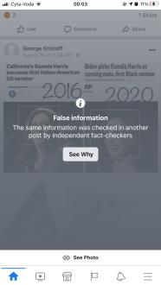
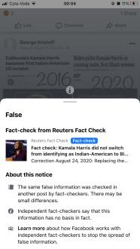
Facebook
Facebook says that it removed more than 20 million pieces of content from across Facebook and Instagram for violating its policies on COVID-19-related misinformation.
Facebook also displayed warnings on more than 190 million pieces of COVID-related content on Facebook that their third-party fact-checking partners rated as false, partly false, altered or missing context.
Nix, N. and Wagner, K., 2021. Bloomberg - Are you a robot?. [online] Bloomberg.com. Available at: <https://www.bloomberg.com/news/articles/2021-08-18/facebook-removed-20-million-pieces-of-covid-19-misinformation> [Accessed 28 September 2021].

Slide 12
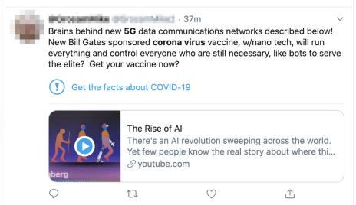
Twitter
Twitter has focused on issuing suspensions and bans to accounts which consistently spread harmful Covid-19 misinformation when they come to the company's attention.
It also began putting warning labels on such tweets in early 2020, announced a collaboration with news organisations as part of an attempt to debunk false information, and started a pilot scheme in January to allow a small number of people to submit "notes" about misleading content.
Spring, M., 2021. Twitter tests 'misleading' post report button for first time. [online] BBC News. Available at: <https://www.bbc.com/news/technology-58258377> [Accessed 28 September 2021].

Slide 13
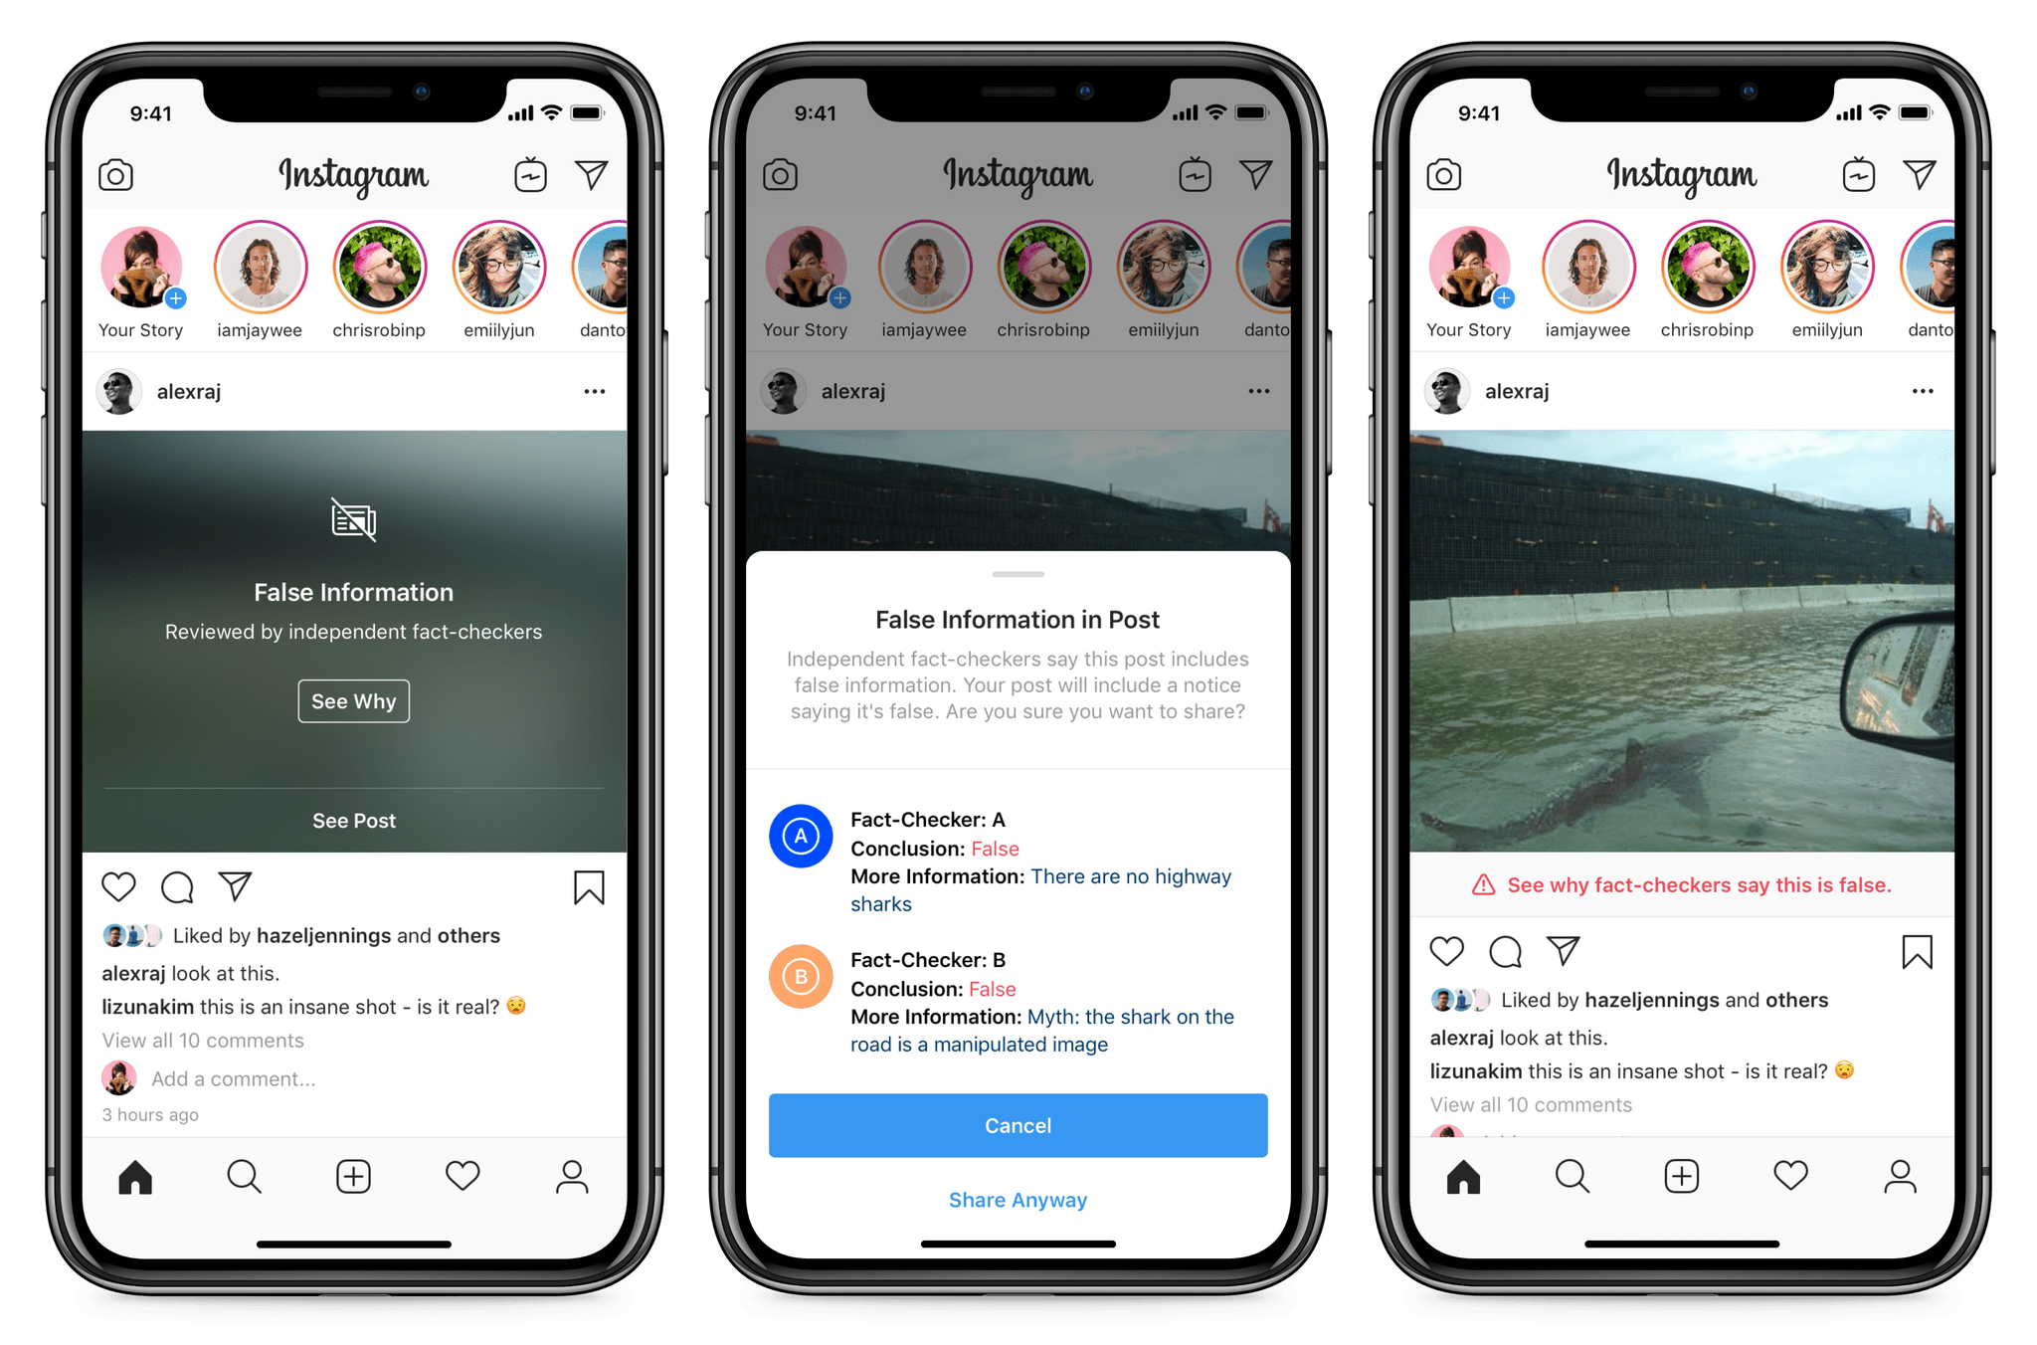
Instagram
If the third party fact checking organization finds information posted is false, a few things happen including:
The photo or video is removed from the explore page and hidden from hashtags used.
Photo is labeled “False Information” and has an overlay that covers the picture.
A warning is given to the account that posted the false information, that they have shared false information.
A label is placed under the post giving the audience information on where to fact check.
Parham, K., 2020. How social media platforms combat fake news. [online] Dixie Sun News. Available at: <https://dixiesunnews.com/news/articles/2020/10/18/how-social-media-platforms-combat-fake-news/> [Accessed 28 September 2021].

Slide 14
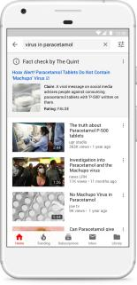
Youtube
YouTube removed more than 1 million videos with "dangerous coronavirus misinformation" since the start of the COVID-19 pandemic.
YouTube removed "thousands" of videos for violating election misinformation policies since the U.S. vote in November, with three-fourths removed before hitting 100 views.
YouTube will start labeling health videos with information on how authoritative the source is.
Three years ago, YouTube started adding fact-check labels beneath videos that dealt with popular conspiracy theories, like those about the moon landing or linking vaccines to autism.
Bergen, M., 2021. YouTube Revamps Health Videos as Biden Criticizes Social Media for Vaccine Misinformation. [online] Time. Available at: <https://time.com/6081597/youtube-health-videos-biden/> [Accessed 28 September 2021].

Slide 15
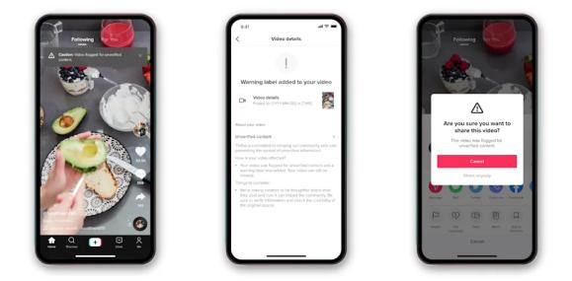
TikTok
If TikTok is unable to verify whether certain content is accurate, the content will include a label saying it includes unverified information.
In addition, if users try to share unverified content, they'll get a message with a "caution" icon asking whether they're certain they want to share it.
Internet Matters. 2020. What are popular platforms doing to stop the spread of fake news online? | Internet Matters. [online] Available at: <https://www.internetmatters.org/hub/news-blogs/stopping-the-spread-of-fake-news-on-popular-online-platforms/> [Accessed 28 September 2021].

Slide 16
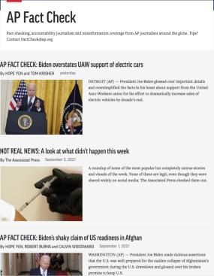
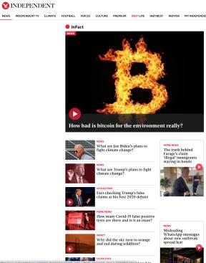
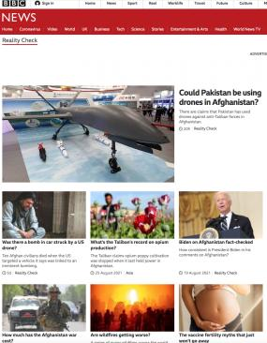
Online press
AP NEWS. n.d. Fact Check: Political & News Fact Check | AP News. [online] Available at: <https://apnews.com/hub/ap-fact-check> [Accessed 28 September 2021].
The Independent. n.d. InFact | The Independent. [online] Available at: <https://www.independent.co.uk/infact> [Accessed 28 September 2021].
BBC News. n.d. Reality Check News - BBC News. [online] Available at: <https://www.bbc.com/news/reality_check> [Accessed 28 September 2021].

Slide 17
Reuters
Reuters partners with Facebook Journalism Project to help newsrooms around the world spot deepfakes and manipulated media
The course aims to combat these risks by teaching journalists about the various types of altered media and the ways in which newsrooms can be better equipped to handle misinformation in order to move forward to verify and publish genuine content from third-party sources.
Reuters. n.d. Manipulated Media. [online] Available at: <https://www.reuters.com/manipulatedmedia/en/> [Accessed 28 September 2021].

Slide 18
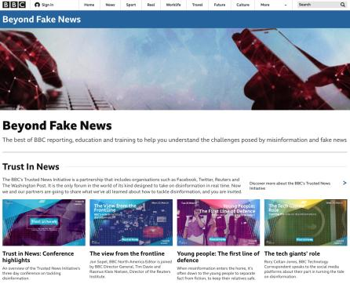
BBC
The BBC's Trusted News Initiative is a partnership that includes organisations such as Facebook, Twitter, Reuters and The Washington Post. It is the only forum in the world of its kind designed to take on disinformation in real time.
BBC. n.d. Beyond Fake News. [online] Available at: <https://www.bbc.co.uk/beyondfakenews/> [Accessed 28 September 2021].

Slide 19
How Social Media respond to Fake News
Were you aware of these measures?
Did you came across to any of these measures? What was your reaction? Did it influenced your response to the information?
Are you aware of any other measures?
Do you believe that social media companies are doing enough about fake news?
DISCUSS!

Slide 20
Literature
Fischer, S., 2020. "Unreliable" news sources got more traction in 2020. [online] Axios. Available at: <https://www.axios.com/unreliable-news-sources-social-media-engagement-297bf046-c1b0-4e69-9875-05443b1dca73.html?utm_campaign=organic&utm_medium=socialshare&utm_source=twitter> [Accessed 28 September 2021].
Hills, T. and Menczer, F., 2020. Information Overload Helps Fake News Spread, and Social Media Knows It. [online] Scientific American. Available at: <https://www.scientificamerican.com/article/information-overload-helps-fake-news-spread-and-social-media-knows-it/> [Accessed 28 September 2021].
Jiaxi Sun, "Research on the Credibility of Social Media Information Based on User Perception", Security and Communication Networks, vol. 2021, Article ID 5567610, 10 pages, 2021. https://doi.org/10.1155/2021/5567610

