Slide 1
Developing the methodology to detect “fake news” from fact-checked articles.

Slide 2
Overview
Introduction & Social Media: Response to Fake News
Fake News Detection Models
How to Recognise False Content - The 5Ws
The Future of Fake News: AI Generated Synthetic Media

Slide 3
Fake News Detection Models
2

Slide 4
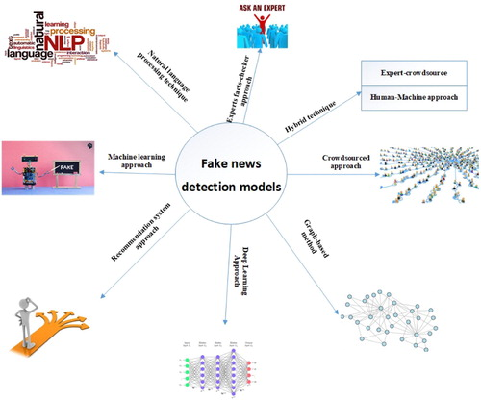
Fake News Detection Models
Due to the rapid development of fake news and the complexity of solving it, some scholars allude that the utilization of artificial intelligence tools and machine learning techniques should be applied (Granik & Mesyura, 2017; Kshetri & Voas, 2017)
Botambu Collins, Dinh Tuyen Hoang, Ngoc Thanh Nguyen & Dosam Hwang (2021) Trends in combating fake news on social media – a survey, Journal of Information and Telecommunication, 5:2, 247-266, DOI: 10.1080/24751839.2020.1847379

Slide 5
Experts or professionals facts-checker approach
Small group of professionals
Easy to manage
High accuracy rate
Issuing corrections
Tagging false content with warnings
Censoring false content by demoting its placement in ranking algorithms so that is less likely to be seen by users
Some are not independent and work for an organisation and often have a lot of limitations
The technique is slow in a situation where they are given a large volume of information to verify due to their small number
The process is manual
Botambu Collins, Dinh Tuyen Hoang, Ngoc Thanh Nguyen & Dosam Hwang (2021) Trends in combating fake news on social media – a survey, Journal of Information and Telecommunication, 5:2, 247-266, DOI: 10.1080/24751839.2020.1847379

Slide 6
Crowdsourced approach
Based on the premise that no matter how smart someone is, the collective effort of individuals or groups supersedes any single individual intellectual capacity.
Experiment conducted in 2019 used crowdsourced judgments of news source on social media and discovered that the crowd is more effective than professional fact-checker.
The crowd is made up of people of different fields and have little knowledge of some news site
Sites which they are unfamiliar with are marked as an untrusted site
Botambu Collins, Dinh Tuyen Hoang, Ngoc Thanh Nguyen & Dosam Hwang (2021) Trends in combating fake news on social media – a survey, Journal of Information and Telecommunication, 5:2, 247-266, DOI: 10.1080/24751839.2020.1847379

Slide 7
Machine learning approach
Proposed by Granik and Mesyura (2017) / Used Naive Bayes classifier
Most Artificial intelligence tools for detecting and flagging fake news rely heavily on Click-Through Rates (CTR). The position of the stream page increases as the CTR increase and some fake news type such as clickbait articles usually have high CTR. Therefore such an approach cannot be used to detect fake news types such as clickbait.
Biyani proposed an approach using Gradient Boosted Decision Trees (GBDT).
The model achieves strong classification performance They were able to identify spam and web pages by defining 8 types of clickbait such as Exaggeration, Teasing, Inflammatory, Graphic, Formatting, Bait-and-Switch, ambiguous, Wrong.
This approach is not without limitation, fake news is a broad issue with several types but this study focuses only on one type of fake news i.e. clickbait which has two ways of detecting it; firstly, it can be easily detected because the content is different from the headline and secondly, based on the fact that the content is of low quality.
Botambu Collins, Dinh Tuyen Hoang, Ngoc Thanh Nguyen & Dosam Hwang (2021) Trends in combating fake news on social media – a survey, Journal of Information and Telecommunication, 5:2, 247-266, DOI: 10.1080/24751839.2020.1847379

Slide 8
Natural language processing technique (NLP)
Automated deception detection technique
Linguistic features are a key factor to NLP including text content and style.
The method is using grammar and style detector and syntactic analyser.
The basic task is to identify some verbal and lexical cues which will point out linguistic differences when human tell lies as opposed to when they tell the truth.
Deceivers produce more total words-count and sense-based words such as those that show lower cognitive complexity, the use of more negative emotion words, extreme positive words.
Botambu Collins, Dinh Tuyen Hoang, Ngoc Thanh Nguyen & Dosam Hwang (2021) Trends in combating fake news on social media – a survey, Journal of Information and Telecommunication, 5:2, 247-266, DOI: 10.1080/24751839.2020.1847379

Slide 9
Hybrid technique: Expert-Crowdsource approach
This approach involves the combination of the two-manual fact-checking systems by applying human knowledge as opposed to automatic facts-checking involving the use of the machines. The key idea behind this approach is that where experts failed, the crowdsourced approach can complement and vice versa.
Facebook has announced the combination of an expert-crowdsource approach in fighting the proliferation of fake news on its network. The expert-based has often been accused of being politically biased, not independent and very slow in detecting fake news.
Botambu Collins, Dinh Tuyen Hoang, Ngoc Thanh Nguyen & Dosam Hwang (2021) Trends in combating fake news on social media – a survey, Journal of Information and Telecommunication, 5:2, 247-266, DOI: 10.1080/24751839.2020.1847379

Slide 10
Hybrid technique: Human-Machine approach
The model employs the fusion of the collective effort of human with that of the machine learning to enhance decision-making model which predict whether a news is fake or not.
Firstly, crowdsourcing was used to classify news from Satire and fake news and distinguish them which was difficult to detect by the machine.
By applying the machine learning techniques they employ baseline classification algorithms
While the crowdsourcing task on fact-checking achieved an accuracy rate of 84%, they designed the hybrid fake news detection model which involves a combination of the previous two results, and they got an overall accuracy rate of 87%.
Botambu Collins, Dinh Tuyen Hoang, Ngoc Thanh Nguyen & Dosam Hwang (2021) Trends in combating fake news on social media – a survey, Journal of Information and Telecommunication, 5:2, 247-266, DOI: 10.1080/24751839.2020.1847379

Slide 11
Graph-based method
Hierarchical Graph Attention Network (HGAT)
Their method represents news articles as nodes and matches related nodes or vertices together and fake news is then identified from using classification tasks.
Using a real-world dataset from PolitiFact, news articles were weighted as neighbours and the same neighbour nodes were aggregated in the schema node.
The model employs the Heterogeneous Information Networks HIN-based fake news article and their result outperforms other states of the art fake news identification graph model.
Botambu Collins, Dinh Tuyen Hoang, Ngoc Thanh Nguyen & Dosam Hwang (2021) Trends in combating fake news on social media – a survey, Journal of Information and Telecommunication, 5:2, 247-266, DOI: 10.1080/24751839.2020.1847379

Slide 12
Recommendation system approach
The recommendation system approach tries to verify some news content deem to be authentic and then recommend these news articles for consumption
Most recommendation system uses human emotions to recommend content.
The collaborative filtering recommendation method recommends news content based on ratings and comments from others.
The method is based on the premise that fake news is being spread through some URLs that can be traced and identified.
Comparing the tweets coming from certain URLs or URLs contained in tweets that are deemed to be an authentic website, these URLs can be flagged off the social media.
Botambu Collins, Dinh Tuyen Hoang, Ngoc Thanh Nguyen & Dosam Hwang (2021) Trends in combating fake news on social media – a survey, Journal of Information and Telecommunication, 5:2, 247-266, DOI: 10.1080/24751839.2020.1847379

Slide 13
Technology and fact checking -
web pages
Snopes: https://www.snopes.com/
Fact Check: https://www.factcheck.org/
Sci Check: https://www.factcheck.org/scicheck/
Open Secrets: https://www.opensecrets.org/
Politifact: https://www.politifact.com/
* Search for your country’s fact checking websites.
* Also there are fact checking facebook pages (i.e. “Fact-Check Cyprus)

Slide 14
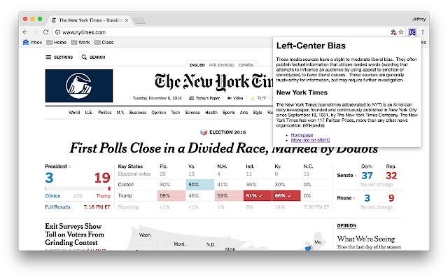
Technology and fact checking -
browser plug ins
Official Media Bias Fact Check Icon
This extension shows an icon denoting the political bias for the current page.
This extension will display a color-coded icon denoting the bias of the page you are currently viewing, according to Media Bias/Fact Check. You can click the icon to read more notes about the site, or visit MBFC for more details.
Chrome.google.com. 2019. Official Media Bias Fact Check Icon. [online] Available at: <https://chrome.google.com/webstore/detail/official-media-bias-fact/hdcpibgmmcnpjmmenengjgkkfohahegk> [Accessed 28 September 2021].

Slide 15
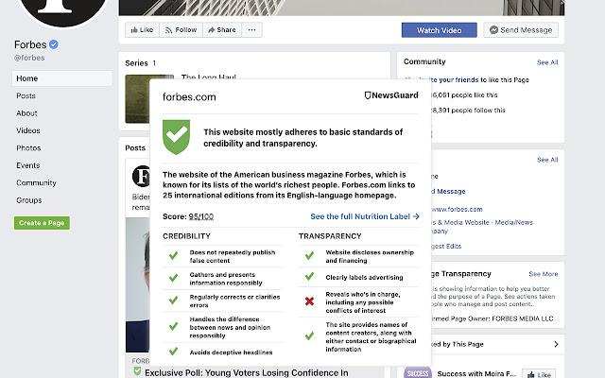
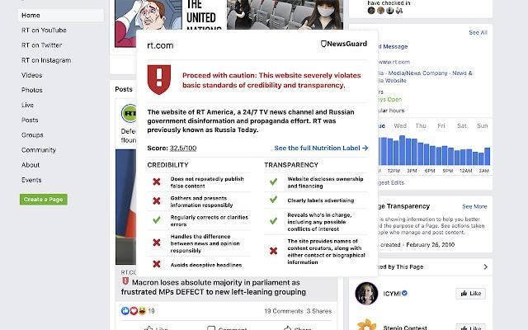
Technology and fact checking -
browser plug ins
News Guard
NewsGuard uses journalism to fight unreliable news. Their trained analysts, who are experienced journalists, research online news brands to help readers and viewers know which ones are trustworthy--and which ones aren't.
The Green-Red ratings signal if a website is trying to get it right or instead has a hidden agenda or knowingly publishes falsehoods or propaganda, giving readers more context about their news online.
Chrome.google.com. 2021. NewsGuard. [online] Available at: <https://chrome.google.com/webstore/detail/newsguard/hcgajcpgaalgpeholhdooeddllhedegi?hl=no&brand=CHMB> [Accessed 28 September 2021].

Slide 16
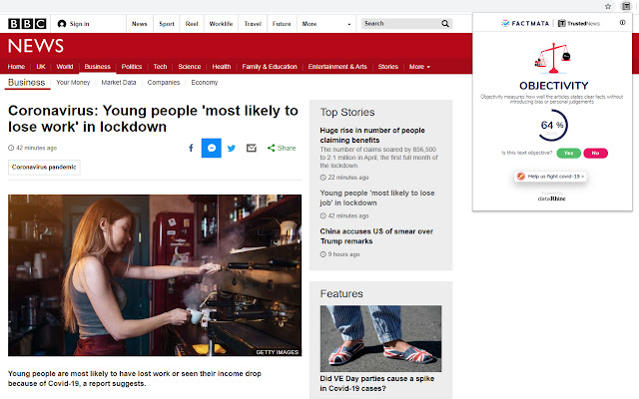
Technology and fact checking -
browser plug ins
Trusted News
Trusted News uses AI to assist newsreaders in evaluating the quality of the online content they read.
In its first release, it scores the objectivity for a selected article, testing whether it is written from a neutral perspective as opposed to a personal one. For example, phrases like "in my opinion" or "I think" are used by authors to reflect their individual thoughts, beliefs, and attitudes.
Chrome.google.com. 2021. Trusted News. [online] Available at: <https://chrome.google.com/webstore/detail/trusted-news/nkkghpncidknplmlkgemdoekpckjmlok?hl=en> [Accessed 28 September 2021].

Slide 17
Activity
Testing the technology
Group activity
I. Choose a fake news topic.
II. Choose a fact-checking online tool.
-Download it and test it by searching for articles related to the fake news topic.
How do you feel about the tool? Was it helpful?
What could be better about its performance?

Slide 18
Literature
Aldwairi, M. and Alwahedi, A., 2018. Detecting Fake News in Social Media Networks. Procedia Computer Science, [online] 141, pp.215-222. Available at: <https://www.sciencedirect.com/science/article/pii/S1877050918318210> [Accessed 28 September 2021].
Collins, B., Hoang, D., Nguyen, N. and Hwang, D., 2021. Trends in combating fake news on social media – a survey. Journal of Information and Telecommunication, [online] 5(2). Available at: <https://www.tandfonline.com/doi/full/10.1080/24751839.2020.1847379> [Accessed 28 September 2021].
Lamprou,Evangelos, Nikos Antonopoulos, Iouliani Anomeritou, and Chrysoula Apostolou. 2021. Characteristics of Fake News and Misinformation in Greece: The Rise of New Crowdsourcing-Based Journalistic Fact-Checking Models. Journalism and Media2: 417–439. https://doi.org/ 10.3390/journalmedia2030025
Tools, M., 2021. How to Spot Real and Fake News: Critically Appraising Information. [online] Mindtools.com. Available at: <https://www.mindtools.com/pages/article/fake-news.htm> [Accessed 28 September 2021].

