Slide 1
Migration (2/3)
Facts, Representations, Stories

Slide 2
Overview
Facts and Figures
Representations of Migration
Migration Stories and Experiences

Slide 3
Representations of Migration
2

Slide 4
Intracorporate transferee
Internally displaced person
Expat
Migrant worker
Economic migrant
Illegal immigrant
Emigrant
Low skilled migrant worker
Immigrant
Guest worker
Highly skilled migrant worker
Refugee
International student
Internal migrant
Second generation migrant
Long-term Migrant
Unaccompanied minor
Itinerant worker
Permanent Resident
International civil servant
Asylum seeker
Undocumented migrant
International migrant
Notes:
Do you know these categories/definitions?
What do you notice about them? Is there anything that strikes you?
What differentiates/unites them? (please note that many of them are interrelated with racial and class categories)
How would you imagine them?
Why do you think there are so many different categories?
Can one person be categorised in different ways at the same time? Or can they change these categorisations through time?
How do these different terms/concepts come about? Think of:
Laws and policies
Political discourses
Media representation
Source: https://publications.iom.int/system/files/pdf/iml_34_glossary.pdf

Slide 5
Do you know these categories/definitions?
What do you notice about them? Is there anything that strikes you?
What differentiates/unites them? (please note that many of them are interrelated with racial and class categories)
How would you imagine them?
Why do you think there are so many different categories?
Can one person be categorised in different ways at the same time? Or can they change these categorisations through time?
How do these different terms/concepts come about? Think of laws and policies, political discourses, media representation

Slide 6
Laws and policies
Read through the excerpt from De Genova (2004),
provided under annex “ Laws and policies”
What is illegality?
Does the situation described happen in Europe as well?
As a follow-up exercise: look at the RESPOND project or the AIDA database that analyse legal country situations:
https://respondmigration.com/
https://asylumineurope.org/
Notes:
De Genova, N. (2004) The Legal Production of Mexican/Migrant ‘Illegality’, Latino Studies 2(2), pp. 160-185. doi: 10.1057/palgrave.lst.8600085
What is illegality?
Does this happen in Europe as well?
As follow-up exercise: look at RESPOND project or AIDA database that analyse legal country situation
Websites:
https://respondmigration.com/
https://asylumineurope.org/

Slide 7
Laws and policies
Read about the case of Somali refugee Mohamad,
provided under annex “ Laws and policies”
How does this story make you feel?
Why do you think the judge has pronounced that sentence? What does this sentence imply?
How have EU policies affected migration movements to EU?
Notes:
How does this story make you feel?
Why do you think the judge has pronounced that sentence? What does this sentence imply?
How have EU Policies affected migration movements to EU?
Sources:
Borderline-Europe (2021a) Lesbos: Refugee faces two life sentences after surviving shipwreck and trying to save 33 lives, 11 May 2021, https://www.borderline-europe.de/unsere-arbeit/lesbos-gefl%C3%BCchtetem-droht-zweimal-lebensl%C3%A4nglich-haft-nachdem-er-bei-einem-schiffbruch?l=en, accessed 11 January 2022.
Borderline-Europe (2021b) Trial report – Lesbos: Mohamad H. sentenced to 142 years in prison, 17 May 2021, https://www.borderline-europe.de/unsere-arbeit/lesbos-mohamad-h-zu-146-jahren-haft-verurteilt?l=en, accessed 11 January 2022.

Slide 8
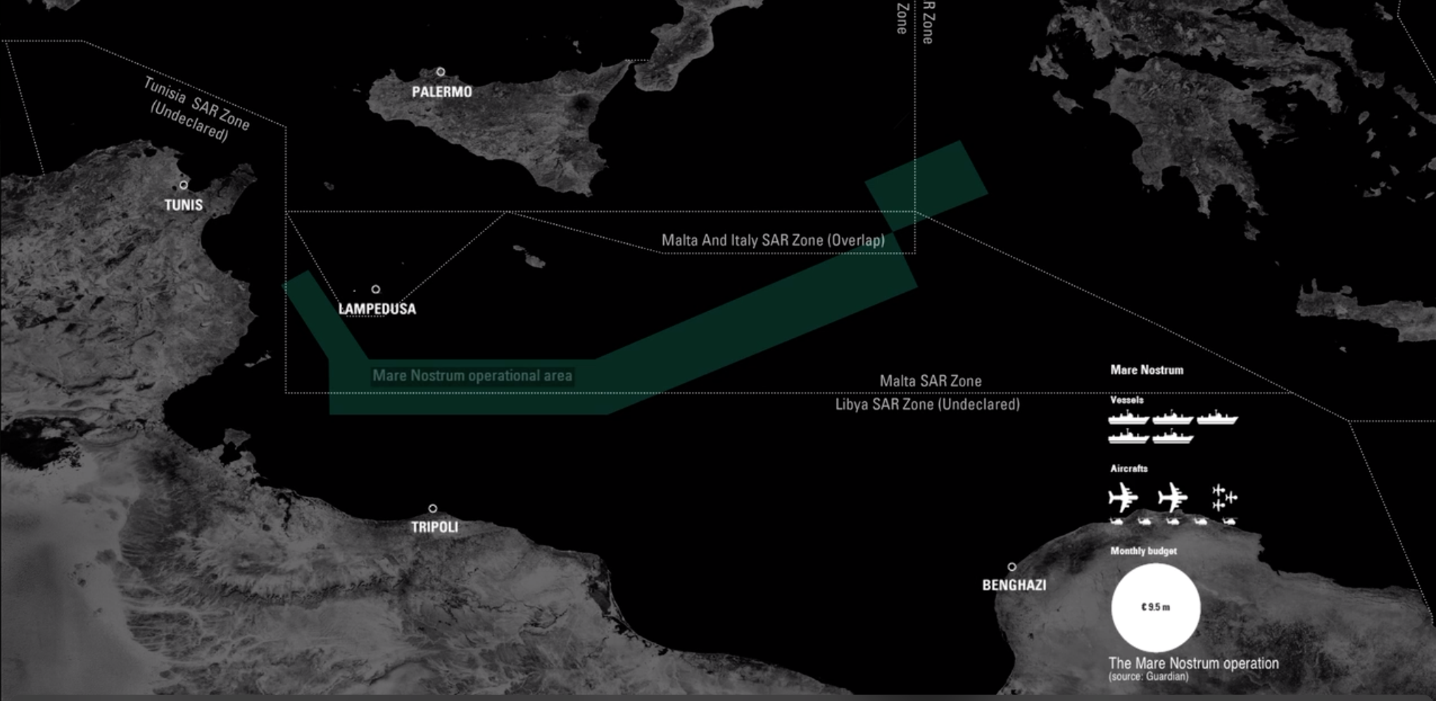
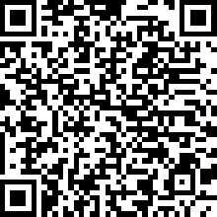
Laws and policies
Forensic Architecture: Death by rescue
How have EU policies affected migration movements to EU?
How have EU policies affected search and rescue operations?
Video:
https://bit.ly/3GgwlM7
Notes:
How have EU policies affected migration movements to EU?
How have EU policies affected search and rescue operations?
https://forensic-architecture.org/investigation/death-by-rescue-the-lethal-effects-of-non-assistance-at-sea

Slide 9
Political discourse
“Kein Migrant, der ILLEGAL nach Österreich gekommen ist, darf aufgenommen werden”
Translation: “No migrant that came to Austria ILLEGALLY can be hosted”
(statement issued by the Austrian politician Herbert Kickl of the Freedom Party via Facebook on 29 July 2020)
How does this connect to the idea of illegality seen before?
Notes:
Translation: “No migrant that came to Austria illegally can be hosted”
How does this connect to the idea of illegality seen before?
Source: Kickl, H. (2020) “Kein Migrant, der IILLEGAL nach Österreich gekommen ist, darf aufgenommen werden” [status update], Facebook, https://www.facebook.com/herbertkickl/photos/a.1989046974706936/2686414448303515/, accessed 11 January 2022.

Slide 10
Political discourse
“IMMIGRAZIONE: OBIETTIVO SBARCHI ZERO. L’ITALIA NON E’ IL CAMPO PROFUGHI D’EUROPA”
Translation: “IMMIGRATION: ZERO LANDINGS TARGET. ITALY IS NOT EUROPE’S REFUGEE CAMP”
(statement issued by the Italian party Movimento 5 Stelle via Facebook on 31 January 2018)
How does this connect to the idea of illegality seen before?
Notes:
Translation: “Immigration: zero landings target. Italy is not Europe’s refugee camp.”
How does this connect to the idea of illegality seen before?
Source: Movimento 5 Stelle Albenga (2018) “IMMIGRAZIONE: OBIETTIVO SBARCHI ZERO” [status update], Facebook, https://www.facebook.com/albengameetup/photos/pillolediprogrammam5s-immigrazioneimmigrazioneobiettivo-sbarchi-zerolitalia-non-/1389440871202375/, accessed 11 January 2022.

Slide 11
Political discourse
“WHAT TIER IS THE ENGLISH CHANNEL UNDER?
Nearly 10,000 illegal migrants have crossed the Channel in 2020”
(statement issued by the British UKIP via Twitter on 22 December 2020)
How does this connect to the idea of illegality seen before?
Notes:
How does this connect to the idea of illegality seen before?
Source: UKIP (2020): “Whilst we’re all being locked away, illegal migrants continue to flood through the Channel at an alarming rate” [tweet], https://twitter.com/UKIP/status/1341370457451352064/photo/1, accessed 11 January 2022.

Slide 12
Political discourse
“Offene Grenzen nach innen und sichere Grenzen nach außen.
Für Deutschlands Zukunft.
Unser Europe bietet Freiheit und Sicherheit”
Translation: “Open internal borders and safe external borders. For the future of Germany. Our Europe offers freedom and security”
(statement issued by the German CDU party via Twitter on 30 April 2019)
How does this connect to the idea of illegality seen before?
Notes:
Translation: “Open internal borders and safe external borders. For the future of Germany. Our Europe offers freedom and security”
Source: CDU (2019): “Offene Grenzen nach innen und sichere Grenzen nach außen” [tweet], https://twitter.com/cdu/status/1123119794578972672?lang=en, accessed 11 January 2022.

Slide 13
Political discourse
“Mineurs isolés étrangers / Coût de l’A.M.E. / infiltration des terroristes / Enrichissement des mafias / Détournement du droit d’asile / Nouvelle filière d’immigration illégale / Bidonville de Calais / Atteintes à l’identité / Problèmes sanitaires.
PROTÉGEONS LES FRANÇAIS! EXPULSONS LES CLANDESTINES”
Translation: “Isolated unaccompanied minors / cost for the State Medical Aid / Terrorist infiltration / Enrichment of mafias / misappropriation of the right of asylum / new source of illegal immigration / Calais slums / attack to the identity / Health problems. Let’s protect the French people. Let’s expel clandestines”
(statement issued by the French Front National party via Twitter on 18 May 2018)
How does this connect to the idea of illegality seen before?
Notes:
Translation: “Isolated unaccompanied minors / cost for the State Medical Aid / Terrorist infiltration / Enrichment of mafias / misappropriation of the right of asylum / new source of illegal immigration / Calais slums / attack to the identity / Health problems. Let’s protect the French people. Let’s expel clandestines”
How does this connect to the idea of illegality seen before?
Source: Rassemblement National 84 (2018) « Protégeons les Français ! Expulsons les clandestins ! » [tweet], https://twitter.com/RNvaucluse/status/997512165354557440/photo/1, accessed 11 January 2022.

Slide 14
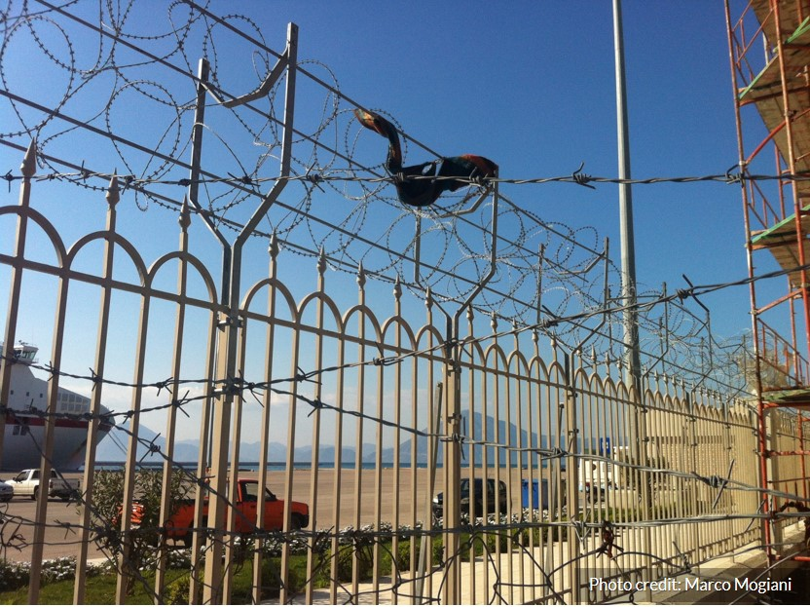
Media representation
Notes:
How do you feel about the images?
What are your first reactions when seeing the image?
What do you think the story is about?
How does this connect to the idea of illegality seen before?
Source: Image by Marco Mogiani

Slide 15
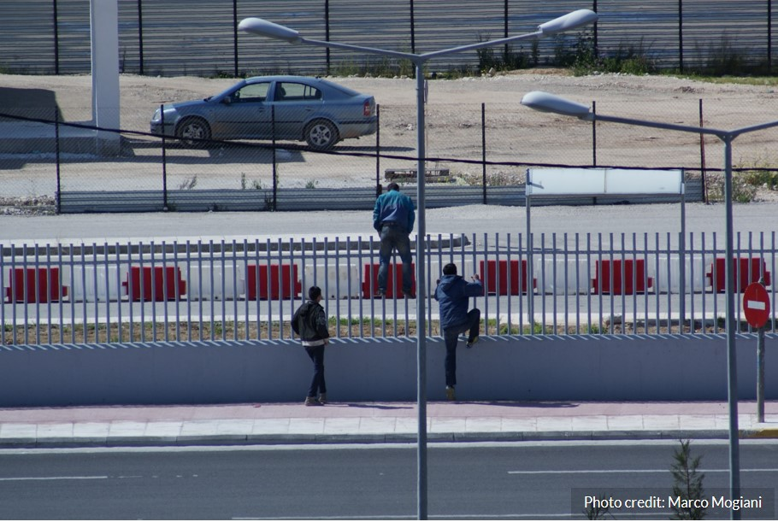
Media representation
Notes:
How do you feel about the images?
What are your first reactions when seeing the image?
What do you think the story is about?
How does this connect to the idea of illegality seen before?
Source: Image by Marco Mogiani

Slide 16
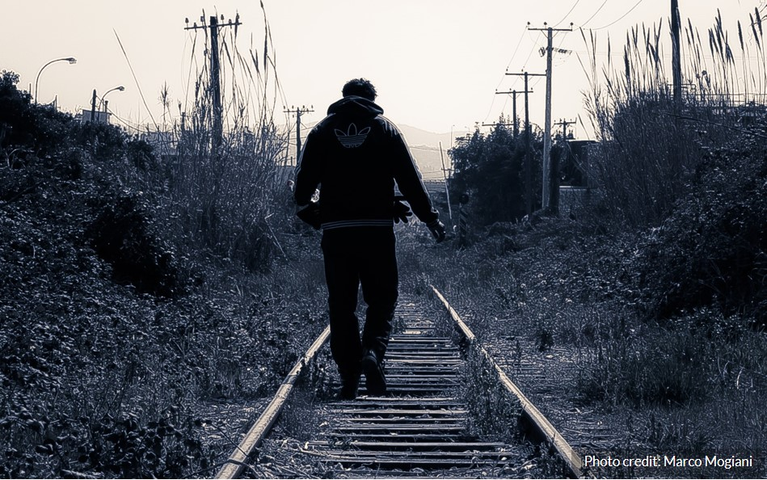
Media representation
Notes:
How do you feel about the images?
What are your first reactions when seeing the image?
What do you think the story is about?
Source: Image by Marco Mogiani

Slide 17
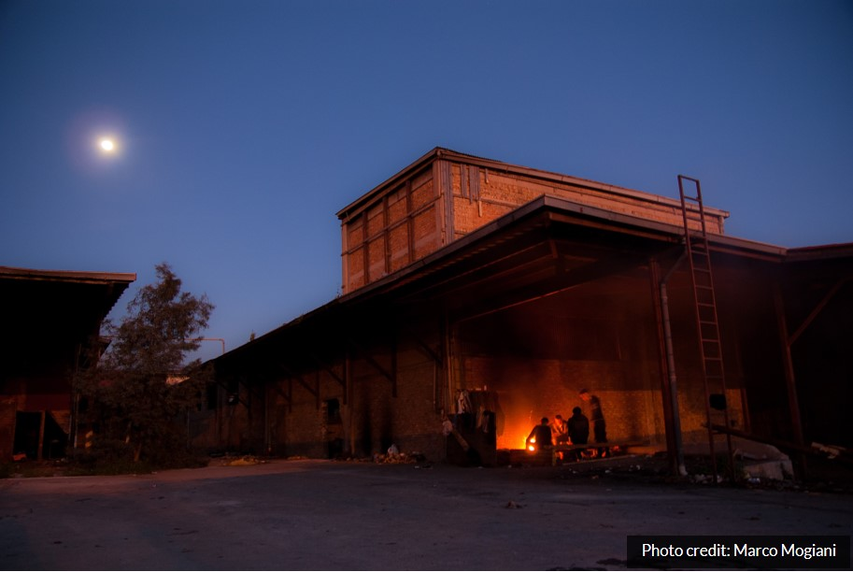
Media representation
Notes:
How do you feel about the images?
What are your first reactions when seeing the image?
What do you think the story is about?
Source: Image by Marco Mogiani

Slide 18
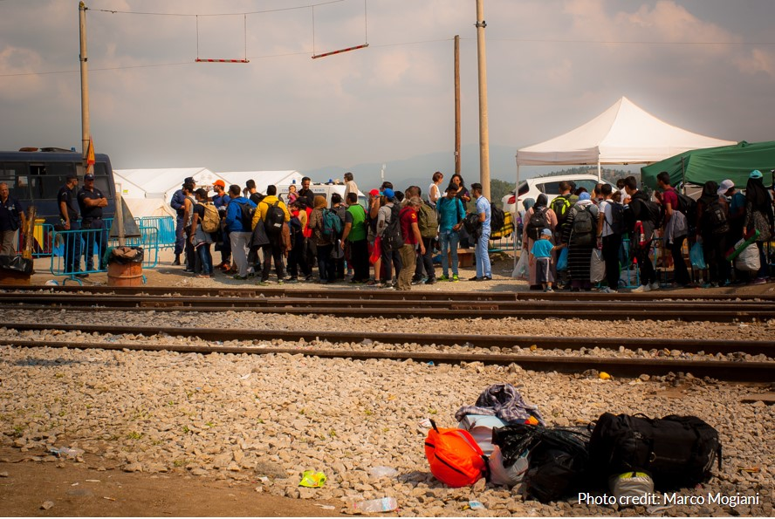
Media representation
Notes:
How do you feel about the images?
What are your first reactions when seeing the image?
What do you think the story is about?
How does this connect to the idea of illegality seen before?
Source: Image by Marco Mogiani
Story: the first four images are from fieldwork in Patras (Greece), where groups of migrants (with different legal statuses – see initial exercise) squat an abandoned industrial area in front of the new port. In the factories, migrants gather together to warm up or prepare food (slide 45), they use the disused railway line away from the main street to move easily around the area without being stopped by police (slide 44), and they always attempt to go inside the port area to sneak under lorries that will bring them to Italy (slides 42 and 43). In September 2015, when North Macedonia temporarily opened its borders to incoming migrants during the so-called “refugee crisis”, many migrants moved from Patras to the small village of Idomeni in northern Greece to continue their journey along the Balkan route (slide 46).

Slide 19
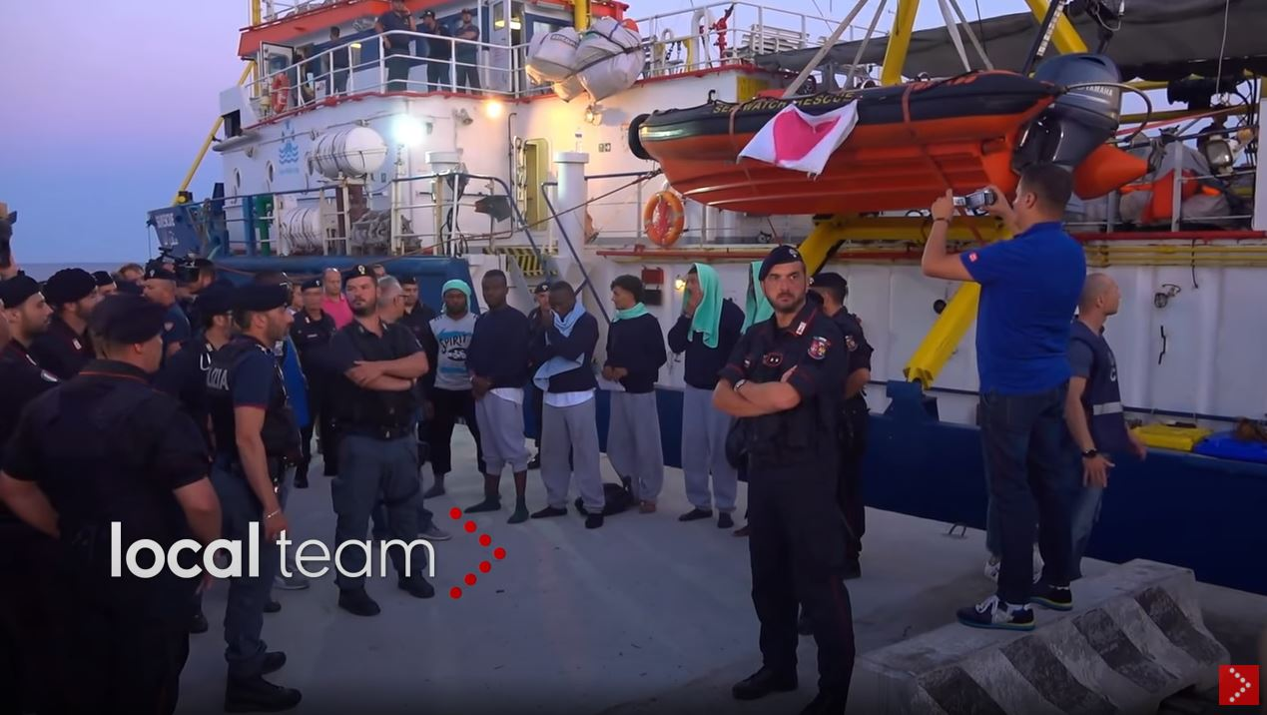
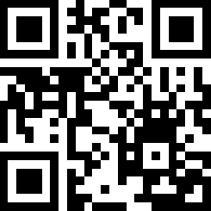
Media representation
Video:
https://youtu.be/9FJquPlVsRg
Notes:
Ask the class to read the ERUM report (chapter on main facts) on the Sea Watch case
Show this video in class
Divide the class in three groups and ask each of them to write a commentary/short article about the video
Each group should be appointed with a different writing style:
One group should focus on the inhumanity of the situation (migration plight, securitisation, etc.)
One group should express hostility towards migrants/migration and NGOs
One group should remain relatively neutral about the situation
When the commentaries are ready, one representative of each group should read them out loud in front of the class
The following debate can focus on following questions:
Was the activity easy/difficult? Why?
How can the same news be reported in different ways?
What does this tell us about information?
As a follow-up, some newspaper articles (from the ERUM report) can be read and discussed, to explore how the news is constructed
Source video: https://www.youtube.com/watch?v=9FJquPlVsRg
Source activity: https://www.unhcr.org/numbers-toolkit/NJN-MANUAL-EN.pdf

Slide 20
Media representation
Open the annex “media representation - examples” and read through the examples provided!
What are the dominant attitudes to migrants and migration in these articles?
What words or phrases do the writers use to heighten emotional impact? Circle/underline these words or phrases.
What impressions might these articles make on public opinion?
How can the same news be reported in different ways?
What does this tell us about information?
Notes:
Ask the class to read the following articles
Divide the class in three groups and ask each of them to focus on the following questions:
What are the dominant attitudes to migrants and migration in these articles?
What words or phrases do the writers use to heighten emotional impact? Circle/underline these words or phrases.
What impressions might these articles make on public opinion?
How can the same news be reported in different ways?
What does this tell us about information?
Source activity: House of European History: Borders and Bridges – Migration, resource 12, https://historia-europa.ep.eu/sites/default/files/Discover/EducatorsTeachers/ActivitiesForYourClassroom/migr-resource-12-en_0.pdf, accessed 11 January 2022.
Photo: https://www.pexels.com/de-de/foto/holz-schreiben-luxus-geschaft-5010877/

Slide 21
Literature and other sources
Borderline-Europe (2021a) Lesbos: Refugee faces two life sentences after surviving shipwreck and trying to save 33 lives, 11 May 2021, https://www.borderline-europe.de/unsere-arbeit/lesbos-gefl%C3%BCchtetem-droht-zweimal-lebensl%C3%A4nglich-haft-nachdem-er-bei-einem-schiffbruch?l=en , accessed 11 January 2022.
Borderline-Europe (2021b) Trial report – Lesbos: Mohamad H. sentenced to 142 years in prison, 17 May 2021, https://www.borderline-europe.de/unsere-arbeit/lesbos-mohamad-h-zu-146-jahren-haft-verurteilt?l=en , accessed 11 January 2022.
CDU (2019): “Offene Grenzen nach innen und sichere Grenzen nach außen” [tweet], https://twitter.com/cdu/status/1123119794578972672?lang=en, accessed 11 January 2022.
De Genova, N. (2004) The Legal Production of Mexican/Migrant ‘Illegality’, Latino Studies 2(2), pp. 160-185. doi: 10.1057/palgrave.lst.8600085
House of European History: Borders and Bridges – Migration, resource 12, https://historia-europa.ep.eu/sites/default/files/Discover/EducatorsTeachers/ActivitiesForYourClassroom/migr-resource-12-en_0.pdf , accessed 11 January 2022.

Slide 22
Literature and other sources
Kickl, H. (2020) “Kein Migrant, der IILLEGAL nach Österreich gekommen ist, darf aufgenommen werden” [status update], Facebook, https://www.facebook.com/herbertkickl/photos/a.1989046974706936/2686414448303515/ , accessed 11 January 2022.
Movimento 5 Stelle Albenga (2018) “IMMIGRAZIONE: OBIETTIVO SBARCHI ZERO” [status update], Facebook, https://www.facebook.com/albengameetup/photos/pillolediprogrammam5s-immigrazioneimmigrazioneobiettivo-sbarchi-zerolitalia-non-/1389440871202375/ , accessed 11 January 2022.
Rassemblement National 84 (2018) « Protégeons les Français ! Expulsons les clandestins ! » [tweet], https://twitter.com/RNvaucluse/status/997512165354557440/photo/1 , accessed 11 January 2022.
UKIP (2020): “Whilst we’re all being locked away, illegal migrants continue to flood through the Channel at an alarming rate” [tweet], https://twitter.com/UKIP/status/1341370457451352064/photo/1 , accessed 11 January 2022.

