Slide 1
FROM SCIENCE TO FREEDOM OF SPEECH (4/6)
Addressing Controversial Issues in the Classroom

Slide 2
Overview
Science and its Role in Relation to Controversial Issues and Models of Science Communication
Scientific Literacy
Refined Models of Scientific Literacy and Opinion formation
Controversial Issues I
Controversial Issues II
Key Take-aways for the Classroom

Slide 3
Controversial Issues I
4

Slide 4
Controversial Issues
crop up everywhere in everyday life (school, work, family, friends, ….)
dealing with them brings some challenges
identification of controversial topics in different areas of life
development of ways to deal with them
look at the question what makes a topic controversial, why it evokes strong emotions and sometimes leads to conflicts
equip the students with strategies how to deal with controversial topics and generate conflict solutions

Slide 5
Definition
“It is generally understood that there is no one simple response to the challenges associated with the teaching of controversial issues. Thus, for example, Stradling (1984) says:
‘It simply is not possible to lay down hard-and-fast rules about teaching controversial subjectmatter to be applied at all times. The teacher has to take account of the knowledge, values and experiences which the students bring with them into the classroom; the teaching methods which predominate in other lessons; the classroom climate … and the age and ability of the students’. (1984: 11)
Since different circumstances in the classroom require different methods and strategies and there is no guarantee that a strategy which works with one set of students will necessarily work with another group, what is needed, it is argued, is sensitivity to context and flexibility of response.”
(Council of Europe 2015, p. 18)

Slide 6
Brainstorming: Controversial Topics
Collect controversial topics in groups of 4 to 5 people and write them down on posters / a whiteboard
→ Present the posters/whiteboards to the rest of the group
→ Clarify open questions
Vaccinations
Climate Change
...
Notes:
Group 1: Controversial topics in class/school? (In which subjects, on which topics are there differences of opinion, are topics discussed controversially?)
Group 2: Controversial topics in society / politics? (On which topics are there disagreements and controversies in society / politics?)
Group 3: Controversial topics in the social environment? (Which topics cause heated discussions or controversies among friends, parents, neighbors, etc.?)
Group 4: Controversial topics among young people? (Which topics cause differences of opinion, discussions or controversies in different youth cultures, peer groups or youth organizations?)

Slide 7
Hot or cold topics?
Color 1: This topic arouses a lot of emotions in me!
Color 2: This topic evokes strong emotions in others, but not so much in me!
Color 3: This topic doesn't affect me (and most other people) emotionally!
You will get 9 points (3 each in 3 different colors) to vote for the hottest/coldest topics
Award the 9 points individually, distribute them over all 4 posters
Cold
Hot
Notes:
each student gets 9 points (3 each in 3 different colors) (either stickers or the points can also be painted with different colors on the posters)

Slide 8
Hot of cold topics II
Argument
What makes the topic controversial?
Which factors influence the perception of this topic?
Why does the topic evoke so much emotion?
What are the different positions on the topic?
What are the positions of the other participants in the discussion in each small group?
Which positions are discriminatory towards affected groups of people?
Dissent
Controversy
Debate
Notes:
Form small groups around the hottest controversial topics and discuss the questions on the slide
This is followed by a presentation of the small group discussion. The most important factors that influence a topic, make it controversial and evoke emotions are collected on a poster.

Slide 9
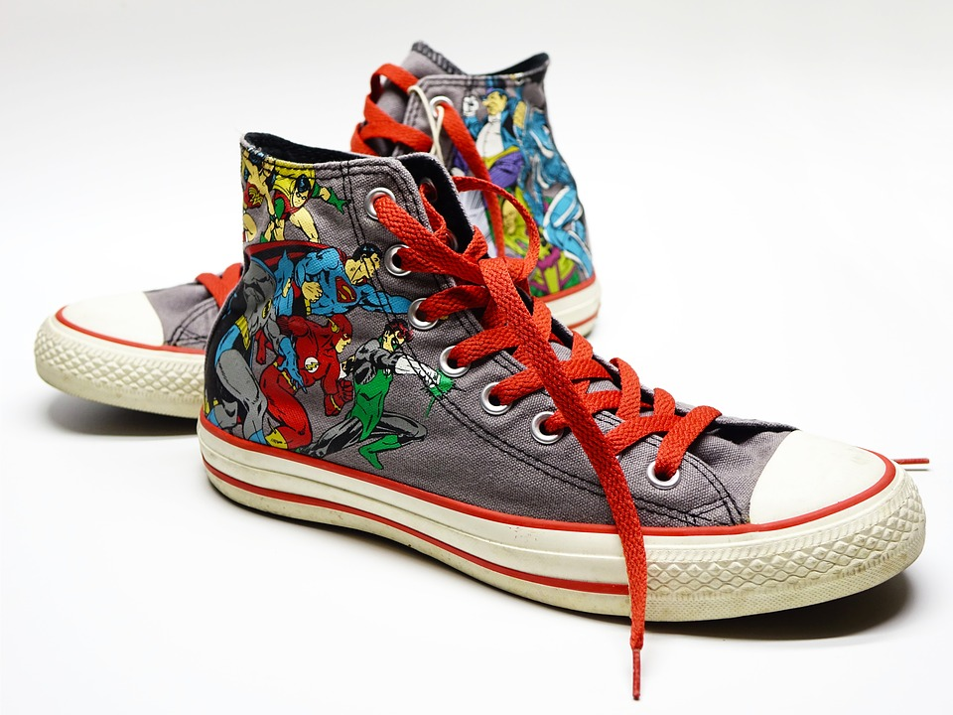
Change of perspective:
Slip into another's shoe
Select a controversial topic
draw an imprint of a shoe / foot, cut it out and write a few catchwords for a given fictional position related to the hot topic (e.g. conservative, liberal, experts, opponents …) on the cutout
mix the shoes/feet are mixed and pick a cutout and "step into the other person's shoe"
take on your new role and discuss the controversial topic according to your new position
Notes:
https://pixabay.com/de/photos/schuhe-turnschuhe-converse-1433925/

Slide 10
DISCUSSION
On which arguments is there consensus in the discussion? On which arguments is there dissent?
Which arguments could reach a compromise?
In which aspects would approximations be important?
Is there a need for a compromise or can contradictions remain?
Which strategies could be used to reach a compromise or consensus?
In which cases it won’t be able to reach consensus? In which cases dissent or disagreement would be okay?
How could a consensus / compromise be found?
Notes:
https://pixabay.com/de/illustrations/puzzle-zusammenarbeit-gemeinsam-1020413/
https://pixabay.com/de/illustrations/puzzle-zusammenarbeit-gemeinsam-1020408/

Slide 11
Literature
Council of Europe (2015) Living with Controversy. Teaching Controversial Issues through Education for Democratic Citizenship and Human Rights (EDC/HRE). Training Pack for Teachers, http://www.demokratiezentrum.org/fileadmin/media/pdf/Materialien/Teaching_Controversial_issues_-_professional_development_pack_for_teachers_EN.pdf , accessed 13 October 2021.

