Slide 1
The Psychology behind Fake News & Applying the methodology and mechanisms to detect Fake News

Slide 2
Overview
The Psychology behind Fake News
Activity: Fact or Fake?
Trust in Media Statistics 2021
Activities: Can you build a fake news empire? & Reverse Theory - Create Fake News

Slide 3
2
Activity: Fact or Fake?

Slide 4
Activity: Fact or Fake?
Group activity
- You will be given 4 topics - one at a time
- In your group you will have 5min to research about the topic in order to distinguish whether it’s fact or fake.
- You should use one or more “fake news detection methods” as explained in the previous module.
- Take notes of your research steps and how you’ve distinguished between fact and fake.
- Discuss in plenum

Slide 5
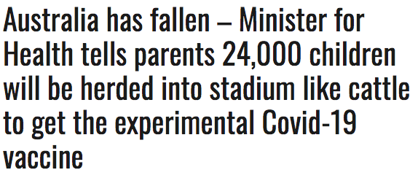
Activity: Fact or Fake?
Are the articles below fake news?
MacGuill, D., 2021. No, Australian Officials Did Not Say They Would 'Seize' and Forcibly Vaccinate 24K Kids. [online] Snopes.com. Available at: <https://www.snopes.com/fact-check/australia-forced-vaccination-stadium/> [Accessed 4 October 2021].

Slide 6
Activity: Fact or Fake?
FAKE
In August 2021, government officials in the state of New South Wales (NSW) announced that, in addition to adults of most age brackets, high school students aged between 16 and 18 would soon be invited to get their first dose of the Pfizer vaccine at the Qudos Arena (also known as the Super Dome) in the state capital of Sydney.
Mindful that high school students are expected to sit the Higher School Certificate (HSC) exams in October, officials in the state urged that cohort of students to get vaccinated in order to facilitate the smooth running of the exams, and prevent further outbreaks.
The story was posted to Twitter without any context, forming the basis of the subsequent online articles. What those articles did not made clear was that: the mass vaccination was voluntary, not forced; the “children” in question were aged 16-18, effectively young adults; they were invited to come to the stadium, not “seized.”
MacGuill, D., 2021. No, Australian Officials Did Not Say They Would 'Seize' and Forcibly Vaccinate 24K Kids. [online] Snopes.com. Available at: <https://www.snopes.com/fact-check/australia-forced-vaccination-stadium/> [Accessed 4 October 2021].

Slide 7
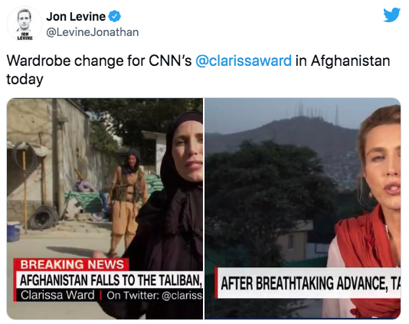
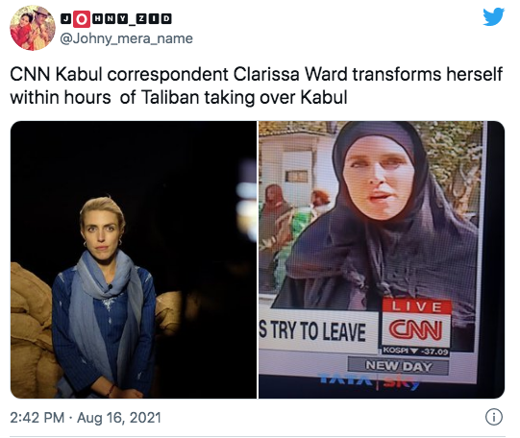
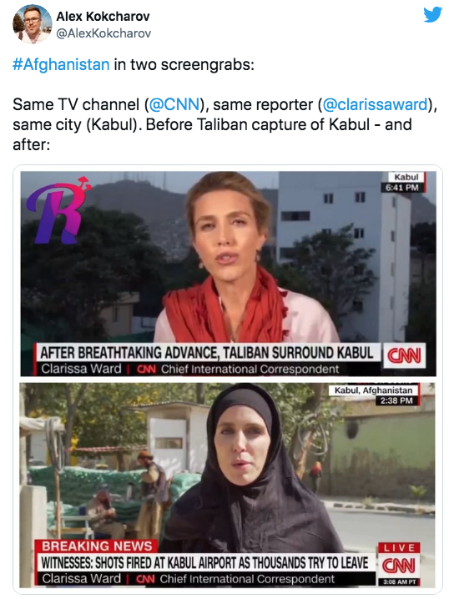
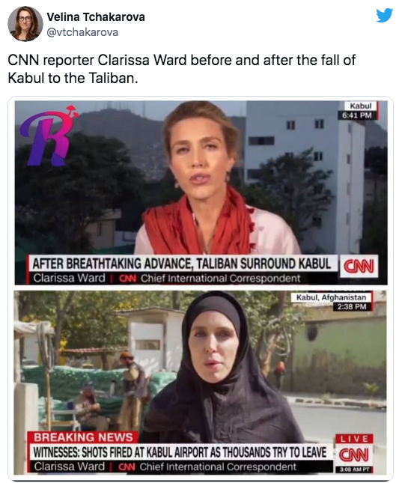
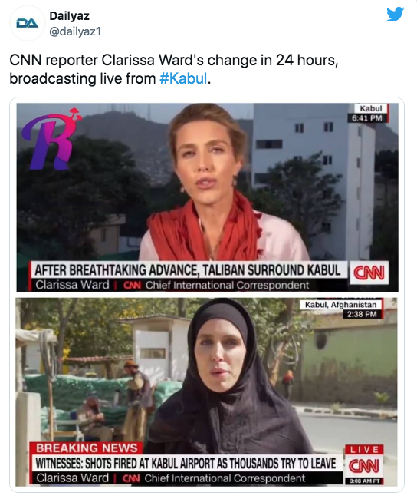
Activity: Fact or Fake?
Are these claims fake news?
Evon, D., 2021. Is This Journalism Before and After Taliban Takeover?. [online] Snopes. Available at: <https://www.snopes.com/fact-check/journalism-taliban-takeover/> [Accessed 4 October 2021].

Slide 8
Activity: Fact or Fake?
MIXTURE
These images show a single example and are not necessarily indicative of how all women reporters dressed before and after the Taliban seized power. Furthermore, Ward explained on Twitter that the "before" image showed her in a private area, and that she had regularly worn a head scarf while in public in Afghanistan. However, Ward acknowledged that she decided to wear an abaya (a full-length outer garment) and cover her hair after the Taliban takeover in August 2021.
Evon, D., 2021. Is This Journalism Before and After Taliban Takeover?. [online] Snopes. Available at: <https://www.snopes.com/fact-check/journalism-taliban-takeover/> [Accessed 4 October 2021].

Slide 9
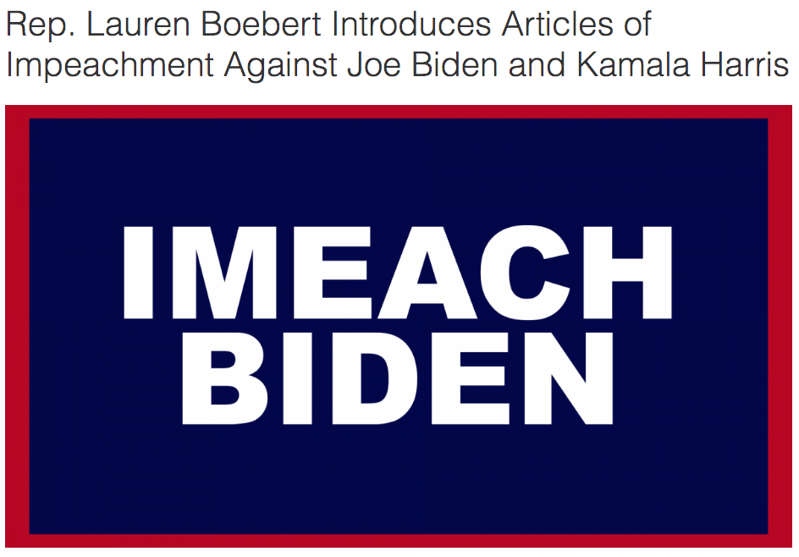
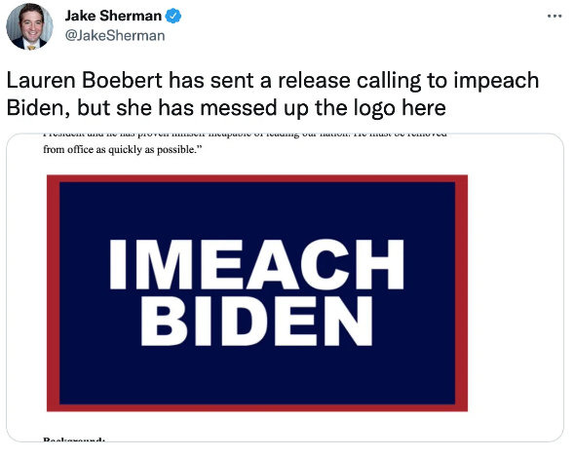
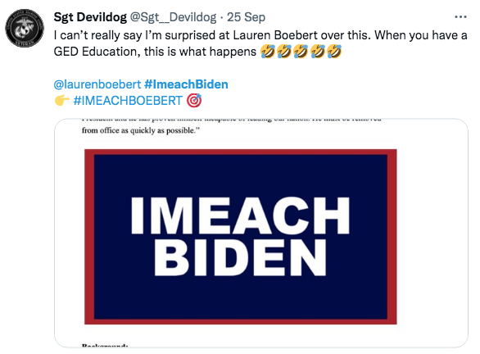
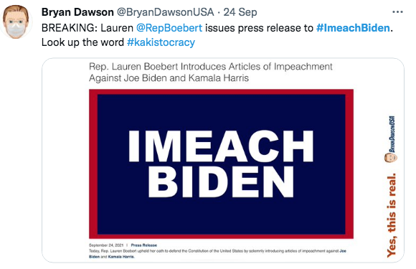
Activity: Fact or Fake?
Fact or Fake?
MacGuill, D., 2021. Yes, Lauren Boebert Called for Biden's Impeachment With the Slogan 'Imeach Biden'. [online] Snopes.com. Available at: <https://www.snopes.com/fact-check/lauren-boebert-imeach-biden/> [Accessed 4 October 2021].

Slide 10
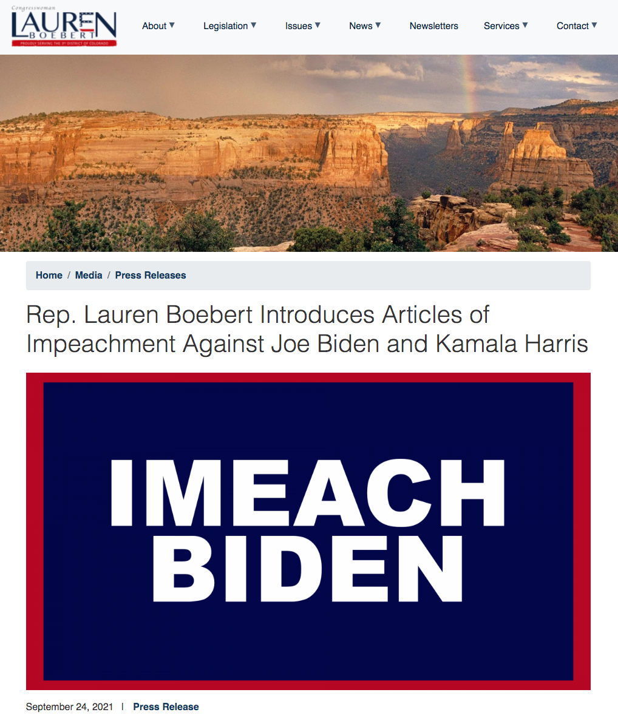
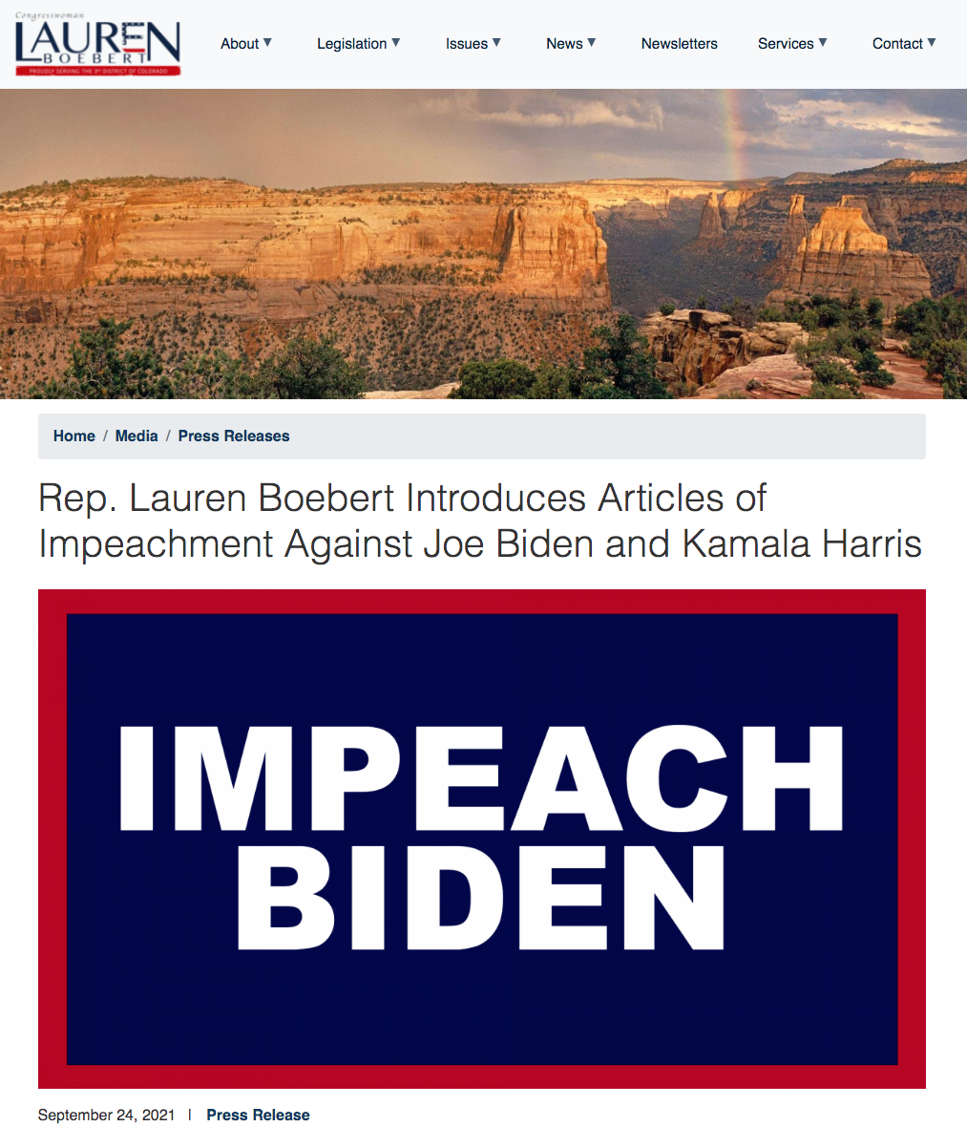
Activity: Fact or Fake?
FACT
On the afternoon of Sept. 24, Boebert issued a news release in which she announced she had prepared articles of impeachment against both Biden and Harris. That announcement contained exactly the misspelled logo shared on social media by Sherman and many others, and by later on that afternoon, #IMEACHBIDEN was a trending topic on Twitter.
A second version of the announcement, with the spelling of the word “impeach” corrected, was quickly issued.
MacGuill, D., 2021. Yes, Lauren Boebert Called for Biden's Impeachment With the Slogan 'Imeach Biden'. [online] Snopes.com. Available at: <https://www.snopes.com/fact-check/lauren-boebert-imeach-biden/> [Accessed 4 October 2021].

Slide 11
Activity: Fact or Fake?
Are these headlines Fact or Fake?
Kasprak, A., 2017. Did Bill Gates 'Admit' Vaccinations Are Designed So Governments Can 'Depopulate' the World?. [online] Snopes. Available at: <https://www.snopes.com/fact-check/bill-gates-vaccinations-depopulation/> [Accessed 4 October 2021].

Slide 12
Activity: Fact or Fake?
FAKE
CNN interview:
Dr. Sanjay Gupta: Ten billion dollars over the next 10 years to make it “the year of the vaccines.” What does that mean exactly?
Bill Gates: Over this decade, we believe unbelievable progress can be made, in both inventing new vaccines and making sure they get out to all the children who need them … We only need about six or seven more — and then you would have all the tools to reduce childhood death, reduce population growth, and everything — the stability, the environment — benefits from that.
In society after society, he saw, when the mortality rate falls—specifically, below 10 deaths per 1,000 people—the birth rate follows, and population growth stabilizes. “It goes against common sense,” Gates says.
Kasprak, A., 2017. Did Bill Gates 'Admit' Vaccinations Are Designed So Governments Can 'Depopulate' the World?. [online] Snopes. Available at: <https://www.snopes.com/fact-check/bill-gates-vaccinations-depopulation/> [Accessed 4 October 2021].

Slide 13
Literature
Evon, D., 2021. Is This Journalism Before and After Taliban Takeover?. [online] Snopes. Available at: <https://www.snopes.com/fact-check/journalism-taliban-takeover/> [Accessed 4 October 2021].
Kasprak, A., 2017. Did Bill Gates 'Admit' Vaccinations Are Designed So Governments Can 'Depopulate' the World?. [online] Snopes. Available at: <https://www.snopes.com/fact-check/bill-gates-vaccinations-depopulation/> [Accessed 4 October 2021].
MacGuill, D., 2021. Yes, Lauren Boebert Called for Biden's Impeachment With the Slogan 'Imeach Biden'. [online] Snopes. Available at: <https://www.snopes.com/fact-check/lauren-boebert-imeach-biden/> [Accessed 4 October 2021].
MacGuill, D., 2021. No, Australian Officials Did Not Say They Would 'Seize' and Forcibly Vaccinate 24K Kids. [online] Snopes. Available at: <https://www.snopes.com/fact-check/australia-forced-vaccination-stadium/> [Accessed 4 October 2021].

