Slide 1
The Psychology behind Fake News & Applying the methodology and mechanisms to detect Fake News

Slide 2
Overview
The Psychology behind Fake News
Activity: Fact or Fake?
Trust in Media Statistics 2021
Activities: Can you build a fake news empire? & Reverse Theory - Create Fake News

Slide 3
The Psychology behind Fake News
1

Slide 4
The Psychology Behind Fake News
Introduction
- We don’t fall for false news just because we’re dumb. Often it’s a matter of letting the wrong impulses take over.
- We don’t have time to read anything but headlines.
- In one of his experiments, MIT’s Rand illustrated the dark side of the fluency heuristic, our tendency to believe things we’ve been exposed to in the past. The study presented subjects with headlines–some false, some true–in a format identical to what users see on Facebook. Rand found that simply being exposed to fake news made people more likely to rate those stories as accurate later on in the experiment. If you’ve seen something before, “your brain subconsciously uses that as an indication that it’s true,” Rand says.
- One reason people knowingly share made-up news is to “call out” the stories as fake. That might make a post popular among like-minded peers on social media, but it can also help false claims sink into the collective consciousness.
Hills, T. and Menczer, F., 2020. Information Overload Helps Fake News Spread, and Social Media Knows It. [online] Scientific American. Available at: <https://www.scientificamerican.com/article/information-overload-helps-fake-news-spread-and-social-media-knows-it/> [Accessed 4 October 2021].

Slide 5
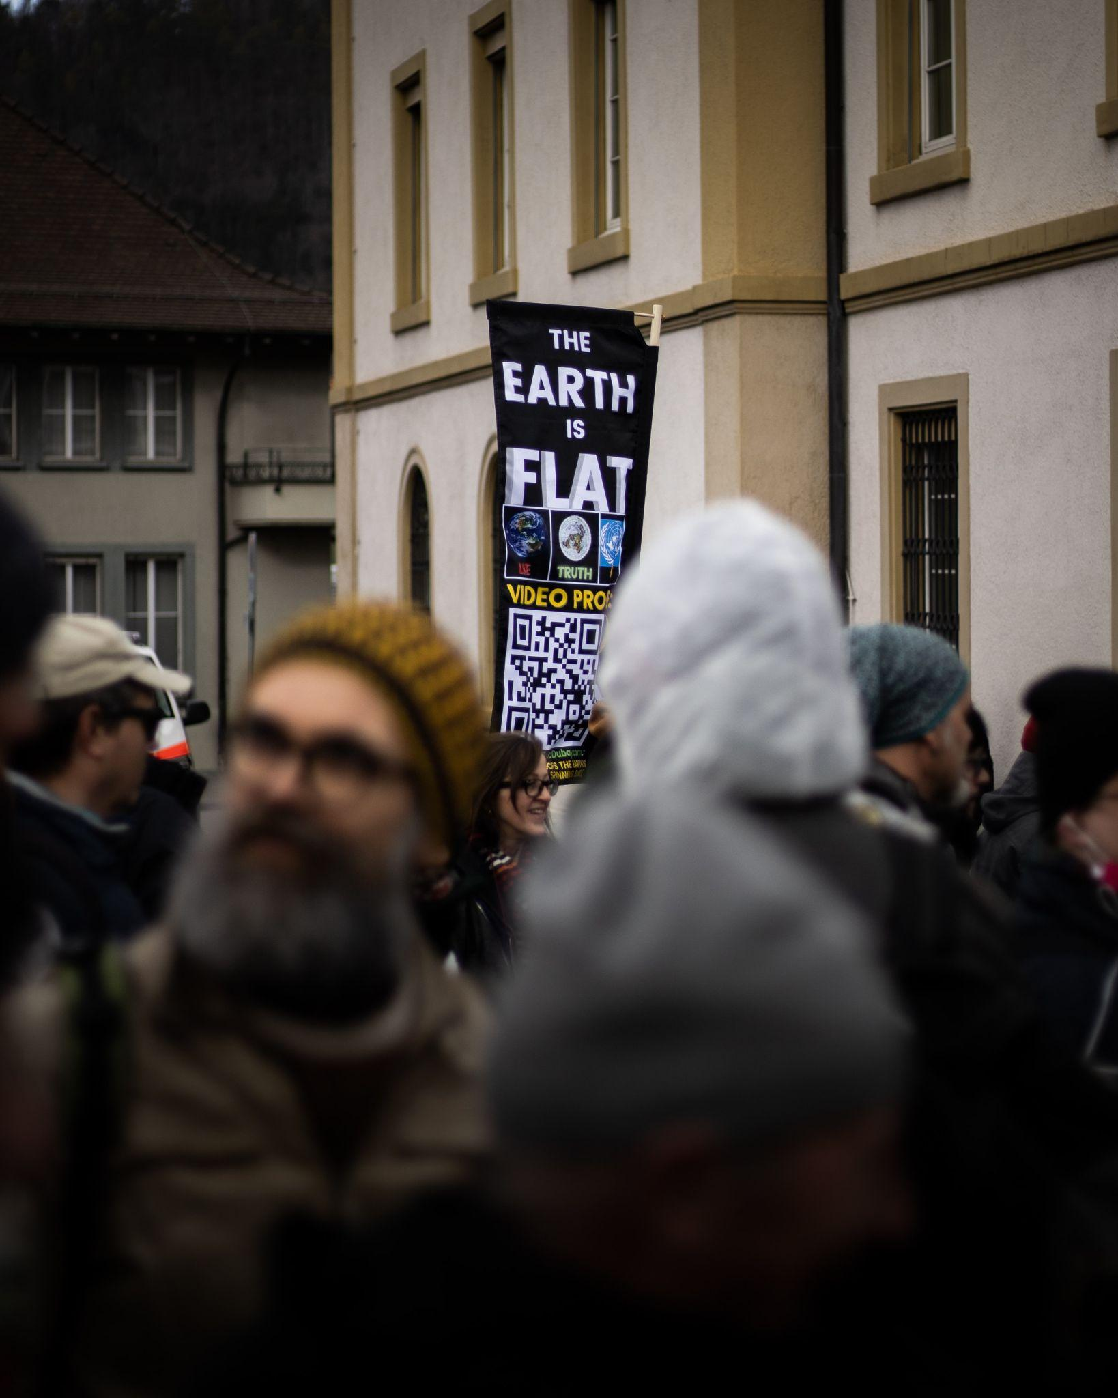
The Psychology Behind Fake News
Confirmation Bias
- Confirmation bias is our tendency to cherry-pick information that confirms our existing beliefs or ideas.
- Our use of this cognitive shortcut is understandable. Evaluating evidence (especially when it is complicated or unclear) requires a great deal of mental energy. Our brains prefer to take shortcuts.
- In “The Case for Motivated Reasoning,” Ziva Kunda wrote, “we give special weight to information that allows us to come to the conclusion we want to reach.” Accepting information that confirms our beliefs is easy and requires little mental energy. Contradicting information causes us to shy away, grasping for a reason to discard it.
Hills, T. and Menczer, F., 2020. Information Overload Helps Fake News Spread, and Social Media Knows It. [online] Scientific American. Available at: <https://www.scientificamerican.com/article/information-overload-helps-fake-news-spread-and-social-media-knows-it/> [Accessed 4 October 2021].

Slide 6
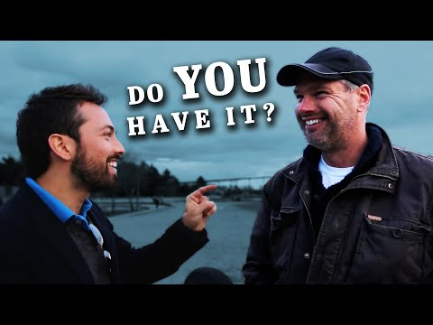
The Most Common Cognitive Bias. 2014. [video] http://www.youtube.com/watch?v=vKA4w2O61Xo: Veritasium.
Notes:
https://www.youtube.com/watch?v=vKA4w2O61Xo&feature=emb_title

Slide 7
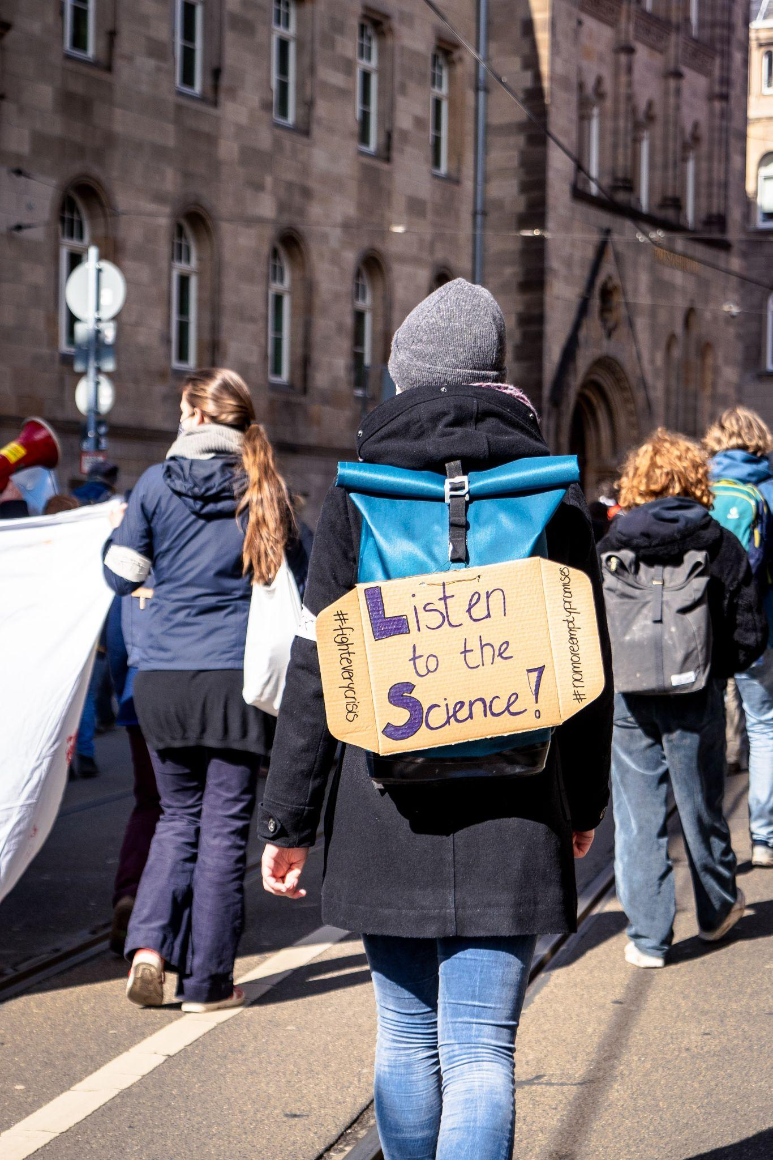
The Psychology Behind Fake News
Naive realism
- Tendency to believe that our perception of reality is the only accurate view, and that people who disagree with us are necessarily uninformed, irrational, or biased.
- Instead of disagreeing with our opponents, we discredit them.
- It is also why some are quick to label any report that challenges their worldview as fake.
- We’re all quick to believe what we’re motivated to believe, and we call too many things ‘fake news’ simply because it doesn’t support our own view of reality.
Pennycook, G. and Rand, D., 2021. The Psychology of Fake News. Trends in Cognitive Sciences, 25(5), pp.388-402.

Slide 8
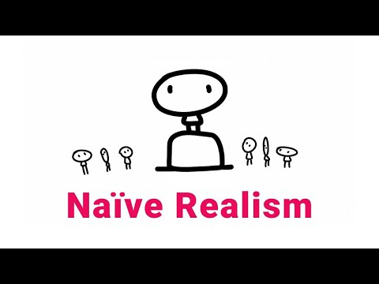
What is Naive Realism: From a Social Psychology Perspective. 2020. [video] http://www.youtube.com/watch?v=jqDZ-Hpdnck: Clarified Mind.
Notes:
https://www.youtube.com/watch?v=jqDZ-Hpdnck&t=1s

Slide 9
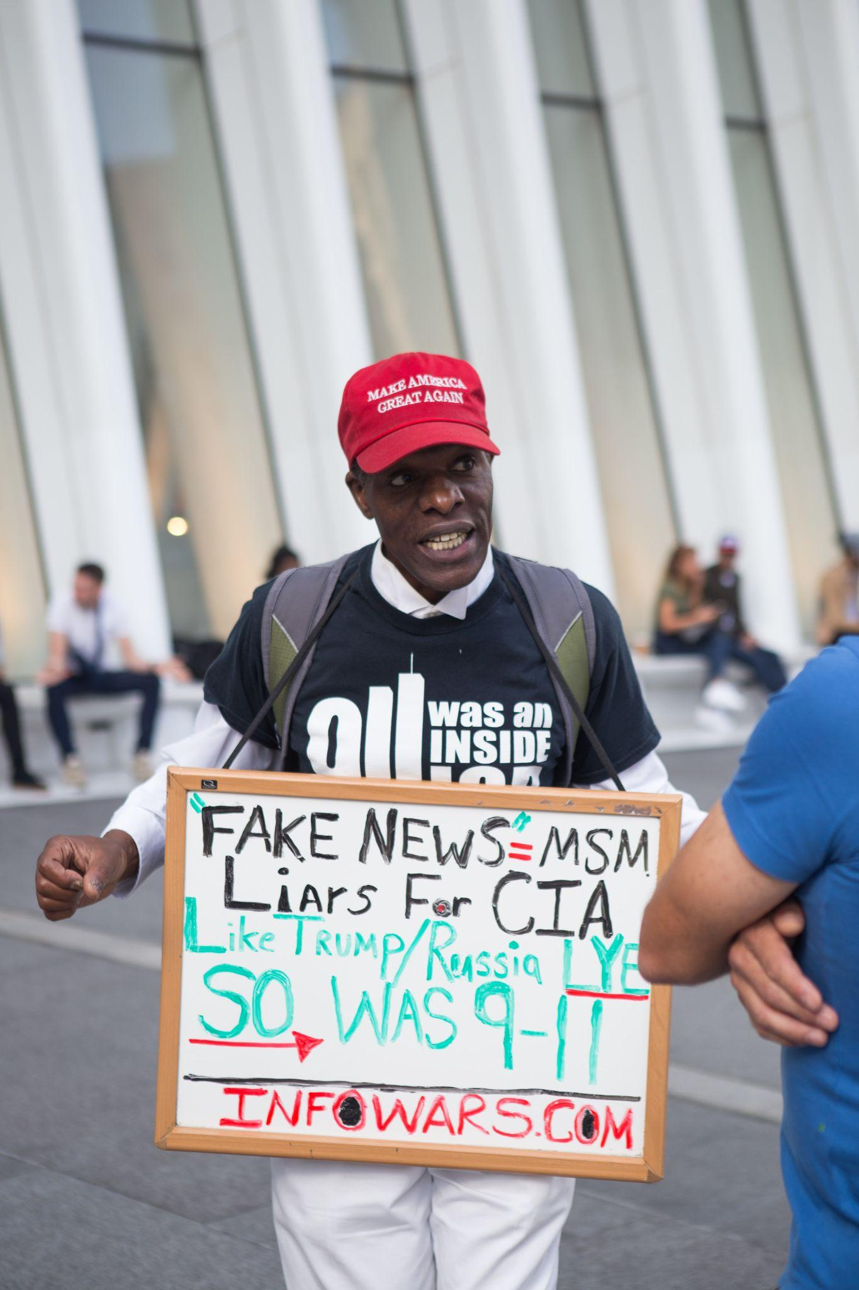
The Psychology Behind Fake News
Collective narcissism
- Collective narcissists are apt to look for imaginary enemies and adopt conspiracy explanations that blame them.This urge is particularly strong when narcissistic people fail, or members of their group fail.
- By singling out an adversary who has “qualities that represent your own culturally influenced view of evil,” people can gain a sense of control over what’s happening to them
- People may also defend the viewpoints of groups they belong to on an even more instinctual level. Humans evolved in groups that competed with one another, sculpting our minds to be wary of outsiders and loyal to our factions.
Hills, T. and Menczer, F., 2020. Information Overload Helps Fake News Spread, and Social Media Knows It. [online] Scientific American. Available at: <https://www.scientificamerican.com/article/information-overload-helps-fake-news-spread-and-social-media-knows-it/> [Accessed 4 October 2021].

Slide 10
The Psychology Behind Fake News
“Make America great again”
“Take back control”
These statements suggest that in the US and the UK, the unique position of the nation has somehow been undermined – and that somehow it needs to be restored.
Zavala, A., 2017. Welcome to the age of collective narcissism. [online] The Conversation. Available at: <https://theconversation.com/welcome-to-the-age-of-collective-narcissism-71196> [Accessed 4 October 2021].

Slide 11
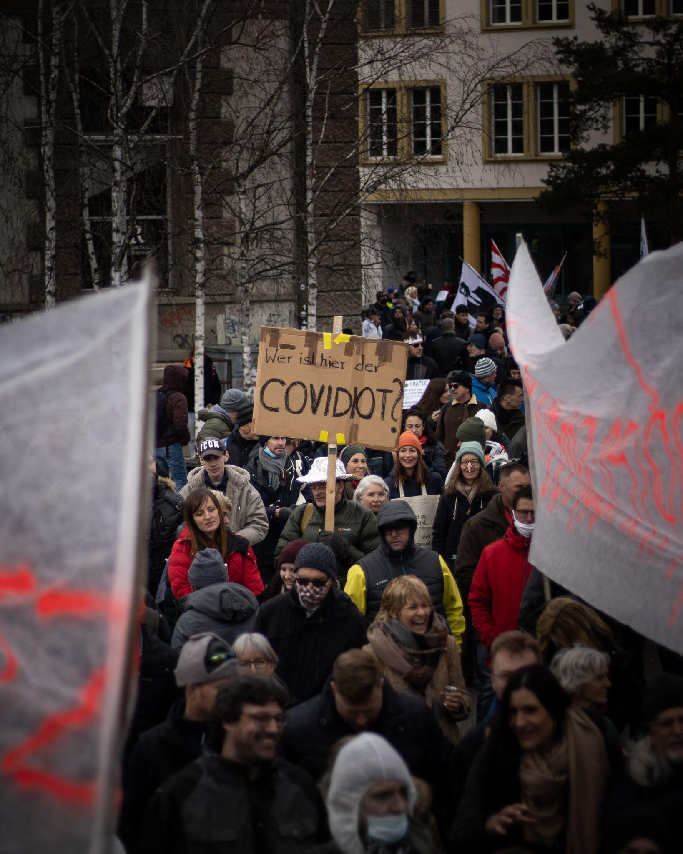
The Psychology Behind Fake News
Follow the leader
- While groups tend to share common beliefs, those beliefs are often sculpted by a handful of influential people.
- People who believe in conspiracy theories usually seek a savior—someone who will help them protect their in-group from conspiring enemies.
- An October 2020 poll of more than 2,000 Americans conducted by Joseph Uscinski, found that what people believed was closely aligned with what they had been told by their political leaders. For example, 56 percent of people who identified as Democrats agreed that there was a conspiracy to stop the U.S. Post Office from processing mail-in ballots, compared to only 31 percent of Republicans.
Kramer, J., 2021. Why people latch on to conspiracy theories, according to science. [online] National Georaphic. Available at: <https://www.nationalgeographic.com/science/article/why-people-latch-on-to-conspiracy-theories-according-to-science> [Accessed 4 October 2021].

Slide 12
The Psychology Behind Fake News
Celebrities breading fake news
Researchers found that spikes in the circulation of COVID-19-related misinformation online were almost always linked to celebrity or media endorsements.
In one example, they examined the recent fake news that 5G cellphone towers spread the coronavirus and found that most “shares” about it happened after “The Hunger Games” actor Woody Harrelson promoted the conspiracy theory on Instagram, and rapper Whiz Khalifa spoke about it in a Facebook video.
In a now-deleted Instagram post, Harrelson, 58, told his more than 2 million followers that he found a report about “the negative effects of 5G” and its supposed role in the coronavirus pandemic “very interesting.”
O'Neill, N., 2020. Celebrities are 'super-spreaders' of coronavirus fake news, study says. [online] New York Post. Available at: <https://nypost.com/2020/04/24/celebrities-are-super-spreaders-of-fake-coronavirus-news-study/> [Accessed 4 October 2021].

Slide 13
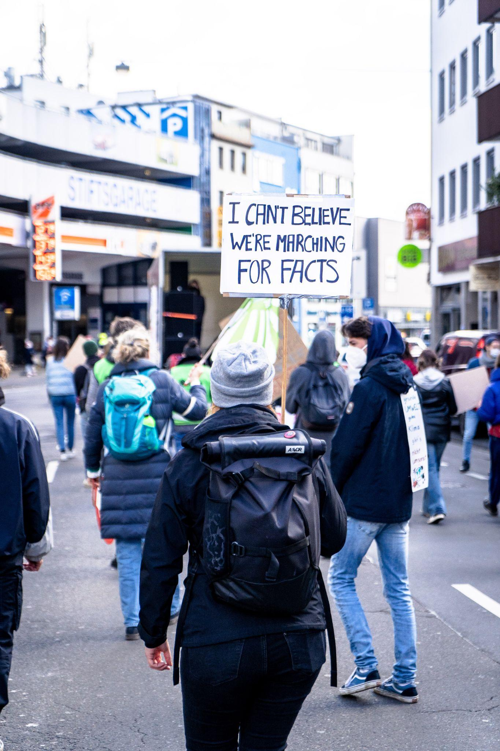
The Psychology Behind Fake News
Identifying the truth
- Once people believe something, it can be almost impossible to dissuade them.
- When misinformation is covered in the news—often in an attempt to disprove falsehoods—the coverage can inadvertently aid in creating familiarity with incorrect beliefs.
- In a recent study, van der Linden looked at whether pre-emptively warning people about the techniques that are used to spread falsehoods can help them gain immunity against fake news. He found that once people were warned about common misinformation techniques—including appealing to people’s emotions or expressing urgency in a message—participants were more likely to identify unreliable information.
Kramer, J., 2021. Why people latch on to conspiracy theories, according to science. [online] National Georaphic. Available at: <https://www.nationalgeographic.com/science/article/why-people-latch-on-to-conspiracy-theories-according-to-science> [Accessed 4 October 2021].

Slide 14
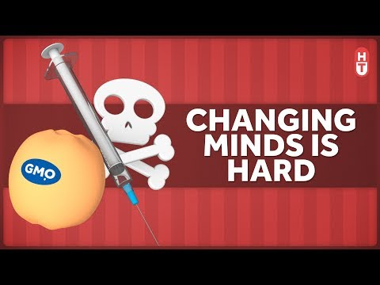
Facts Don't Really Change Minds. 2019. [video] https://www.youtube.com/watch?v=5tc2X8xLGPI: Healthcare Triage.
Notes:
https://www.youtube.com/watch?v=5tc2X8xLGPI

Slide 15
Literature
Brotherton, R., 2021. Bad News: Why We Fall for Fake News. Zed Books.
Hills, T. and Menczer, F., 2020. Information Overload Helps Fake News Spread, and Social Media Knows It. [online] Scientific American. Available at: <https://www.scientificamerican.com/article/information-overload-helps-fake-news-spread-and-social-media-knows-it/> [Accessed 4 October 2021].
Kramer, J., 2021. Why people latch on to conspiracy theories, according to science. [online] National Georaphic. Available at: <https://www.nationalgeographic.com/science/article/why-people-latch-on-to-conspiracy-theories-according-to-science> [Accessed 4 October 2021].
Pennycook, G. and G. Rand, D., 2021. The Psychology of Fake News. Trends in Cognitive Sciences, [online] 25(5). Available at: <https://www.sciencedirect.com/science/article/pii/S1364661321000516#!> [Accessed 4 October 2021].
Steinmetz, K., 2018. How Your Brain Tricks You Into Believing Fake News. [online] Time. Available at: <https://time.com/5362183/the-real-fake-news-crisis/> [Accessed 4 October 2021].

