Slide 1
Migration (3/3)
Facts, Representations, Stories

Slide 2
Overview
Facts and Figures
Representations of Migration
Migration Stories and Experiences

Slide 3
Migration Stories and Experiences
3

Slide 4
We all come from somewhere!
How can nationalism influence our sense of belonging and identity?
Which are the main factors that shape our identity, and how do these put us in relation (or conflict) with others?
Can we talk about “migrants” before the development of nation states and borders?
Video: https://youtu.be/tyaEQEmt5ls
Notes:
How can nationalism influence our sense of belonging and identity?
Which are the main factors that shape our identity, and how do these put us in relation (or conflict) with others?
Can we talk about “migrants” before the development of nation states and borders?
Source: https://www.youtube.com/watch?v=tyaEQEmt5ls

Slide 5
We all come from somewhere!
Think about and write down some (8-10) aspects that define your identity (aspects can be not only about class, nationality, religion, gender, sexuality, ethnic origin, etc. but also about job, music, interests, hobby, politics, sport, etc.)
Have these aspects changed over time?
Which aspects did you choose and which one were you born with?
How have these aspects developed?
Which aspects are social constructs and which are inherent and fixed?
If you wrote down your nationality what does it mean for you? What does it mean to be Austrian, German, etc.? → probably it would mean different things for different people
How much are people judged by their individual identity and how much by the group that they belong?
Notes:
Think about and write down some (8-10) aspects that define your identity (Aspects can be not only about class, nationality, religion, gender, sexuality, ethnic origin, etc. but also about job, music, interests, hobby, politics, sport, etc.)
Think about:
Have these aspects changed over time?
Which aspects did you choose and which one were you born with?
How have these aspects developed?
Which aspects are social constructs and which are inherent and fixed?
If you wrote down your nationality what does it mean for you? What does it mean to be Austrian, German, etc.? → probably it would mean different things for different people
How much are people judged by their individual identity and how much by the group that they belong?

Slide 6
We all come from somewhere!
Complete the table “The part of my identity that …” (available as an annex)
How did this exercise make you feel?
How does intersectionality relate to identity and justice?
How do power and privilege impact people’s relationships with each other and with institutions?
How do our intersecting identities shape our perspectives and the way we experience the world?
How can intersectionality be applied in education to teach about multiple identities and oppression?
Notes:
Completion of the table (this can be done also in presence, having learners move around the room
Final question after the filling of the table:
How did this exercise make you feel?
How does intersectionality relate to identity and justice?
How do power and privilege impact people’s relationships with each other and with institutions?
How do our intersecting identities shape our perspectives and the way we experience the world?
How can intersectionality be applied in education to teach about multiple identities and oppression?
If results are homogenous, discussion can go towards nationalism, privileges, or identity politics

Slide 7
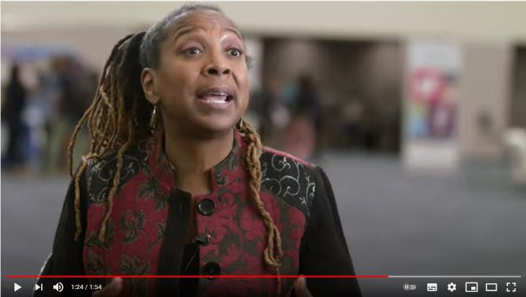
Intersectionality
Video: https://youtu.be/ViDtnfQ9FHc
Notes:
Source: https://www.youtube.com/watch?v=tyaEQEmt5ls

Slide 8
Migration letters
Open the annex “migration letters” and read through the letters and excerpts provided!
annex: „migration letters“
What are the main topics/concerns of each letter as described by the authors?
What impressions do these letters give about life as a migrant in the late nineteenth and early twentieth centuries?
Can you identify any similarities and differences between the experiences of these migrants and those of today?
Notes:
Ask the class to read the following articles
Divide the class in three groups and ask each of them to focus on the following questions:
What are the main topics/concerns of each letter as described by the authors?
What impressions do these letters give about life as a migrant in the late nineteenth and early twentieth centuries?
Can you identify any similarities and differences between the experiences of these migrants and those of today?

Slide 9
Write your own letter/diary!
choose a country of origin/destination and collect (historical) information about it
write a letter to relative or a diary entry to describe the situation or narrate an event
Why did they decide to leave their home country?
Why did they choose that country of destination?
How did they travel (routes and methods of transport) and what obstacles did they face along the way?
What was the experience of arriving in a new country?
Present your letter/diary and discuss the results
Notes:
Ask students to choose a country of origin/destination and to collect (historical) information about them
Ask them to write a letter to relative or a diary entry to describe their situation or narrate an event
At the end, ask them to present their letter/diary in front of class and discuss the results
The letter/diary entry should include:
Why did they decide to leave their home country?
Why did they choose that country of destination?
How did they travel (routes and methods of transport) and what obstacles did they face along the way?
What was the experience of arriving in a new country?

Slide 10
The luggage – migrants’ objects
The teddy bear
After World War II thousands of people were accommodated in displaced persons camps. This teddy bear was owned by a young Latvian girl who passed through many of these camps until her eventual arrival in the USA. She was one of 460,000 people accepted into the country. Her teddy bear was a childhood reminder of happier times before the war.
(cf. House of European History)
The school report
Migrants crossing the Mediterranean often sew their belongings inside their clothes, in order to hide them from guards or smugglers, or to preserve them from the water. A school report was found sewn inside the jacket of a 14-year-old boy from Mali, who drowned in the Lampedusa shipwreck on April 2015. The school report represented his most valuable belonging, allowing him to build his future in Europe.
(cf. Infomigrants 2019)
The life jacket
Life jackets are fundamental to cross the short strip of sea that separates Turkey from Aegean islands. In the island of Lesvos, thousands of life jackets are amassed on the ground, as a sign of the passage of people through the island. Yet, as the demand for life jackets have increased, they have become object of speculation: in Turkey they are often sold at high prices or filled with nylon or paper.
(cf. Strickland 2015)
Notes:
Source picture/story:
House of European History: Borders and Bridges – Migration, resource 4, https://historia-europa.ep.eu/sites/default/files/Discover/EducatorsTeachers/ActivitiesForYourClassroom/migr-resource-4-en_0.pdf, accessed 11 January 2022.
Infomigrants (2019) Deceased migrants found carrying report cards, soil from home, https://www.infomigrants.net/en/post/14626/deceased-migrants-found-carrying-report-cards-soil-from-home, accessed 11 January 2022.
Strickland, P. (2015) Life-jacket mountain a metaphor for Greece’s refugees, Al Jazeera, https://www.aljazeera.com/features/2015/12/29/life-jacket-mountain-a-metaphor-for-greeces-refugees, accessed 11 January 2022.

Slide 11
The luggage – experiment of thought
You are living a relatively peaceful and successful life in your country, but suddenly the war bursts out and you are told that it is better for you to leave your town immediately and to flee abroad.
You have one hour to pack your luggage (like the one in the picture) with your most important belongings.
What would you bring with you and why?
What would you leave behind?

Slide 12
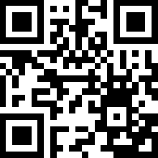
From Migrant Farmer to Future Teacher
Video: https://youtu.be/lk9vP62EiL8
Notes:
Source: https://www.youtube.com/watch?v=lk9vP62EiL8
Story: https://www.raiseyourhandtexas.org/stories/from-migrant-farmer-to-future-teacher/

Slide 13
Literature and other sources
House of European History: Borders and Bridges – Migration, resource 4, https://historia-europa.ep.eu/sites/default/files/Discover/EducatorsTeachers/ActivitiesForYourClassroom/migr-resource-4-en_0.pdf , accessed 11 January 2022.
Infomigrants (2019) Deceased migrants found carrying report cards, soil from home, https://www.infomigrants.net/en/post/14626/deceased-migrants-found-carrying-report-cards-soil-from-home , accessed 11 January 2022.
Strickland, P. (2015) Life-jacket mountain a metaphor for Greece’s refugees, Al Jazeera, https://www.aljazeera.com/features/2015/12/29/life-jacket-mountain-a-metaphor-for-greeces-refugees , accessed 11 January 2022.

