Slide 1
CONSPIRACY MYTHS (4/5)
The world of universal explanations

Slide 2
Overview
Introduction & Definition
History of conspiracy myths and historical examples
Ideology of conspiracy and the link to Antisemitism
Forms of practice and expressions – contemporary examples
Strategies: Identifying and dealing with conspiracy myths

Slide 3
Forms of Practice and Expressions – contemporary examples
4

Slide 4
Language and Communication
→ visual and verbal forms
role of the media
Media, language, verbal and visual forms, places of communication (online and other media …)
Economy of conspiracy myths: Who profits?
Content and subjects/topics of famous and infamous myths
Notes:
Repetition from first chapter: Where are conspiracy myths spread? → reflect on what was mentioned by students in first chapter

Slide 5
Role of the MEDIA
Old and new forms of distribution
News
Social media: YouTube, Telegram, etc.
Memes, videos, etc.
Internet and algorithms – a new phenomenon? Internet as a new form to spread old conspiracy myths

Slide 6
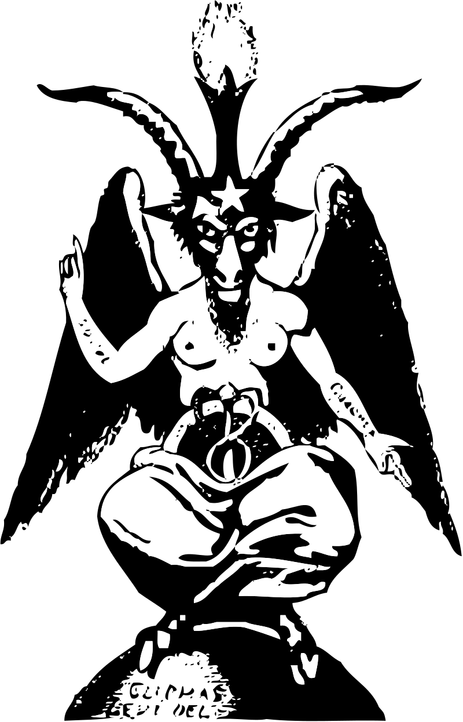
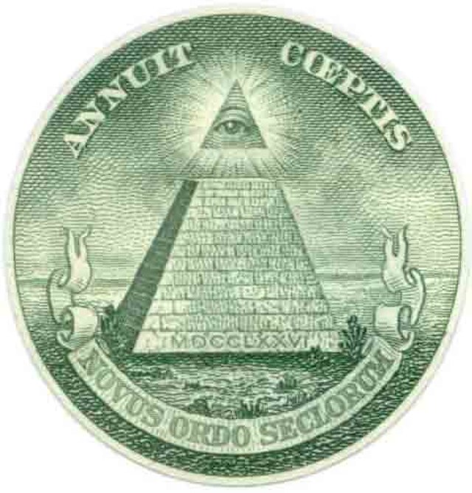
Importance of symbols and codes – verbal and visual
Visual forms – symbols to look out for
Pyramid/Triangle (Illuminati)
Star of David (Judaism)
Baphomet/devil and square&compasses (Freemason symbol)
Q, 23, …
animals like octopus, historical differences e.g. antisemitic codes after 1945
23
Where applicable, sources of depictions are available through click on items (public domain).
Notes:
sources: creative commons / no copyright (wiki commons):
square&compasses: https://commons.wikimedia.org/w/index.php?search=square+compass&title=Special:Search&profile=advanced&fulltext=1&ns0=1&ns6=1&ns12=1&ns14=1&ns100=1&ns106=1#/media/File:Square_and_compasses2.JPG
Baphomet: https://commons.wikimedia.org/w/index.php?search=baphomet&title=Special:Search&profile=advanced&fulltext=1&ns0=1&ns6=1&ns12=1&ns14=1&ns100=1&ns106=1#/media/File:Baphomet-small.svg
Dollar Eye Pyramid: https://commons.wikimedia.org/wiki/File:Eye.jpg
Star of David and 23: selfmade

Slide 7
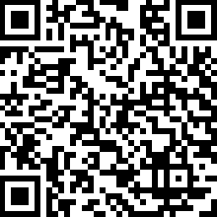
what story do these pictures tell?
what symbols and animals are used?
what do they stand for?
what implication can be made about ideological motives?
the octopus & the controller
(cf. Antisemitism Policy Trust 2020)
Scan the QR-code or use the link below to look up the pictures of the octopus (p. 5) and the controller (p. 14)
https://antisemitism.org.uk/wp-content/uploads/2020/07/Antisemitic-imagery-May-2020.pdf
Notes:
Find the pictures in: Antisemitism Policy Trust (2020) Antisemitic Imagery, https://antisemitism.org.uk/wp-content/uploads/2020/07/Antisemitic-imagery-May-2020.pdf accessed 20 May 2021, p.5 and p.14.
images:
A Nazi anti-Semitic cartoon by Seppla (Josef Plank), circa 1938--An octopus with a Star of David over its head has its tentacles encompassing a globe. Source: Library of Congress, courtesy of USHMM Photo Archives. https://collections.ushmm.org/search/catalog/pa4913
Poster of a Jewish man controlling spiders weaving a conspiracy. Source: USHMM, no license https://collections.ushmm.org/search/catalog/irn542394
about the “octopus” image:
“The Octopus is a common antisemitic image foundin anti-Jewish images and cartoons, representing the antisemitic canard of Jewish control. In 1903, the antisemitic forgery, The Protocols of the Elders of Zion, alleged, among many other falsities, that Jewish leaders were conspiring to control the world, including global politics, the world economy, and the media. The image of an octopus, with its tentacles wrapped around the world, or penetrating the globe, is an antisemitic representation of this canard. The Octopus is comparable to the puppet master, pulling the strings of control, an image also used to portray this antisemitic canard.”
about the “controller” image:
“As with the Enemy and the Corruptor, the Controller embodies the entire focus of The Protocols of the Elders of Zion. The Jews sow their seeds around the world, like the Octopus with its tentacles penetrating the globe. The Controller uses its power to control the world, whether it be the economy, the media or politics. When a reader sees this, they are able to blame their societal position on the Jews; they couldn’t succeed in one way or another because everything is being controlled. As the antisemitic German historian Heinrich von Treitschke put it, “the Jews are our misfortune”.”
source: Antisemitism Policy Trust (2020) Antisemitic Imagery, https://antisemitism.org.uk/wp-content/uploads/2020/07/Antisemitic-imagery-May-2020.pdf, accessed 20 May 2021, p.5 and p.14.

Slide 8
The octopus & the controller
What story do these pictures tell?
What symbols and animals are used?
What do they stand for?
What implication can be made about ideological motives?
Scan the QR-code or use the link below to look up the pictures of the octopus (p. 5) and the controller (p. 14)
https://antisemitism.org.uk/wp-content/uploads/2020/07/Antisemitic-imagery-May-2020.pdf
Notes:
Find the pictures in: Antisemitism Policy Trust (2020) Antisemitic Imagery, https://antisemitism.org.uk/wp-content/uploads/2020/07/Antisemitic-imagery-May-2020.pdf accessed 20 May 2021, p.5 and p.14.
images:
A Nazi anti-Semitic cartoon by Seppla (Josef Plank), circa 1938--An octopus with a Star of David over its head has its tentacles encompassing a globe. Source: Library of Congress, courtesy of USHMM Photo Archives. https://collections.ushmm.org/search/catalog/pa4913
Poster of a Jewish man controlling spiders weaving a conspiracy. Source: USHMM, no license https://collections.ushmm.org/search/catalog/irn542394
about the “octopus” image:
“The Octopus is a common antisemitic image foundin anti-Jewish images and cartoons, representing the antisemitic canard of Jewish control. In 1903, the antisemitic forgery, The Protocols of the Elders of Zion, alleged, among many other falsities, that Jewish leaders were conspiring to control the world, including global politics, the world economy, and the media. The image of an octopus, with its tentacles wrapped around the world, or penetrating the globe, is an antisemitic representation of this canard. The Octopus is comparable to the puppet master, pulling the strings of control, an image also used to portray this antisemitic canard.”
about the “controller” image:
“As with the Enemy and the Corruptor, the Controller embodies the entire focus of The Protocols of the Elders of Zion. The Jews sow their seeds around the world, like the Octopus with its tentacles penetrating the globe. The Controller uses its power to control the world, whether it be the economy, the media or politics. When a reader sees this, they are able to blame their societal position on the Jews; they couldn’t succeed in one way or another because everything is being controlled. As the antisemitic German historian Heinrich von Treitschke put it, “the Jews are our misfortune”.”
source: Antisemitism Policy Trust (2020) Antisemitic Imagery, https://antisemitism.org.uk/wp-content/uploads/2020/07/Antisemitic-imagery-May-2020.pdf, accessed 20 May 2021, p.5 and p.14.

Slide 9
Literature
Antisemitism Policy Trust (2020) Antisemitic Imagery, https://antisemitism.org.uk/wp-content/uploads/2020/07/Antisemitic-imagery-May-2020.pdf accessed 20 May 2021, p. 5 & p. 14.

