Slide 1
Every picture tells a story: Understanding & practicing visual language
prof. Kristina Juraite
Vytautas Magnus University, Lithuania
kristina.juraite@vdu.lt

Slide 2
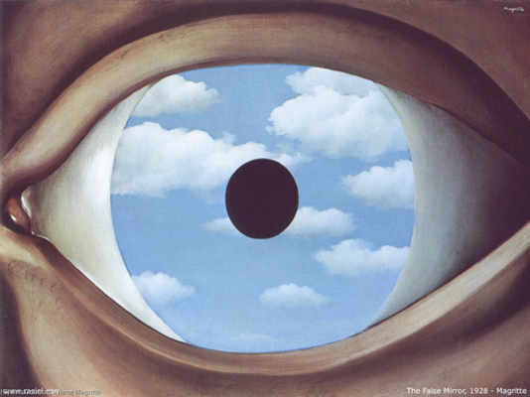
Part 3: Practicing visual storytelling
‘The False Mirror’, Rene Magritte, 1928

Slide 3
Why visual storytelling?
Visual storytelling includes a single or a collection of visuals (i.e. images, visualizations, or any combination thereof) that are either part of a larger text or have little or non-accompanying text (Figueiras 2014).
Visual stories can be told in thousands of different ways.
The story is first a story as it is created, that means it is a cognitive scheme.
The author constructs the story.
The raw material of the story is from the reality.

Slide 4
Visual storytelling
Visuals shall endow value to the story
Visual proofs and documentation for the claims/problems/incident revealed
Visuals contribute with information and help fast-thinking
Visuals can create identification
Visuals can create fascination
Visual sequences provide a forward motor
Visuals translate abstract concepts or terms that have different meanings across disciplines (Maher et al. 2018)
Visual narratives help to process and make sense of new information by relating it to the specific context (Downs 2014)

Slide 5
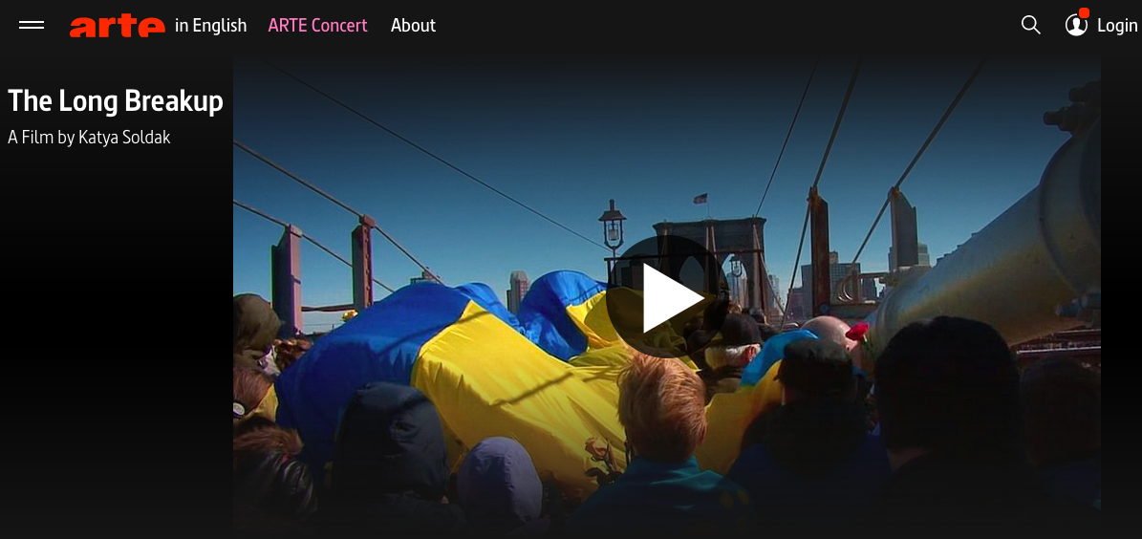
https://www.arte.tv/en/videos/108340-000-A/the-long-breakup/

Slide 6
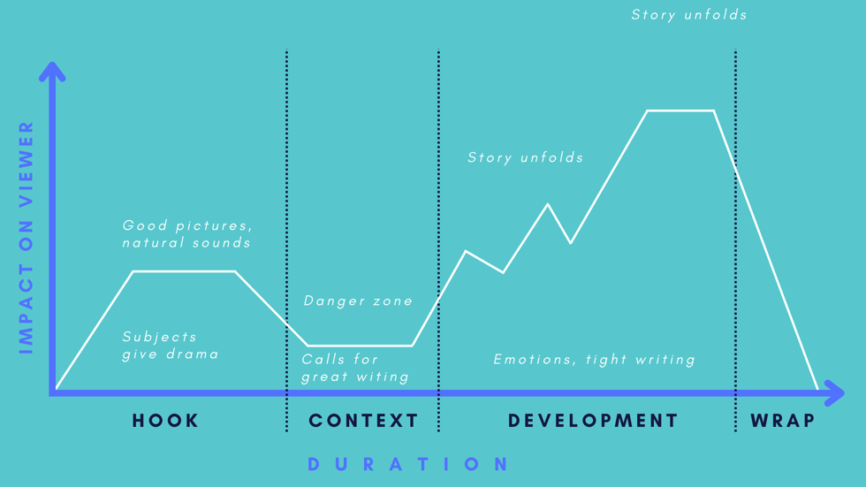
“Going up the hill” strategy in storytelling

Slide 7
Creative assignment
Visual storytelling project - you’re free to choose to develop an educational video, a mock ad campaign, produce a brand identity strategy, design a blog or social media site, create an art work or multimedia art exhibit, produce a video of artistic, journalistic or promotional interest, develop a photo essay, interview an artist, director, photographer or producer, etc.
A project brief (visual concept) - project idea described in detail, including objectives, target audience, content, aesthetic and technological means, research done, constraints, your motivation and role in the project, etc.
A process book - your motivation, feelings, observations, experience and self-evaluation.

Slide 8
Production stages
Pre-production - a planning phase, when ideas are generated and an overall vision of the project is planned in detail (writing a script for video or developing an idea/topic, deciding on location, subjects, media, etc.):
A cycle of activities involve gathering facts, researching, mind-mapping, sketching, asking questions to a potential audience, etc.
Production - an implementation of the outline developed in the previous phase (photographing, filming, animating, etc.). Here you will work out the lighting requirements, framing and composition.
Post-production - a final refinement phase, after production is finished. It includes special effects, color correction, music, images, texts, etc.

Slide 9
Writing a script for a visual story
Introduction
The start of your story is where you need to grab your audience’s attention. If the content is not captivating, then your target audience is likely to get bored and leave. Offer some background information about the topic. Highlight your experience. The introduction is your opportunity to clarify the subject and set the tone for the story boosting your prospects.
Body
The body of the script should include the main points of your story or the issues you may be trying to raise. The body of the script is your opportunity to make a case for why your story is special. Keep your message to the point. Include support material.

Slide 10
Writing a script for a visual story
Conclusion
Your concluding statements need to convert your target audience into believers. If you have retained them up to this stage of your story, then now is your opportunity to convince them why your idea is so special. This conversion process requires a thorough understanding of your target audience and their feelings. Summarize your main points. Finish the circular journey by connecting your beginning and end. Use a strong closing statement to show the story is over.

Slide 11
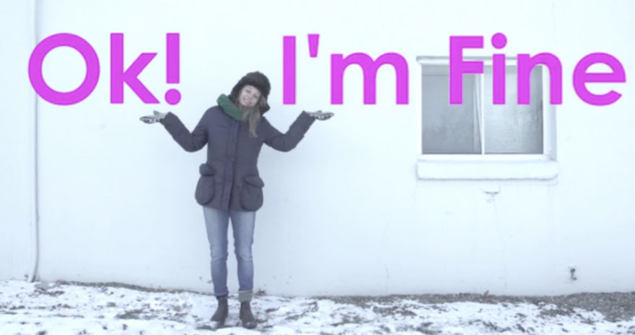
Discuss the example of visual storytelling
https://www.brainpickings.org/2015/08/20/bianca-giaever-the-scared-is-scared/

Slide 12
Practice & enjoy visual storytelling!

Slide 13
Resources & readings

