Slide 1
Every picture tells a story: Understanding & practicing visual language
prof. Kristina Juraite
Vytautas Magnus University, Lithuania
kristina.juraite@vdu.lt

Slide 2
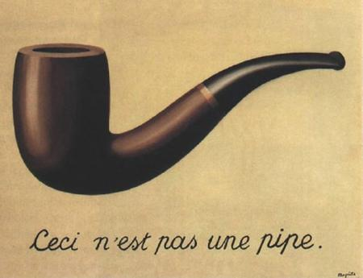
Part 2: Understanding visual semiotics
‘The Treachery of Images’, Rene Magritte, 1929

Slide 3
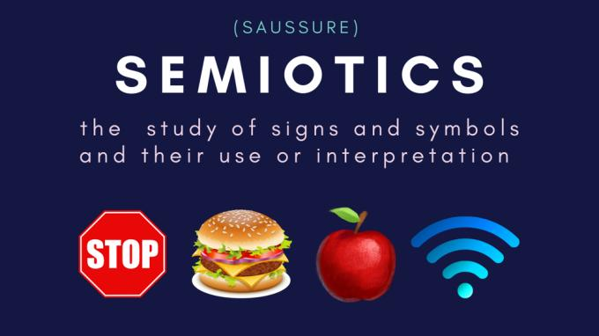

Slide 4
Understanding a sign
Semiotics is concerned with everything what can be taken as a sign (Umberto Eco 1976).
Anything can be a sign as long as it is interpreted as signifying something by a human being. Nothing is a sign unless it is interpreted as a sign.
Semiotics could be find anywhere. Signs include language, images, drawings, paintings and photographs, sounds and body language, also buildings, spaces, fashion, interiors, etc.
Semiotics embraces different disciplines, incl. linguistics, philosophy, psychology, sociology, anthropology, literary studies, arts, aesthetics, media studies, psychoanalysis, education studies, etc.

Slide 5
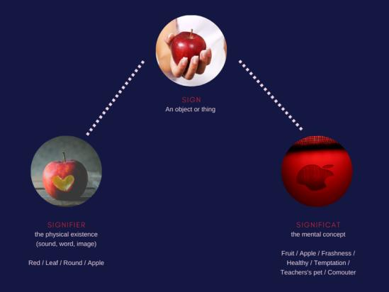
What we mean by the sign?

Slide 6
Differences in reading a sign
Visual semiotics is interested in fine arts, images, films, architecture, commercial advertisement, etc.
Modern semiotic theory is also sometimes allied with a Marxist approach which stresses the role of ideology and power.
Ideology refers to a system of values, beliefs, and ideals guided by a worldview that shapes the ways in which people act.
Cultural approach is particularly important, because how we read a sign, depends on our culture.
Semiotics can be used to illuminate and explain interesting and in many cases neglected or overlooked aspects of everyday life.

Slide 7
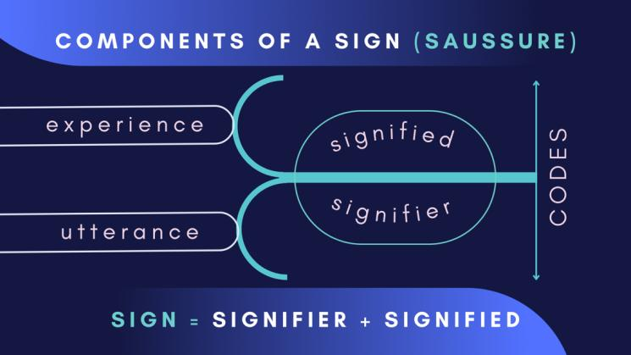

Slide 8
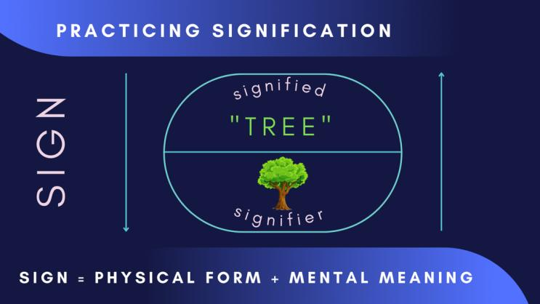

Slide 9
Making meaning of a sign
Semiotics is about signs, their systems and structures, as well as culture.
A sign is being composed of signifier (physical form in which the sign takes place) and the signified (the concept it represents).
No sign can make sense on its own, but only in relation to other signs. Signs are not meaningful in isolation, but only when they are interpreted in relation to each other.

Slide 10
Systems of meaning
The meaning of a sign depends on the code within which it is situated.
Codes provide an interpretative framework within which signs make sense.
There are social codes, logical codes, aesthetic codes.

Slide 11
Typology of signs by Charles Peirce
Iconic signs convey direct link and similarity between the signifier and signified and represent the object in a concrete way (portrait, photography, cartoons, sound effects, imitative gestures, road signs, maps, etc.).
Index is a sign which is connected to the object it represents in a causal way rather than directly or in a concrete way (evidence, smoke, footprints, pain, thermometer, clock, knock on the door, handwriting, etc.).
Symbols are signs which have NO direct link at all with the thing it represents. The only reason we know what they mean is due to convention. 100% of them need to be learned (language, alphabet, numbers, traffic lights, colors, etc.).

Slide 12
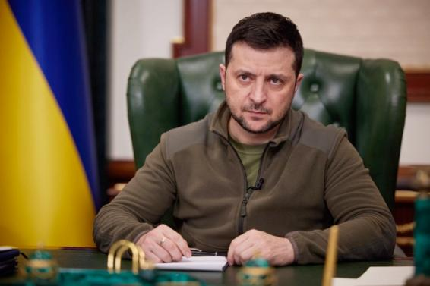
Iconic sign
https://www.businessinsider.com/president-zelenskyys-unadorned-strategy-is-the-future-of-crisis-leadership-2022-3

Slide 13
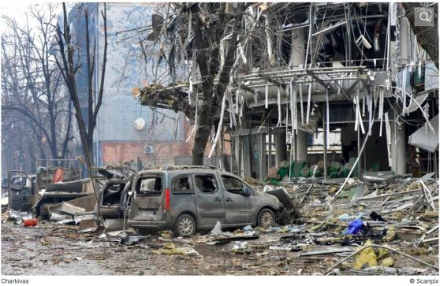
Index

Slide 14
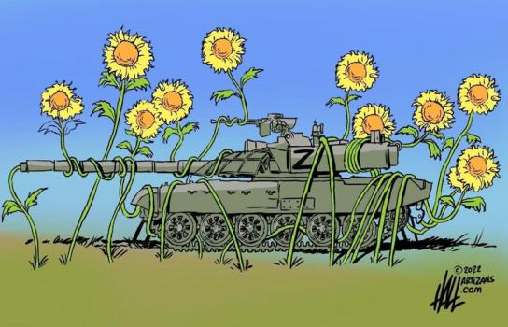
Symbol

Slide 15
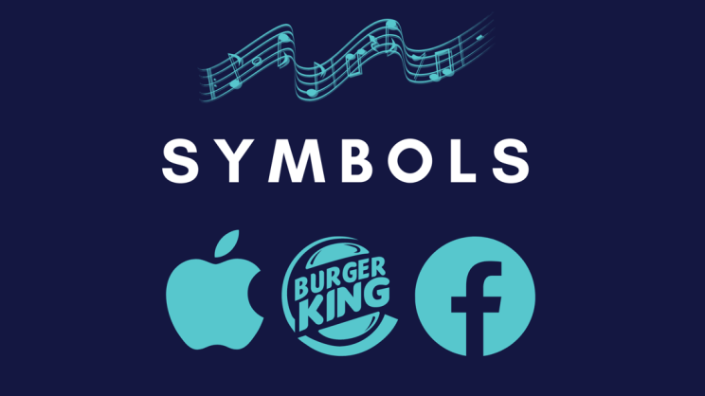

Slide 16
Find different signs in this video
https://youtu.be/vnj8fpNQJgk

Slide 17
Roland Barthes’ framework of signification
Denotation is the first order of signification, meaning the primary, literal, obvious or common sense meaning of a sign.
Connotation is a second order signification, referring to the figurative, inferred, suggested meaning or association.
Combination of many consistent interpretations produce ideology or myth, which is the third order of signification.

Slide 18
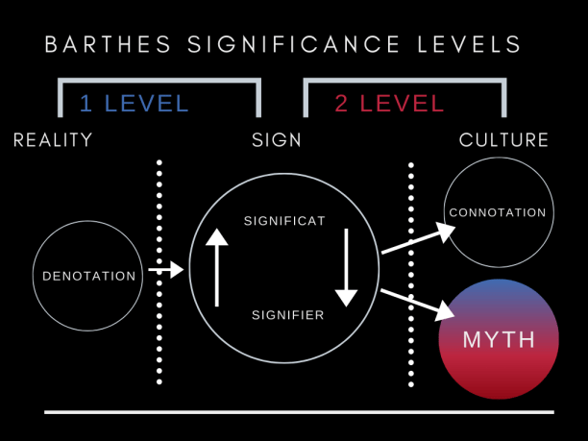

Slide 19
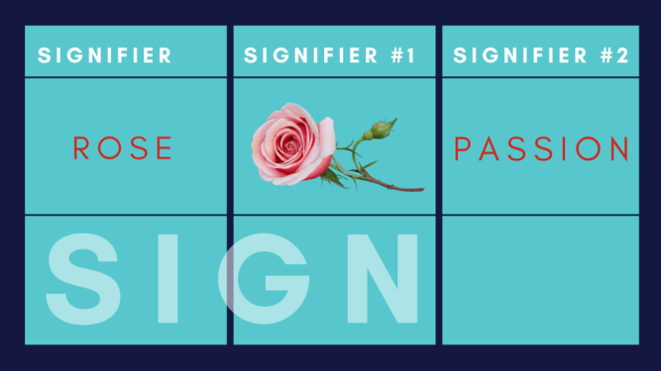
Example of “rose”
Denotative meaning - flower, rose.
Connotative meanings - passion, love, romance, other?

Slide 20
Roland Barthes “Myth Today”
Myth is a semiological system:
Mythology represents a collective system of interpretative perspectives, including ideologies that are often shared and debated within a culture.
Myth is a second-order semiological system.
A connotative sign system of representation that implies meanings within a particular cultural context that are accepted as true according to habit without the possibility of verification.
Myth is a type of speech:
“Myth is not defined by the object of its message, but by the way in which it utters its message: there formal limits to myth, there are no ‘substantial’ ones. Everything, then, can be a myth? Yes, I believe this, for the universe is infinitely fertile in suggestions.” (p. 107)

Slide 21
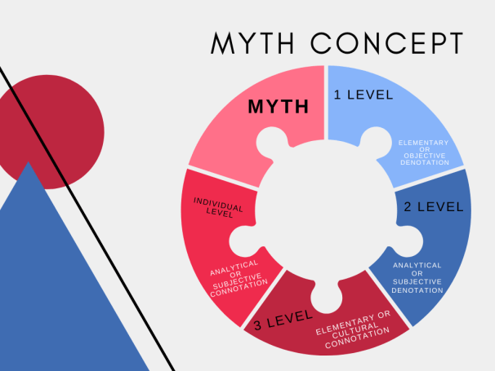

Slide 22
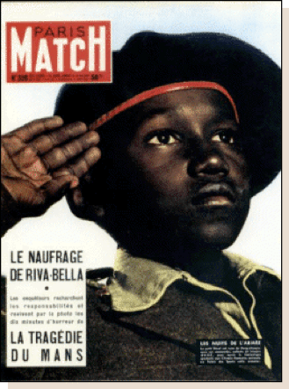
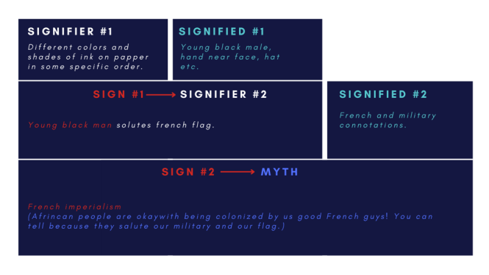
What is myth? (Barthes, 1972)

Slide 23
Myths are alive in everyday life
A myth is where a “socially agreed” symbolic association becomes widely accepted and legitimated to be seen as iconic.

Slide 24
Questions for semiotical analysis
Decide what the signs are represented
Decide what they signify
Think about how they relate to other signs
Explore their connections to wider systems of meaning, from codes (conventionalized signs) to ideologies (legitimated representations of power)
Return to the signs via their codes to explore precise articulation of ideology and mythology

Slide 25
https://www.youtube.com/watch?v=XjJQBjWYDTs

Slide 26
Major visual figurations
Metaphor and metonymy are two types of trope, that is, “a word or phrase used in a sense other than that which is proper to it” (Leithart, Peter):
In metaphor, “a descriptive word or phrase is transferred to an object or action different from, but analogous to, that to which it is literally applicable”. In metonymy, “a word or phrase denoting an object, action, institution, etc.,” is functionally replaced with “a word or phrase denoting one of its properties or something associated with it”.
A visual metaphor is the representation of a person, place, thing, or idea by means of a visual image that suggests a particular association or point of similarity. It's also known as pictorial metaphor and analogical juxtaposition.

Slide 27
Major visual figurations
A pictorial, or visual, metaphor occurs when one visual element (tenor/target) is compared to another visual element (vehicle/source) which belongs to a different category or frame of meaning.
Metonymy is a figure of speech (or trope) in which one word or phrase is substituted for another with which it's closely associated (such as "crown" for “royalty”, “Brussels” for “EU”, “Sabonis” for “Lithuanian basketball”).
Metonymy is also the rhetorical strategy of describing something indirectly by referring to things around it, as in describing someone's clothing to characterize the individual.

Slide 28
"Metonymy and metaphor also have fundamentally different functions. Metonymy is about referring: a method of naming or identifying something by mentioning something else which is a component part or symbolically linked. In contrast, a metaphor is about understanding and interpretation: it is a means to understand or explain one phenomenon by describing it in terms of another." (Murray Knowles and Rosamund Moon, Introducing Metaphor. Routledge, 2006)

Slide 29
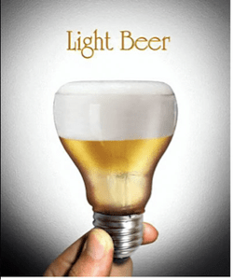
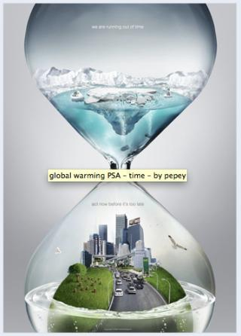
Find metaphors and metonymies

Slide 30
The use of semiotic analysis (Gaines, 2010)
Helps media users make informed decisions
Educates media culture and encourages them to make ethical and socially responsible creative decisions
Develops an understanding of the role of the media in society, politics, economics and culture
Helps to understand where our knowledge comes from, what and how we know, what the limits of our knowledge are, etc.
Reinforces critical thinking and media literacy
Improves resilience to disinformation

Slide 31
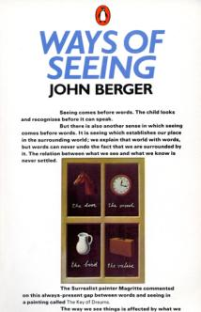
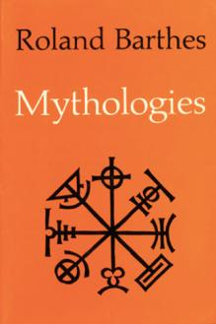
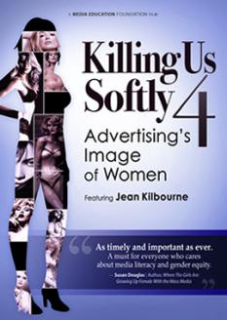
Resources & readings

