Slide 1
Every picture tells a story: Understanding & practicing visual language
prof. Kristina Juraite
Vytautas Magnus University, Lithuania
kristina.juraite@vdu.lt

Slide 2
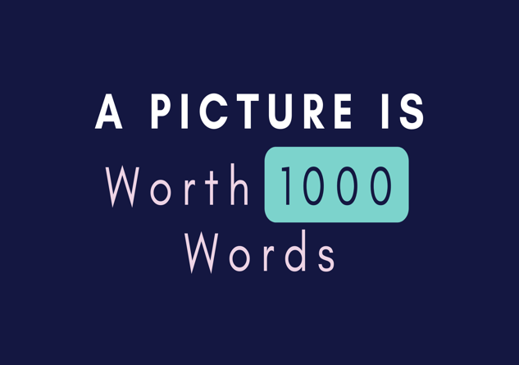
Outline of the module
The power of image & visual literacy
Understanding visual semiotics
Practicing visual storytelling

Slide 3
I Part: The power of image & visual literacy
“The more you know; the more you sense (notice)
The more you sense; the more you select (you will pay attention more)
The more you select; the more you perceive (you will understand more)
The more you perceive; the more you remember (memory is enhanced)
The more you remember; the more you learn (compare and contrast)
The more you learn; the more you know (use more of what you see).“
Aldous Huxley ‘The Art of Seeing’, 1943

Slide 4
The power of image
Visual turn, panopticon, ocularcentrism, hegemony of vision in modernity, madness of vision, noise of visuals, etc.
Visuality is a form of knowledge that is performed in the act of looking, constructed in the dynamic relationship between seeing and being seen.
Diverse aspects of visuality and visual culture include different ways of image production, content and consumption.
Visual literacy refers to the ability and skills of reading images and creating meaningful images.

Slide 5
Understanding visual culture
Visual culture examines a set of objects that we see, have seen or imagined, i.e. art, cinema, television, photography, dance, architecture, landscape, parks, furniture, tools, toys, advertising, fashion, accessories, lighting, maps, websites, etc.
Visual culture in a crossroad of different disciplines, incl. history, film studies, comparative literature, anthropology, museology, cultural studies.
Seeing is a cultural practice performed by individuals and institutions.

Slide 6
Why is visual culture important?
Visual culture is not in the first place about images at all. Nor is it about the technologies used to generate and distribute images.
Instead the term visual culture describes a particular relationship between seeing and knowledge.
It is within this relationship that meanings are developed and ascribed to the multiplicity of images generated and distributed as an increasingly accepted if problematized aspect of contemporary daily life.
Pictures and new image technologies do not produce visual culture. They are its artefacts.

Slide 7
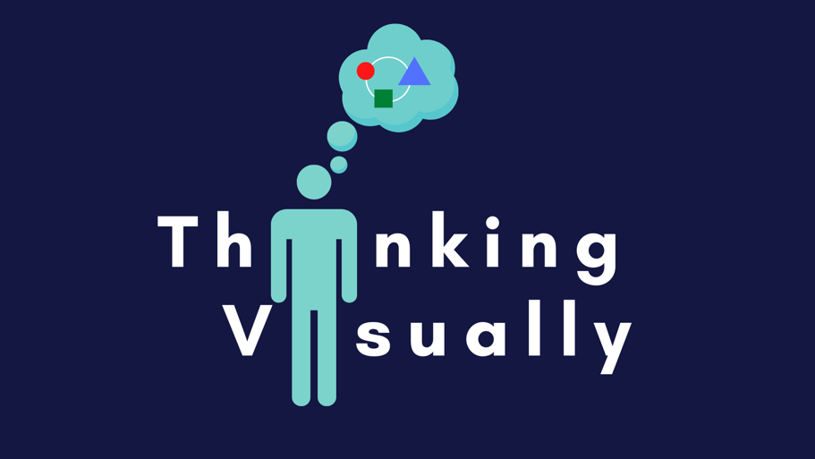

Slide 8
Developing visual literacy
What is visible is not self-evident but arises out of a set of social and cultural conditions that create the condition for seeing a particular phenomenon or artefact. In order for it to be considered visual, it must fit into a meaningful structure of information and knowledge.
A critical thinking and understanding of the role of visuals and visuality as a social interaction process is a must.
Becoming a viewer assumes that one has learned to approach an agreed set of objects as both visible and visual, that is as both seeable and worth looking at.

Slide 9
Primary visual analysis: asking 4 Qs
What do I see?
What do you observe? What else?
What does it remind me of?
Another image? A personal experience?
What’s the artist’s purpose?
To analyze? Persuade? Express? Document? Report?
So what?
What is the significance? Why does it matter?

Slide 10
Safety in Paradise: Air New Zealand Safety Video
https://www.youtube.com/watch?v=q0tkeGPG_8Q

Slide 11
Deep viewing guidelines
Literal observation level
What is pictured? What type of language is used? How is space used?
Interpretation level
What are the most important words? Which words do you have questions about? Describe your feelings about the photo/video. What other images are you reminded of, past or present? What messages are implicit and explicit? How did you analyze the image? What do you understand now that you didn't before?
Evaluation/application level
Does the implied purpose of the image convey ideas that are important? How? Is the visual biased? How so?

Slide 12
Apply the questions to discuss the ads
https://www.youtube.com/watch?v=AHYE8CJPlH4

Slide 13
Resources & readings

