Slide 1
Public Risk Perception Dealing with Public Polarization and Resistance in the Momentum of Global Crisis
Assoc. Prof. Inesa BUNEVICIENE Vytautas Magnus University, Kaunas, Lithuania 2021

Slide 2
Issues to be discussed:
Living in the Contemporary Risk Society and Dealing with Global Risks
The Positive and Negative Effects of Science, Research and Technologies: can we control them?
Understanding and Managing Global Risks: Data-based Evaluations, Public Perception and the Role of Media
Dealing with Public Polarization and Resistance in the Momentum of Global Crisis: Case of COVID19 Vaccine Hesitancy

Slide 3
4. Dealing with Public Polarization and Resistance in the Momentum of Global Crisis

Slide 4
Read more here.

Slide 5
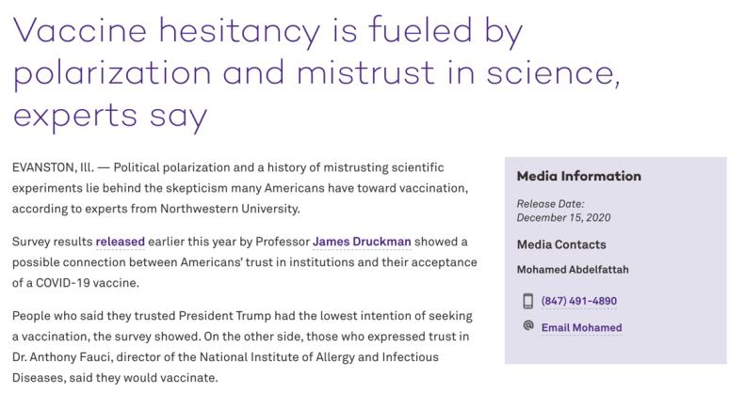
Read more here.

Slide 6
Vaccine hesitancy
Vaccine Hesitancy Named Threat to Global Health: Have vaccines become victims of their own success?
Vaccine hesitancy is the reluctance or refusal to vaccinate despite the availability of vaccines. Many patients may feel reluctant about getting the COVID19 Vaccine. Often this reluctance stems from lack of information or misinformation about the vaccine. As a healthcare provider, your recommendation plays a significant role in a patient’s decision to vaccinate.

Slide 7
Building vaccine confidence

Slide 8
Supporting material and literature:
Brunsonm, E. K., Buttenheim, A., Omer, S., Quinn, S. C. (2021) Strategies for Building Confidence in the COVID-19 Vaccines. Accessible online here.
Clyde, J., Corpuz, G. (2021). Building vaccine confidence through public participation. Journal of Public Health. Accessible online here.
UNICEF VIDEO | COVID-19 Vaccines: Sorting fact from fiction. Accessible online here.

