Slide 1
Public Risk Perception Dealing with Public Polarization and Resistance in the Momentum of Global Crisis
Assoc. Prof. Inesa BUNEVICIENE Vytautas Magnus University, Kaunas, Lithuania 2021

Slide 2
Issues to be discussed:
Living in the Contemporary Risk Society and Dealing with Global Risks
The Positive and Negative Effects of Science, Research and Technologies: can we control them?
Understanding and Managing Global Risks: Data-based Evaluations, Public Perception and the Role of Media
Dealing with Public Polarization and Resistance in the Momentum of Global Crisis: Case of COVID19 Vaccine Hesitancy

Slide 3
3. Understanding and Managing Global Risks: Data-based Evaluations, Public Perception and the Role of Media

Slide 4
Risk management
Risk management - encompasses the structures and processes required for joint decision-making on risk issues with governmental organizations and non-governmental actors (Nye and Donahue, 2000).
At the global level, risk management is implemented through horizontally organized structures that bring together governmental and non-governmental actors for joint decision (Rosenau, 1992; Wolf, 2002, 2005).
Global risks must be managed not only horizontally but also vertically.
 | Governmental organizations | Industries | Research centers, universities, etc. | Public
Local
Regional
National
International
Global

Slide 5
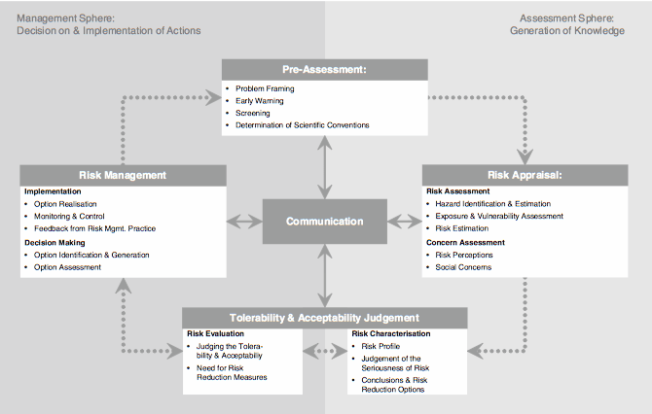
In assessing and managing risks, experts use scientific methods and make decisions and draw conclusions after long-term research or observations.
Communication is in the center of successful risk management.

Slide 6
Risk Perception Gap
Risk is socially constructed.
The characteristics of construct are determined by the psychological, social, institutional, and cultural environment in which the individual operates. Socially constructed risk is not an objective and constant.
… hence, different people make different decisions in similar or identical risk situations. In most cases, the real risks calculated by scientists do not seem very significant to society. Conversely, fears prevailing in society are often not scientifically based.
Frewer et al., 2003

Slide 7
… People base their risk assessments primarily on emotions and do so irrationally - the human brain is designed in such a way that any potential danger is accompanied by a defensive reaction;
… People tend to make decisions without shortcuts, especially when it comes to threats. How we respond to risks is determined by other factors:
A real threat based on a specific situation or scientific calculations;
Personal beliefs and values;
Belonging to a risk group;
Political beliefs;
New versus old risks (eg. seasonal influenza and Coronavirus);
Extent of the risk (what are the possible consequences?);
Risk representation in public space.

Slide 8
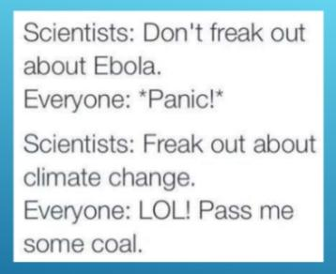
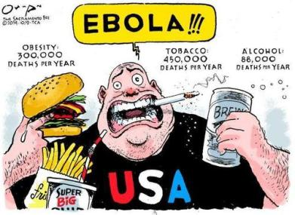
Source: www.marketwatch.com

Slide 9
Ability to understand and use scientific knowledge regarding the risks
“The public must be able to understand the basics of science to make informed decisions. Perhaps the most dramatic example of the negative consequences of poor communication between scientists and the public is the issue of climate change, where a variety of factors, not the least of which is a breakdown in the transmission of fundamental climate data to the general public, has contributed to widespread mistrust and misunderstanding of scientists and their research”
Read more: Brownel et al. (2013). Science Communication to the General Public: Why We Need to Teach Undergraduate and Graduate Students this Skill as Part of Their Formal Scientific Training. J Undergrad Neurosci Educ.

Slide 10
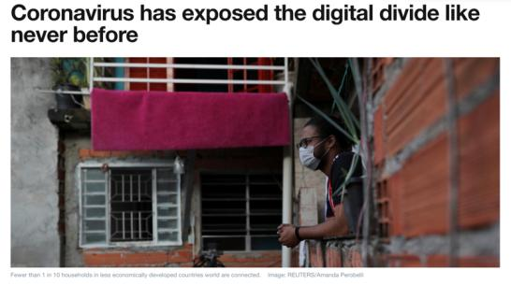
January 2021
4.66 billion people use internet worldwide, which makes up 59.5 percent of the global population.
92.6 percent (4.32 billion) of them accessed the internet via mobile devices.
Northern Europe ranks first with a 96 percent internet penetration rate among the population.
UAE, Denmark, and Sweden have highest internet penetration.
North Korea with virtually no online usage penetration among the general population, ranking last worldwide
Read more here: Statista | Worldwide Digital Population
“In total, 3.7 billion people have no internet access. The majority are in poorer countries, where the need to spread information about how to combat COVID-19 is most urgent. Migrants and the poorest are most vulnerable to the virus, says the World Health Organization (WHO)”.
Read more here: World Economic Forum | COVID19 and Digital Divide

Slide 11
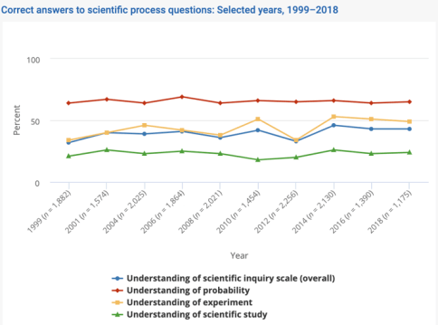
Read more here: https://ncses.nsf.gov/pubs/nsb20207/public-familiarity-with-s-t-facts

Slide 12
Risk Communication
“The field of risk communication emerged from cognitive research in risk perception that showed that ‘lay’ concerns about hazards – from nuclear reactors to chemical plants, radon, space, and genetic engineering – do not correspond with experts quantifications”. (Bouder, 2015)
WHO: Risk Communication(s) refers the real-time exchange of information, advice and opinions between experts or officials and people who face a threat (hazard) to their survival, health or economic or social well-being. Its ultimate purpose is that everyone at risk is able to take informed decisions to mitigate the effects of the threat (hazard) such as a disease outbreak and take protective and preventive action. Risk Communication uses a mix of communication and engagement strategies and tactics, including but not limited to, media communications, social media, mass awareness campaigns, health promotion, stakeholder engagement, social mobilization and community engagement.

Slide 13
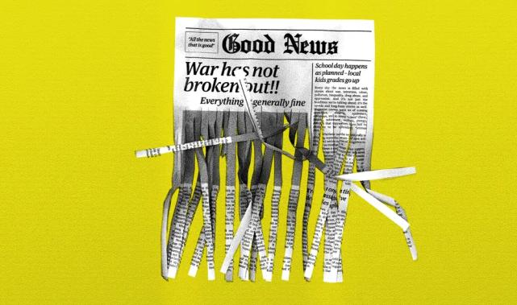
The Role of Mass Media

Slide 14
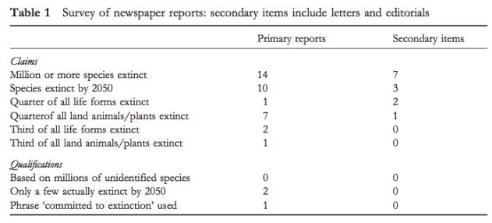
Nature, 2004: A study was published to model the potential effects of global warming on specific terrestrial animal and plant species.
RESEARCH RESULTS: Under the average global warming scenario, approximately 15-37 percent of the plant and animal species selected from the 1103 will be doomed to extinction by 2050.

Slide 15
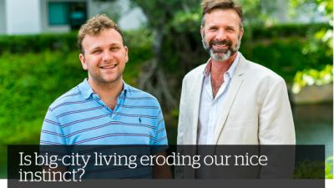
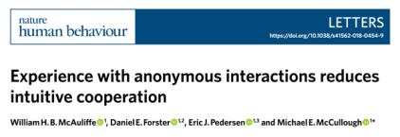
The game of the “Broken Phone”
University press-release
Original paper
Headline in media
Study found that: “people become less generous over time when they make decisions in an environment where they don’t know or interact with other people”.
Interpretations were not correct because the study was performed in a laboratory, not in a city. And the desire of the subjects to support something, to allocate funds to charity, but not to their “kindness” in general, was studied.

Slide 17
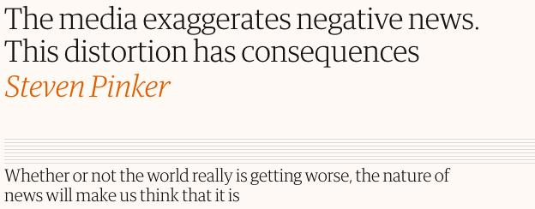
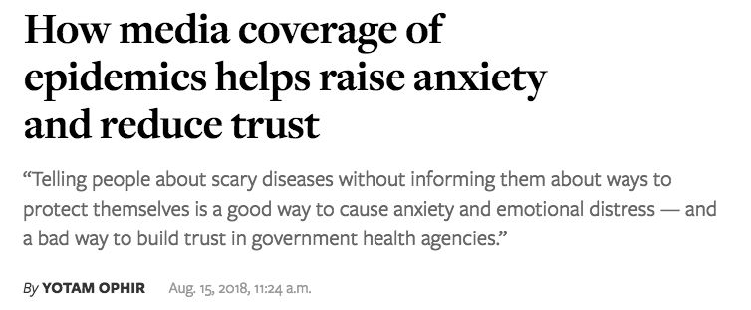

Slide 18
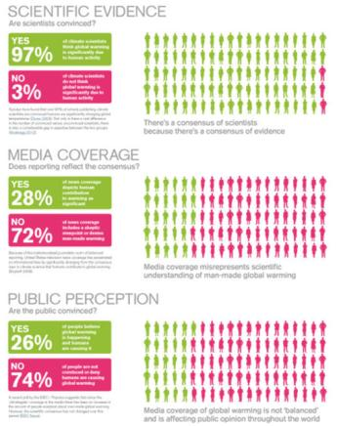
Full article by Anup Shah in Global Issues: https://www.globalissues.org/article/710/global-warming-spin-and-media
When everyone is an expert on everything… By: Bronwyn Williams

Slide 19
Supporting material and literature:
Ellis, L. D. The Need for Effective Risk Communication Strategies in Today’s Complex Information Environment. Accessible online here.
Bol, G. F. (2016). Risk communication in times of crisis Pitfalls and challenges in ensuring preparedness instead of hysterics. EMBO Reports. Vol. 17, No. 1. Accessible online here.
World Health Organization. (2013). Health and Environment: Communicating the Risk.
Schmalzle, R., Renner, B., Schupp, H. T. (2017). Health Risk Perception and Risk Communication. Policy Insights from the Behavioral and Brain Sciences. Vol. 4, No. 2, 163-169.
Bouder, F. (2015). Risk communication of vaccines: challenges in the post-trust environment. Accessible online here.
PAHO. Guide for the preparation of a risk communication strategy for COVID-19 vaccines: A Resource for the countries of the Americas. Accessible online here.
CDC. Communicating About COVID-19 Vaccine Safety and Risk. Accessible online here.

