Slide 1
Public Risk Perception Dealing with Public Polarization and Resistance in the Momentum of Global Crisis
Assoc. Prof. Inesa BUNEVICIENE Vytautas Magnus University, Kaunas, Lithuania 2021

Slide 2
Issues to be discussed:
Living in the Contemporary Risk Society and Dealing with Global Risks
The Positive and Negative Effects of Science, Research and Technologies: can we control them?
Understanding and Managing Global Risks: Data-based Evaluations, Public Perception and the Role of Media
Dealing with Public Polarization and Resistance in the Momentum of Global Crisis: Case of COVID19 Vaccine Hesitancy

Slide 3
2. Positive and negative effects of science, research and technologies: how do they affect the way we understand risks?

Slide 4
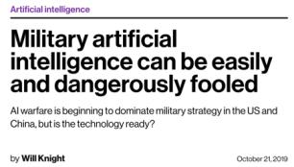
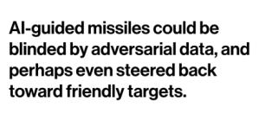
Science and technologies – do they help to solve the global risks or do they create them?
In “Risk society” humanity must deal with a set of global risks that it has itself created by its scientific and technological activities for which the planet has become a vast laboratory.
Paradoxically, in order to handle these “risks”, our societies have an even greater need for science and technology which alone can provide the conceptual and technical tools to enable mankind to grasp, identify, quantify, classify and guard against such risks.
Boudia S. ir Jas N., 2007
Read more here

Slide 5
Changing conditions of science
Scientific information is highly appreciated and even vital in a society full of uncertainties, risks and crisis.
However, in the second modernity, the way we do and understand science is changing in a number of ways:
Growing scientific uncertainties in the era of post-normal science;
Speed and quality in science during global pandemic;
Commercialization and commodification of science;
Politicization of scientific issues.
“The idea of how far science, technology and psychology have come is unnerving to some. With how much we already know, it’s even scarier to wonder what else is left to develop.
What’s stopping some mad scientist from secretly conducting crazy experiments on people or building a deadly weapon to destroy humanity? Well, a lot actually.”
ETHICS IN MODERN SCIENCE
by Erin Brache | published Sep. 9th, 2021 Read more here
Notes:
Hence again, - science itself is powerless to deal with global risks without political and public engagement.
Therefore, we have to speak about the ways how to bring science to people in order to make their lifes easier and to assure that their choices are informed and best in the situation.
Here we must speak about such concepts as information literacy and scientific literacy. Scientific information is highly appreciated and even vital in a society full of uncertainties, risks and crisis. High information literacy is the requirement to the contemporary society to successfully manage daily life, correctly evaluate risks and handle various crisis.
Scientific literacy is not (only) about the facts!
Ability to access information: Amid the global COVID-19 pandemic, UNESCO has announced “access to information in times of crisis” as the theme of the 2020 edition of the International Day for Universal Access to Information (IDUAI), celebrated every year on 28 September.
Ability to understand and use it in a proper way:

Slide 6
Growing scientific uncertainties in the era of post-normal science
We (don’t) know what we don’t know: we understand that Science and scholarly research produces not only progress and well-being but also may cause huge risks and losses. The stakes are high and risk management is required to assess and control science and technology related risks.
POST-NORMAL SCIENCE: A condition where scientists cannot be completely certain about processes or phenomenon they study, where “facts are uncertain, values in dispute, stakes high, and decisions urgent” (Funtowicz & Ravetz, 1992). In other words, traditional scientific models do not provide scholars with instruments able to solve the riddles of our times.

Slide 7
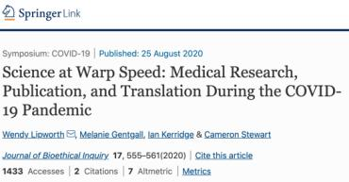
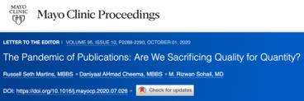
Speed and quality
To make research findings available quickly, many researchers are publishing versions of papers that have not yet been peer reviewed;
A recent study in The Lancet found that much of the discussion (and even policymaking) about COVID-19's transmissibility during January 2020 was driven by preprints rather than peer-reviewed literature.
Article accessible here: https://link.springer.com/article/10.1007/s11673-020-10013-y

Slide 8
Commercialization and commodification of science: common good versus private good
Advantages:
Increased research funding
New possibilities and broader approach to the issue
More successful science results’ applications in practice
Disadvantages:
Increased possibility of science biases
Decreasing trust in science
Concerns about the quality of science
Inequality to access scientific innovations
Today, scientific knowledge is produced in rather broad, transdisciplinary social, economic, political, and social context (Gibbons, et at., 1994).
It is hard to find the dividing line between science and industry, between public interest and private ambitions, between “common good” and “private good”.
Scientific research is increasingly nestled down in private patronage (Bauer, 2008) and science step by step is becoming a commodity, which is produced and sold as any other good.
Krimsky in his book “Science in the Private Interest” (2004) argues that influx of private money into the universities or individual professors’ pockets leads to conflicts of interest and possibly keep academia from pursuing its true social purpose.

Slide 9
Politicization of scientific issues
‘Stick to the science’: when science gets political: A three-part podcast series explores the intimate relationship between politics and science. Accessible here.
“Politicization is inevitable when governments provide funding for science. The public expects to get something back from the science they support——for example, better health, national security, jobs. This normal politicization does no harm and may even be good for science and society. But politicization taken to the extreme can be very harmful. In extreme politicization, governments or powerful advocacy groups use science and scientists who share or benefit from the politicization to drive science out of technical decisions and to promote a nonscientific agenda”
Read more here: William Happer | Harmful Politicization of science

Slide 10
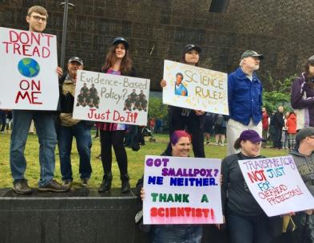
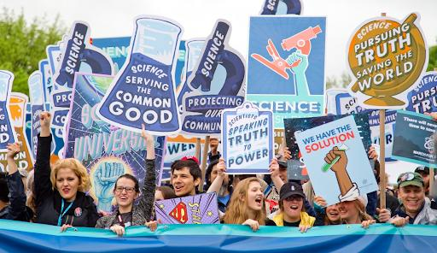
Source: Northeastern university political review | The Politicization of Science is Going to Kill Us

Slide 11
Democratization of science as a solution?
Researchers of post-normal science suggest that democratization of science is a way out – such ‘‘opening’’ or pluralization of the science allows other thoughts, observations, and data to make their way into the scientific processes to the betterment of scientific knowledge (Funtowicz & Ravetz, 1993; Carolan, 2006).
Democratization of science means that scientific decisions are made not by scientists alone, but instead, they are reached in consultancy with citizens. As scientific issues concern all of us, they also should be discussed openly. Democratization of science first and most importantly refers to what is called “civic science”, which is broad term encompassing three levels of relationship between scientists and society:
science representation (learning publics),
public participation in science (dialogue with publics),
and democratization of science (deliberation with publics) (Walker and Daniel, 2004).

Slide 12
Challenges of Democratization processes
What is expected from the public?
To be a part of scientific process, public is expected to have some knowledge and understanding
“…From primary school to university, we learn to “know”. But we also need to learn to doubt. We need to learn to hesitate. We need to learn to reconsider.
If you are not in doubt, try thinking whether you should be. The point is not that you should always so no, or always be in doubt, but that, if you are, then it is entirely legitimate state to be in.”
Svend Brinkmann,
The National, 2017

Slide 13
Pre-requirements for the public…
Scientific literacy is a concept defining level of public knowledge regarding scientific issues. Scientific literate public is a public which have least necessary knowledge to effectively act in a society.
Term of public understanding of science is a narrower concept than scientific literacy and it implies required knowledge about scientific content (scientific concepts), scientific enquiry (scientific processes), and scientific impact on society (social factors) (for more see Burns, O’Connor & Stocklmayer, 2003; Millar, 1996).
Meanwhile, concept of public awareness of science is a set of positive attitudes toward science (and technology) that are evidenced by a series of skills and behavioral intentions (Gilbert, Stocklmayer, and Garnett, 1999).
Public participation and engagement: Public participation is a concept describing public’s actions related to assistance in decision making, support for policy implementation, etc. Ideas of public participation lies in the core of democratic ideals – public must have a right to express their beliefs and attitudes about public issues which concern them and their life (Stave, 2002; Cox, 2013)

Slide 14
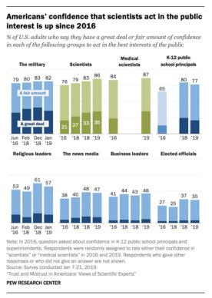
People trust in science, but they do not believe in it? (Pew Research Center, 2017)
public confidence in the scientific community remains relatively strong;
public trust in scientists in matters connected with childhood vaccines, climate change, and genetically modified (GM) foods is more varied;
only 47% of people say that medical scientists understand the health effects of the measles, mumps, and rubella (MMR) vaccine “very well.”
Pew Research Center, 2019: Trust in practitioners like medical doctors and dietitians is stronger than that for researchers in these fields, but skepticism about scientific integrity is widespread”.
Source: https://www.pewresearch.org/fact-tank/2020/02/12/key-findings-about-americans-confidence-in-science-and-their-views-on-scientists-role-in-society/
Notes:
Regarding public trust in science, we should mention, that public trust is quite high and stable, but when it comes to more sensitive and controvercial topics like climate change, vaccination, genetically modified foods, etc., trust is more varied. To be more precise, - only 47% of people say that medical scientists understand the health effects of the measles, mumps, and rubella (MMR) vaccine “very well.”
What does it mean? It raises questions, how to communicate this kind of topics to build and maintain public trust in science and scientists?

Slide 15
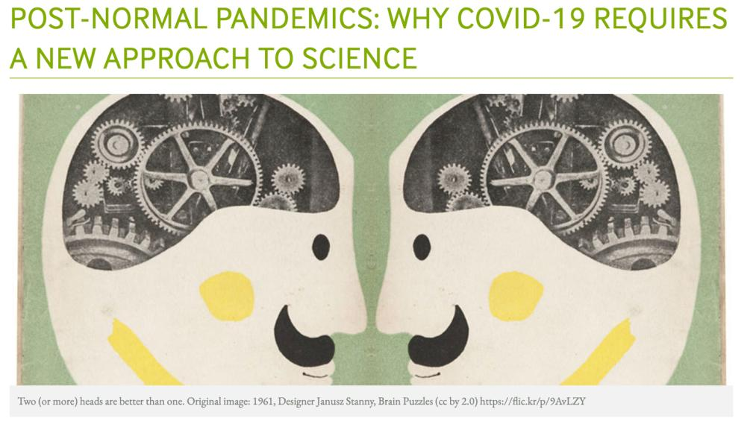

Slide 16
Trust. Participation. Transparency.

Slide 17
Supporting material and literature:
Waltner-Toews, D., Biggeri, A., De Marchi, B., Funtowicz, S., Giampietro, M., O’Connor, M., Ravetz, J. R., Saltelli, A. and van der Sluijs, J. P. (2020). Post-normal Pandemics: Why COVID19 Requires a New Approach to Science? Accessible online here.
Sodha, S. (2021). We’re living in a time of high stakes and scientific risks need to be taken. The Guardian. Accessible online here.
Analysis: Science in a Time of Covid is on BBC Radio 4 on 22 March at 8.30pm. Accessible online here.

