Slide 1
Public Risk Perception Dealing with Public Polarization and Resistance in the Momentum of Global Crisis
Assoc. Prof. Inesa BUNEVICIENE Vytautas Magnus University, Kaunas, Lithuania 2021

Slide 2
Issues to be discussed:
Living in the Contemporary Risk Society and Dealing with Global Risks
The Positive and Negative Effects of Science, Research and Technologies: can we control them?
Understanding and Managing Global Risks: Data-based Evaluations, Public Perception and the Role of Media
Dealing with Public Polarization and Resistance in the Momentum of Global Crisis: Case of COVID19 Vaccine Hesitancy

Slide 3
1. Living in the contemporary risk society and dealing with global risks

Slide 4
“The primary conflict during the early 20th century focused on the distribution of wealth among different social groups;
After the Second World War, and particularly during the 1960s, the focus changed to the distribution of power in politics and economics.
In more recent times, the major conflict has been about the distribution and the tolerability of risks for different social groups, regions and future generations.”
Renn, 2008
Ulrich Beck: Defining Risk Society works since 1992
Contemporary societies are risk societies, which are forced to face and fight the global risks created by mankind.
Global risks are not natural risks, so we do not know their consequences and it is difficult to predict them.
So we live in a world we don’t control (although it may seem different to us).

Slide 5
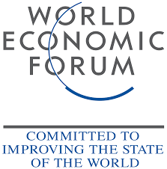
Risks and global risks
Risk is a social construct.
The characteristics of this construct are determined by the psychological, social, institutional, and cultural environment in which the individual operates.
Socially constructed risk is not an objective and constant.
Global risks are uncertain events and/or conditions that, if occur, could have adverse consequences for several countries (or industries) at different levels over a 10-year period.
A key feature of global risk is their potential systemic nature, i.e., the processes that determine risk occur in a way that affects the entire system rather than an individual or community.

Slide 6
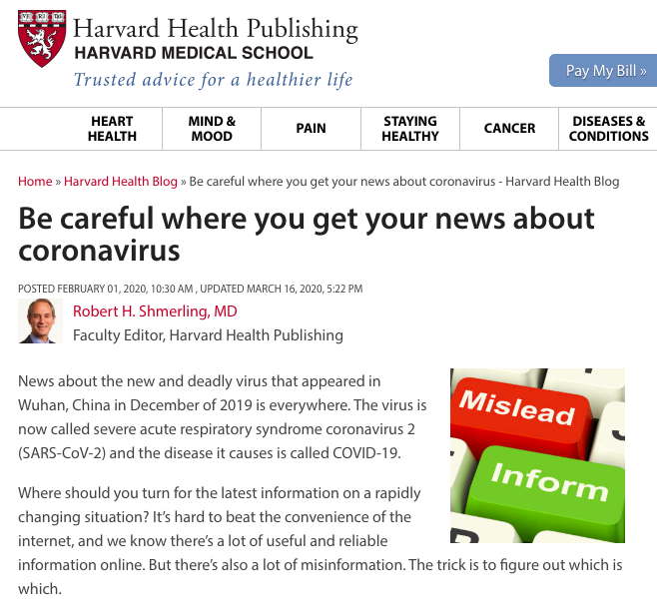
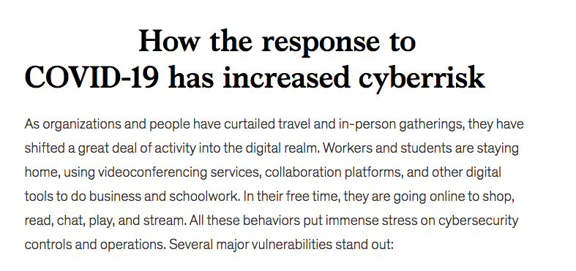
Coronavirus is not only a health crisis anymore as it has negative impact on global economy also affect geopolitical, environmental and technological areas…

Slide 7
Risk Society: Main Characteristics
DELOCALIZATION:
spatial: new risks are not limited to one space or a specific area;
time: new risks are often extended over time;
social: these risks are not just a problem of one generation or one social group.
NON-CALCULATION AND NON-COMPENSATION:
new threats are hypothetical risks that are not based on accurate and traditional scientific calculations, rather speculations.
security in modern societies has been based on scientific calculations and the belief that threats and risks can be predicted, calculated and avoided fairly accurately, but not in post-modern societies.

Slide 8
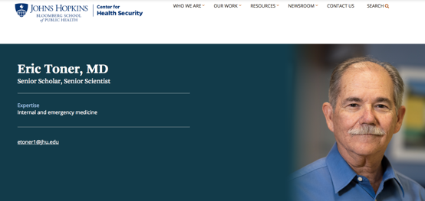
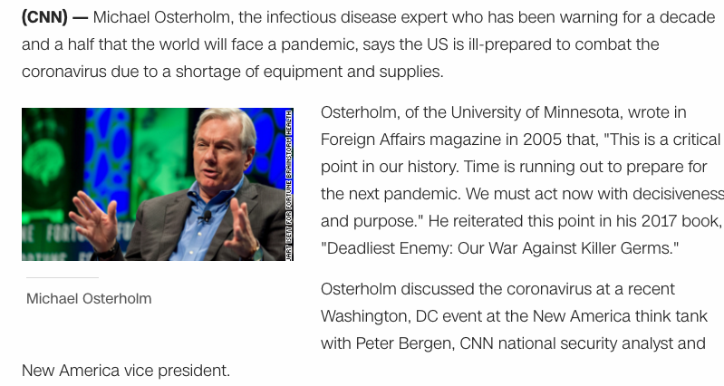

Slide 9
The World Economic Forum is an international, independent, non-profit organization founded in 1971 in Geneva, Switzerland. The organization seeks to bring together political, business, cultural and other leaders to shape a global, regional and industrial agenda. Read more here.
Annual Global Risk Reports provide an overview of the global situation, anticipating the highest risks of the year. The report draws on global experts, their insights and arguments to identify the risks that are most likely to effect societies and having highest impact. The following risk groups are assessed annually: Economic global risks
Ecological global risks
Geopolitical global risks
Social global risks
Technological global risks

Slide 11
According to A. Giddens (1991)…
Living today is not necessarily more “risky” than before, but constant thinking about risks becomes part of our daily lives, leading to the development of risk consciousness in our society.
Today’s culture of risk is characterized by the decentralization of science and other institutions. There is a strong critical approach to the progress of science, its "justice", and the concept of post-normal science emerges.
The need for dialogue in democracy is growing, which is what Habermass calls Deliberative democracy.

Slide 12
Supporting material and literature:
World Economic Forum. Global Risks Report 2021
Beck, U. (2006). Living in a World Risk Society. Economy and Society, Vol. 35, No. 3
Fardin Mansouri and Fatemeh Sefidgarbaei. (2021). Risk Society and COVID19. Canadian Journal of Public Health. Vol. 112(1): 36–37. Accessible online here.
Constantinou, C. S. (2021). “People Have to Comply with the Measures”: Covid-19 in “Risk Society”. Journal of Applied Social Science. Accessible online here.
Power, M. (2004). The Risk Management of Everything. Rethinking the Politics of Uncertainty
Williams, M. J., (2008). (In)Security Studies, Reflexive Modernization and the Risk Society. Cooperation and Conflict: Journal of the Nordic International Studies Association Vol. 43(1): 57–79.
#WorldEconomicForum #Davos

