Slide 1
Science communication about Arctic research
Module prepared by Prof. Jan Borm,
UVSQ/Université Paris-Saclay

Slide 2
Lesson 2: Science communication of some major Arctic institutional stakeholders
The Arctic Council’s working groups:
Arctic Contaminants Action Program (ACAP)
Arctic Monitoring and Assessment Programme (AMAP)
Conservation of Arctic Flora and Fauna (CAFF)
Emergency Prevention, Preparedness and Response (EPPR)
Protection of the Arctic Marine Environment (PAME)
Sustainable Development Working Group (SDWG)
COMMUNICATION NOTABLY THROUGH
Pathways, The Arctic Council’s Magazine

Slide 3
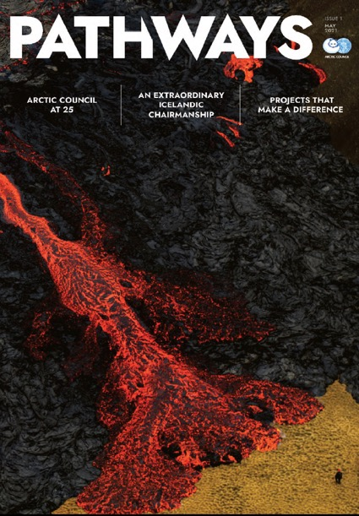
Pathways, May 2021 issue

Slide 4
Pathways, example

Slide 5
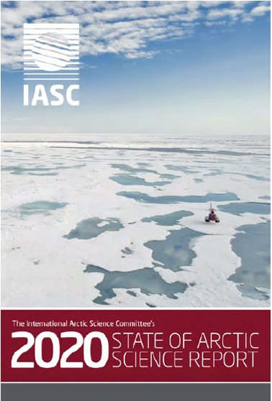
International Arctic Science Committee
Publications:
Bulletin (annual)
State of Arctic Science
(annual)
One-page flyer
in English and Russian

Slide 6
IASC Bulletin, example

Slide 7
IASC, examples

Slide 8
IASC, examples

Slide 9
University of the Arctic
About Uarctic (https://www.uarctic.org):
The University of the Arctic (UArctic) is a cooperative network of universities, colleges, and other organizations committed to higher education and research in the North. Our members share resources, facilities, and expertise to build post-secondary education programs that are relevant and accessible to northern students. Our overall goal is to create a strong, sustainable circumpolar region by empowering northerners and northern communities through education and shared knowledge.

Slide 10
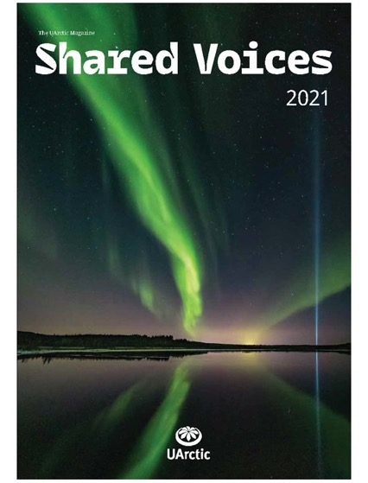
Shared Voices, UARCTIC’s magazine
Table of Contents
Letter from the President
By Lars Kullerud
Editorial
By Outi Snellman
…
CHARTER – Towards a Broader Understanding of Arctic Complexity
By Philip Burgess
Eating Plants to Mitigate the Impacts of Climate Change on Tundra?
By Isabel C. Barrio et al

Slide 11
Shared voices – excerpt of an article
Eating Plants to Mitigate the Impacts of Climate Change on Tundra?
“The rapid climate warming in Arctic regions is affecting herbivores in many ways. Warming may lead to shortage of food during warmer winters when freezing rains lock vegetation under ice layers, or to increased food availability during longer and warmer summers. At a circumpolar scale, climate warming has triggered the expansion of trees and tall shrubs to and within tundra, but herbivores may also buffer this vegetation expansion in the treeless tundra. However, the impacts of herbivores and their effectiveness to counteract warming-induced changes in vegetation vary regionally and depend on many site-specific factors such as the type and abundance of herbivores.”

Slide 12
Student activity in pairs
textual/visual communication of the three institutions, including social media
e.g.: IASC
@IASC_Arctic
The International Arctic Science Committee (IASC) is a non-governmental, international scientific organization.
iasc.infoA rejoint Twitter en octobre 2020
216 abonnements
676 abonnés
iascchannel

