Slide 1
“Identifying different audiences of scientific information: tackling disinformation on scientific issues” Part III
Dr. Nikos Panagiotou, Associate Professor
Dpt of Journalism and Mass Media Communication
Aristotle University of Thessaloniki

Slide 2
Communicating Science in the New Media Environment
New media transforms science communication from a relatively linear process of gatekeeping, publishing, directed-search and retrieval, to a multi-stakeholder socialized digital sphere of interactivity, discussion, and recommendation
New media introduced blurring the lines between producers and consumers of information and enabling any Internet user to create and share content.
Νew media are changing people‘s expectations about the sources, availability, and uses of information.
Notes:
Communicating Science in the New Media Environment: The Advancement of Science Literacy. Available from: https://www.researchgate.net/publication/347317651_Communicating_Science_in_the_New_Media_Environment_The_Advancement_of_Science_Literacy [accessed Nov 20 2021].
https://jcom.sissa.it/archive/20/03/JCOM_2003_2021_A05

Slide 3
Communicating Science in the New Media Environment
On the consumption level:
needs to be highlighted that the internet, and in particular social media, allows for a more intensive and diverse amount of information exposure
widen the focus to the actors that provide the information as a new and seemingly unmanageable variety of new actors appears on stage
Notes:
https://jcom.sissa.it/archive/20/03/JCOM_2003_2021_A05

Slide 4
Communicating Science in the New Media Environment
On the participation level:
participation and dialogue are generally seen as an effective means of creating a relationship of trust between science and the public.
the new media environments offer unique potential for low-threshold participation opportunity for many different users

Slide 5
Communicating Science in the New Media Environment
On the generating level:
even less is known about how this behaviour — either of lay users or of scientists — affects trust and credibility judgements
the new roles of scientists need to be considered: as scientists themselves increasingly engage in public online discourse by (participating and) generating, such as reacting to mis-/disinformation or commenting on journalistic content referencing their work, scholarly attention should increase regarding the understanding of reciprocal and dialogue-oriented processes of science-related discussions.

Slide 6
Solutions for science disinformation
A range of psychological, technical and political measures including
inoculation
debunking recommender systems
fact-checking
raising awareness, media literacy and
innovations in science communication and public engagement.
Contribution to tackling problems such as
knowledge resistance
pseudoscience
undermining of trust
confirmation bias
filter bubbles
Notes:
Extensive research over the past several years has identified cognitive features of the human mind, as well as fast and efficient transmission channels, that contribute to the prevalence of science disinformation in our societies. Potential solutions cover a range of psychological, technical and political measures including inoculation, debunking, recommender systems, fact-checking, raising awareness, media literacy, and innovations in science communication and public engagement. Together, they contribute to tackling problems such as knowledge resistance, pseudoscience, undermining of trust, confirmation bias, filter bubbles, echo chambers, and other problems related to science disinformation

Slide 7
Ways of tackling disinformation
Inoculation
limit the harm caused by disinformation, it has been shown that it is “better to prevent than to cure”
protection against falsehoods by informing people beforehand about misinformation tactics and presenting its contents in weakened form
term borrowed from immunology: ‘inoculation’. It is also known as ‘pre-bunking’

Slide 8
Ways of tackling disinformation
Debunking
why it is incorrect, and to provide correct information after this misinformation has been exposed and explained
uncover the tactics and potential intentions of its sender
carry it out in a pedagogical way so that the correct information is not confused with the misinformation it is intended to debunk

Slide 9
Debunking Steps
1. Describe the facts. 2. Warn that there is a myth. 3. Explain in what way the myth is incorrect. 4. Repeat the facts to consolidate this information.

Slide 10
How to debunk
Here are some tips from misinformation researchers:
Arm yourself with media-literacy skills, at sites such as the News Literacy Project (newslit.org), to better understand how to spot hoax videos and stories
Don’t stigmatize people for holding inaccurate beliefs. Show empathy and respect, or you’re more likely to alienate your audience than successfully share accurate information
Translate complicated but true ideas into simple messages that are easy to grasp. Videos, graphics and other visual aids can help
When possible, once you provide a factual alternative to the misinformation, explain the underlying fallacies (such as cherry-picking information, a common tactic of climate change deniers)
Mobilize when you see misinformation being shared on social media as soon as possible
Notes:
https://www.sciencenews.org/article/fake-news-misinformation-covid-vaccines-conspiracy

Slide 11
How to check an unfamiliar topic
Check whether references to sources are provided
Check if those sources are reasonably recent (if products are marketed with references to old sources, this may indicate that the results have not been verified, have not held up to scrutiny, or have not been worth pursuing)
Check if the sources are credible scientific journals

Slide 12
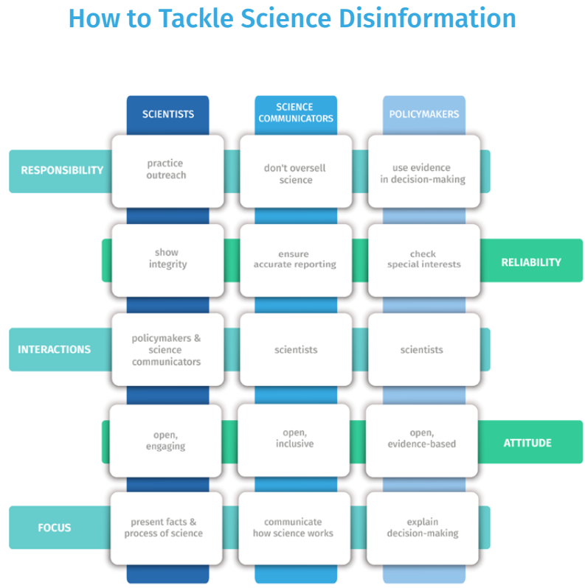

Slide 13
Science Communication and Public Engagement
communication practices of researchers and journalists play a central role in tackling science disinformation
reach new audiences with new methods, but also paves the way for the problematic mechanisms
lack of exchange between science communicators and scientists
need for more dialogue in science communication practices
focus on communicating how science works, i.e. standards and methods, will raise science literacy as well as media literacy
communication with the public must be open and inclusive

Slide 14
Tools That Fight Disinformation Online
BotSlayer (https://osome.iu.edu/tools/botslayer)
browser extension that helps track and detect potential manipulation of information spreading on Twitter
uses a detection algorithm to identify hashtags, links, accounts, and media that are being amplified in a coordinated fashion by likely bots
users can view/explore tweets and accounts associated with such amplification on Twitter or search for related content.
Notes:
https://www.rand.org/research/projects/truth-decay/fighting-disinformation/search.html#q=&typeOfTool=Verification

Slide 15
Tools That Fight Disinformation Online
2. Climate Feedback (https://climatefeedback.org/)
Climate Feedback is a web-based content annotation tool that allows scientists to annotate articles to provide additional context and draw attention to inaccuracies. The process results in a credibility score.
3. Emergent.Info
Emergent.Info is a web-based tool that tracks, verifies, or debunks rumors and conspiracies online. Rumors are suggested by individuals on the site, and then staff review and determine whether the claim is verified or false.

Slide 16
Tools That Fight Disinformation Online
4. PolitiFact (https://www.politifact.com/)
Politifact is a website that fact-checks "newsworthy and significant" statements and rates these statements as "True," "Mostly True," "Half True," "Mostly False," "False," and "Pants on Fire."
The process involves reviewing other fact-checking sources, Google searches, online database seraches, expert consultation, and other literature reviews.

Slide 17
Tools That Fight Disinformation Online
5. The Factual (https://www.thefactual.com/index.html)
The Factual is a mobile app and browser extension that scores news content based on "the extent and quality of its sources," "the expertise of the journalist," "the opinionated nature of the language used," and "the historical reputation of the sight."
It ranks the content on a 0-100 scale to measure the quality of the content. It is mainly automated. The tool rates news quality based on diversity of sources, author expertise, language used, etc. It also identifies higher quality sources and sources from the other side of the political spectrum.

Slide 18
Working with tools
Assignment: Find any topic of your interest and based on the criteria we discussed in combination with the tools we presented
Pick a topic
Find several articles on this topic
Fact-check the articles with a tool

Slide 19
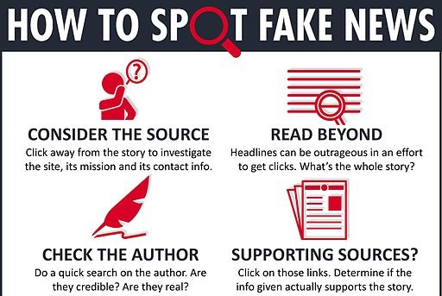
Core/Important Steps

Slide 20
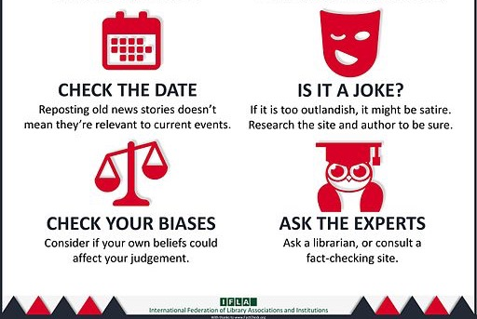
Core/Important Steps

