Slide 1
“Identifying different audiences of scientific information: tackling disinformation on scientific issues” II
Dr. Nikos Panagiotou, Associate Professor
Dpt of Journalism and Mass Media Communication
Aristotle University of Thessaloniki

Slide 2
Trust Busters
“Trust busters” indicate you should immediately look elsewhere for credible news.
They include:
False or untrue content
Clickbait tactics
Lack of balance
Manipulated images or videos
State-run or state-sponsored propaganda
Dangerous, offensive and malicious content

Slide 3
Conspirational beliefs
Theories in which explanations for events and phenomena offer “as a main causal factor a small group of persons (the conspirators) acting in secret for their own benefit, against the common good”.
Conspiratorial beliefs can thus involve not only a willful rejection of scientific consensus but also false attributions of intent to members of the scientific community, as well as the fabrication of relationships between actors.
Conspiratorial beliefs are typically understood as distinct from simple ignorance or misperception about isolated facts. Many of us believe in facts that turn out to be wrong.
Notes:
Conspiracy theories appeal to our psychological need for a simple explanation and someone to blame. You can stumble across them online even when searching for reliable information. These compelling narratives, and the false evidence they include, can draw you in, manipulating your emotions and using your cognitive biases against you to trick you into believing them. This quiz is designed to help you learn to recognize conspiratorial thinking and understand its consequences.

Slide 4
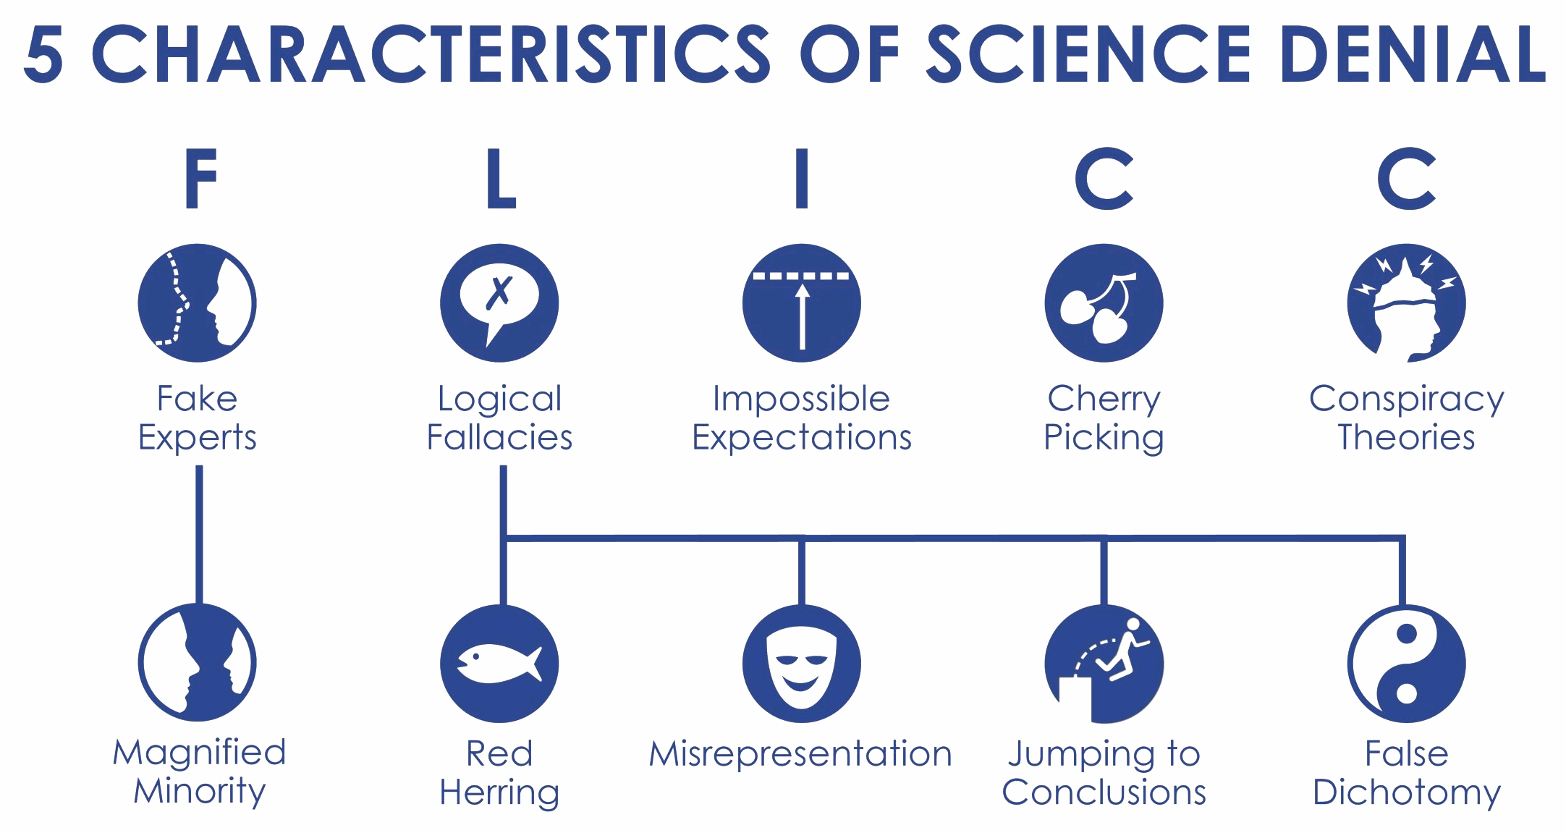
Characteristics
Notes:
Whether the topic is climate change, lung cancer’s link to smoking, vaccines & autism, AIDS or MSG, denial of scientific findings relies on a set of techniques that can be summed up by the acronym FLICC
Source: https://skepticalscience.com/print.php?n=4074

Slide 5
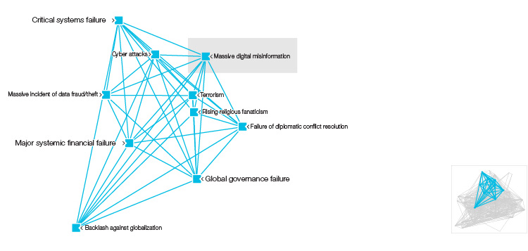
Figure: Digital Wildfires in a Hyperconnected World Constellation
Source: World Economic Forum
Notes:
https://reports.weforum.org/global-risks-2013/risk-case-1/digital-wildfires-in-a-hyperconnected-world/?doing_wp_cron=1637392130.9012899398803710937500#read

Slide 6
Avoid the trap of conspiratorial thinking
Which of these two scenarios can be best described as a conspiracy theory?
Note: Actual conspiracies have occurred throughout history, but they differ from conspiracy theories in important ways.
a) Documents leaked to a news organization show that two major tech companies have been mishandling people’s private data in ways that are illegal in some countries.
b) Social media posts from someone claiming to work for the federal government claim that clouds are not naturally occurring but are actually part of a secret government program to spread chemicals that control the weather.
Notes:
Anonymous social media posts from someone claiming to be in a position of authority and making far-fetched claims without evidence are best described as a conspiracy theory. Leaked documents showing two corporations hiding damaging information and illegal practices are strong evidence of an actual conspiracy.

Slide 7
Avoid the trap of conspiratorial thinking
Do the characteristics of this scenario fit those of an actual conspiracy or a conspiracy theory? An anonymous social media post shows a complex diagram with map locations, secret codes and grainy photos to claim that hundreds of the most powerful people in society — including billionaires, political leaders, media executives and celebrities — are part of a secret group that for decades has been orchestrating tragic events to control people with fear.
a) Actual conspiracy
b) Conspiracy theory
Notes:
An anonymous claim online involving a complex web of clues involving a secret group of prominent people from different fields signals that this is a conspiracy theory.

Slide 8
Avoid the trap of conspiratorial thinking
Do the characteristics of this scenario fit those of an actual conspiracy or a conspiracy theory? Senior executives at a large corporation use a variety of illegal accounting maneuvers to hide billions of dollars of debt to make the company appear more profitable and keep the stock price up. A second company that provided accounting and records-keeping services to this large corporation destroyed documents and other evidence in an attempt to conceal evidence from government investigators.
a) Actual conspiracy
b) Conspiracy theory
Notes:
Corporate executives working to illegally hide financial information that would damage the company’s reputation and stock price illustrate what an actual conspiracy looks like.

Slide 9
Avoid the trap of conspiratorial thinking
Which of the following are reasons why conspiracy theories appeal to people?
Note: People are drawn to conspiracy theories because they satisfy psychological needs and help people deal with complex emotions about difficult events.
a) Conspiracy theories give people something or someone to blame as they cope with fears, anxieties and pain.
b) Conspiracy theories always have charismatic leaders.
c) Conspiracy theories offer simple explanations for complicated events and phenomena.
d) Conspiracy theories provide people with a sense of belonging, support and comfort.
e) None of the above.
Notes:
Conspiracy theories appeal to people because they often provide simple explanations, something or someone to blame and a sense of belonging to a community of believers.

Slide 10
Avoid the trap of conspiratorial thinking
Someone who believes that the government is always lying and manipulating people, and who refuses to believe the accuracy of data or other information released by a government agency, is likely exhibiting which of the following?
Note: Conspiratorial thinking includes three key elements that work together to strengthen conspiratorial beliefs. The first key element is motivated reasoning, which is reasoning that seeks to confirm what a person already wants to believe or thinks is true. The second element is institutional cynicism — the belief that institutions like government and corporations have a secret, self-serving motive and cannot be trusted. The third is illusory pattern perception (or patternicity) — the thinking that meaningful patterns exist in random details, facts or events.
Answers
Institutional cynicism
Illusory pattern perception
Confirmation bias
Motivated reasoning
Notes:
Someone who believes that the government is lying and manipulating people, and who refuses to believe the accuracy of data or other information released by a government agency, is likely exhibiting institutional cynicism.

Slide 11
Avoid the trap of conspiratorial thinking
True or false: Some groups have been victimized more by actual conspiracies and thus have legitimate reasons for heightened levels of skepticism about some institutions.
True
False
Notes:
Institutions contain the same biases as the societies in which they operate, and do not serve all groups of people equally. Different groups of people have different historical relationships with institutions.

Slide 12
Avoid the trap of conspiratorial thinking
Which type of cognitive bias does this FALSE statement best demonstrate? There is no way a tiny little parasite like a virus could cause the entire world to shut down. There must be another explanation. Note: Cognitive biases are common errors in the ways we take in and frame information. These three cognitive biases often make conspiratorial thinking seem more legitimate than it actually is: 1. Proportionality bias is the belief that major events must have major causes. 2. Intentionality bias occurs when instead of accepting the randomness of certain events, people sometimes seek information that helps them portray the event in question as intentional. 3. Confirmation bias is the natural tendency of people to readily accept claims that agree with or reinforce their existing beliefs, and to find reasons to dismiss claims and evidence that contradict or complicate their beliefs in some way.
Answers:
a) Proportionality bias
b) Intentionality bias
c) Confirmation bias
Notes:
It’s tempting to think that big events have causes that are “proportional” (that are also big) — but that’s often not the case.

Slide 13
Avoid the trap of conspiratorial thinking
Which type of cognitive bias does this FALSE statement best demonstrate? Viruses as deadly as the new strain of coronavirus don’t just happen naturally. This must have been developed as a biological weapon. That’s the only thing that explains why so many people have died.
a) Proportionality bias
b) Intentionality bias
c) Confirmation bias
Notes:
This is an example of intentionality bias — a cognitive bias that involves an intentional act seeming more likely or true than explanations that involve accidents.

