Slide 1
“Identifying different audiences of scientific information: tackling disinformation on scientific issues”
Dr. Nikos Panagiotou, Associate Professor
Dpt of Journalism and Mass Media Communication
Aristotle University of Thessaloniki

Slide 2
Aims of the module
provide an overview of how and why audiences become misinformed about science
analysis of science communication in new media environments.
importance for audiences to be misinformed about science
how to tackle disinformation on scientific issues
Notes:
Tool: Mentimeter or blackboard

Slide 3
Misinformation – Main Points
Misinformation can be broadly defined as information that is incorrect, possibly by accident debate surrounding what it means to be “misinformed,” compared with “uninformed”
Being misinformed:
is often conceptualized as believing in incorrect or counterfactual claims
is to not being informed in the first place, or to making decisions based on factors other than the best available information
has sometimes been understood as both holding inaccurate views and being uninformed about scientific facts and processes
Notes:
Citizens can be uninformed and misinformed all at once—for example, they may be uninformed about how scientific processes work while being misinformed about the facts of a specific scientific issue—and these factors may influence each other. In practice, then, it is difficult to cleanly separate the “misinformed” from the “uninformed.”

Slide 4
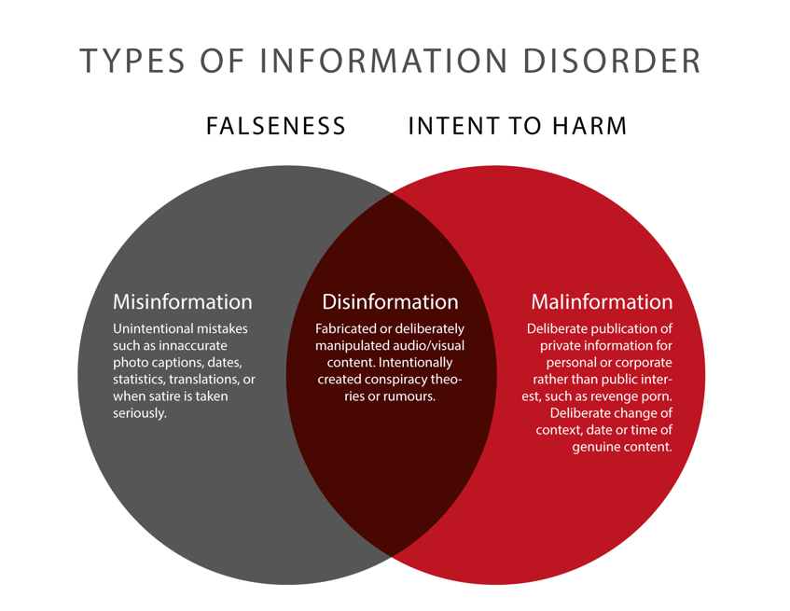
Figure 2: 3 Types of Information Disorder. Credit: Claire Wardle & Hossein Derakshan, 2017.

Slide 5
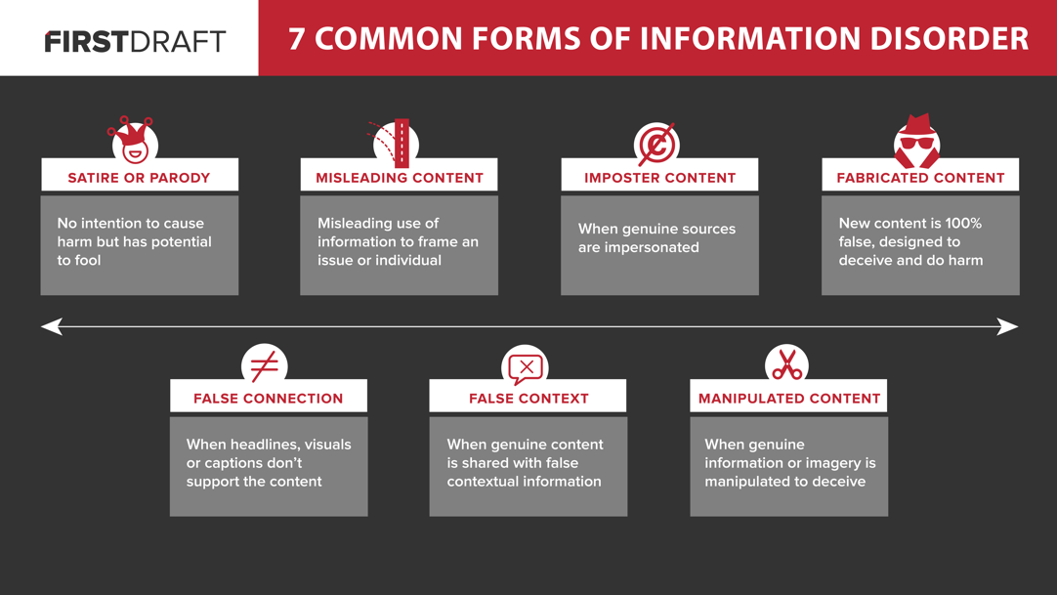
Figure: 7 Categories of Information Disorder. Credit: Claire Wardle, 2017.

Slide 6
Figure: 3 Phases of Information Disorder. Credit: Claire Wardle & Hossein Derakshan, 2017

Slide 7
Disinformation on scientific issues – Main Points
‘Science disinformation’ can be understood as
factually incorrect information regarding claims that concern scientific matters and that is fabricated or deliberately manipulated with the intention to deceive.
includes claims that deliberately look and sound scientific although they are not.
Notes:
‘Science disinformation’ can be understood as factually incorrect information regarding claims that concern scientific matters and that is fabricated or deliberately manipulated with the intention to deceive. It also includes claims that deliberately look and sound scientific although they are not. This can include the deliberate spread of science misinformation; incorrect information regarding scientific matters that has been produced by mistake but without the intention to cause harm, caused for instance by scientific misconduct, lack of research integrity, or poor communication of scientific results

Slide 8
Examples
the deliberate spread of science misinformation
incorrect information regarding scientific matters that has been produced by mistake but without the intention to cause harm, e.g caused by
scientific misconduct
lack of research integrity
poor communication of scientific results

Slide 9
Characteristics and Mechanisms of Science Disinformation
Knowledge Resistance & Confirmation Bias
humans prone to absorbing information that supports established personal beliefs and opinions based on previous information or emotional appeal, an effect known as 'biased assimilation’
leads to ‘motivated reasoning’ and self-deception
leads to counterarguing
opinions rely on misplaced trust, i.e., trust in authorities that turn out to be unreliable sources of information
Notes:
Knowledge Resistance & Confirmation Bias We humans are generally prone to absorbing information that supports our established personal beliefs and opinions based on previous information or emotional appeal, an effect known as 'biased assimilation’ that often leads to ‘motivated reasoning’ and may even result in self-deception. This often leads to counterarguing or finding reasons to disparage sources of evidence. It can be both value-based and identity-protective. Opinions can also rely on misplaced trust, i.e., trust in authorities that turn out to be unreliable sources of information, which may be unpleasant to admit.
Sense-Making Stories Many misconceptions resulting from misinformation have become established as common beliefs because they have a certain appeal. They are stories that appear to make sense. Knowledge gaps are challenging to most people, which is why we tend to fill missing links in our chains of knowledge with invented explanations. Stories without knowledge gaps are easier to remember because they offer continuous chains of explanations. Made-up stories can usually be recognized because they are typically vague about the sources of information, for instance so-called ‘urban myths’.

Slide 10
Characteristics and Mechanisms of Science Disinformation
Sense-Making Stories
misconceptions resulting from misinformation are stories that appear to make sense
stories without knowledge gaps easier to remember because they offer continuous chains of explanations
made-up stories can be recognized because they are vague about the sources of information, for instance so-called ‘urban myths’

Slide 11
Tips to Identify Fake News
Check the history and reputation of the author and publication
Determine whether other outlets are reporting the same news
Be leery of sensational headlines
Carefully scrutinize photos and other media that accompany the stories
Consider the reasons why this person is sharing this news with you at this time
Make sure the story isn’t intended to be humorous
Do some research to determine whether there are any facts to support bold claims you hear on TV

Slide 12
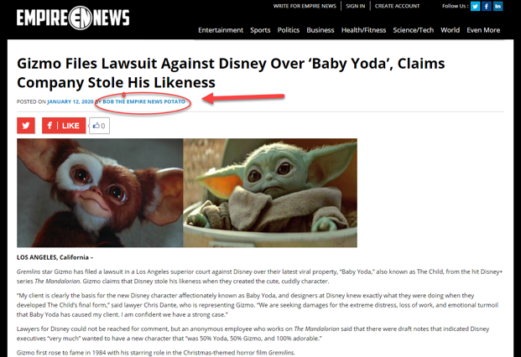
QUIZ
1. This website includes articles with suspicious bylines (such as “Bob the Empire News Potato,” seen below) – an immediate red flag. Why are legitimate bylines on news coverage a sign of credibility?
a) They aren’t. This is a trick question.
b) Bylines demonstrate transparency and accountability.
c) Bylines show that journalists want to receive accolades for their work.
d) Bylines are simply a journalism tradition that reputable news organizations have always observed.
Notes:
Bylines indicate who reported or produced content (transparency). They also make it easier to contact journalists with feedback or questions on news coverage (accountability). Be skeptical of news sources that lack clear bylines, or include suspicious or satirical bylines, as in the example.

Slide 13
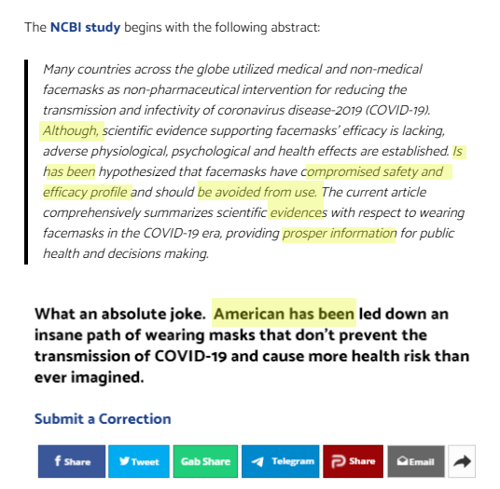
Quiz
These excerpts are from an online story published by a partisan conspiracy website. The article cites a since-retracted study that is riddled with grammatical and punctuation errors (in yellow). In addition to repeating falsehoods without evidence, the article text itself (in bold) also contains an obvious typo.
Why do these kinds of grammar and spelling mistakes undercut a source’s credibility? Select all that apply.
a) These mistakes indicate that a story may have been quickly or hastily written.
b) show a lack of attention to detail, which raises questions about the accuracy of other aspects of a news report.
c) might suggest lax editing processes or little oversight prior to publication.
d) prove that stories with any typos or grammatical errors cannot be trusted.
Notes:
There are several important factors here. Spelling and grammar errors may seem like small issues, but they can point to bigger problems with a source’s credibility. Such mistakes might suggest questionable reporting and editing processes, while also casting doubt on the accuracy of other information in a news report. However, typos alone do not discredit a news source. Occasional mistakes of this nature happen even in newsrooms with rigorous editing standards in place. But when these errors appear alongside substandard reporting practices — as in this story, which is based on a single source, uncritically amplifies unverified claims and offers mostly commentary — they are generally red flags signaling to look elsewhere for credible information.

Slide 14
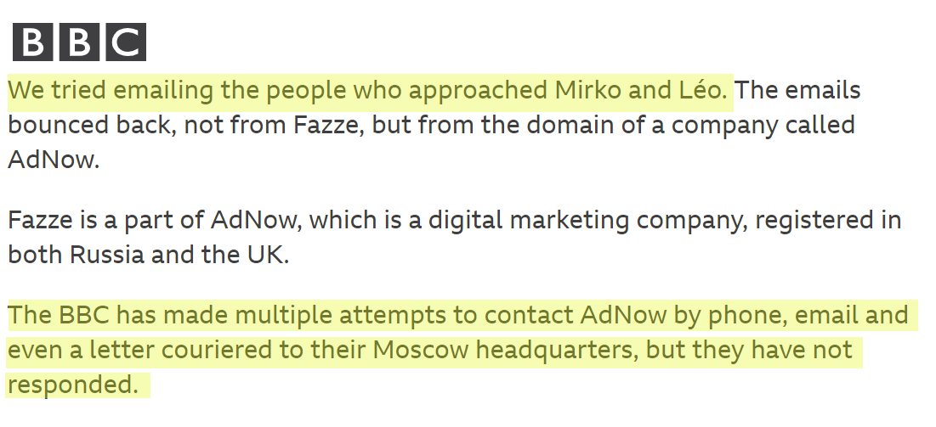
Quiz
In this news report, BBC journalists detail steps taken to give various story subjects a chance to comment and respond to article findings. Why does including this build credibility?
a) It demonstrates fairness.
b) It shows that reporters were polite.
c) It suggests that reporters knew the story subjects in some way.
d) It involves deceitful reporting tactics.
Notes:
It demonstrates fairness, a key standard of quality journalism. Being fair includes reaching out to main sources or subjects in news coverage to allow them to share their points of view and respond to any claims or allegations. Credible news organizations should note when sources could not be reached prior to publication, or when they decline to comment. Be wary of news coverage that does not demonstrate this fundamental journalism standard.

Slide 15
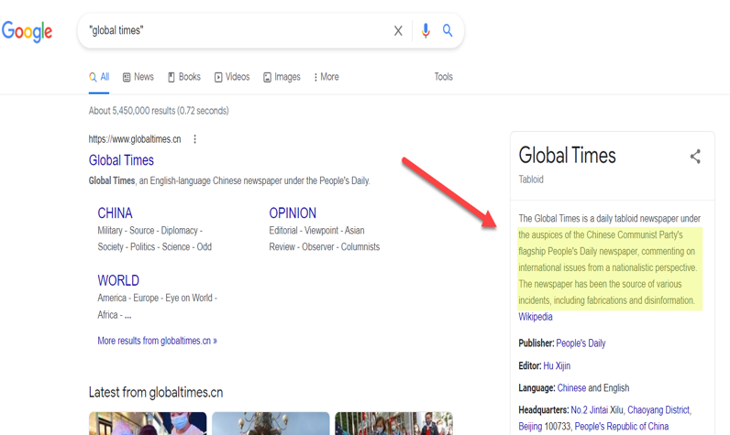
Quiz
You come across a news report by an unfamiliar source called “Global Times.” A quick search for the publication title pulls up a Wikipedia preview with some important information (in yellow). Why should this information raise red flags? Select all that apply.
a) It shows that Global Times is published in two languages.
b) It confirms that Global Times lacks independence.
c) It reveals that Global Times is published daily.
d) It suggests that Global Times has published demonstrably false content.
Notes:
There are two important factors here. Global Times is a publication of People’s Daily, a state-run news agency that is controlled by the Communist government of China. It is not independent and is used by the government to promote the interests of the Chinese state. Credible sources should be independent, meaning that the information they produce is not subject to undue influence or conflicts of interest. Also, publishing false or untrue content is an immediate “trust buster” – or clearly indicates a source cannot be trusted for credible news.

Slide 16
Quiz
Tip: Conducting a simple search for information about a news source is a key step in evaluating its credibility. Wikipedia can be a useful stop on your search, leading you to relevant source links.

Slide 17
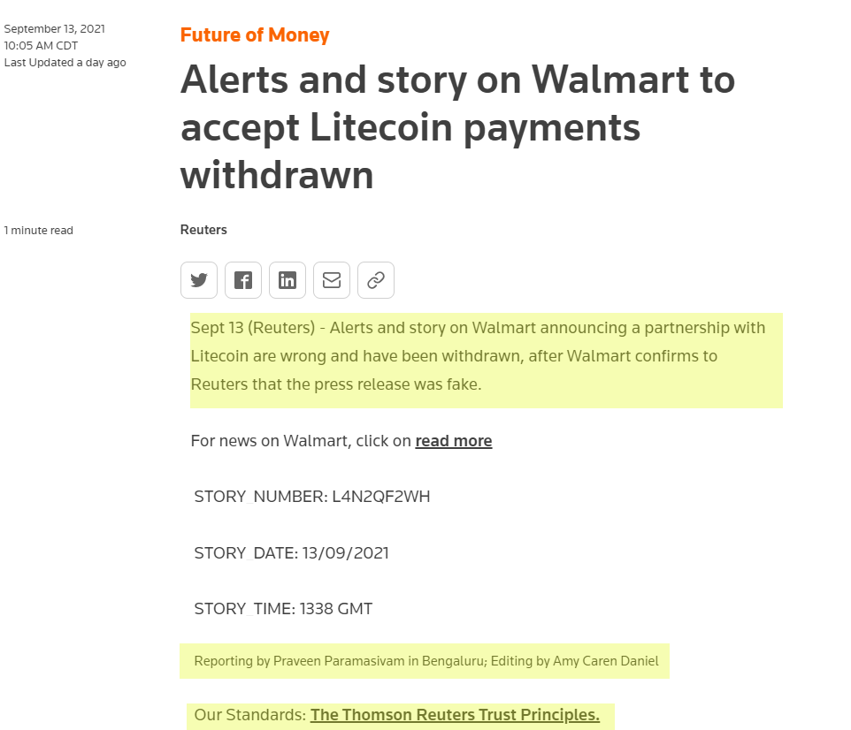
Quiz
This Reuters report acknowledges a retraction issued after the global news organization learned that its story was based on a fake press release. Does this response to a major reporting error demonstrate credibility? (Be sure to read the sections highlighted in yellow.)
a) Yes, this response demonstrates credibility.
b) No, this response does not demonstrate credibility.
Notes:
While mistakes do undermine the accuracy of a news report, this response publicly and prominently spotlights a major reporting misstep and explains how it occurred. It also links to the news organization’s editorial standards and identifies who wrote and edited this retraction. Quality news organizations take factual inaccuracies very seriously. Being transparent about mistakes — and accountable for them — are key characteristics that separate credible news organizations from other sources of information. Major errors like this retraction are rare in standards-based newsrooms. They are also different from corrections, which amend factual inaccuracies without retracting the rest of a story. Beware of sources that fail to be transparent about errors, including changing or deleting articles without documenting or explaining such actions publicly.

Slide 18
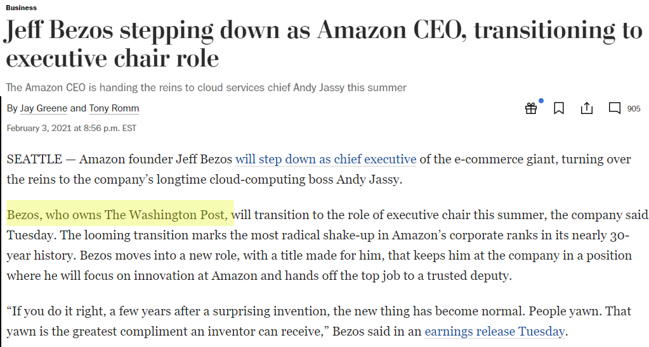
Quiz
This Washington Post news report on Amazon founder Jeff Bezos discloses that Bezos owns the Post (in yellow). Why does including such disclosures build credibility?
a) It doesn’t. This is a trick question.
b) These disclosures demonstrate transparency.
c)These disclosures show who is really in control of editorial decisions at a news organization.
d) These disclosures demonstrate an attention to detail.
Notes:
The main reason that including such disclosures builds credibility is that it demonstrates transparency. To be credible, standards-based news organizations must be transparent about ownership ties. That includes disclosing these ties if they are relevant to particular news coverage, as in this story. But remember: Just because a publication has an owner or outside ownership does not mean it yields editorial control. Quality newsrooms have strict standards in place to protect editorial independence, including from owner interference.

Slide 19
Sources evaluation
Do a quick search: Conducting a simple search for information about a news source is a key first step in evaluating its credibility.
Look for standards: Reputable news organizations aspire to ethical guidelines and standards, including fairness, accuracy and independence.
Check for transparency: Quality news sources should be transparent, not only about their reporting practices (see above), but also about their ownership and funding.
Examine how errors are handled: Credible news sources are accountable for mistakes and correct them. Do you see evidence that this source corrects or clarifies errors?
Assess news coverage: An important step in vetting sources is taking time to read and assess several news articles.

