Slide 1
Developing the methodology to detect “fake news” from fact-checked articles.

Slide 2
Overview
Introduction & Social Media: Response to Fake News
Fake News Detection Models
How to Recognise False Content - The 5Ws
The Future of Fake News: AI Generated Synthetic Media

Slide 3
The Future of Fake News: AI Generated Synthetic Media
4

Slide 4
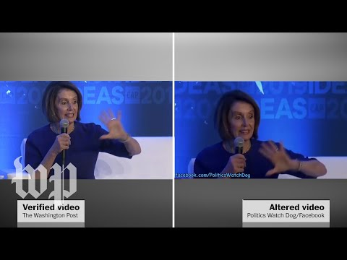
The Future of Fake News:
AI Generated Synthetic Media
Example 01 Cheapfakes
A video circulating on social media shows House Speaker Nancy Pelosi speaking in a slurred and awkward manner. One popular post boasts 91,000 shares on Facebook and bears a caption reading: “This is unbelievable, she is blown out of her mind, I bet this gets taken down!” The video, however, has been manipulated to make Pelosi appear drunk and incoherent.
Pelosi videos manipulated to make her appear drunk are being shared on social media. 2019. [video] http://www.youtube.com/watch?v=sDOo5nDJwgA: Washington Post.

Slide 5
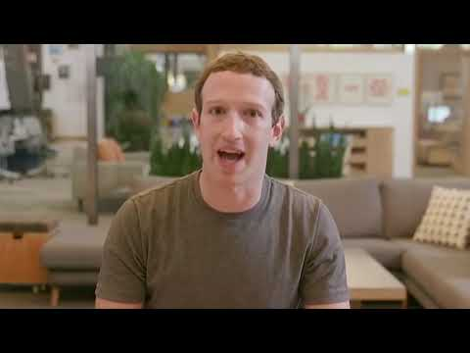
The Future of Fake News:
AI Generated Synthetic Media
Example 02 Deepfakes
Mark Zuckerberg reveals the truth behind Facebook: predicting the future behaviours of its users and manipulating them.
Zuckerberg never pronounced these words. It’s a deepfake created by artists Bill Posters & Daniel Howe.
'I wish I could...' (2019). 2019. [video] https://www.youtube.com/watch?v=3f66kBwfMto: Brandalism Project.

Slide 6
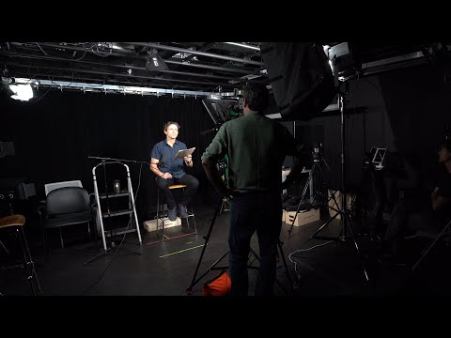
The Future of Fake News:
AI Generated Synthetic Media
Example 03 Deepfakes
Burgund and co-creator Francesca Panetta created an art installation in 2019 that combined actual footage of Nixon’s resignation speech, and the text of an in-memoriam draft speech that had been written by Nixon speechwriter Bill Safire in case of a failed moon landing. The result is a deepfake video that, despite the creators’ attempts to be transparent about the fabrication, still tricked some viewers into thinking it was an unaired version of the speech.
In Event of Moon Disaster - TRAILER. 2020. [video] http://www.youtube.com/watch?v=rci1GykTI9w: In Event of Moon Disaster.

Slide 7
The Future of Fake News:
AI Generated Synthetic Media
Deepfakes
Deepfakes are synthetic media (fake) generated using the Artificial Intelligence technique of deep (deep) learning.
Cheapfakes
Cheapfakes are simple manipulation through easy conventional editing techniques like speeding, slowing, and cutting, as well as nontechnical manipulations like restaging or recontextualizing existing media. Cheapfakes or Shallowfakes are defined as manipulated media created by using more straightforward image and video editing techniques to spread mis/disinformation or to change the narrative of a story.
Jaiman, A., 2020. AI Generated Synthetic Media, aka deepfakes. [online] Towards data science. Available at: <https://towardsdatascience.com/ai-generated-synthetic-media-aka-deepfakes-7c021dea40e1> [Accessed 28 September 2021].

Slide 8
The Future of Fake News:
AI Generated Synthetic Media
Face-swapping
Face swapping is when one person’s face is replaced or reconstructed by another person’s face or key features from another face.
Puppeteering
Puppeteering is rendering manipulated full-body actions and behavior using AI. It is a technique to create a 3D model of the target face and body in a video to act and say as the puppeteer.
Lip-sync
Lip Synching is a technique to render mouth movements and facial expressions to make the target say things with their voice and the right tone and pitch. AI algorithms can take an existing video of a person talking and alter the lip movements in the video to match new audio.
Jaiman, A., 2020. AI Generated Synthetic Media, aka deepfakes. [online] Towards data science. Available at: <https://towardsdatascience.com/ai-generated-synthetic-media-aka-deepfakes-7c021dea40e1> [Accessed 28 September 2021].

Slide 9
The Future of Fake News:
AI Generated Synthetic Media
Voice Cloning
Voice Coning is a deep-learning algorithm that takes in the voice recordings of an individual to generate synthetic voice that is overly like the original voice. It is a technique to create custom voice font of an individual and then use the font to generate speech.
Image Synthesis
Image Generation or Image Synthesis is a technique to use computer vision technology, deep Learning and Generative Adversarial Networks (GANs) to synthesize new images. It can produce a computer-generated image of a person or any object that is not real.
Text Generation
Text Generation is a method to automatically generate text, write stories, prose, and poem, create abstracts of long documents, and synthesize using AI techniques for text and deep learning.
Jaiman, A., 2020. AI Generated Synthetic Media, aka deepfakes. [online] Towards data science. Available at: <https://towardsdatascience.com/ai-generated-synthetic-media-aka-deepfakes-7c021dea40e1> [Accessed 28 September 2021].

Slide 10
The Future of Fake News:
AI Generated Synthetic Media
Malicious use
- Fabricate media
- Damage reputations
- Fabricate evidence
- Defraud the public
- Undermine trust in democratic institutions
- Thread to individuals
- Thread to society
- Thread to democracy
- Thread to businesses
Jaiman, A., 2020. AI Generated Synthetic Media, aka deepfakes. [online] Towards data science. Available at: <https://towardsdatascience.com/ai-generated-synthetic-media-aka-deepfakes-7c021dea40e1> [Accessed 28 September 2021].

Slide 11
The Future of Fake News:
AI Generated Synthetic Media
Positive use
-Education (i.e. historical figures can come to life and create more impact and engagement)
-Art (i.e. “Mona Lisa” was brought to life using Deepfake technology)
-Autonomy & Expression (i.e. Deepfake can be used to anonymise voice and faces to protect their privacy)
-Reach and Message Amplification (i.e. Localise video and audio content to broaden the reach of a public message)
-Public Safety & Digital reconstruction (i.e. Reconstructing the crime scene)
-Innovation (i.e. Deepfake news presenter, Fashion trends on virtual customers)
Jaiman, A., 2020. AI Generated Synthetic Media, aka deepfakes. [online] Towards data science. Available at: <https://towardsdatascience.com/ai-generated-synthetic-media-aka-deepfakes-7c021dea40e1> [Accessed 28 September 2021].

Slide 12
Activity - Detect Political Fakes
https://detectfakes.media.mit.edu/
Instructions:
- You will watch a variety of media snippets including transcripts, audio files, and videos.
- Sometimes, there are subtitles. Sometimes, the video is silent.
- You can watch the videos as many times as you would like.
- Please share how confident you are that the individual really said what you see.
- If you have seen the video before today, please select the checkbox that says “I’ve already seen this video.”

Slide 13
Literature
Jaiman, A., 2020. AI Generated Synthetic Media, aka deepfakes. [online] Towards Data Science. Available at: <https://towardsdatascience.com/ai-generated-synthetic-media-aka-deepfakes-7c021dea40e1> [Accessed 28 September 2021].
Jaiman, A., 2020. Deepfake harms and threat modeling. [online] Towards Data Science. Available at: <https://towardsdatascience.com/deepfakes-harms-and-threat-modeling-c09cbe0b7883> [Accessed 28 September 2021].
Somers, M., 2020. Deepfakes, explained. [online] MIT Sloan. Available at: <https://mitsloan.mit.edu/ideas-made-to-matter/deepfakes-explained> [Accessed 28 September 2021].

