Slide 1
CONSPIRACY MYTHS (2/5)
The world of universal explanations

Slide 2
Overview
Introduction & Definition
History of conspiracy myths and historical examples
Ideology of conspiracy and the link to Antisemitism
Forms of practice and expressions – contemporary examples
Strategies: Identifying and dealing with conspiracy myths

Slide 3
History of Conspiracy Myths and Historical Examples
2

Slide 4
Roots of conspiracy myths
Historical examples
development of legends and libels over time
from ancient and medieval times to modern and contemporary examples

Slide 5
Ancient and medieval times
The dualism between God and Satan as the first conspiratorial world explanation!
The devil conspiracy – typical features:
dividing in good and evil and applying a dualistic world view
The devil as the one and only reason and explanation for all evil in the world
Evolving stereotypes:
Christian theology: Judas betrayal of Christ – evolvement of the stereotypes: falsehood, treason, deceitfulness
murder of Christ
host desecration
(cf. Wippermann 2007)
Notes:
see Wippermann, W. (2007) Agenten des Bösen. Berlin: be.bra.

Slide 6
Ancient and medieval times
The devil conspiracy
Targets of ancient and medieval accusations and myths,
believed to be the main „agents“ of the devil:
Jews but also women (witches)
later Illuminati and Freemasons

Slide 7
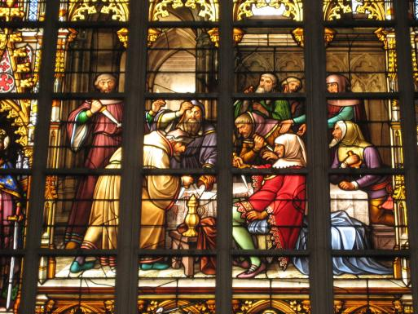
Ancient and medieval times
Host desecration
& murder of christ accusations
Photo: stained glass window by Jean-Baptiste Capronnier.
CC BY-SA 3.0 Zinneke at lb.wikipedia
Notes:
input description:
Early on, there were conspiracy allegations that Jesus Christ had fallen victim to a planned murder plot. The focus was on his disciple Judas, who later became the symbol of all Jews and the bearer of anti-Jewish accusations. Over time, the accusations developed into an important legend that continues to this day and is repeated, for example, in myths about the desecration of the Host. Persecutions and pogroms against the Jewish population from the Middle Ages onwards were the result.
Stained glass window by Jean-Baptiste Capronnier in the Sainte-Gudule-Saint-Michel Cathedral in Brussels/ "Hostieprofanatioun" - Kierchefënster an der Kathedral St.Michel-Ste. Gudule zu Bréissel, ëm 1880. source/licence: https://commons.wikimedia.org/wiki/File:Hostieprofanatioun.JPG

Slide 8
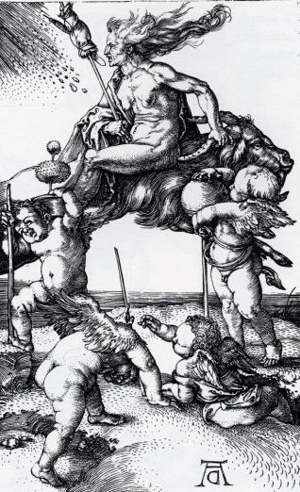
Ancient and medieval times
Witch trials / “Witch hunt” in 15th and 16th century
Painting of Albrecht Dürer
witch riding backwards on a goat
goat as a symbol of the devil
Photo: „Die Hexe“ by Albrecht Dürer, ca 1500
public domain
Notes:
input description:
Witch hunts were linked to accusations and legends resembling conspiracy myths. A secret group of women was imagined as threatening and non-Christian or areligious practices were imagined and declared as a danger. Many women were humiliated and murdered because of such false accusations.
Albrecht Dürer ca. 1500: Die Hexe / Witch Riding Backwards On A Goat; source: https://commons.wikimedia.org/wiki/File:Die_Hexe_(Albrecht_Dürer).jpg

Slide 9
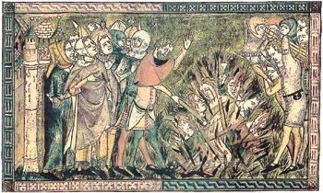
Ancient and medieval times
Natural disasters –
Legends of „well poisoning“ and the intentional spread of the plague in 14th century
– accusations against Jews leading to pogroms all over Europe
some even starting before the arrival of the disease
Photo: Drawing of Jews of Strasbourg being burned to death during the Black Death, 1349
public domain
Notes:
input description:
Similar to the witch hunt and the host desecration accusations, the accusations of well poisoning also build on old legends that seemed to offer a solution to unexplainable problems and catastrophes in times of uncertainty. Various groups could become victims of such accusations; in addition to women as "witches", Jews in particular were identified as enemies in Christian Europe. Even ritual washing in Judaism could become a cause for “suspicion". Murder and persecution were the result.
2000 Jews burned to death in Strasbourg 1349 during the Black Death. “A contemporary drawing of the 2000 Jews of Strasbourg being burned to death over a pit on Feb. 14, 1349 in the Strasbourg Massacre during the Black Death persecutions. The Jews were accused of causing the Black Death by poisoning the wells. Babies thrown out to be saved were thrown back into the fire. The monument to this massacre erected in the early 20th century was removed by the Nazis.” https://commons.wikimedia.org/wiki/File:Jews_burned_to_death_in_Strasbourg_Feb._14_1349_during_the_Black_Death.jpg

Slide 10
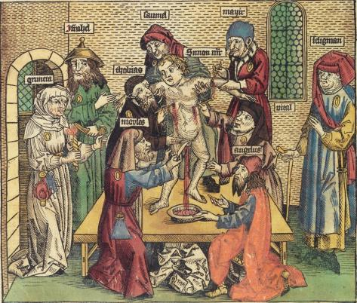
Ancient and medieval times
ritual murder accusations / blood libels
well poisoning legends – the plague
blood and infanticide
witch trials in 15. and 16. century (“witch hunt”)
Photo: Martyrdom of Simon von Trent, depiction from the Nuremberg World Chronicle by Hartmann Schedel, 1493
public domain
Notes:
input description:
Another legend from the Middle Ages that directly follows the legend of the murder of Christ is the ritual murder libel. Although its content is again very absurd, Jews were repeatedly identified as the alleged perpetrators in some villages after the disappearance of children or young people. The accusations had no basis in fact, but it was imagined that Jews - who had a different religion and different rites than the Christian majority society - needed children's blood for religious purposes. This is particularly absurd given that blood is taboo in traditional Judaism.
“Martyrdom of Simon von Trent, depiction from the Nuremberg World Chronicle by Hartmann Schedel.” Simon of Trent blood libel. Illustration in Hartmann Schedel's Weltchronik, 1493. https://commons.wikimedia.org/wiki/File:Ritualmord-Legende.jpg

Slide 11
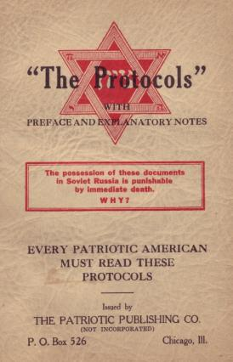
Modern times
… historical overlap with antisemitism…
Spread of Antisemitism as a complex world view in the 19th century
world conspiracy
early 20th century: The Protocols of
the Elders of Zion
(pure fiction!)
anti-communist conspiracy myths
Photo: The Protocols of the Elders of Zion.
A 1934 imprint by the so-called "Patriotic Publishing Co.”
public domain
Notes:
The Protocols of the Elders of Zion. A 1934 imprint by the so-called "Patriotic Publishing Co.” https://commons.wikimedia.org/wiki/File:1934_Protocols_Patriotic_Pub.jpg
modern times
(World conspiracy, severe antisemitism and national socialism)
The modern world wasn’t ruled by feudalistic structures anymore, but this new era came with the spread of capitalism and national states. That also implied the secularization of conspiratorial believes.
As in times of big changes before this time brought struggle and insecurities. But especially the fact that rule wasn’t direct and visible anymore, but rather other pressures were central, industrialization, capitalism and national states made everything much more complex, many felt the urge to blame someone for their misery. As there was no obvious guilty person to blame but rather a complex system and economical order evolving, a popular way to interpret it was to divide in good and evil – once again. So, the complex model to explain the world became more important: conspiracy ideology.
As hegemony after the end of feudalism wasn’t visible anymore and got more complex, the idea of a hidden world government, a conspiracy, became popular.
old and well-known stereotypes helped to identify the scape goats – Jews, Illuminati and Freemasons remained the main target.
e.g. The Protocols of the Elders of Zion

Slide 12
Modern times
Conspiracy ideology in National Socialism:
“Jewish world conspiracy” and the “international Jew”
revival of biologist language and animal metaphors: “parasites”, “bloodsuckers”
Jews as universal image of the enemy: behind Bolshevism and Capitalism/Finance market
→ culminating in the ideology of the Nazis’ eliminationist antisemitism

Slide 13
Contemporary
…codes as new form of expression
blaming in personalised form
→ no longer „the Jews“ but rather certain names and codes
from “Jewish world conspiracy” to “ZOG” = “Zionist Occupied Government”
from “International Jew” to “Elites on the East Coast”
from “the Jews” to “the Rothschilds” or “George Soros”
coded accusations
Notes:
contemporary (new forms of expression, from „Holocaust Hoax“ to „New World Order“ and „QAnon“)
codes as newer forms
blaming in personalised form – no longer „the Jews“ but rather certain names („the Rothschilds“, Soros, … Bill Gates)

Slide 14
Contemporary
New forms of expression – some examples:
„Holocaust Hoax“
„New World Order“
9/11
Climate change hoax – „The Great Reset“
„QAnon“
„deep state“
„Great Replacement“ (der Große Austausch)
Plandemic
5G
… the list goes on!

Slide 15
Historical examples
ancient/
medevial
Devil conspiracy
Murder of Christ – blood legend
modern
World conspiracy
Finance sphere
contemp-orary
Coded accusations
Vaccines/health hazards
Child abuse and ritual murder
Well poisoning – spread of plague
Protocols of the Elderly of Zion
Alien and flat earth ideology
Media manipulation myth
Witchery
Notes:
Summary: What conspiratorial imagery can you remember?
what passes on over the episodes of time?

Slide 16
Historical myth revived
CHOOSE A CONTEMPORARY EXAMPLE OR TOPIC AND …
I. research and reflect in small groups
research and reflect on the historical roots of the narrative
how is the old myth revived today?
what historical elements can you reconstruct?
what is different?
what are similarities?
II. discuss in plenum
Notes:
Research and reflect in small groups (15 minutes)
Discussion in plenum (15 minutes)
explanation:
Instructor: choose a topic for students compatible to your subject matter – introduce the students to the main statements and conclusions of the conspiracy myth, give an article or picture about the myth to work with!
e.g. Covid19 and myths about the plague
“plandemic”
topic: health in conspiracy myths – finding a responsible person or group for an illness
then: alleged well-poisoning accusations against Jews
today: alleged compulsory vaccinations accusations against Bill Gates
history of myths around pandemics: the plague
research material:
Nocun, K. (2020) "It must be a plot!" – Coronavirus conspiracy theorists take to streets in Germany, Heinrich Böll Stiftung, 20 September 2020, https://eu.boell.org/en/2020/09/10/it-must-be-plot-coronavirus-conspiracy-theorists-take-streets-germany, accessed 20 May 2021.

Slide 17
Literature
Wippermann, W. (2007) Agenten des Bösen. Berlin: be.bra.

